Slide 1
Computer Security
2. Cryptography

Slide 2
Contents of this section
2.1 Introduction to Cryptography
2.2 Steganography

Slide 3
Some Definitions
Cryptography: Science of secret writing
Plaintext: Original message
Ciphertext: Transformed message
Encryption: plaintext -> ciphertext process
Decryption: ciphertext -> plaintext process
Cipher: Secret method of writing (i.e. algorithm)
Key: Some critical information used by the cipher, known only to sender and/or receiver
Cryptanalysis: Attempting to discover plaintext or key or both
Cryptology: Study of both cryptography and cryptanalysis

Slide 4
Two major techniques for encryption
Symmetric Encryption
  Sender and receiver use same key (shared secret)
  Also known as:
    Conventional Encryption
    Secret Key Encryption
  Was the only method used prior to the 1970s
  Still most widely used
Public Key (Asymmetric) Encryption
  Sender and receiver use different keys
  First public key technique published in 1976

Slide 5
Block Cipher vs Stream Cipher
Block cipher processes a block of plaintext at a time, producing a corresponding block of ciphertext at a time (e.g. 64 or 128 bits)
  Optimised for transfer of files and non-real-time data
  Used in SSL/TLS, for example
Stream cipher processes input continuously (e.g. one bit or one byte at a time)
  Optimised for real-time and two-way communications
  Used for mobile phone encryption

Slide 6
Basic cipher operations
Substitution
  Maps each plaintext element onto corresponding element of ciphertext element
Transposition
  Rearranges the plaintext
Modern ciphers usually combine several elements of both substitution and transposition

Slide 7
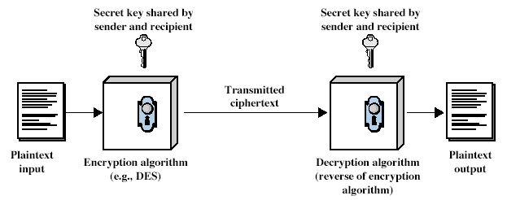
Simplified Model (symmetric encryption)
Encryption
C = E_{K}(P)
Decryption P = D_{K}(C)

Slide 8
Five Ingredients
An encryption scheme has five ingredients
  Plaintext
  Encryption Algorithm
  Key(s)
  Ciphertext
  Decryption Algorithm
Kerckhoffs’ principle:
  Security depends on the secrecy of the key, not the secrecy of the algorithm(s)

Slide 9
Strong Encryption
An encryption algorithm needs to be strong
This means that an attacker who knows:
  the algorithm
  some pieces of ciphertext
  some plaintext-ciphertext pairs (possibly)
cannot deduce:
  the plaintext, or
  the key

Slide 10
Cryptanalysis
Cryptanalysis is the process of trying to find the plaintext or key
Two main approaches
  Brute Force
    try all possible keys
  Exploit weaknesses in the algorithm or key
    e.g. key generated from password entered by user, where user can enter bad password

Slide 11
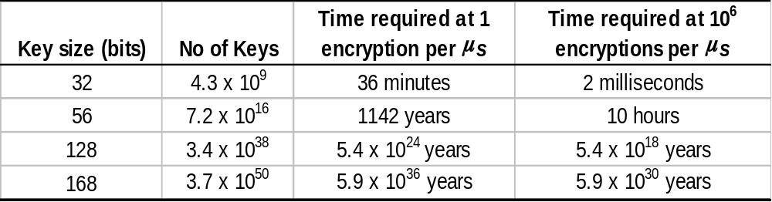
Cryptanalysis: Brute Force Attack
Try all possible keys until code is broken
On average, need to try half of all possible keys
Infeasible if key length is sufficiently long
  Age of universe: ~ 10¹⁰ years
  Note: DES has a 56 bit key; AES key has 128+ bits

Slide 12
Is an unbreakable encryption scheme possible?
In theory, No!
  Except for the one-time pad technique, which is impractical in most situations
In practice, though, it is possible to have a scheme that is effectively unbreakable :
  i.e. the chances of someone breaking it are very close to zero
  Such a system has
    No known weaknesses
    A key with so many possible values that they can’t all be tried

Slide 13
An encryption scheme is computationally secure if:
  Cost of breaking the cipher exceeds value of information
  Time needed to break cipher exceeds lifetime of information

Slide 14
Steganography
an alternative to encryption
hides existence of message
  using only a subset of letters/words in a longer message marked in some way
  using invisible ink
  hiding in least significant bit in graphic image or sound file
has drawbacks
  high overhead to hide relatively few info bits
More on this later….

