Slide 1
Computer Security
3.0 Public Key Cryptography

Slide 2
Contents of this section
Motivation
Applications
Limitations
Algorithms
  RSA
  Diffie-Hellman
Elliptic Curve Crytography

Slide 3
Motivation
Major limitations of Symmetric Encryption:
  Key Distribution Problem
    How do we reach a point where both parties have the same key (chicken-and-egg situation)?
  Not suitable for authentication: receiver can forge message & claim it came from sender
Addressed by Public Key Encryption
  Also known as Asymmetric Encryption
Public Key methods based on sender and receiver using different keys

Slide 4
Public Key Cryptography
Considered the most significant advance in the 3000 year history of cryptography
Each party has two keys:
  a public key, known potentially to anybody, used to encrypt messages, and verify signatures
  a private key, known only to its owner, used to decrypt messages, and create signatures
Made possible by clever application of number theory
Complements rather than replaces symmetric cryptography

Slide 5
Applications of Public Key Cryptography
Can classify uses of public key cryptography into 3 categories:
  encryption/decryption (provide secrecy)
  digital signatures (provide authentication)
  key exchange (of session keys) for symmetric encryption
Some public key algorithms are suitable for all uses; others are specific to one of the above

Slide 6
Application: Secrecy
Bob sends message to Alice by encrypting with her (Alice’s) public key
Message can only be decrypted with Alice’s corresponding private key (known only to her)

Slide 7
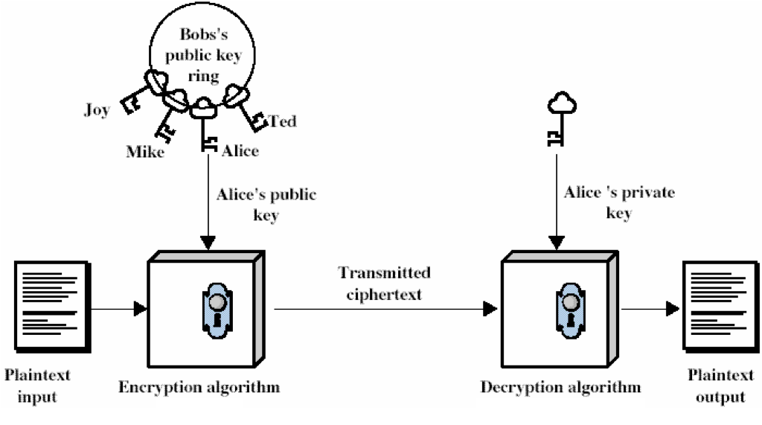
Application: Secrecy
Bob
Alice

Slide 8
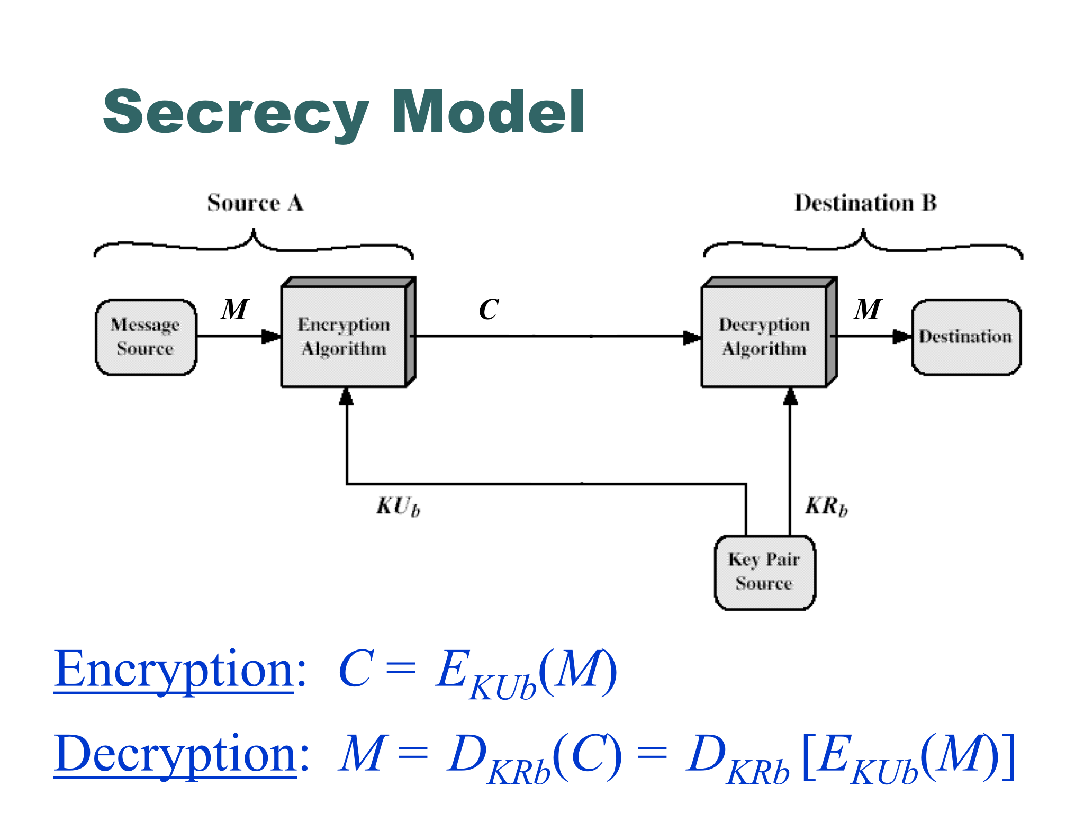

Slide 9
Application: Authentication
Bob sends message to Alice encrypting it with his own private key (i.e. he signs the message)
Everyone with Bob’s public key can decrypt the message. A message that can be decrypted with Bob’s public key must have come from Bob.

Slide 10
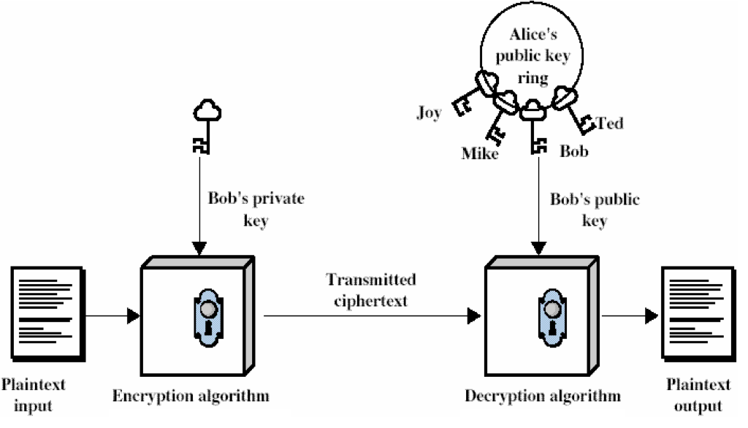
Application: Authentication
Bob
Alice

Slide 11
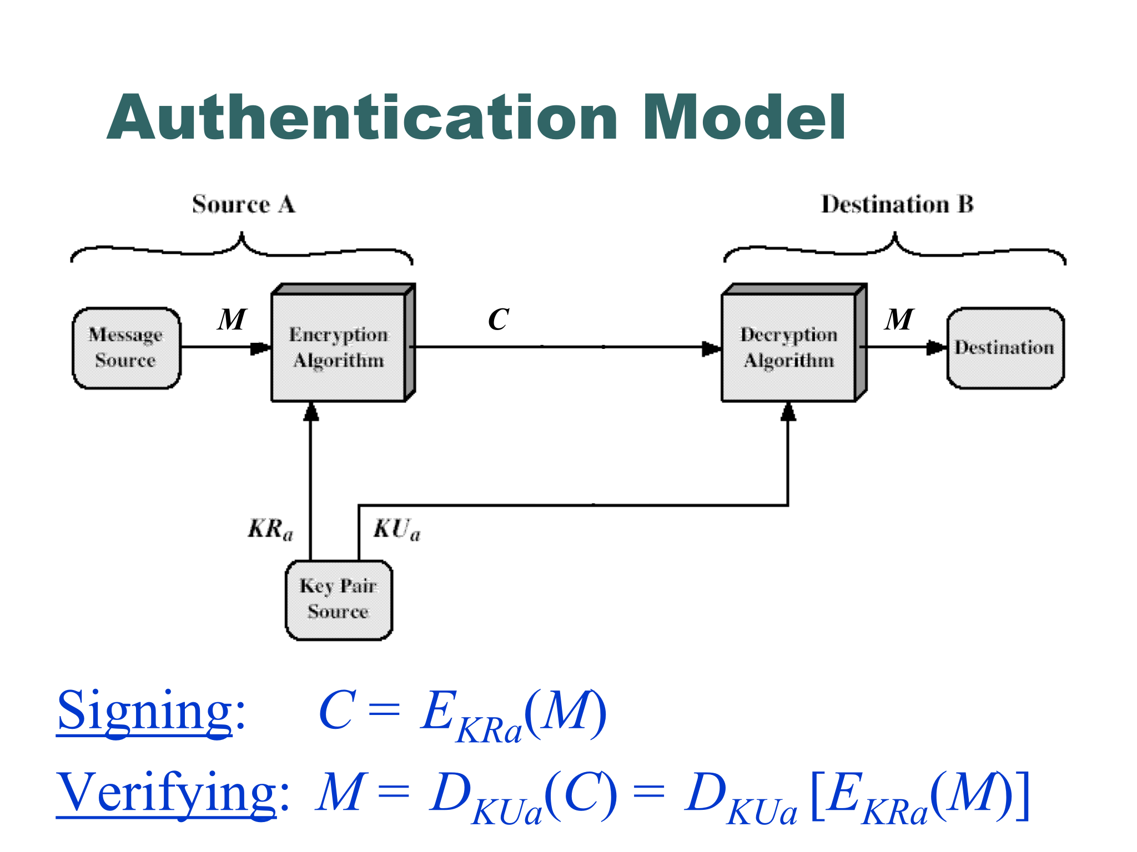

Slide 12
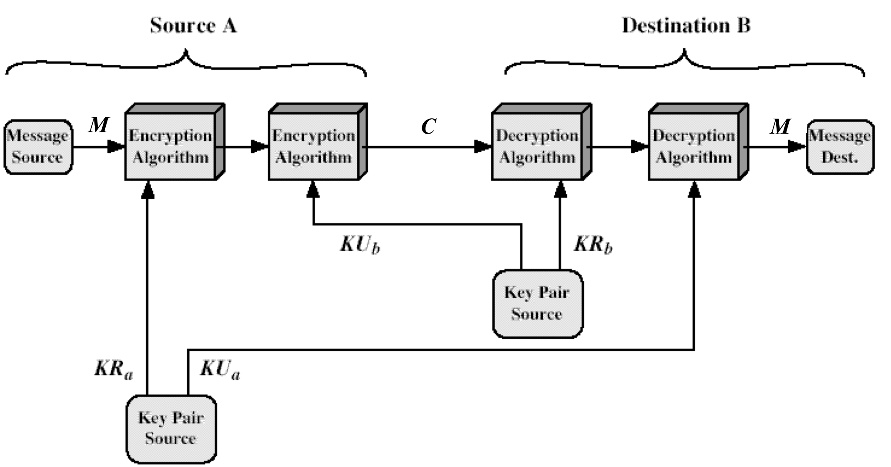
Secrecy & Authentication combined

Slide 13
Secrecy & Authentication combined
Secrecy “nested” within authentication steps
  Source signs and then encrypts
  Destination decrypts and then verifies signature
Source: C = E_{KUb}(E_{KRa}(M))
Destination: M = D_{KUa}(D_{KRb}(C))
= D_{KUa}(D_{KRb}(E_{KUb}(E_{KRa}(M))))

Slide 14
Application: Key Exchange
Alice wishes to communicate with Bob using a shared secret key
  First, she generates a random key (if DES then this has 56 bits)
  Then she uses Bob’s public key to encrypt this shared secret key and sends it to him
  Bob opens the message with his private key and retrieves the shared secret key
  Alice & Bob then use the shared secret key to communicate with each other

Slide 15
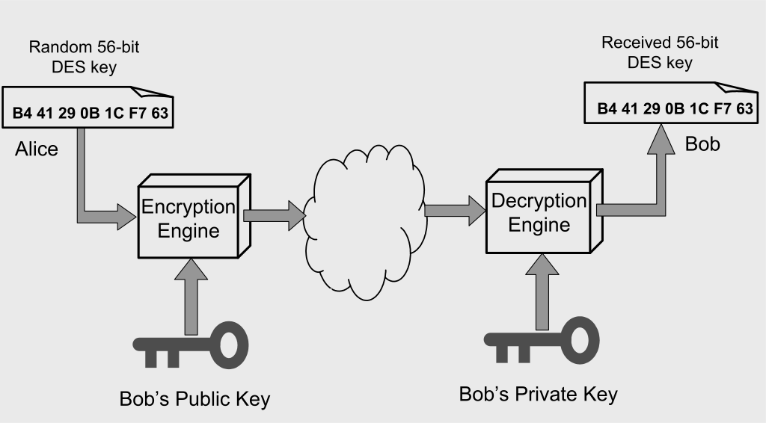
Application: Key Exchange
Once exchanged, Alice & Bob then use the shared secret key to communicate using symmetric encryption

Slide 16
Public Key Algorithms – Requirements
Computationally easy for party B to generate a public/private key pair – i.e. KU_{b} & KR_{b}
Computationally easy for sender A, knowing B’s public key and the message to be encrypted, M, to generate ciphertext:
C = E_{KUb}(M)
Computationally easy for receiver B to decrypt resulting ciphertext using the private key
Computationally infeasible to determine private key, KR_{b}, on knowing public key, KU_{b}

Slide 17
Public Key Algorithms – Requirements (cont.)
Computationally infeasible for opponent, knowing public key KU_{b} and ciphertext C, to recover original message, M
Either key can be used for encryption with the other used for decryption
M = D_{KRb}[E_{KUb}(M)] = D_{KUb}[E_{KRb}(M)]
The 6th requirement is desirable rather than essential

Slide 18
Limitations of Public Key Cryptography
1. Processing speed
  Calculations required for public-key algorithms (mainly multiplications) much slower than those of conventional algorithms (permutations & XORs)
  Thus public-key methods not suitable for general-purpose encryption/decryption
  Instead often just use public-key method to exchange session (secret) key at beginning of session & use session key thereafter

Slide 19
Limitations of Public Key Cryptography
2. Authenticity of public keys
  Bob’s public key is in the public domain and only Bob has the corresponding private key
  What happens though if an eavesdropper (Eve) generates another key pair and advertises the public key produced as belonging to Bob?
  People then may send messages to Bob using the wrong public key, for which Eve has the corresponding private key.
  Need to be able to trust that a public key
  belongs to whom it’s reputed to belong.

Slide 20
Public Key Cryptography Algorithms

Slide 21
RSA
Rivest, Shamir & Adleman, MIT, 1977
Most known & widely used public-key scheme
Uses large integers as keys (>1000 bits)
Security due to extreme difficulty of factoring large integers (esp. if product of two prime numbers)
Patent expired in Sept 2000

Slide 22
Note on RSA security
Most common application of RSA is in the encryption of session keys for use in symmetric encryption.
However, RSA should not be used directly for encrypting session keys
  Due to Meet-in-the-middle attack where plaintext block is relatively short and can be factorised

Slide 23
How to use RSA in practice
Instead of directly encrypting a symmetric session key using RSA, use RSA to encrypt larger random number x and use H(x) as session key
  Where H(x) is the cryptographic hash of x (see next section on hashing algorithms)

Slide 24
RSA – efficient computation of large powers
RSA encryption/decryption requires raising numbers to large powers in modulo arithmetic
This needs to be done efficiently

Slide 25
RSA Security – Factoring
RSA depends on difficulty in factoring n
  Note than n is part of the public key
Time needed to factor a large number increases exponentially with the number
Large key (number) size ensures safety from brute force attack
RSA Inc. in the past periodically issued factoring “challenges” to research community & some progress has been made
    http://www.emc.com/emc-plus/rsa-labs/historical/
    768-bit modulus factored in 2009
      2 years, “hundreds” of machines
      Equivalent to 2000 years of computing on single 2.2GHz core
    1024-bit modulus considered 1000 times harder to factor

Slide 26
RSA Security – Other Attacks
Timing Attack
  The time it takes to compute C^{d} (mod n) can expose d.
Power Attack
  The power consumption of a smartcard while it is computing compute C^{d} (mod n) can expose d.
Quantum Computing (in theory)
  Factorisation of large numbers in reasonable time is theoretically possible with quantum computers

Slide 27
RSA Key Generation Trouble (Feb 2012)
Experiment: tested millions of real public keys
Result: able to factor 0.4% of total!
Cause: poor entropy (randomness) at startup:
Lesson: Make sure random number generator is properly
seeded when generating keys
https://freedom-to-tinker.com/blog/nadiah/new-research-theres-no-need-panic-over-factorable-keys-just-mind-your-ps-and-qs/

Slide 28
Diffie-Hellman
Public Key Technique for exchanging secret keys
  First public key technique (1976)
The secret key is calculated by both parties
Requires some global public parameters

Slide 29
ElGamal
Diffie-Hellman just does key exchange
But can be adapted for public key encryption
  This is the ElGamal scheme
  Used in GPG
  GNU Privacy Guard (free replacement for PGP)

Slide 30
Elliptic Curve Cryptography
Majority of public-key crypto (RSA, D-H) use either integer or polynomial arithmetic with very large numbers/polynomials
Imposes a significant load in storing and processing keys and messages
An alternative is to use elliptic curves
Offers same security as RSA with smaller bit sizes and lower processing and memory overhead
Limitations (compared to alternatives):
  Not quite as well tried and tested (in use for about 15 years)

Slide 31
Comparable Key Sizes for Equivalent Security
Symmetric scheme (key size in bits) | ECC-based scheme (size of n in bits) | RSA (modulus size in bits)
56 | 112 | 512
80 | 160 | 1024
112 | 224 | 2048
128 | 256 | 3072
192 | 384 | 7680
256 | 512 | 15360

