Slide 1
Fusion Paranoia
Conspiracy podcast – presentation
20075914, 20076649, 20075687 & 20071864

Slide 2
Overview of the Business
Irish based conspiracy podcast based in Co. Waterford, Ireland.
Company consists of four people taking turns with segments and information collection.
Members of business have background that delve into tech support, web building and database building.
Company is based in 280 East Thorne Street, Waterford, Ireland. Recording studio to be used for podcast costing around 200 euro.
The name Fusion Paranoia came from a group of members back in 1964 trying to figure out the JFK shooting.

Slide 3
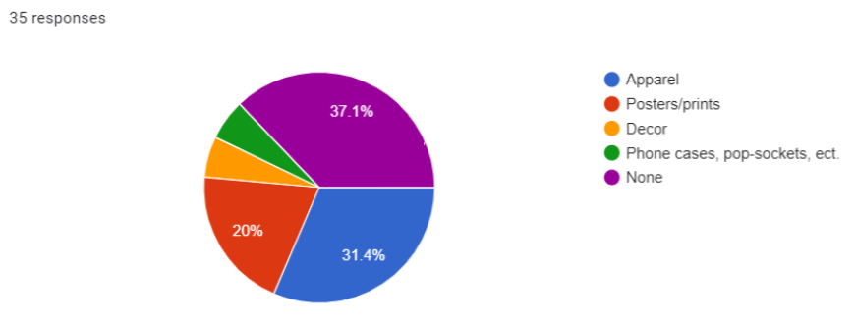
Products and Services
Merchandise to be setup such as T-shirts, Mugs, Badges, and Other accessories.
From survey results, majority of people prefer Apparel over others.

Slide 4
Competitors
Those Conspiracy Guys
The Truth is somewhere
Conspiracy Theories podcast
Irish podcast from Wicklow.
Produce related content and have 15,649 followers.
Discussed topics include political intrigue, extra-terrestrials, rogue governments etc.
They explain that “our aim is to cast a light into the dark corners of corruption, conspiracy and suppression.
Small podcast channel on YouTube with 9 followers but 48,385 downloads on PodBean.
Is a conspiracy theory and mystery discussion podcast run by two members.
Consists of dark humour, junk science, real science etc.
A related podcast channel with 6k followers and 27 episodes on Podbean.
Discuss controversial stories and events as well as possible cover up stories.
Podcast is part of the Parcast Network and a Cutler Media Production.

Slide 5
Projected Growth Plan
Move out of current facility into larger area with more space for recording podcasts.
Aim to get better recording equipment and video equipment to allow for a more personal experience.
Hire additional staff members to aid in maintenance, camera switching, social media, reddit pages and looking through web for articles.
Additional time and resources put into promoting the podcast channel via online and real world.

Slide 6
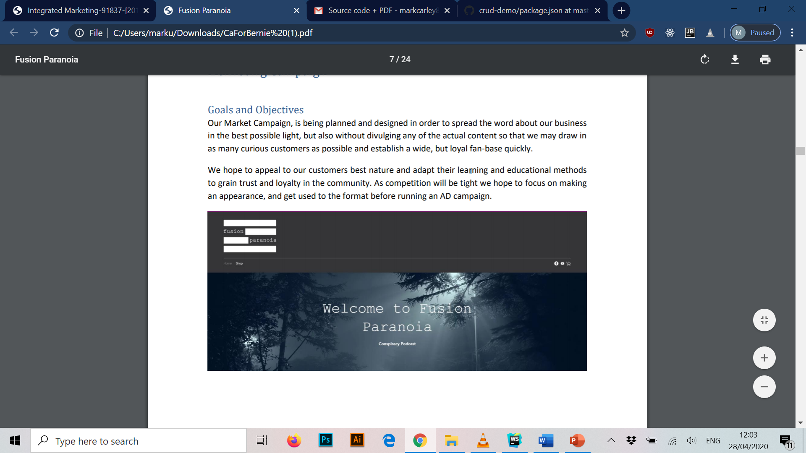
Marketing Campaign
Marketing Campaign for this business is being planned and designed in order to spread the word of the business but without divulging any actual content from the show in order to draw in more attention.
Focus on running an AD campaign to make appearance and show spotlight when against other competitors.
Hope to appeal to best nature of customers and adapt to their learning to gain trust and loyalty from the customer base.

Slide 7
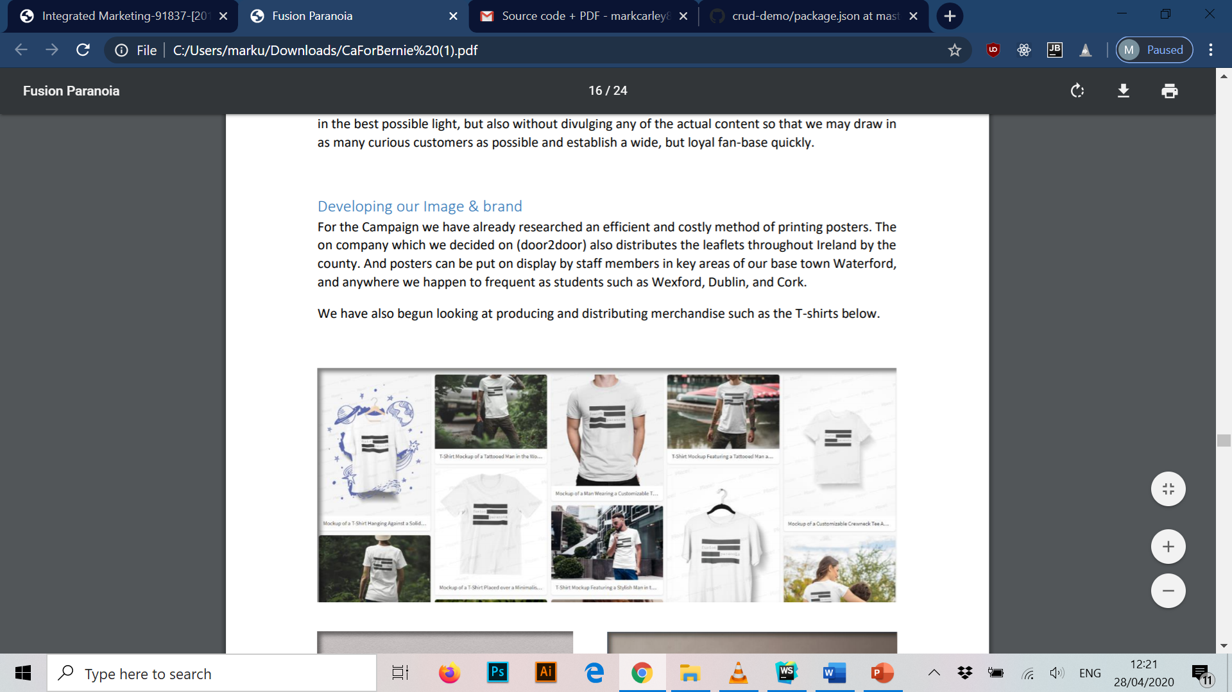
Digital/Online Marketing Campaign
Goals and Objectives
Spread word of business without providing information about what’s discussed to draw in attention.
Get potential viewers that show curious to the podcast to quickly attract a loyal fan-base.
Developing our Image & Brand
Printing posters.
Go door2door to distribute leaflets throughout the county.
Poster displays on shops and public areas.
Producing merchandise such as T-shirts.

Slide 8
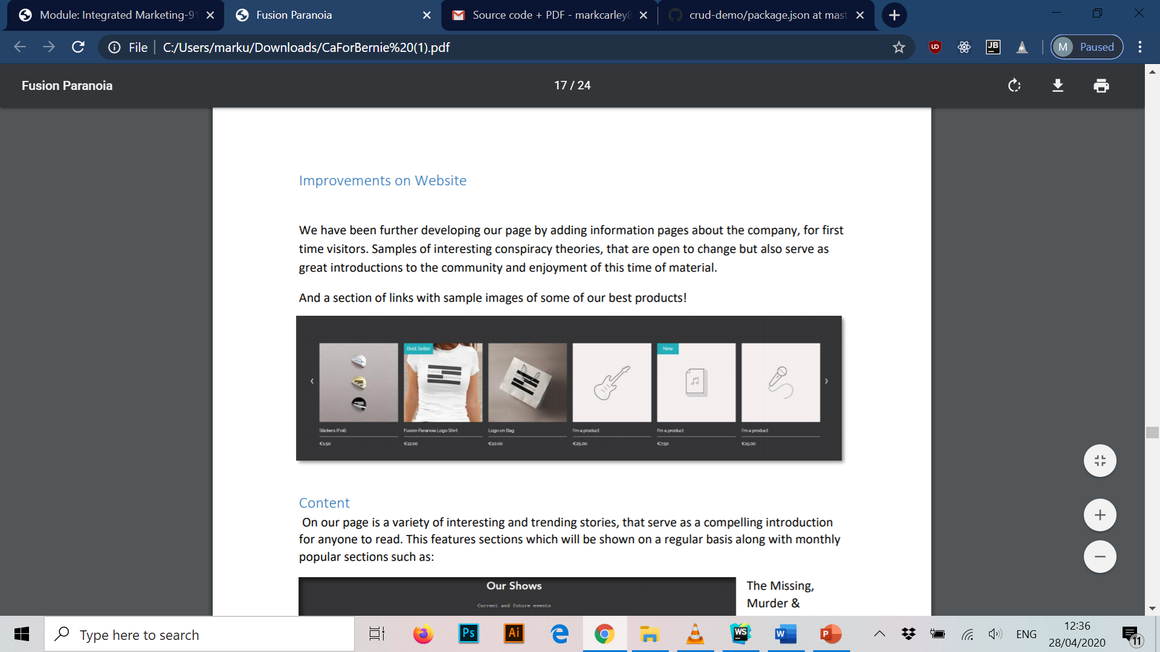
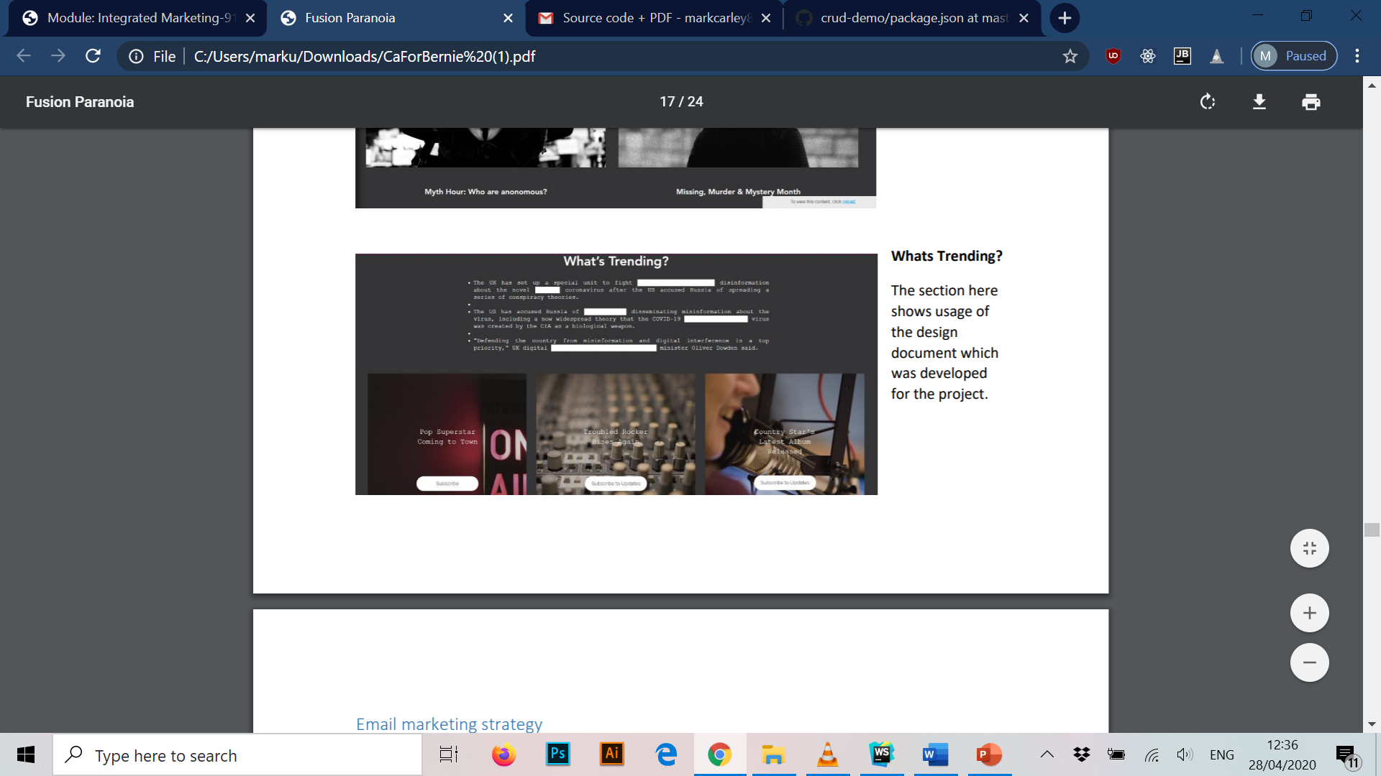
Website & Content
Improvements on Website
Adding information pages about company (first time visitors).
Sections to link sample images of best products.
Content
Shows section (what’s upcoming).
Monthly popular section.
Merchandize and Trending page.

Slide 9
Email marketing strategy
Conducted a survey and a phone in segment of the podcast show.
From conducting marketing campaign, have collected emails with suggestions to show.
Due to GDPR, information to be kept between staff members.
From conducted research of a successful e-mail marketing campaign.
Need to focus on those who’s search history matches the demographic.
Using a reply optional email which comes across as approachable.
Break down email responses into different categories once gathered in the database.

Slide 10
Search Engine Optimisation
Search Engine Optimisation is an evolving equation that grows more complex.
Use of key words used in Website and Social Media such as “Conspiracy”, “Truth”, “Happened”, “Hacking”, and “Believe”.
Avoid words such as “Government” to not be involved in upsetting political parties while setting up business.
Plan on using string of key words and other generated words in text boxes and headers.
Incorporate links to other popular websites to boost google search results.
Last option is to invite as many people as possible to generate traffic.

Slide 11
Analysing the responses to the Marketing Campaign
Response analysis is the process of analysing response data to determine how well a direct marketing campaign actually performed.
Five platforms of online marketing used:
Facebook
Twitter
Instagram
YouTube
Company website (Wix)
General responses given on platforms are either add more content, more merchandize setup and continuation of certain speaking topics.

Slide 12
Measuring the effectiveness of the Campaign.
Cost per head (cost-effectiveness factor of marketing campaigns).
Measuring incremental sales of merchandize sold.
Google Analytics for measuring and analysing the traffic of both social media and website.
Multi-Channel Funnels which allow channels of traffic to the main website to social media and vice-versa.
Topics of measuring growth of a business
Cost per head
Incremental sales
Google Analytics
Multi-Channel Funnels

Slide 13
Recommendations to further the company online
Google Ads
Advertisement Congruence
Incorporate Google Ad Sense on company website for passive income.
Placing Google Ads for merchandize for front page searches of Google that come up as related searches.
Ad congruence is when your ads and the landing (website) look the same and have the same message.
Having a consistent theme and message when advertising our merchandize.
If platforms are vastly different, gives a bad impression.

Slide 14
Recommendations to further the company online
Utilize website pop-ups
Boost Posts
Not needed in high numbers.
Allows collection of data such as email addresses.
Good way to entice is offer free trails, coupons or special offers on services/merchandize.
Platforms such as Facebook allow a service called boosting posts.
Allows company and merchandize to be shown more often to bigger audience.
Increases engagement and further promotes business.

Slide 15
Conclusion
Thank you for watching

