Slide 1

Marketing CA1
Fusion Paranoia – Conspiracy Podcast

Slide 2
Micro-Economics
Demographic: Between ages of 18 and 28, from the survey it was found 48.6% were male and 37.1% Female, leaving 14.3 in Other.
Economic: Products not necessary to survive and are mostly online.
Natural: No raw material, outsourced merchandise and local printing
Technological: Podcast, internet connection & smart device to access
Legal, Regulatory & Political: Discussion of Pre-existing conspiracy's not creating allegations. Not explicitly aimed at politics.
Social & Cultural: Irish based & English speaking (translations/captions)

Slide 3
Macro-Economics
The Company
Cost Drivers
Electricity & Web Hosting
Competitive cost advantage
Undercutting & price fluctuation
Source of competitive differentiation
Age Range
Heritage
Topics of choice
Suppliers:
Eastern vs Western
Marketing Intermediaries:
Sales Team + Printing stores
Customers
Personal
Psychological
Social
Competitors
- Those Conspiracy Guys
- The truth is out there
- Conspiracy Podcasts
Publics
Family friendly appearance

Slide 4
Segmentation
Geographics
Waterford IRE
Single Language
Demographics
18 – 24
Students
Full – Time Education
All Gender Suitability
Psychographics
Enjoys Conspiracy Theories
- Enjoys questioning events & Individuals
- analyzing situations & occurrences
Behavioral
Engages with online streaming services frequently
Enjoys listening to podcasts specifically

Slide 5
Our Mix
Product: Conspiracy Podcast with Merchandising & accessories
Price: Exclusive to merchandise with free shipping within Ireland
Place: Dedicated within Ireland but broadcasting in GMT worldwide
Promotion: Social Media, Youtube, Flyers, Stickers

Slide 6
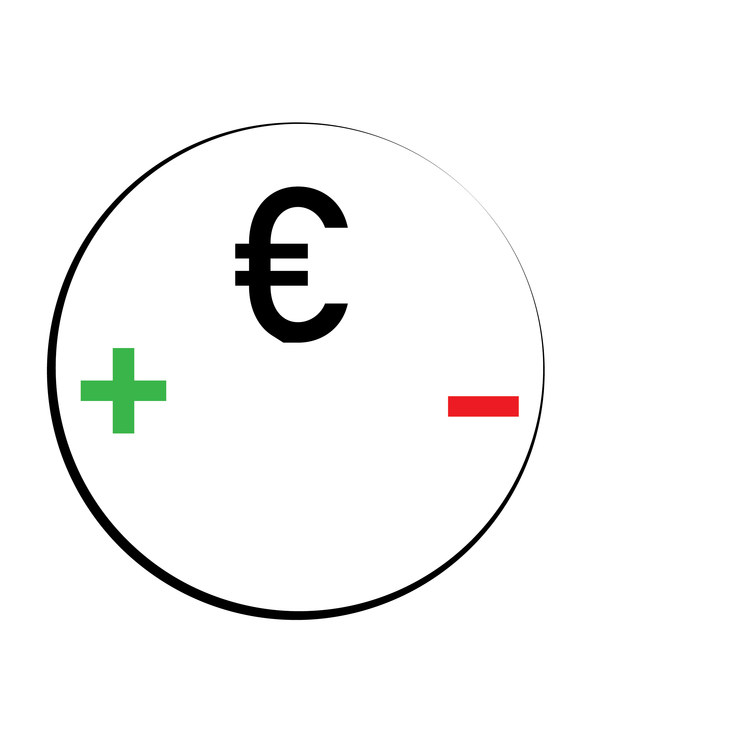
Pricing Decisions
The factors
Deciding the price for product/service.

Slide 7
Company Factors
Marketing & Pricing Objective
Product/Branding Strategy & Positioning
Marketing Communications
Costs
Capacity of the Organization
Market Factors
Competitors' prices and responses
Market segmentation
Channel member’s expectations

Slide 8
Environmental Factors
Legislation and Regulations
Exchange Rates
Pricing Policies
Price Skimming
Price Penetration
Psychological Pricing
Professional Pricing

Slide 9
Price Estimations
Basics
Website Hosting
Recording Equipment
Electricity
Merchandise
T-shirt
Sticker
Promotions
Leaflets
Posters

Slide 10
Distribution Policy
Direct Policy
Sell products to the customer directly
Works in line with Direct Exclusive
Single sales channel
Single location efficiency
Small overhead
Will provide the largest profit margin
Agents
Sales Representatives
Partners
Wholesalers & Distributers – If Expanded

Slide 11
Promotion
How to get the word out about the podcast
Posters
Ads
Mysterious stickers
Waterford walls incorporation
Flyers
Business cards
Social Media's

Slide 12
Promotion & Social Media
Advertising/ Publicity
Mission
Money
Messages
Media
Measurement
Sales Promotion
Trade Incentive
Social Encouragement
Sales promotion
Public Relations
Press release
Business Image
Direct Marketing
Direct Channels
Social Media's
YouTube
Twitter
Instagram

Slide 13
Results of survey – Sample Persona
19-Year-Old Student.
Watches Shane Dawson conspiracy videos on YouTube.
Wants to branch out into conspiracy specific streaming services.
Study nine to five, Monday to Friday.
Engage with conspiracy streaming services on a Friday at 6pm.
Has a specific interest in unsolved murders.

