Slide 1
charnley/rmsd
A Python Package
Presented By: Andrea Miller, Mark Tamale, Evie Lee, & Alisha Gurule

Slide 2
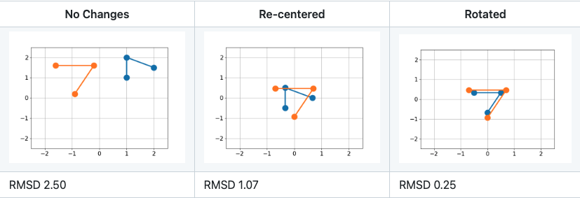
What the package does:
Calculates the Root Mean Square Deviation (RMSD) of two structures, such as a molecule or protein, and rotates them until their positions relative to each other result in the minimum RMSD
The user can specify whether to use the Kabsch Algorithm (1976) or the Quaternion Algorithm (1991) for the rotation
Goal: Compare the structural difference between two molecules based on the atoms and their positions.
Notes:
As you can see, finding the position with the minimal RMSD will allow for the most direct structural comparison.

Slide 3
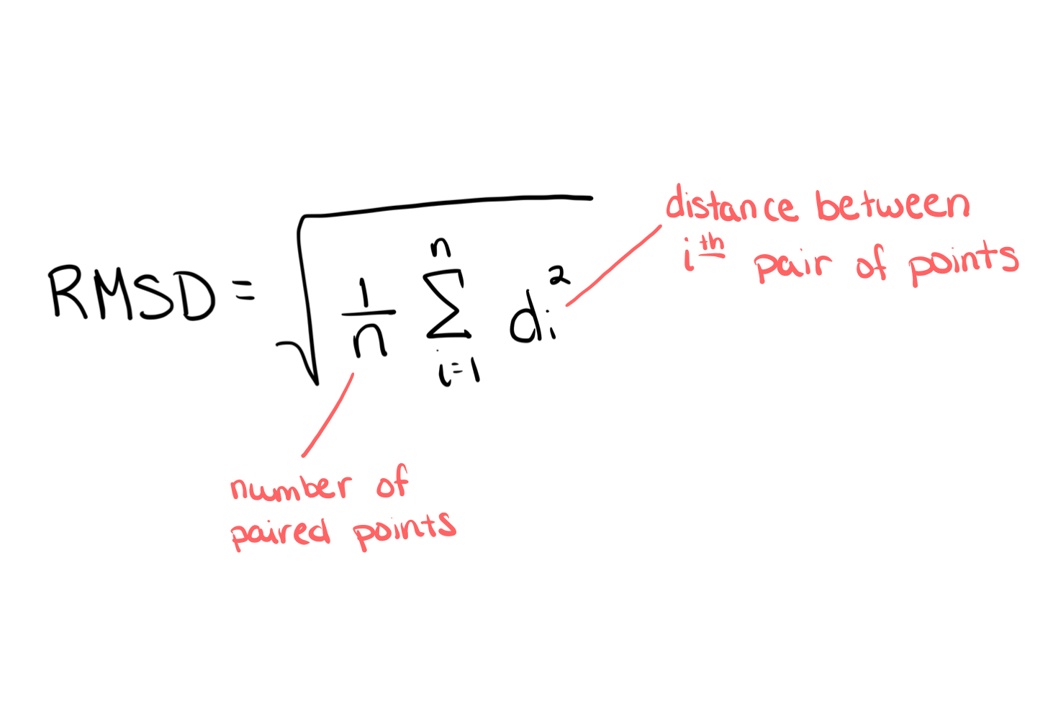
How does it do it:
Computes the minimal RMSD for the distance between the data points by rotating and translating one of the matrices
RMSD:
Standard deviation of the points
Every point -
Calculate the distance between two points
Square the distance
Sum all of the squared distances
Divide by number of points less 2 (n -2)
Then take the square root of that
Notes:
Standard equation for calculating the RMSD between two sets of points

Slide 4
Kabsch Algorithm
Process
Method to calculate optimal translation and rotation to then calculate the RMSD between paired data points.
Given two n x d matrices, P and Q:
Calculate the center for both P and Q
Rotate P onto Q to minimize resulting RMSD:
NewMat = Q P
[U, S, V ] = SVD(NewMat)
RotationMat = U V
RotatedP = RotationMat * P
Shift RotatedP by centered values of Q
T
T
T
T
Source: https://towardsdatascience.com/the-definitive-procedure-for-aligning-two-sets-of-3d-points-with-the-kabsch-algorithm-a7ec2126c87e
Notes:
Process to rotate Matrix P to fit best onto Q is:
Calculate the center for P and Q (typically 0,0,0 → subtract mean of column from each value)

Slide 5
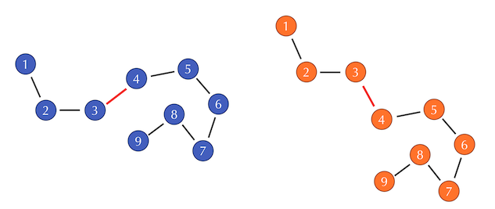
Kabsch Algorithm: Problems
If two structures are very similar, the bond angle early in the atom sequence differs, the distance between the remaining atoms can be skewed.
Source: https://biologicalmodeling.org/coronavirus/accuracy#:~:text=The%20Kabsch%20algorithm%20offers%20a,point%20from%20each%20amino%20acid.
Notes:
Although there are multiple scenarios that can cause Kabsch Algorithm to be less effective, this is one example. As you can see, the bond angle between atom 3 and 4 differs and the distances for the remaining atoms all result much higher than needed.

Slide 6
Quaternion Algorithm
Key Idea
Finds a rotation matrix between two coordinate systems that minimizes the loss in accuracy.
Find the expression of the loss function as a quadratic form using the Cayley-Hamilton Theorem and Newton Method to solve for the eigenvalue problem and make a stable solution.
This approach is supposed to be more accurate and more efficient computationally
Source: https://link.springer.com/chapter/10.1007/978-3-030-48791-1_37
Notes:
The math behind this algorithm is very complex and not the point of this presentation, so we won’t go too deep into it.

Slide 7
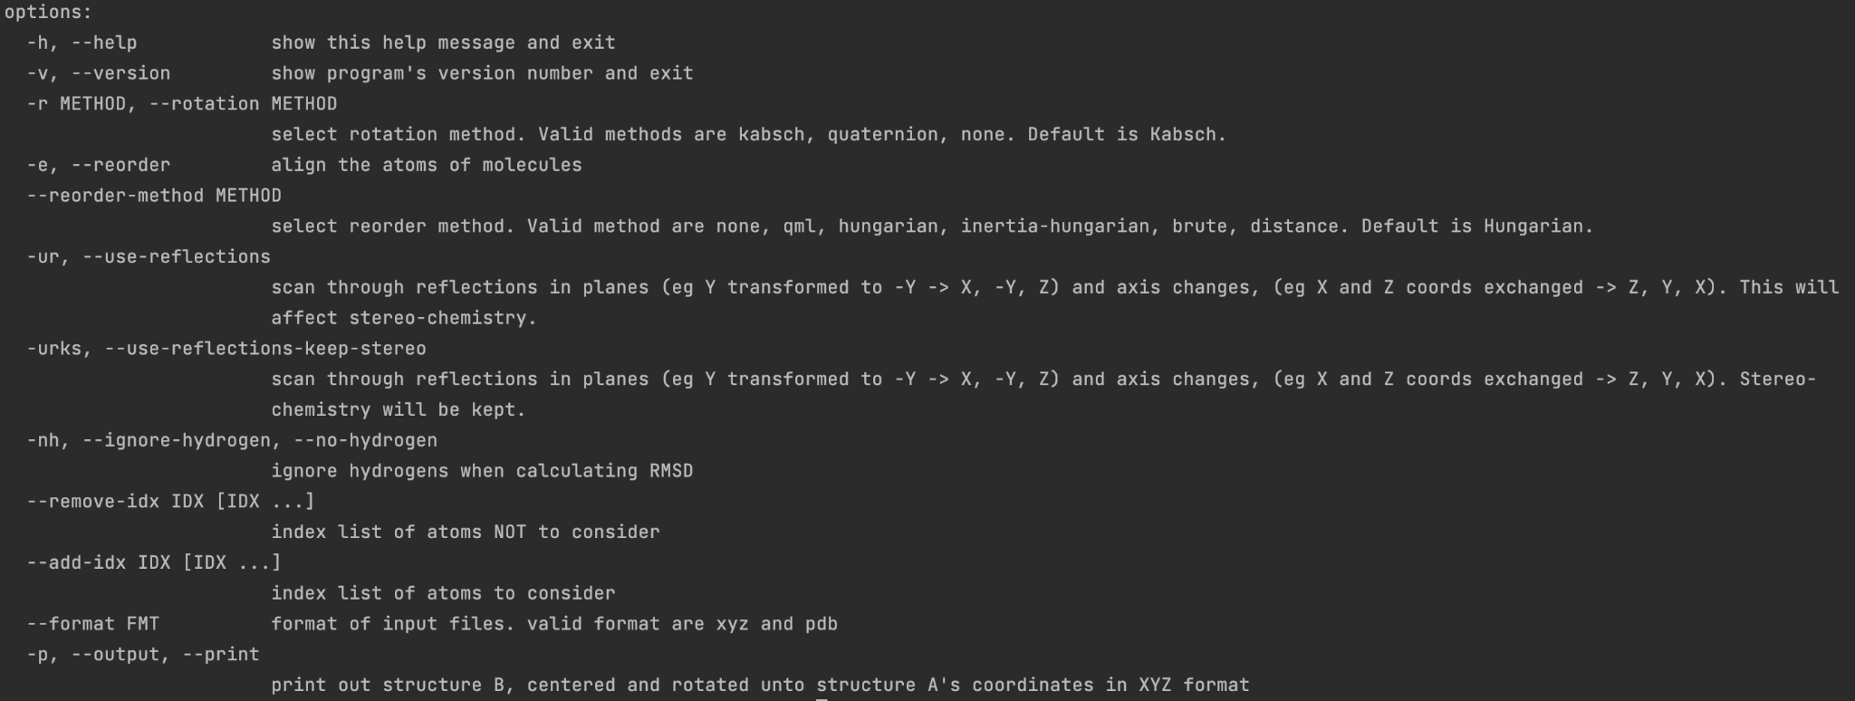
Package Features:

Slide 8
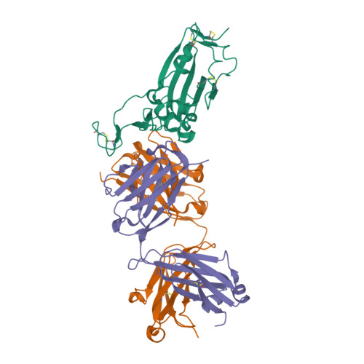
Motivation
What and how
Learn more about molecular structure processing and comparison
Chose package because it utilizes both SVD and Newton’s Method
2D and 3D comparison of different molecules
Protein rotation comparison with original structure
Comparison on results and performance of both methods of rotation
Communicated on Discord
Tasks were Ad Hoc as we worked through the functionality of the package
Random molecule pulled from https://www.rcsb.org/

Slide 9
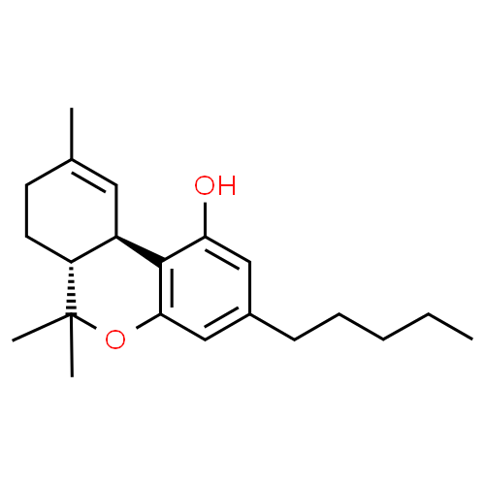
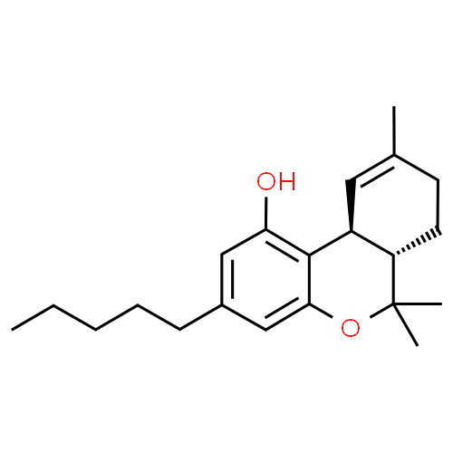
Comparing different molecules - 2D
Comparison between two different Tetrahydrocannabinal molecules:
ID: 15266
ID: 118751
Notes:
Left is (-)-δ9-trans-Tetrahydrocannabinol, the right is (+)-trans-δ9-Tetrahydrocannabinol
(because they are the same structure, but right handed and left handed versions of each other → chirality)

Slide 10
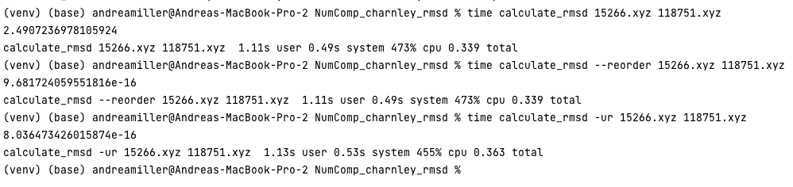
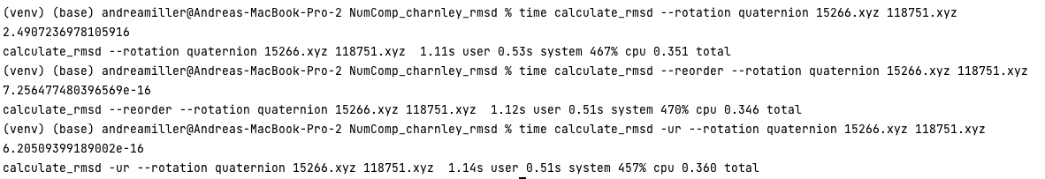
2D Results:
Kabsch Algorithm (default):
Quaternion Algorithm:

Slide 11
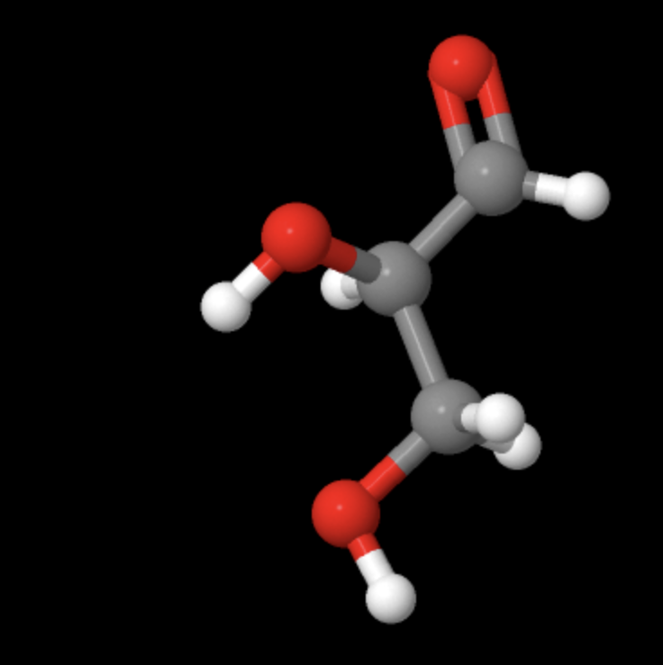
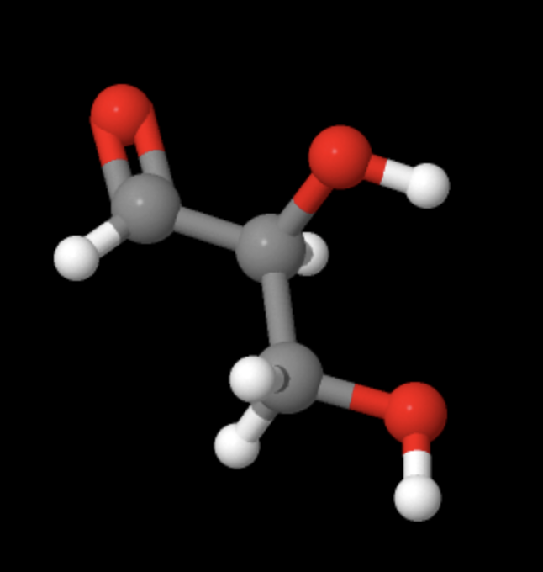


Comparing different molecules - 3D
Comparison between D-glyceraldehyde (71347) and L-glyceraldehyde (388787):
ID: 71347ID
ID: 388787
Notes:
Achiral - think of human hands with finger pointing out

Slide 12
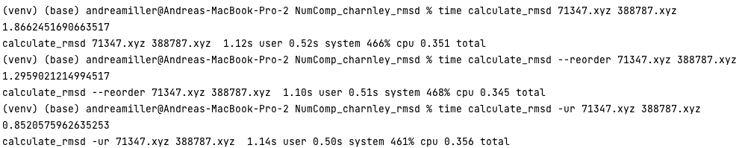
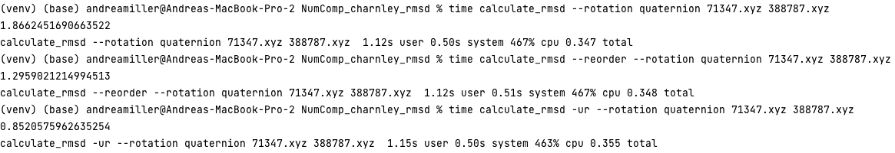
3D Results:
Kabsch Algorithm (default):
Quaternion Algorithm:

Slide 13
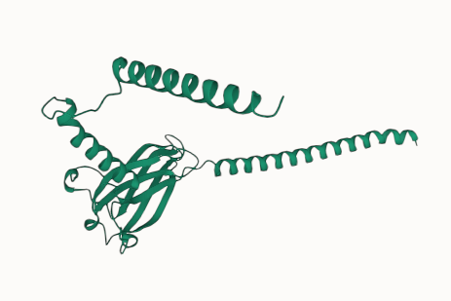
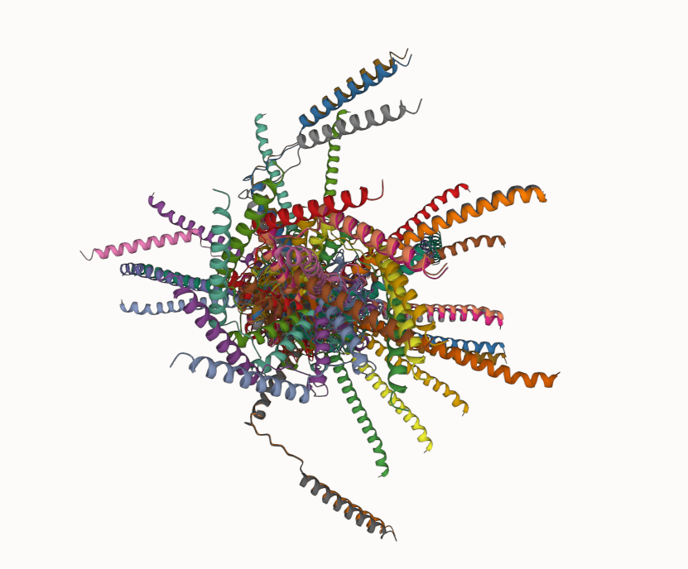
Testing on 20 random rotations
Take fairly complex structure— AlphaFold prediction of an E. Coli genomic chromosome
Randomly rotate around axis in 3D (x, y, z)
Compare each rotated structure with the original using RMSD and Kabsch or Quaternion
RMSD should be zero
Done using: Jupyter Notebook, Python (biopython, numpy, rmsd, timeit)
E. Coli
20 random rotations
Protein structure visualizations created using Protein Viewer By Arian Jamasb (VS Code Extension)

Slide 14
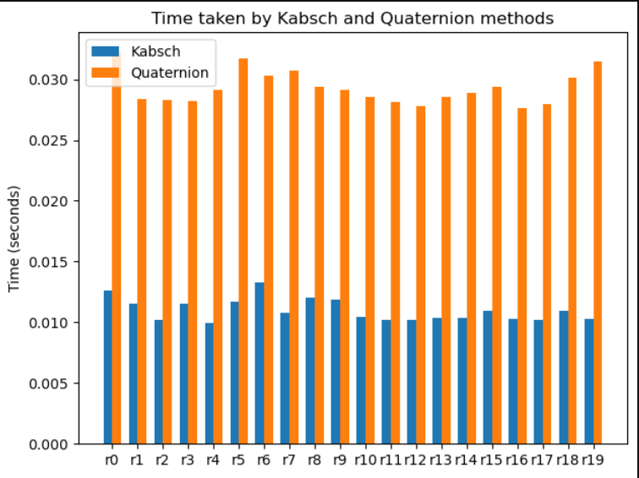
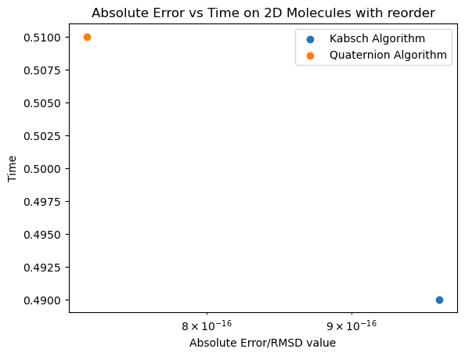
Metrics/Quality
Quaternion gets us a slightly closer approximation but w/ slightly more time.

Slide 15
Results:
Data shows
Quaternion algorithm was slower when used on the 2D molecules; mixed results for 3D.
Both algorithms produces approx. same results; Quaternion algorithm producing a slightly smaller error; mixed results for 3D.
Inferences
3D molecules closer in structure before reorder
2D molecules closer in structure after reorder
2D RMSD after reorder was very close to zero; they have the same structure.

Slide 16
Advantages and Disadvantages:
Advantages
This is helpful when comparing different states of molecular structures.
This is helpful to scientists studying chemistry, biochemistry, and structural biology.
Potentially lead to better research with molecular biology which can lead to breakthroughs in health and drugs.
Disadvantages
Package is very limiting, stuck within the constraints of its functionality
Incorrect input data or interpretation can lead to skewed results, so it is up to the user to correctly interpret results

Slide 17
Additional packages used:
Additional Sites used:
Biopython → specifically, the PDB module to parse the atomic structure of a .pdb file into a modifiable data structure (which we used to rotate around some axis)
http://www.cheminfo.org/Chemistry/Cheminformatics/FormatConverter/index.html
For converting .mol files to .xyz
PDB rotation reference
AlphaFold Protein Structure Database
To obtain a complex enough protein to run tests on
(Papers cited for structure prediction:)
Jumper, J et al. Highly accurate protein structure prediction with AlphaFold. Nature (2021).
Varadi, M et al. AlphaFold Protein Structure Database: massively expanding the structural coverage of protein-sequence space with high-accuracy models. Nucleic Acids Research (2021).

Slide 18
Additional Sources:
Jimmy Charnley Kromann GitHub Link - package creator
Jimmy Charnley Kromann LinkedIn Link - creator profile
http://www.chemspider.com/Chemical-Structure.118751.html?rid=6324d97d-94ff-4a1e-837a-e05695892726
http://www.chemspider.com/Chemical-Structure.15266.html?rid=15ba37de-f3c4-444b-8d1a-21dc3a630ba5#synonymsTab
http://www.chemspider.com/Chemical-Structure.71347.html?rid=e569f2e5-283f-4870-955f-3ea080e19515
http://www.chemspider.com/Chemical-Structure.388787.html?rid=2937c387-5fe5-45ab-8597-708051bfb860

