Slide 1
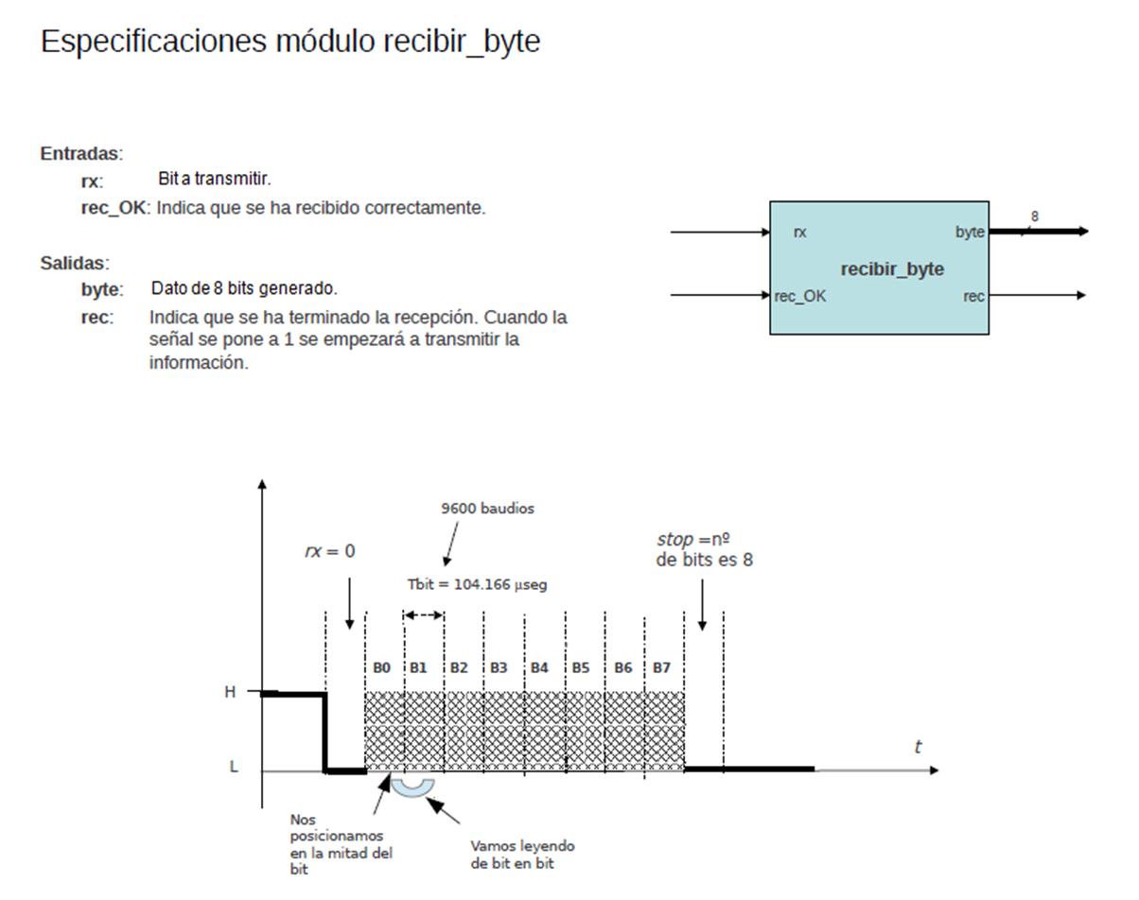

Slide 2
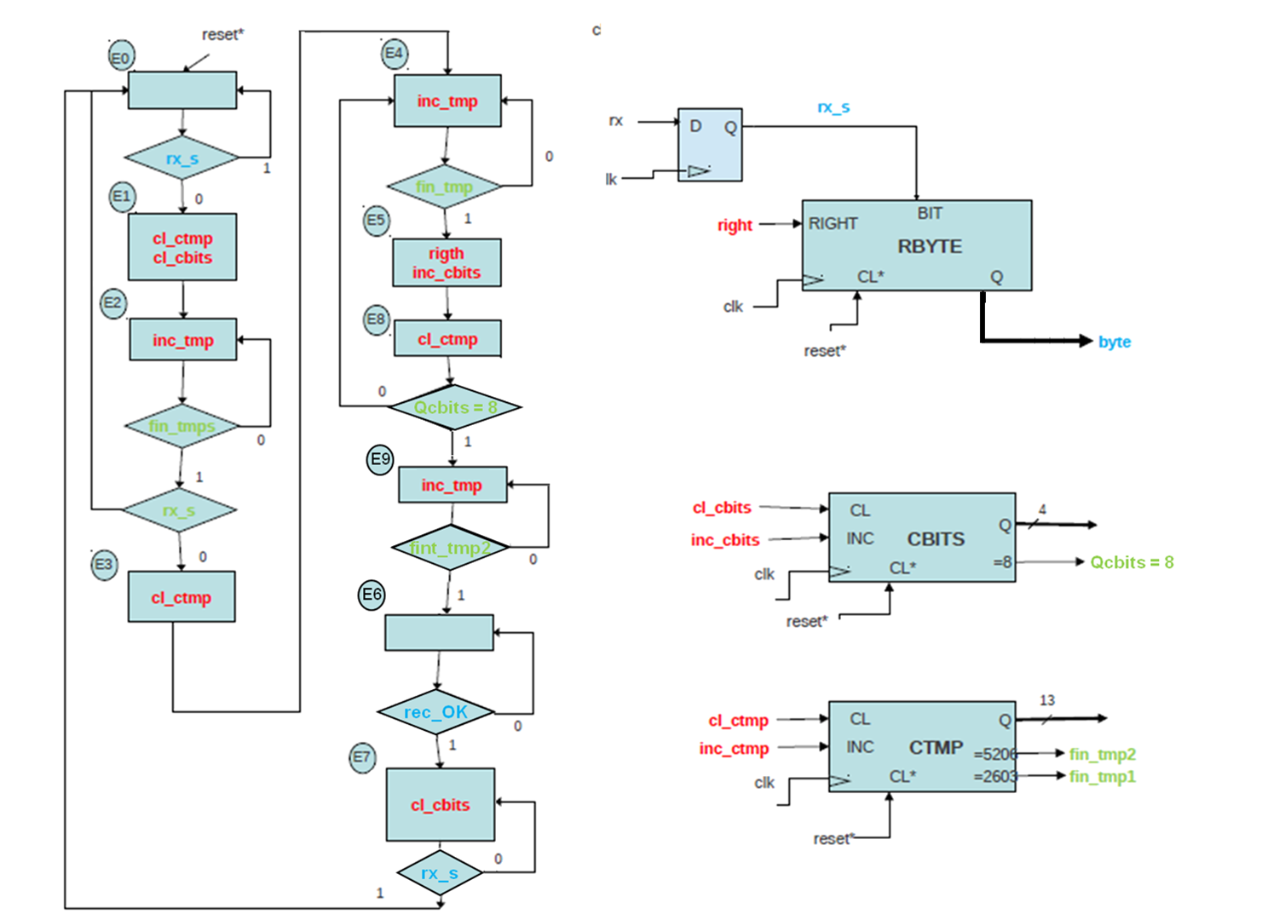
rx_s
rx
fin_tmp2
8
fin_tmp1
rec

