Slide 1
Employee Data Analysis using Excel
STUDENT NAME: Sudarshan Sriram
REGISTER NO: 312220853
DEPARTMENT: Department of Commerce
COLLEGE : Kumararani Meena Muthaiah College of Arts and Sciences, Chennai

Slide 2
PROJECT TITLE
Employee Productivity Analysis through Excel

Slide 3


AGENDA
Problem Statement
Project Overview
End Users
Our Solution and Proposition
Dataset Description
Modelling Approach
Results and Discussion
Conclusion
3/21/2024 Annual Review

Slide 4

PROBLEM STATEMENT
Employee Productivity is contingent on Employment Status and Employment Type.
Identifying the type of Employees having least productivity.

Slide 5

PROJECT OVERVIEW
.Identifying the employees based on productivity and designing solution to transition the organization to the upper-echelons on the productivity scale.

Slide 6

WHO ARE THE END USERS?
Shareholders
Board of Directors
CEO, CFO, CIO and other CXO officers
Project Managers

Slide 7

OUR SOLUTION AND ITS VALUE PROPOSITION
Identifying the Employee Categories have lower levels of productivity
Transitioning the low-productive employees into high productive employees through administrative changes necessary based on type of employees.
This leads to employee-retention and higher productive output of transitioned employees.

Slide 8
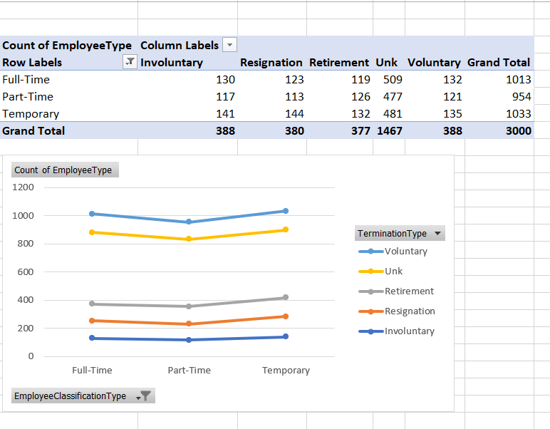
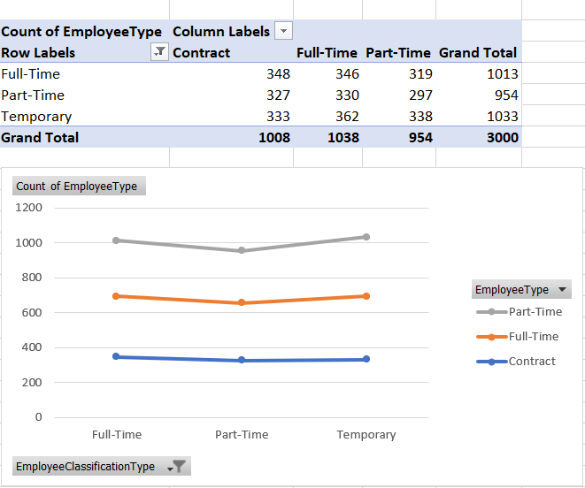
Dataset Description
Based on Employee Count, the number of employees split across the various departments within the organization have been identified.
This split can be further analyzed to determine the performance scores of various Employees who are :
Contract
Part-Time
Full Time

Slide 9
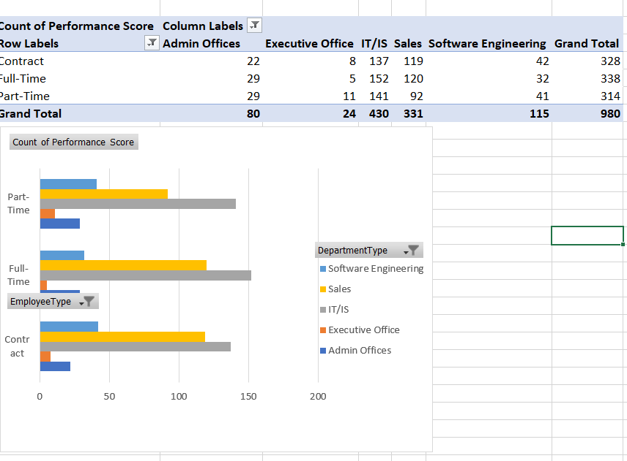
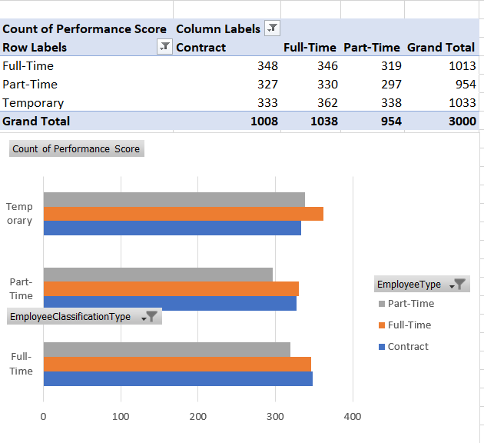
Deep-dive of Employee Type combined with the Employee Classification leads us to believe that the employees who are engaged part-time are the least productive and employees hired on contract-basis are the most productive.

Slide 10

THE "WOW" IN OUR SOLUTION
Our solution is to convert the part-time employees into contract employees in order to achieve maximum efficiency.
However, an large instant conversion will be counter-productive to the organization.
Hence, the organization is advised to convert a part of its part-time workers into contract employees who are contracted for a period of 2 years immediately, and the remaining part-time employees are transitioned into full-time employees.
To accommodate such a large conversion, the organization is also advised to reduce the remuneration of full-time employees by 10% and the all contracts for contract employees have to be entered into at 12.5% reduction that the existing remuneration, so as to accommodate the entire onboarding.
3/21/2024 Annual Review
10

Slide 11
MODELLING
Downloading Dataset from Edunet Dashboard.
Filtering the Employee DataSet to identify the factors of analysis.
Selecting entire Table and creating a PivotTable
Placing the Following Filters :
Employee Type :
Column – Employee Type
Row – Employee Classification Type
Value – Count of Employee Type
Employee Productivity
Column – Departments, Employee Type
Row – Employee Type, Employee Classification Type
Value – Performance Score Count
Converting the Data Sheets into Charts to understand the productivity movements across employee types.
Onboarding Data onto PowerPoint to conduct productivity analysis
11

Slide 12

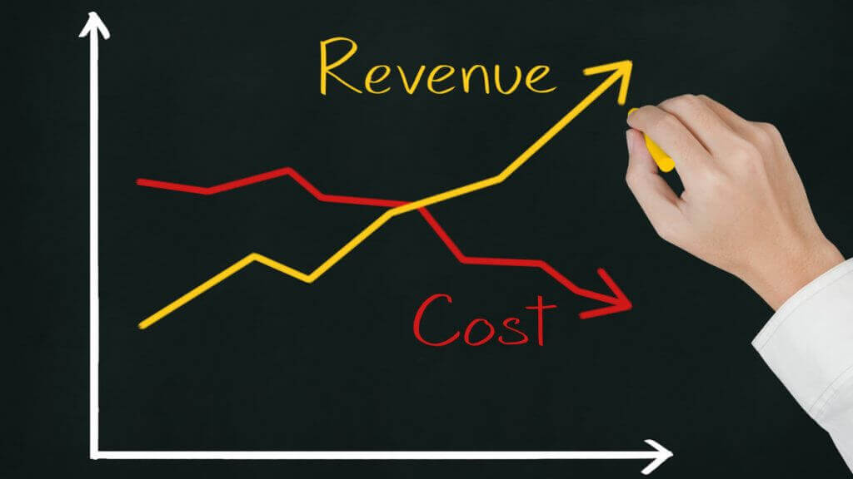
RESULTS
This operation directly results in increased productivity of employees in the organistion.
Over the span of 2 Quarters, the results will be displayed through Increased Revenues, Increased Profitability, Reduced Employee Turnout.
12

Slide 13
conclusion
This project and solution will aid the organization in achieving its financial objectives, conquer its market and defeat rivals.
This will also improve the organisations stakeholder-management and participation improving the organization's place in the market-place

