Slide 1

Splendidlimos

Slide 2
About Us
Welcome to Splendid Limos, your premier choice for executive limousine service from Miami to the West Palm Beach areas. We are dedicated to providing our clients with an unparalleled luxury transportation experience, tailored to meet the unique needs of each journey.
At Splendid Limos, we pride ourselves on being reliable and punctual. We understand the importance of your time and strive to ensure that you reach your destination safely, comfortably, and on schedule. Our professional chauffeurs are meticulously trained, courteous, and committed to delivering the highest standards of service.
Your health and safety are our top priorities. That's why our drivers rigorously sanitize the car after every ride, ensuring a clean and safe environment for all our passengers. Whether you are traveling for business or pleasure, we want you to feel at ease and enjoy every moment of your journey with us.
Our fleet of luxury vehicles, including Cadillac Escalades, Mercedes Sprinter Vans, and Rolls Royces, is equipped to accommodate any occasion. From airport transfers to private events, chauffeur services to corporate accounts, and transportation to yachts or parties, we offer a comprehensive range of services designed to exceed your expectations.
At Splendid Limos, we believe that every trip should be a memorable experience. Our attention to detail, commitment to excellence, and passion for delivering exceptional service set us apart in the industry. We invite you to experience the Splendid Limos difference and discover why we are the preferred choice for executive transportation in South Florida.
Whether you need a reliable ride to the airport, a sophisticated vehicle for a special event, or a professional chauffeur for your corporate needs, Splendid Limos is here to serve you. Contact us today to book your next journey and travel in style and comfort with Splendid Limos

Slide 3
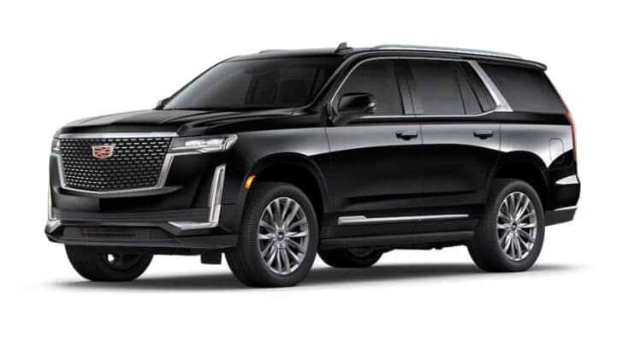
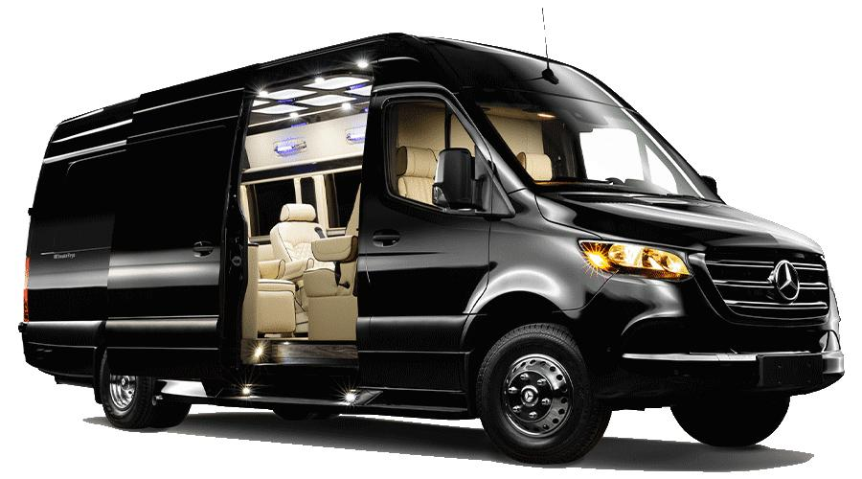
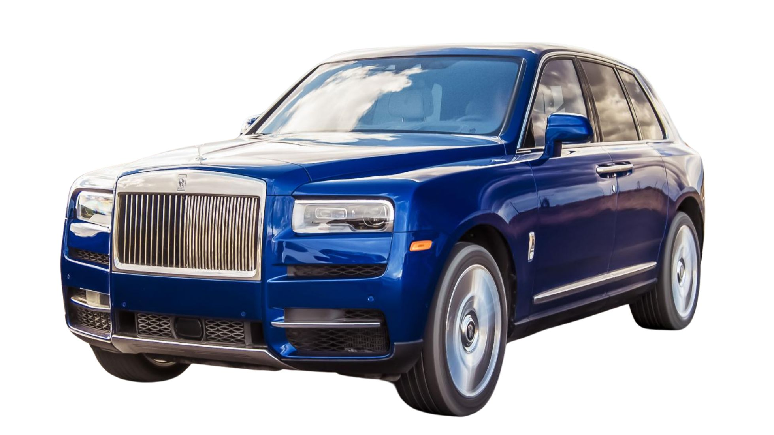


Our Fleet
Cadillac Escalade
Cadillac Escalade
Cadillac Escalade
Mercedes Sprinter
Rolls Royce Cullinan
Bentley Bantayga
Maybach

Slide 4
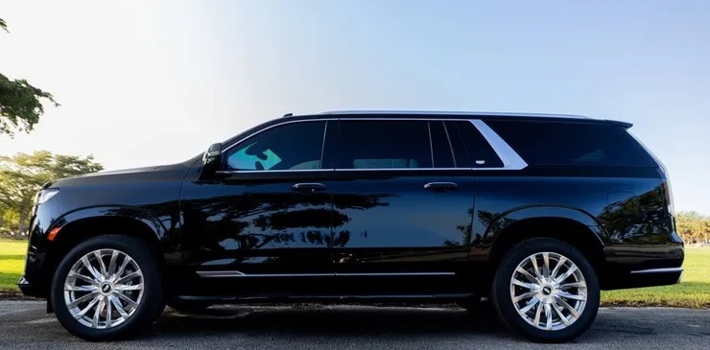
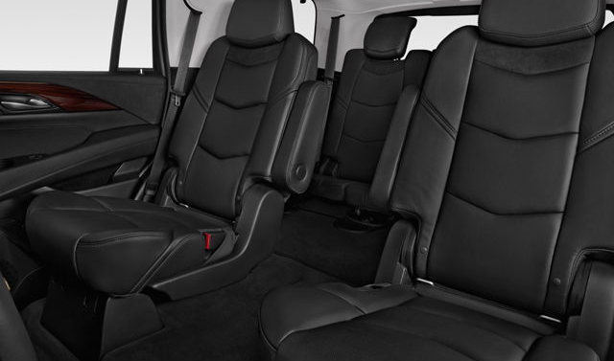
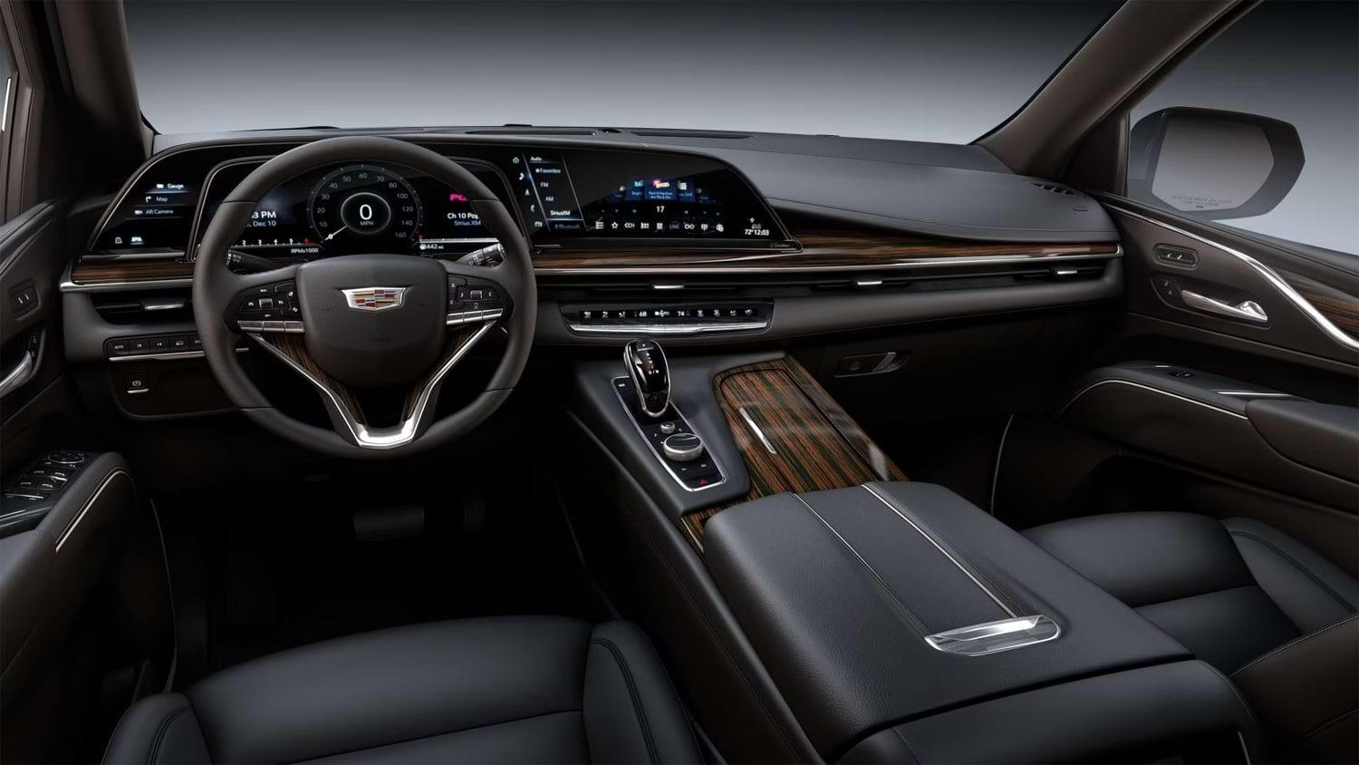

Cadillac Escalade
Splendidlimo Exclusives:
Complementary water, wine or hard liquors.
Free Wifi and charging cables.
Sanitization between rides.
The 2023 Cadillac Escalade epitomizes American luxury in an SUV form, combining robust performance with a lavish design. Sporting a standard 6.2-liter V-8 engine or an optional turbodiesel, the Escalade delivers power and efficiency, adorned with cutting-edge technology to enhance every drive. It stands as a testament to three-row luxury, offering a unique blend of style, power, and sophistication.

Slide 5
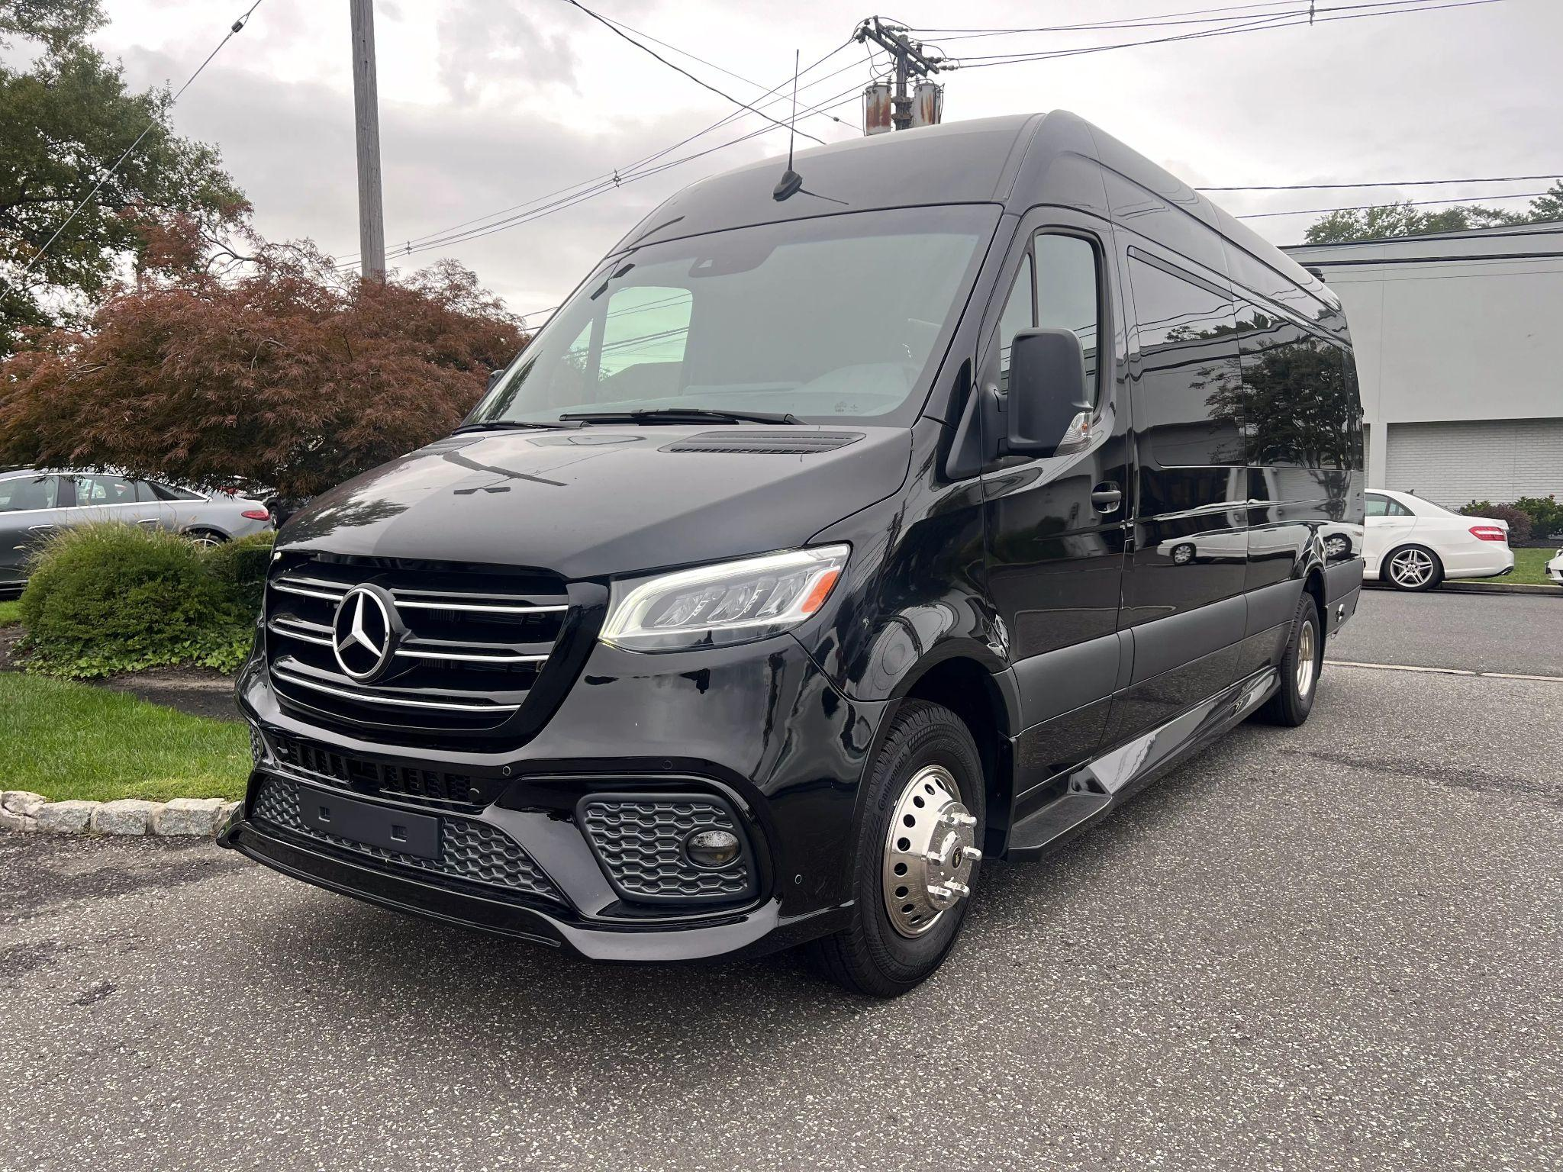
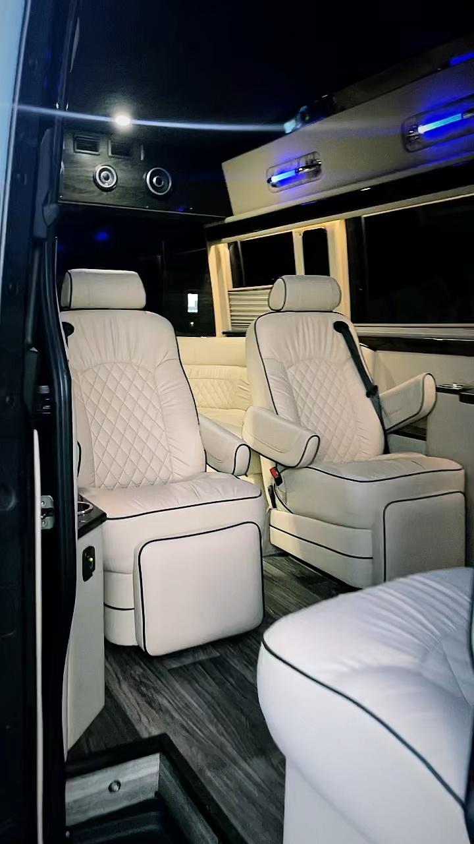
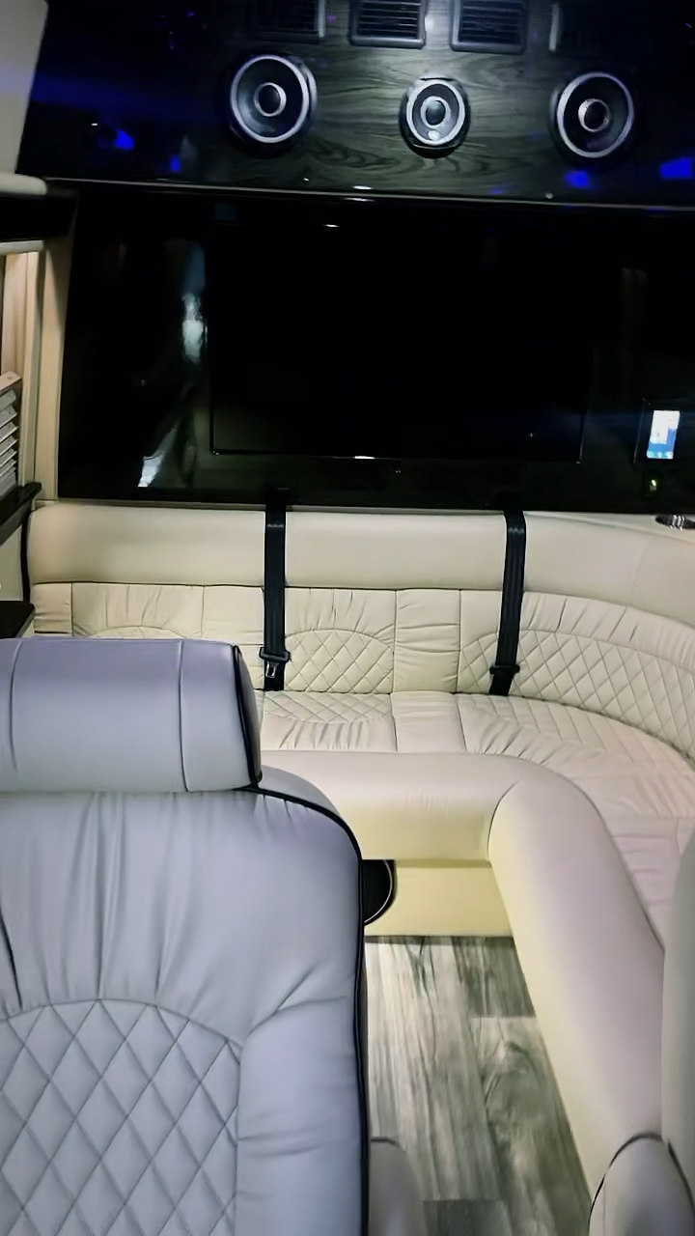
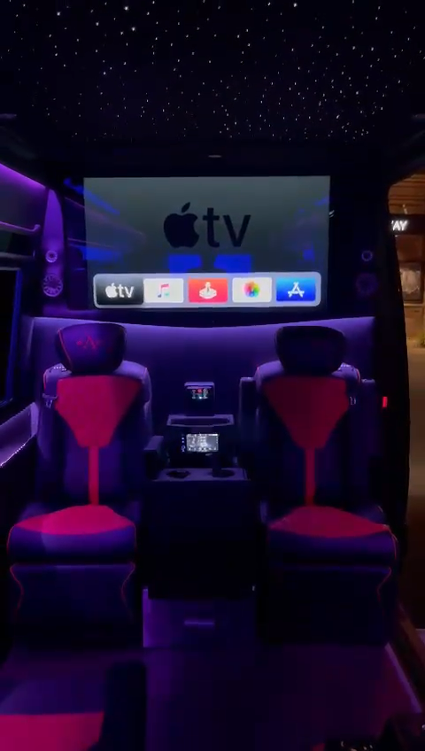
Mercedes Sprinter
Embark on a journey of refined group travel with the Mercedes-Benz Executive Sprinter. This luxury van, designed for both elegance and performance, is your gateway to a new era of travel. The Executive Sprinter, with its sleek black exterior and sophisticated profile, is engineered to deliver a seamless driving experience. It stands as a testament to Mercedes-Benz's commitment to luxury, offering unparalleled comfort with its state-of-the-art interior and technology. Discover the unmatched features that define this premium vehicle.
Splendidlimo Exclusives:
Bring food and drinks onboard.
Free Wifi and charging cables.
Sanitization between rides.

Slide 6
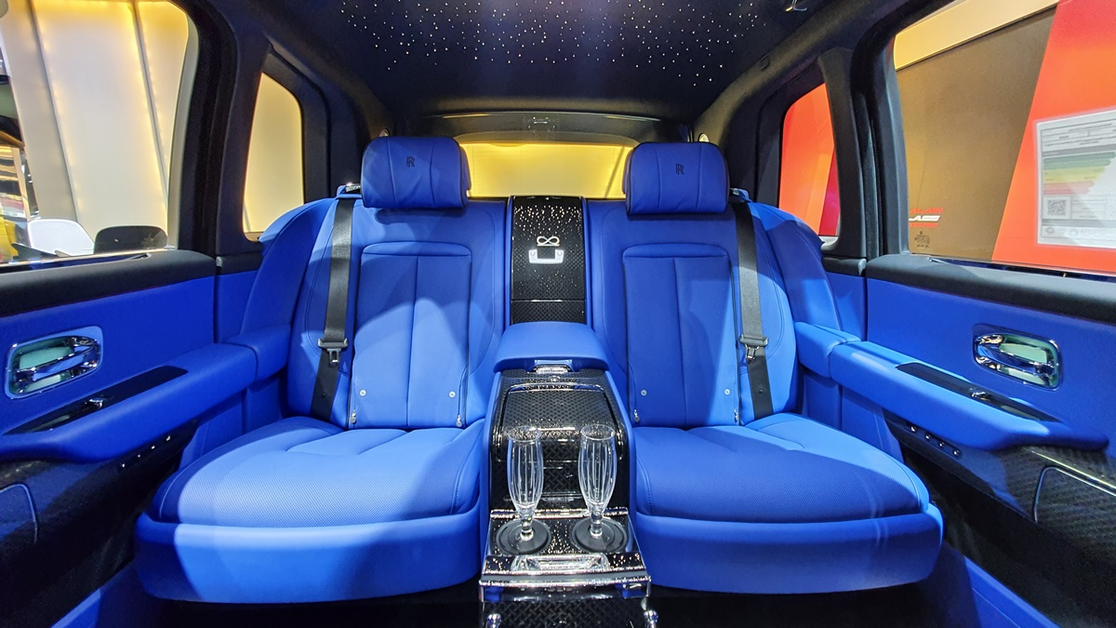
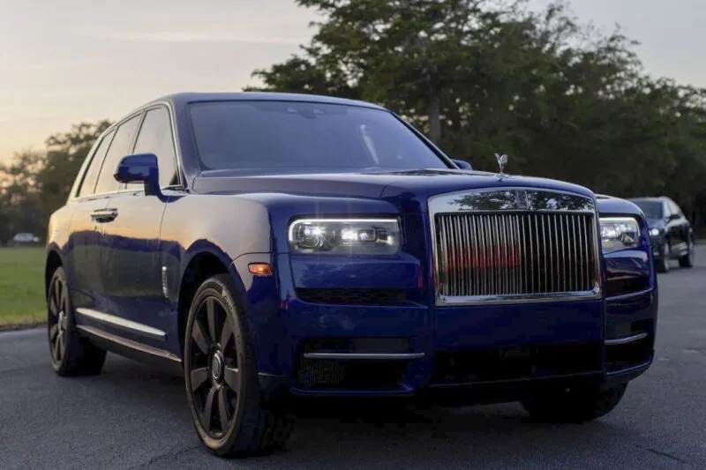

Rolls Royce Cullinan
Splendidlimo Exclusives:
Complementary water, wine or hard liquors.
Free Wifi and charging cables.
Sanitization between rides.
The Rolls Royce Cullinan, available for rental in Miami, is an ultra-luxury SUV with both exceptional styling and impressive performance.
Named after the largest diamond ever found and powered by a potent V12, the Cullinan is crafted to perfection, offering the smoothest and most comfortable traveling experience ever created. This is achieved using cutting-edge technology both inside and outside the car.

Slide 7
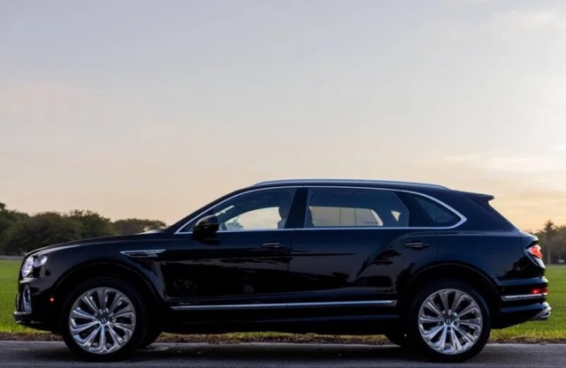
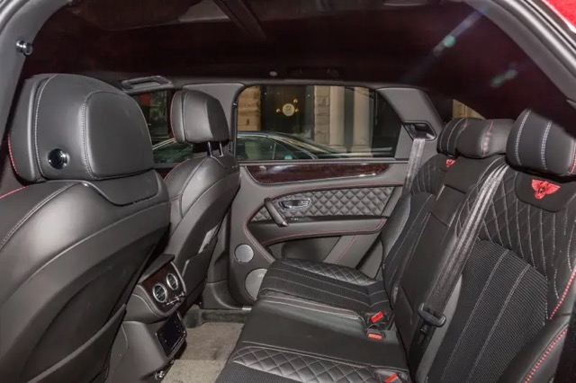
Bentley Bentayga Night Rider
The Bentley Bentayga distinguishes itself in the ultra-luxury SUV market with its harmonious combination of elegance and power.
Inspired by the "Roque Bentayga," a striking peak in Gran Canaria, and powered by a formidable W12 engine, the Bentayga excels in both impeccable craftsmanship and outstanding performance.
Splendidlimo Exclusives:
Complementary water, wine or hard liquors.
Free Wifi and charging cables.
Sanitization between rides.

Slide 8
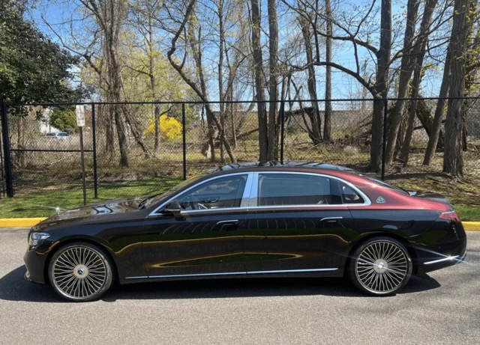
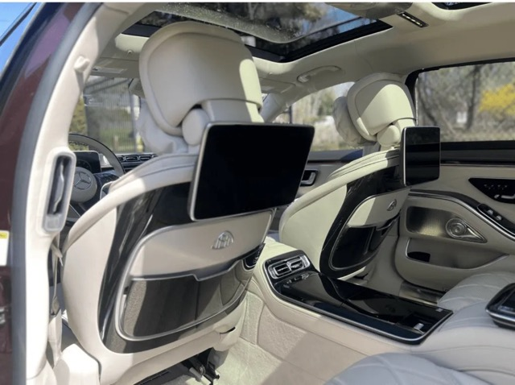
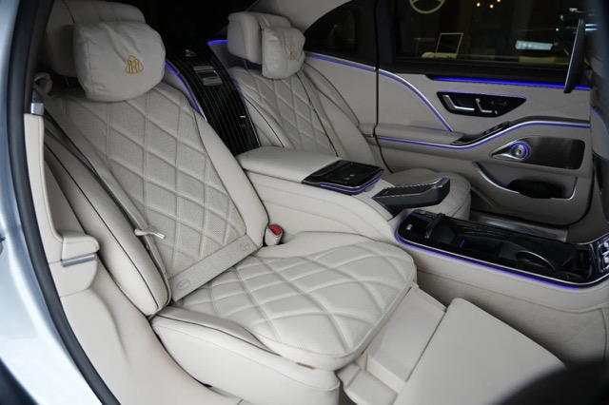
Maybach S580
The interior of our Maybach S580, masterfully crafted with the best materials, features an elegant white leather that echoes the elegance of a sophisticated evening gala. Its smooth texture provides a luxurious feel, amplifying the sense of refinement. Outfitted with a state-of-the-art dual-screen and captain seating arrangement, it offers both superior functionality and entertainment, ideal for serene evening drives.
Splendidlimo Exclusives:
Complementary water, wine or hard liquors.
Free Wifi and charging cables.
Sanitization between rides.

Slide 9

Our Services

Slide 10
Pricing
Cadillac Escalade
Miami to Miami Airport: $175
Miami to Ft. Lauderdale Airport: $225
Weekday hourly: $150/hr (3hrs min)
Weekend hourly: $175/hr (4hrs min)
Mercedes Sprinter
Miami to Miami Airport: $400
Miami to Ft. Lauderdale Airport: $475
Weekday hourly: $200/hr (4hrs min)
Weekend hourly: $250/hr (4hrs min)
Rolls Royce
Miami to Miami Airport: $350
Miami to Ft. Lauderdale Airport: $450
Weekday hourly: $325/hr (4hrs min)
Weekend hourly: $350/hr (4hrs min)
Add 20% gratuity not included in prices. Weekday is Monday thru Thursday.

Slide 11
Pricing
Bentley Bantayga
Miami to Miami Airport: $300
Miami to Ft. Lauderdale Airport: $375
Weekday hourly: $275/hr (3hrs min)
Weekend hourly: $325/hr (4hrs min)
Maybach S580
Miami to Miami Airport: $275
Miami to Ft. Lauderdale Airport: $300
Weekday hourly: $225/hr (3hrs min)
Weekend hourly: $250/hr (4hrs min)
Add 20% gratuity not included in prices. Weekday is Monday thru Thursday.

Slide 12
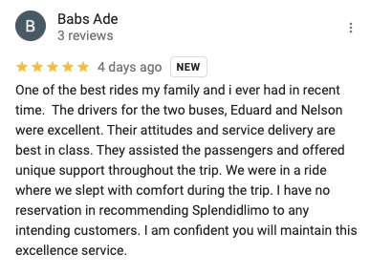

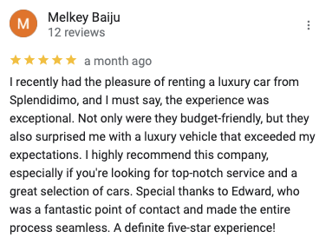
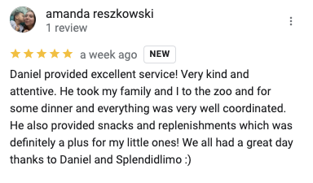
Our Reviews
We have over 183 5-Star reviews. Try us today to experience the Splendidlimo difference for yourself.

Slide 13
Contact Us
Eduard Orenshteyn,
CEO
954-669-8444

