Slide 1
EEG Motor Imagery Classification

Slide 2
Motivation
Even if someone is unable to perform a certain task it does not mean that they cannot imagine it

Slide 3
EEG signals
01

Slide 4
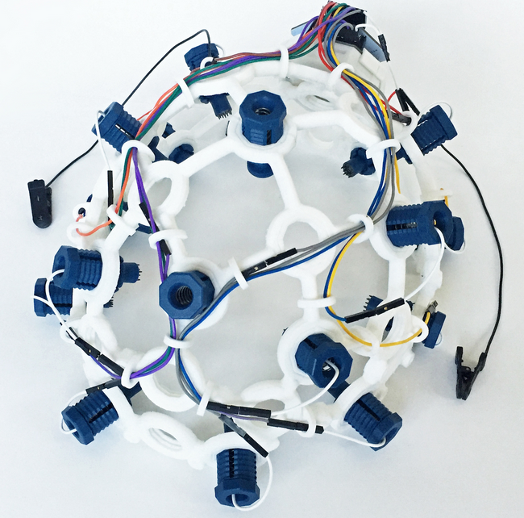
Electroencephalogram(EEG)
Recording of the electrical activity of the brain
Does not have constant amplitude or constant frequency
Data acquisition is done in a non-invasive way

Slide 5
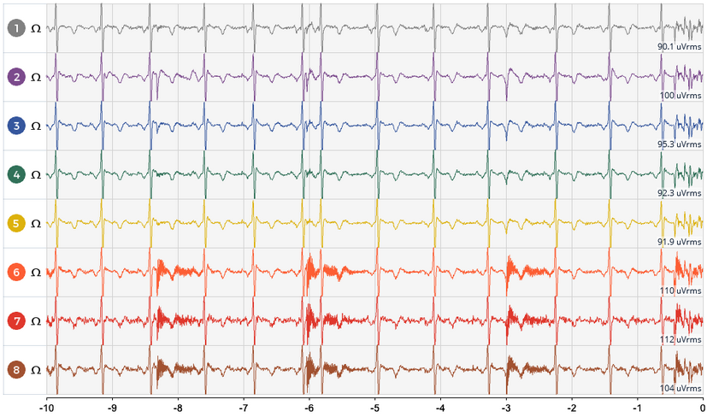
Electroencephalogram(EEG)
Measured on multiple channels
Neighbour electrodes share similarities

Slide 6
Brain Computer Interface(BCI)
02

Slide 7
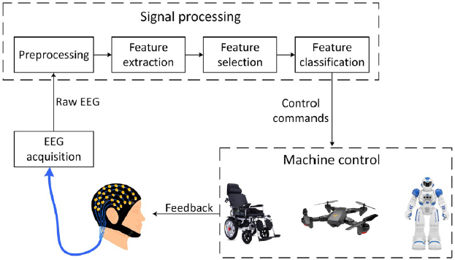
Brain Computer Interface(BCI)
Closed loop control system

Slide 8
EEG signals classification
03

Slide 9
EEG signals classification
Methods:
Classic approach using Machine Learning witch has multiple disadvantages
A modern approach using Convolutional Neural Networks

Slide 10
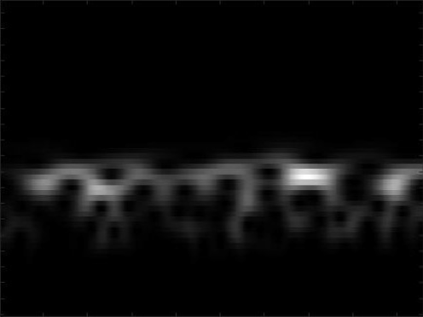
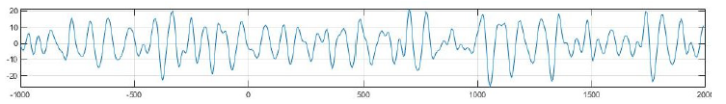
EEG signals classification
From signal to Image

Slide 11
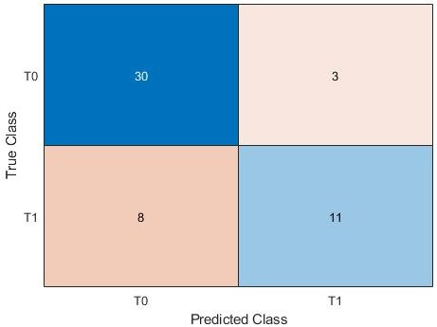
EEG signals classification
Results: Single subject classification
Accuracy: 78%

Slide 12
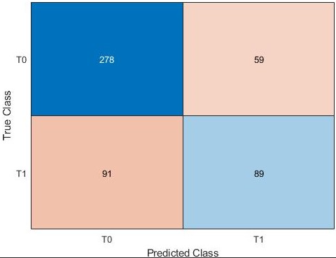
EEG signals classification
Results: Multiple subjects classification
Accuracy: 70%

Slide 13
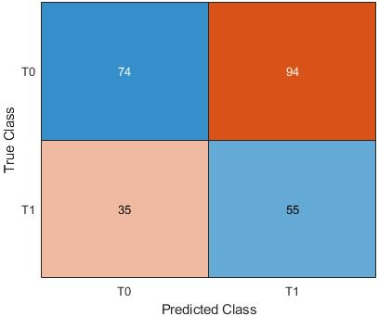
EEG signals classification
Results: Classification across different subjects
Accuracy: 50%

