Slide 1
Alumni management system: System Architecture
James Lenard Soriano CHRIST JANCINTH ROBLES IAN CARL SARMIENTO RENZ LOUIE PERMEJO

Slide 2
Overview
Our project is to develop a sustainable alumni system that can be used easily by the alumni administration with an implementation of data analytics and visualization, and a prescription module for the assistance on selecting notable alumni to acknowledge graduates on their accomplishments in their profession, and contribution towards the community, and also a Geographic Information Systems (GIS) module for the alumni population tracing that will assist and gives insight for the administrators of the house of alumni regarding large opportunities via location.

Slide 3
Introduction to the system
Alumni Management Systems are essential for providing enduring connections between educational institutions and their graduates, which are recognized as valuable assets contributing to reputation and industry networks. Alumni involvement is important for schools as they are great resources and can make the schools better, as they have an important role in the educational sector as they are the legacy runners of the institute they used to belong to (Vidyalaya, 2022). University alumni systems exist to promote active and ongoing relationships between graduates and their alma mater. (Chi, Jones, & Grandham, 2012).

Slide 4
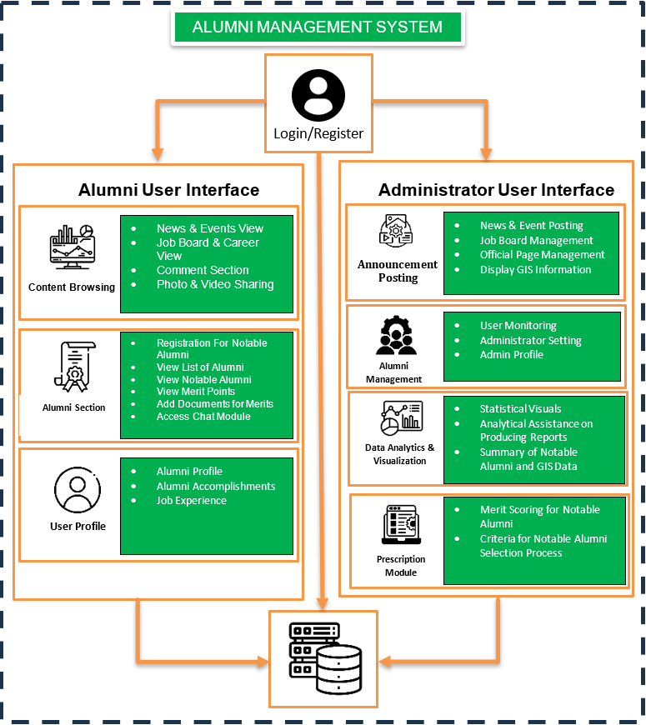
OVERVIEW OF SYSTEM ARCHITECTURE

Slide 5
KEY COMPONENTS OR MODULES
Information and Announcement Posting
This includes managing news and events updates, and career opportunities. The goal is to create a user platform for both alumni and the institution to access and efficiently raise user engagement.
Data Analytics and Visualization
This section involves using data analysis methods to study alumni data and give insights by creating representations like charts, graphs and dashboards to present these findings in a clear and understandable manner.
Notable Alumni Merit System
This module aims to identify and highlight notable alumni through a module based on their achievements and contributions. By using data analytics, the system recognizes individuals who have made significant impacts based on the criteria and merits of the alumni.

Slide 6
KEY COMPONENTS OR MODULES
Geographic Information Systems (GIS) Module
The GIS Information Module will provide viewers the general place of each alumni’s job/profession. For more detailed and accurate information, the places of each alumni’s occupation will be separated based on the year.
User Activity Heatmap
This keeps track of the user’s activity within the website through their clicks, thus this way the administrators will give an overview on the most visited section of the web system, and monitor how active the web system is.
Live Chat Module
Sustaining alumni and institutional administrators’ active communication is vital to be bridged as it will connect several parties no matter how far they are.

Slide 7
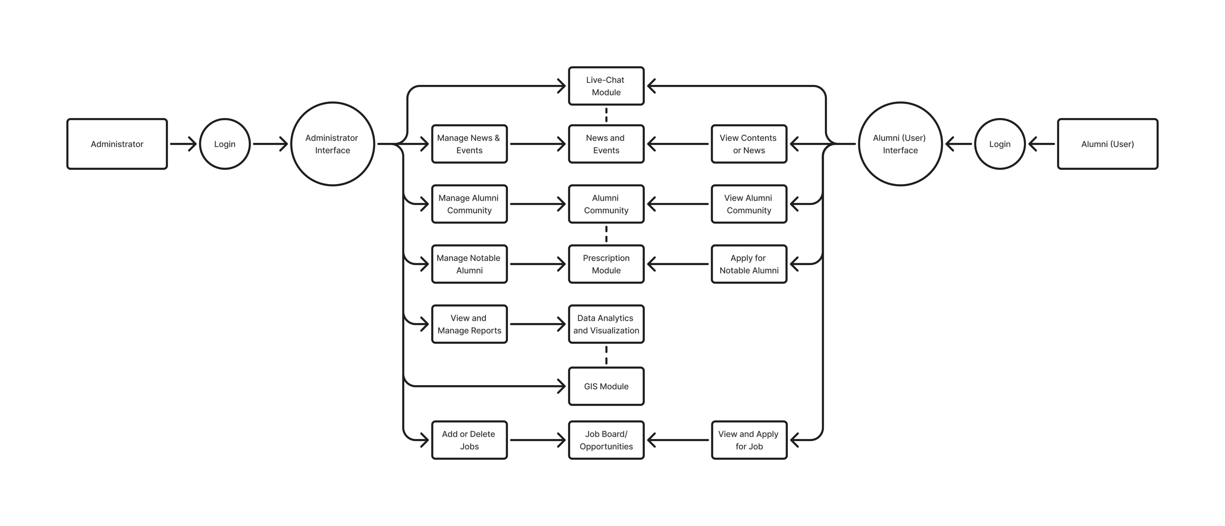
Data Flow

Slide 8
System Interactions
To summarize, the alumni management system we are designing consists of two interfaces: admin and alumni user interface. In the alumni UI, they can explore the website for news, events, and any announcements regarding university-related activities, as well as remark to stimulate user engagement. They can also visit the community page to see other alumni/alumna, read the prominent alumni list, and register as one by uploading documentation describing their accomplishments or contributions. This will be confirmed by the administrator. Finally, the profile page, which is effectively the alumni user's profile backdrop, allows them to change and update their information.

Slide 9
System Interactions
The interaction of the system and the admin is vital for this system, since the administrators are responsible for managing the system. They can post and announce news and planned events, they can verify alumni users, access the charts and other graphs for their insight of the results, and lastly, to monitor every activity happening within the system.

Slide 10
CONCLUSION
The system architecture we drew shows the modules regarding alumni website engagement for users and the responsibilities and management that will be handled by the administrators. Furthermore, in the diagram, we included sub-components for each main modules to show the overview of what they can do within the system.

