Slide 1

Rocker Timesheet
User Guide

Slide 2
Content
Dashboard / Calendar view
Dashboard / List view
Add timesheet rows / report work done
Add timesheet rows / dialog
Company defaults
User defaults
Edit Project types, edit project’s company
Project/Task visibility
Project/Task visibility dialog
Project/Task visibility, filtering
Original HR_timesheet
Excel export
Excel import
Hour Bank report
Edit Leave types
Import Public Holidays
Modify company working calendar

Slide 3
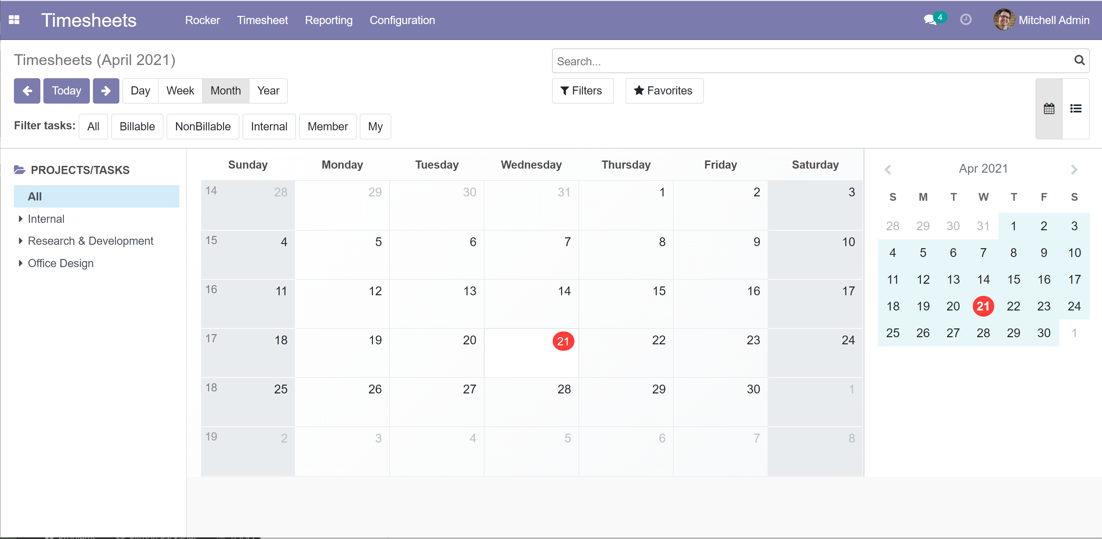
Dashboard / Calendar view
Calendar views
Calendar view /List view
Project/Task Filters
List of Projects/task

Slide 4
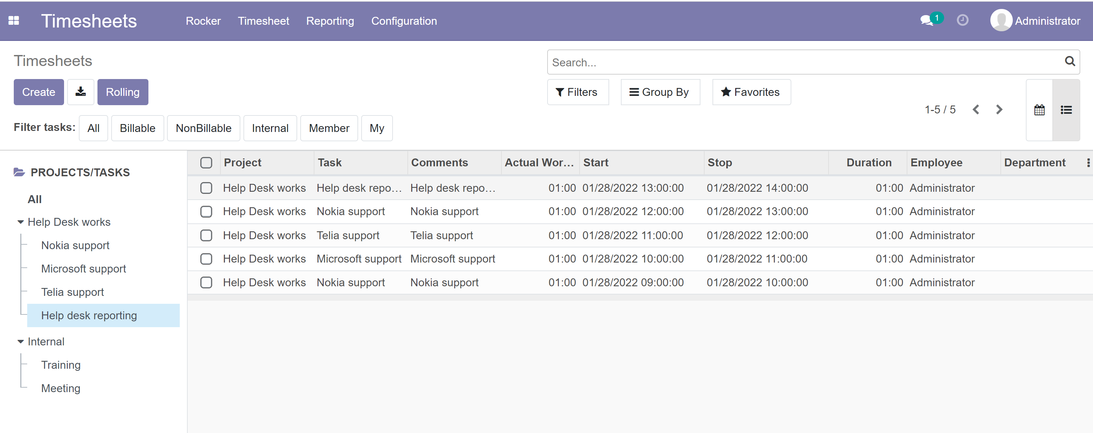
Dashboard / List view
Create new timesheet row, use company or user defaults
Create new timesheet row, Start time is taken from maximun Stop time, Rolling work amount used
Project/Task Filters
Calendar view /List view
New in 2022 version: Rolling rows ☺
List of Projects/Task

Slide 5
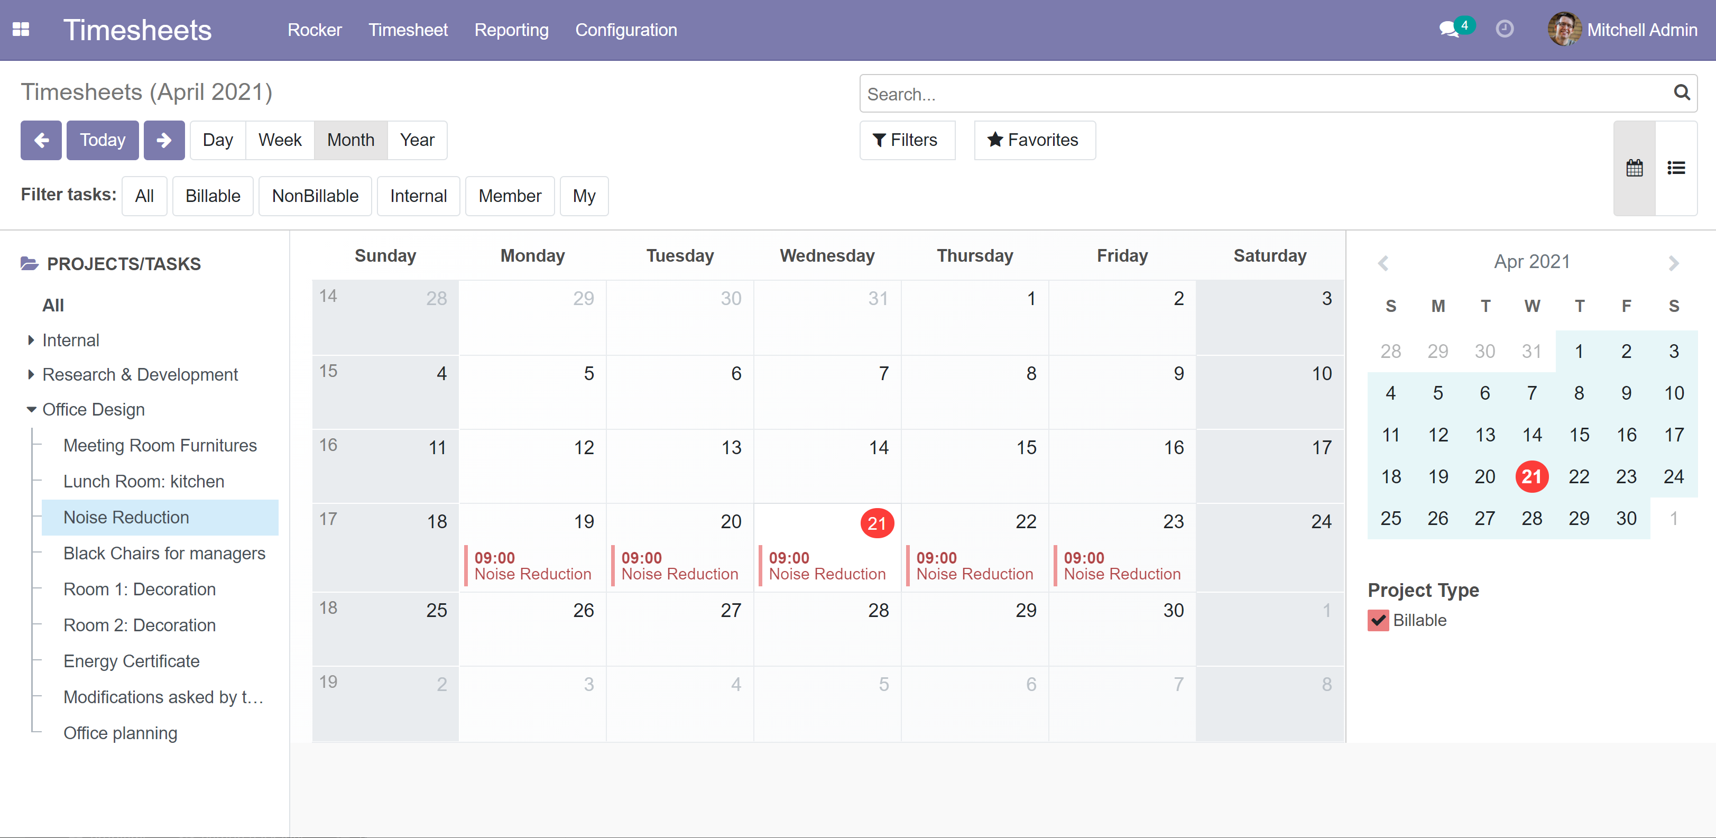
Add timesheet rows / report work done
Click calendar and while holding mouse down select all days needed
Select one of the Tasks.
If you select a Project, then Project and Task is empty in opening dialog (you can select those from drop-downs in the dialog)

Slide 6
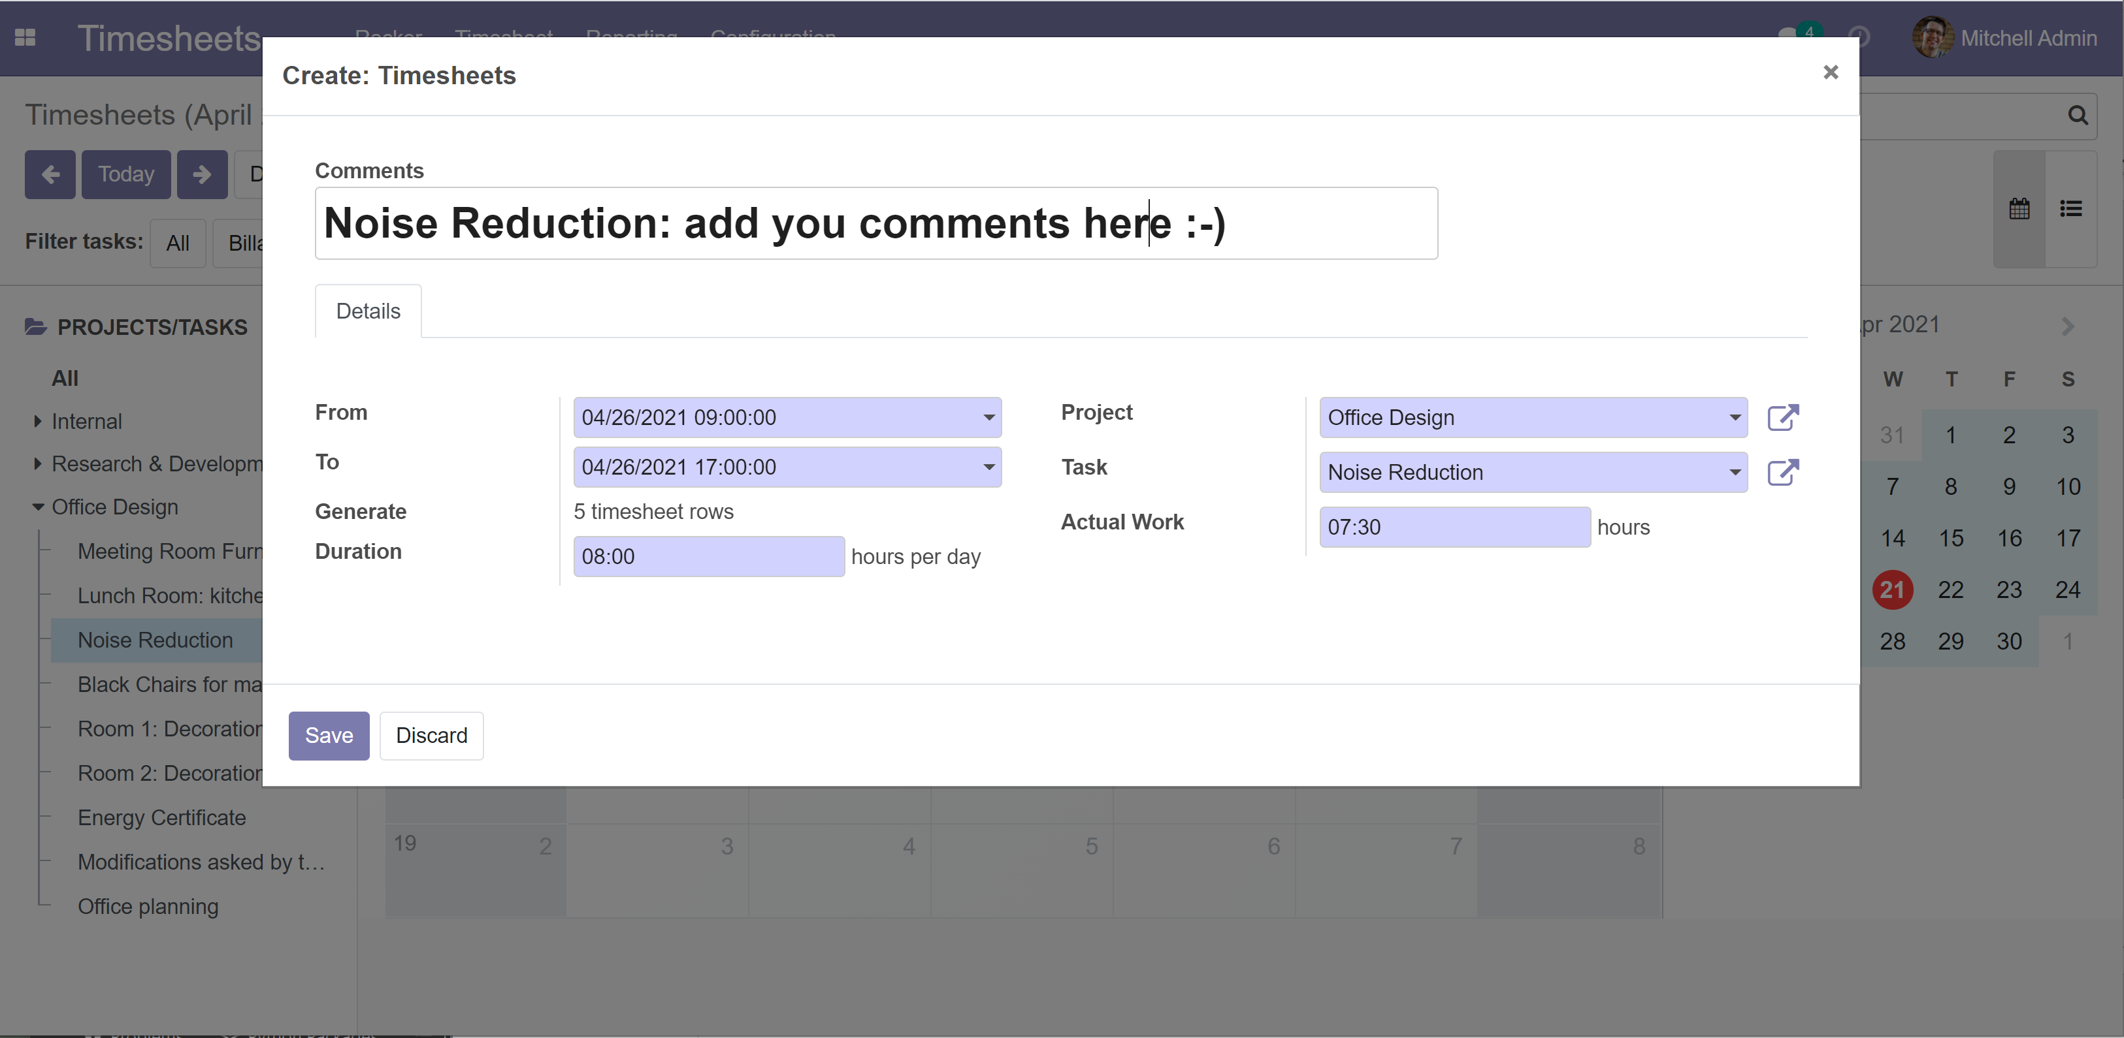
Add timesheet rows / dialog
Selected days
If you selected more than one day, this one tels how many report rows is generated
You can change duration and work amount. (these comes from Company defaults or User defaults, see separate slide)

Slide 7
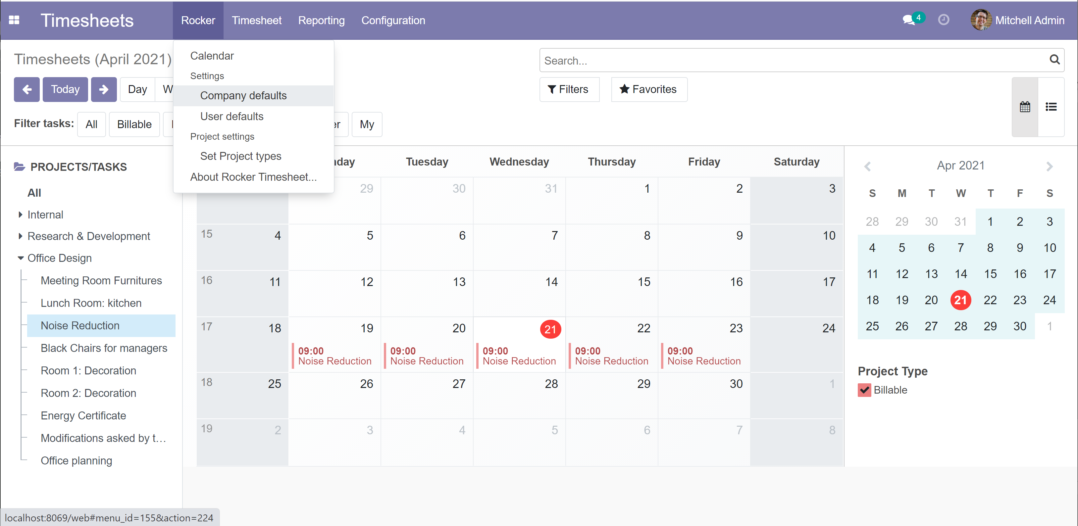
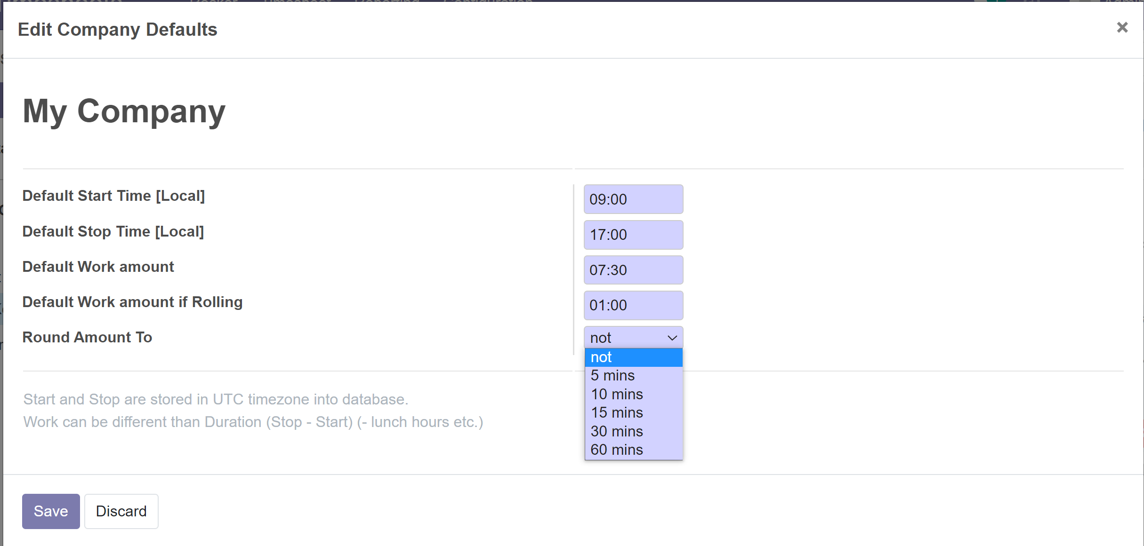
Company defaults
You need to be Administrator for changing company defaults
Verify your timezone before updating these figures. Times are stored in UTC but shown here in you local timezone
This is the default work amount to be reported. Duration is calculated from Stop - Start
Default work if Rolling button clicked
Default work if Rolling button clicked
Work is rounded to nearest
Odoo has quite complicated working calendar for users (morning working hours, afternoon working hours, different odd weeks etc.) but rocker uses this simplified ☺
Work is rounded to nearest

Slide 8
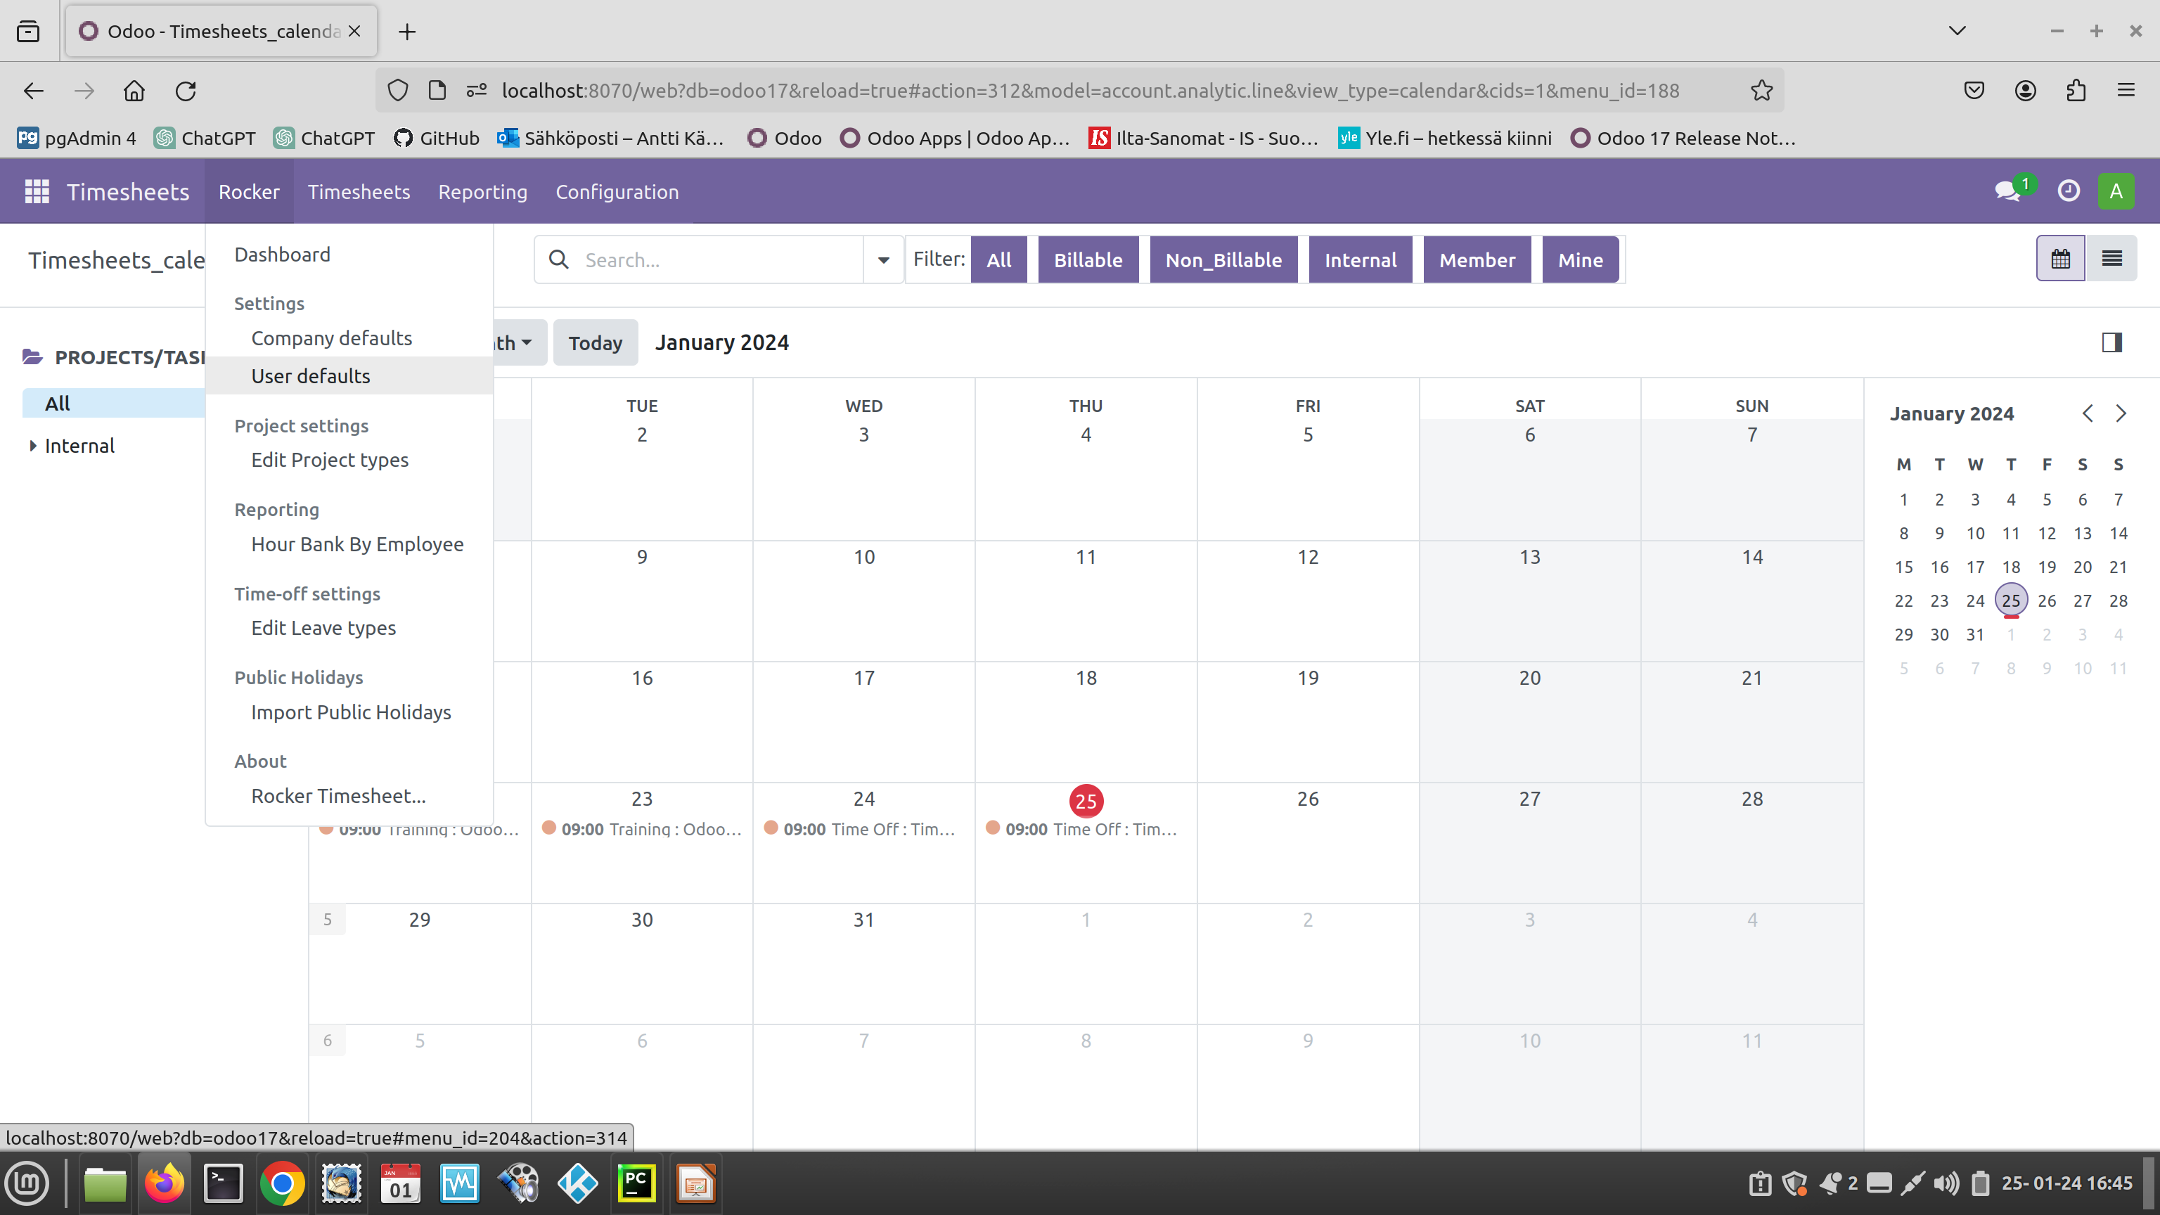
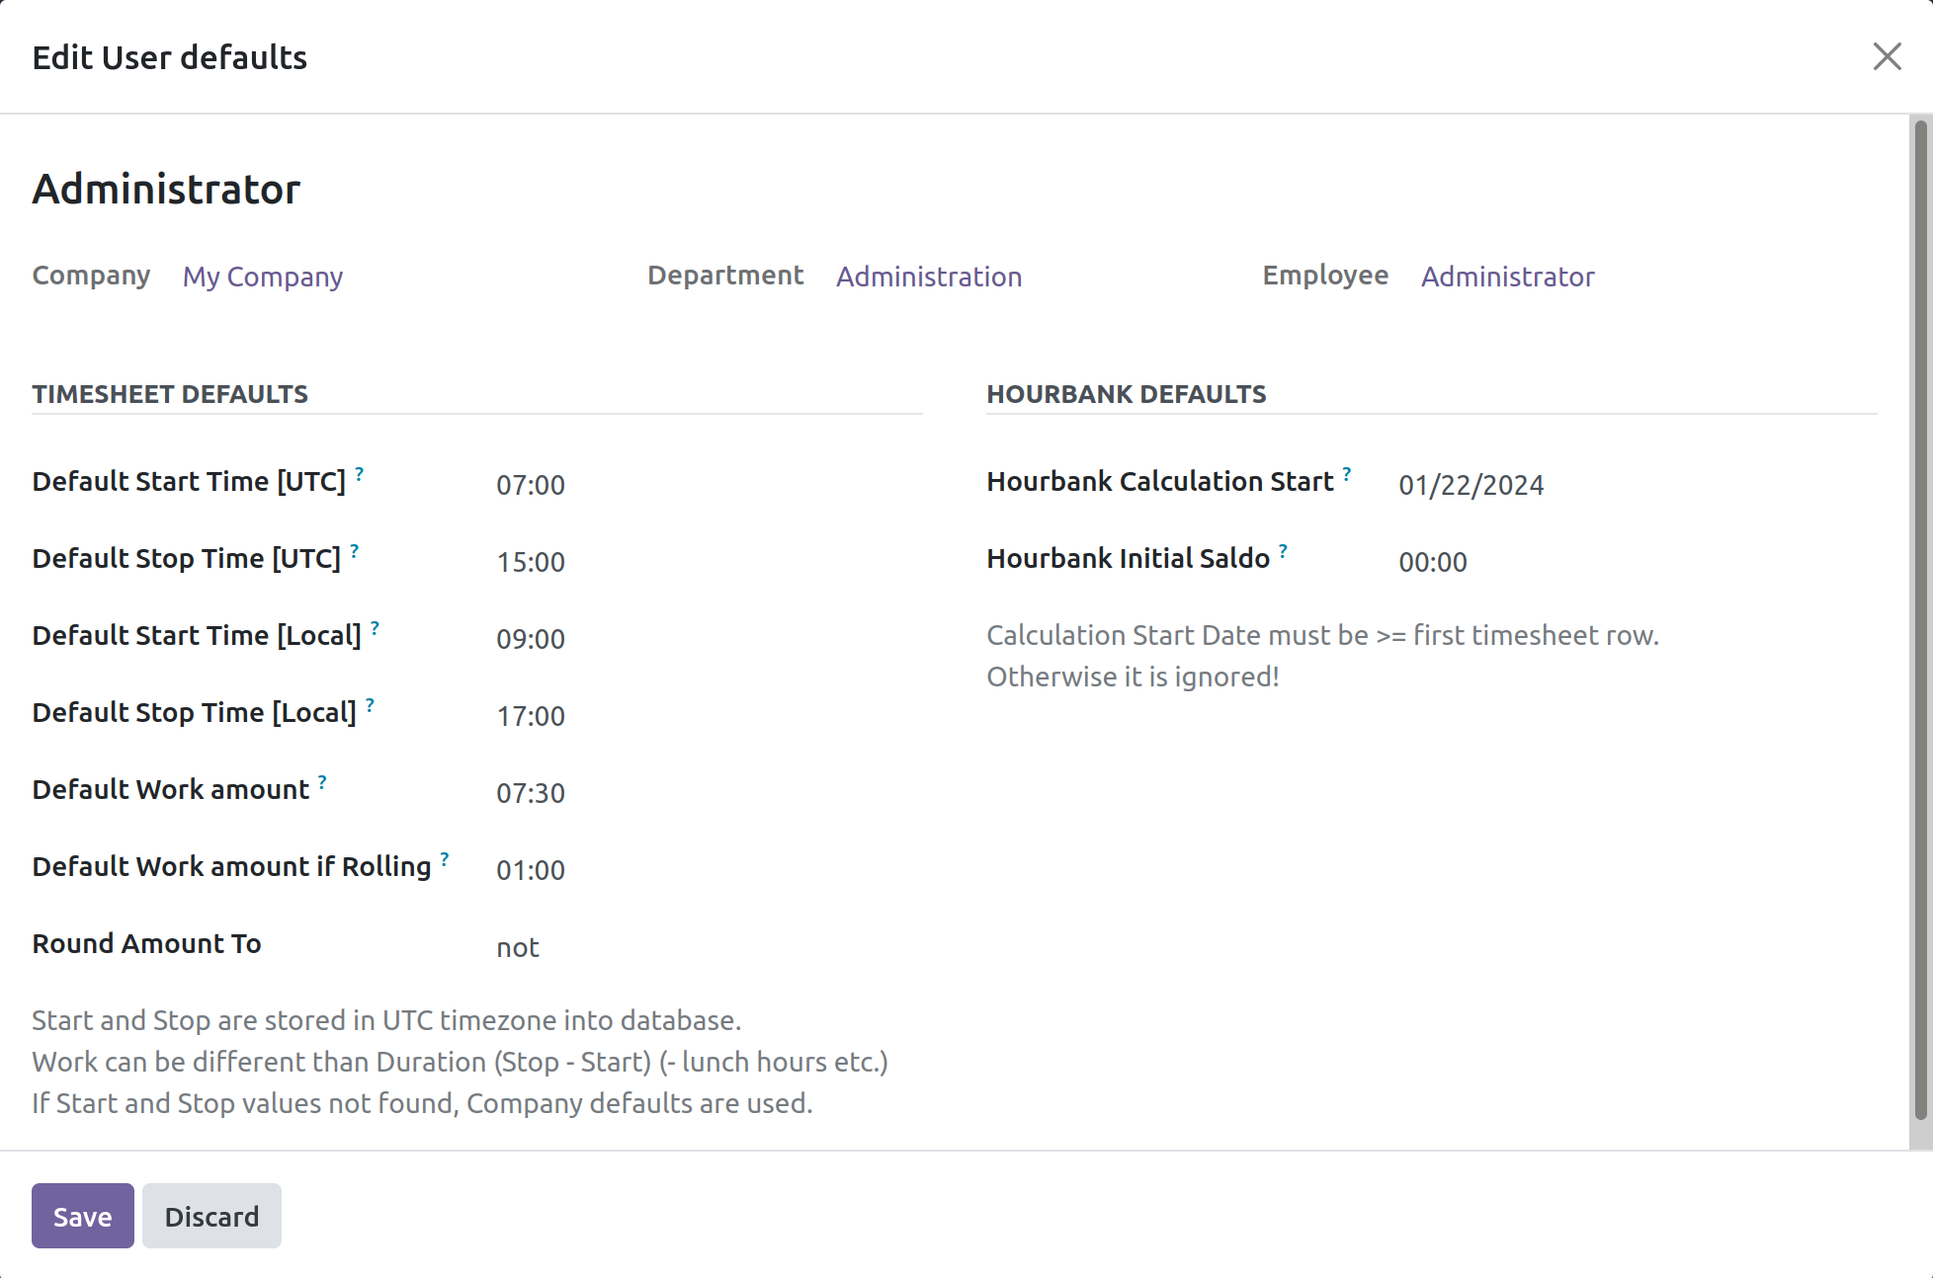
User defaults
If user has not created defaults for him/her self, then company defaults are used
HourBank report start date. NOTE that a timesheet row has to exist for that day. (Don’t use 1.1. :-) you are not working that day)
User defaults
Verify your timezone before updating these figures. Times are stored in UTC but shown here in you local timezone
This is the default work amount to be reported. Duration is calculated from Stop - Start
Work is rounded to nearest
Default work if Rolling button clicked

Slide 9
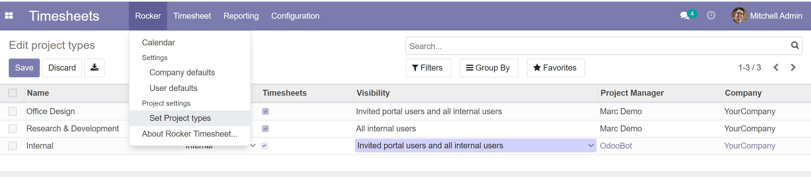
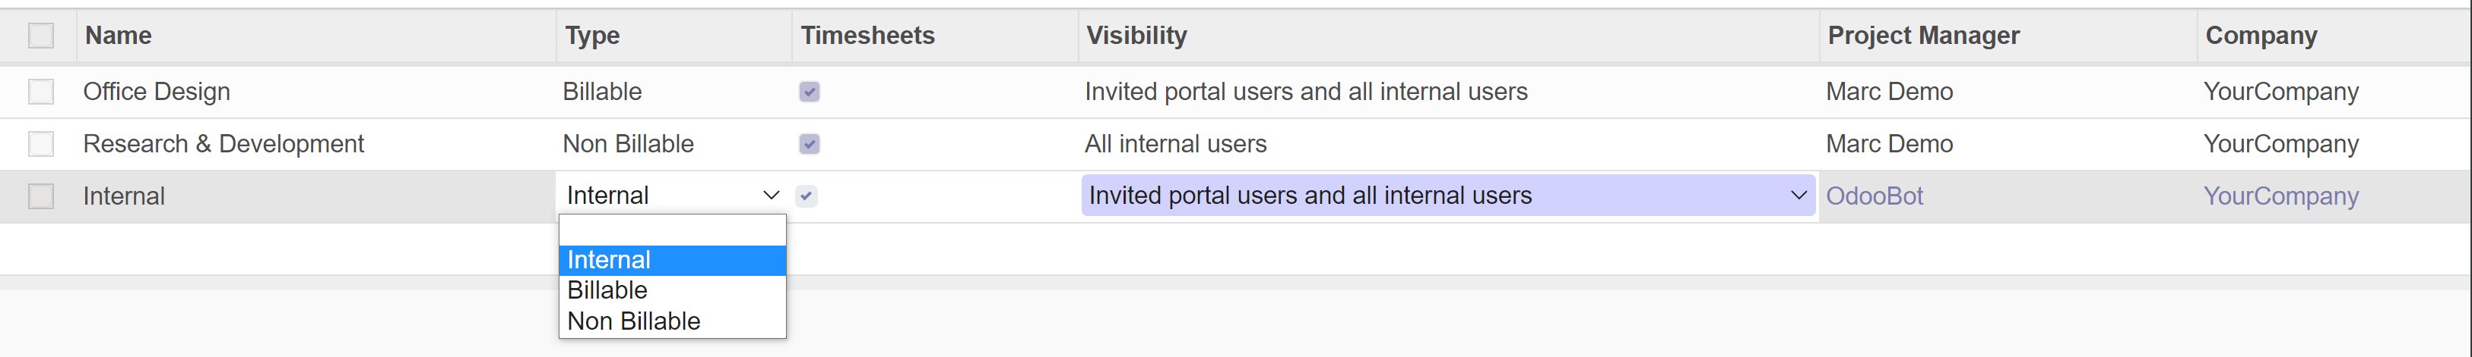
Edit Project types, edit project’s company
Select Timesheets if you allow to report work for the Project
Click Open, then you can edit Companyg
These are for Project/Task filtering
Project visibility to users. You can change here but if you need special access to selected users, change it in Project views

Slide 10
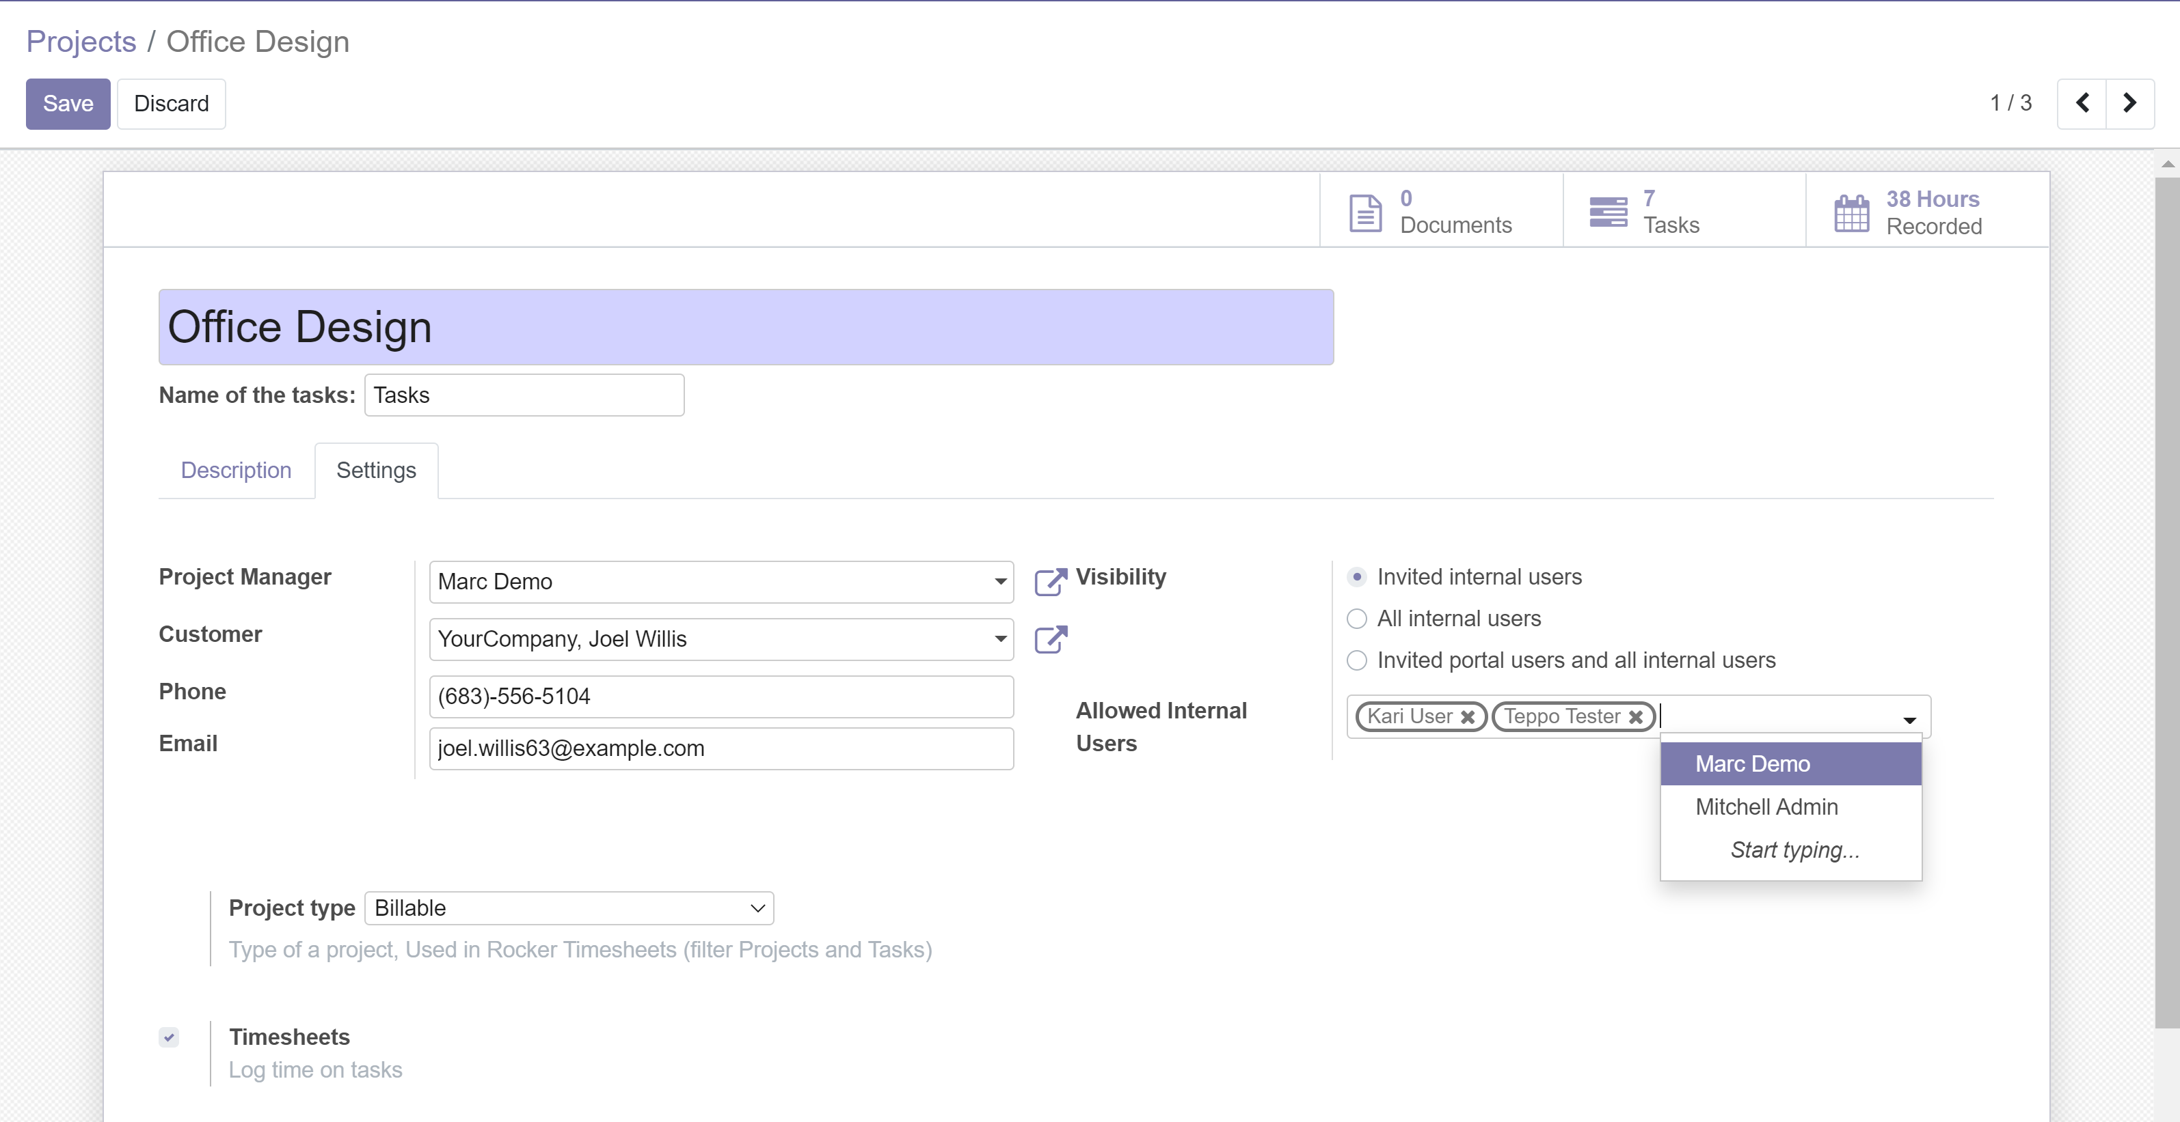
Project/Task visibility
Invited internal users: Only listed users can see this project and report work.
Filter buttons for Project/Task hierarchy
All internal users: All users can see this project and report work.
Allow timesheets

Slide 11
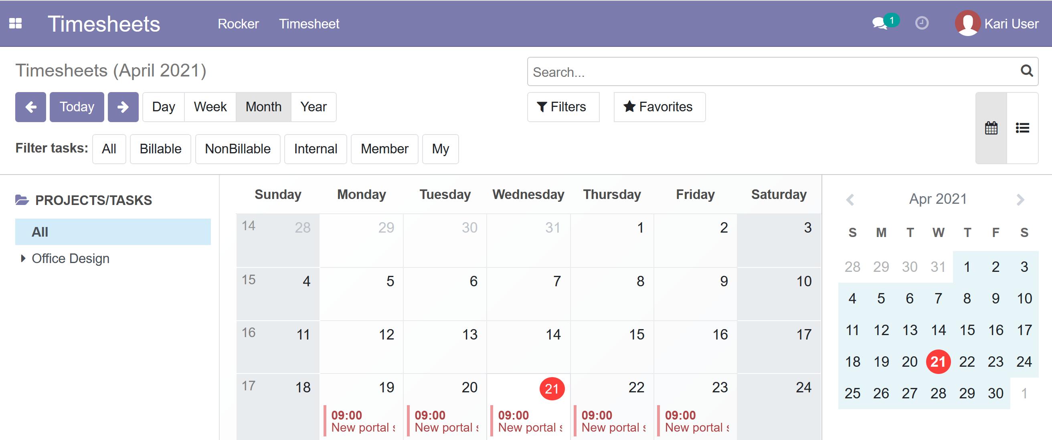
Project/Task visibility dialog
Click Member filter
Invited internal users
Only projecs where you are invited

Slide 12
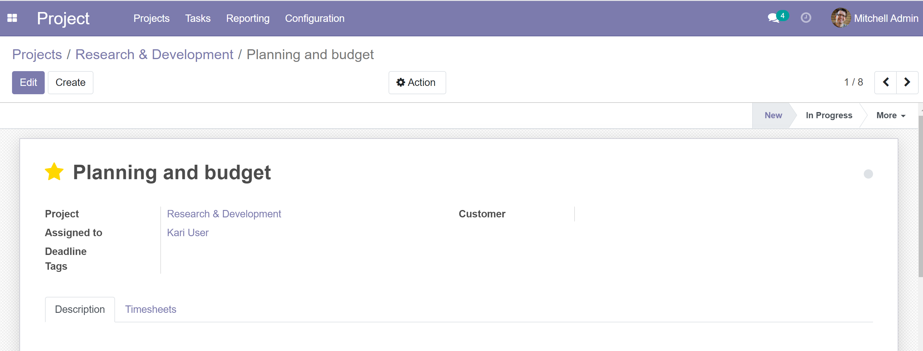
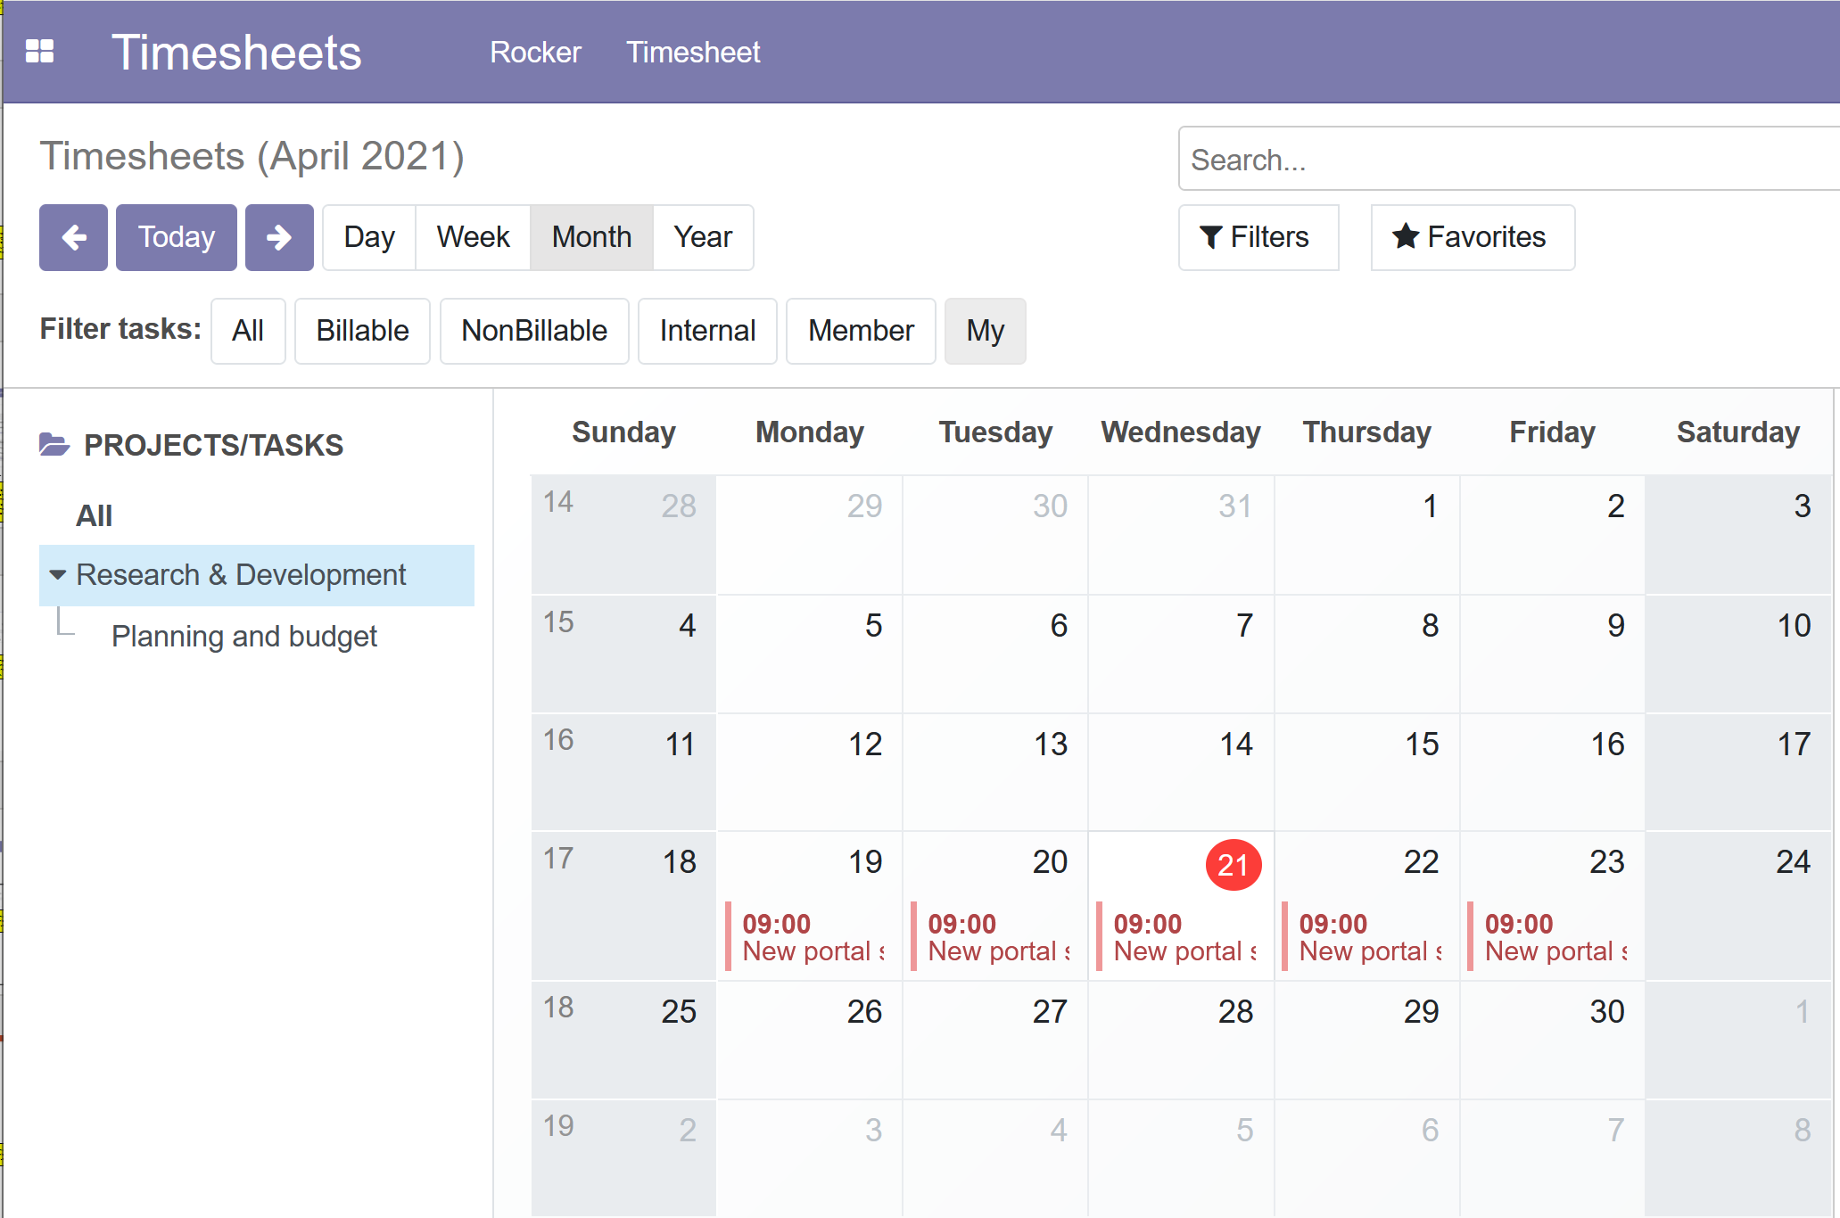
Project/Task visibility, filtering
Click My filter
Project Task assigned to user
Only tasks where you are in Assigned To

Slide 13
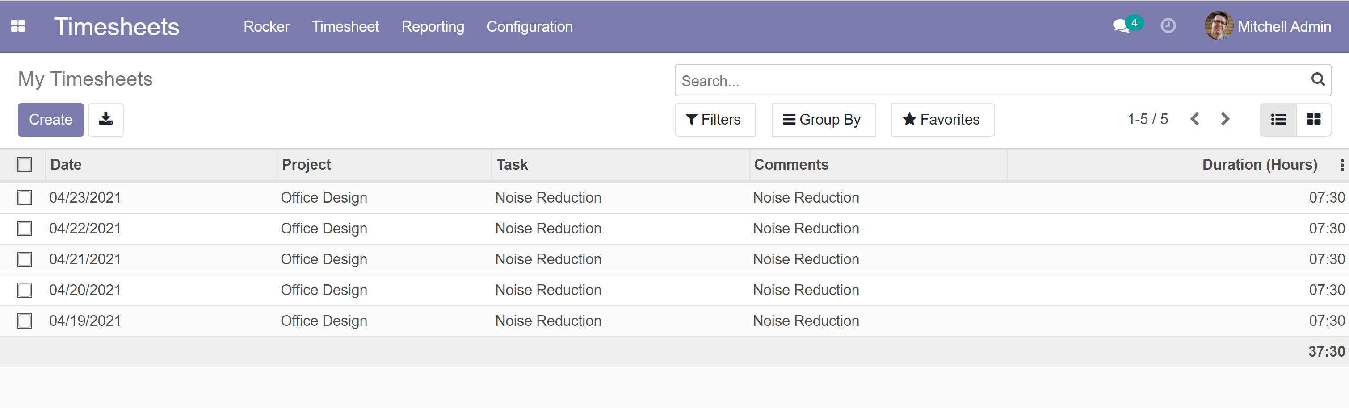
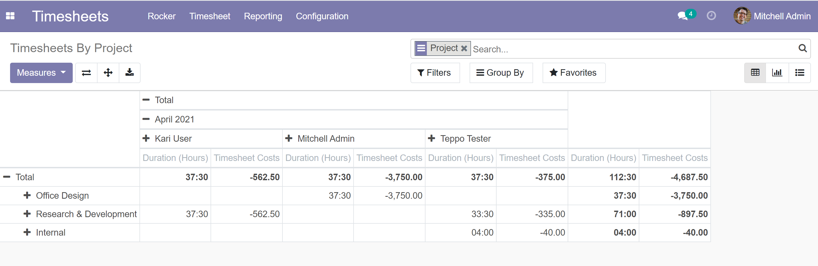
Original HR_timesheet
Work_amount in Rocker side (not duration, duration contains lunch hours which are not payable
All rows generated in Rocker side are visible in hr_timesheet module
All hr_timesheet module & project modul reports are usable

Slide 14
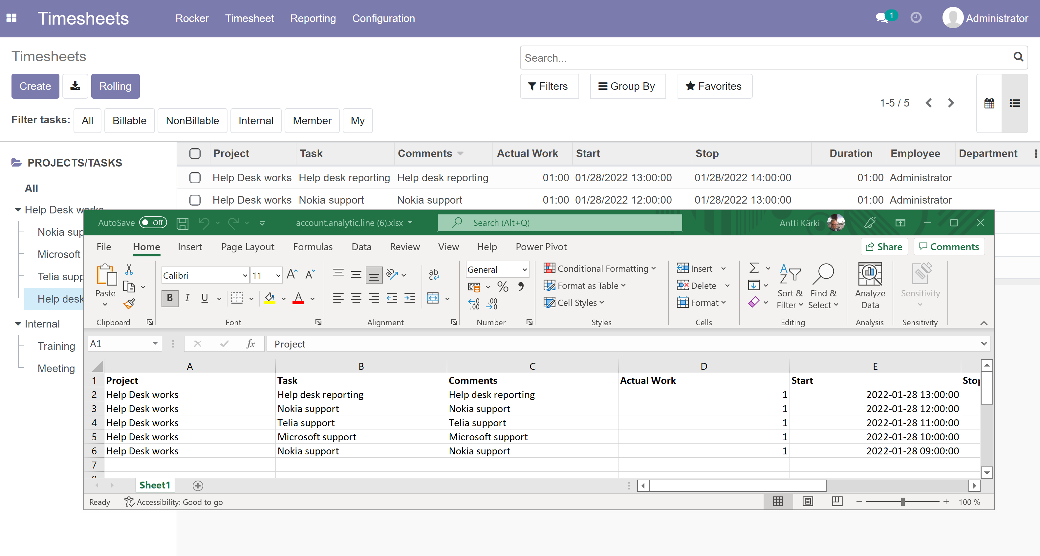
Excel export
Click export

Slide 15
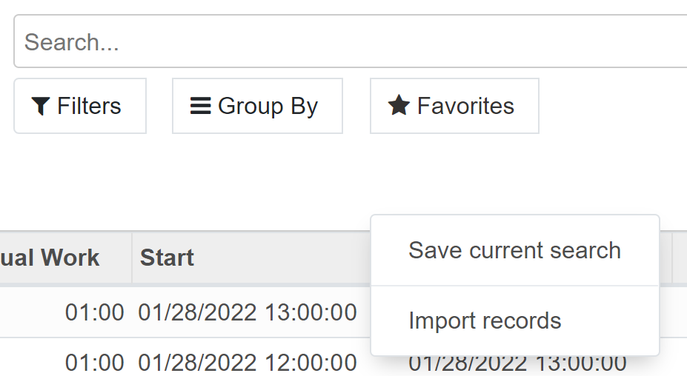
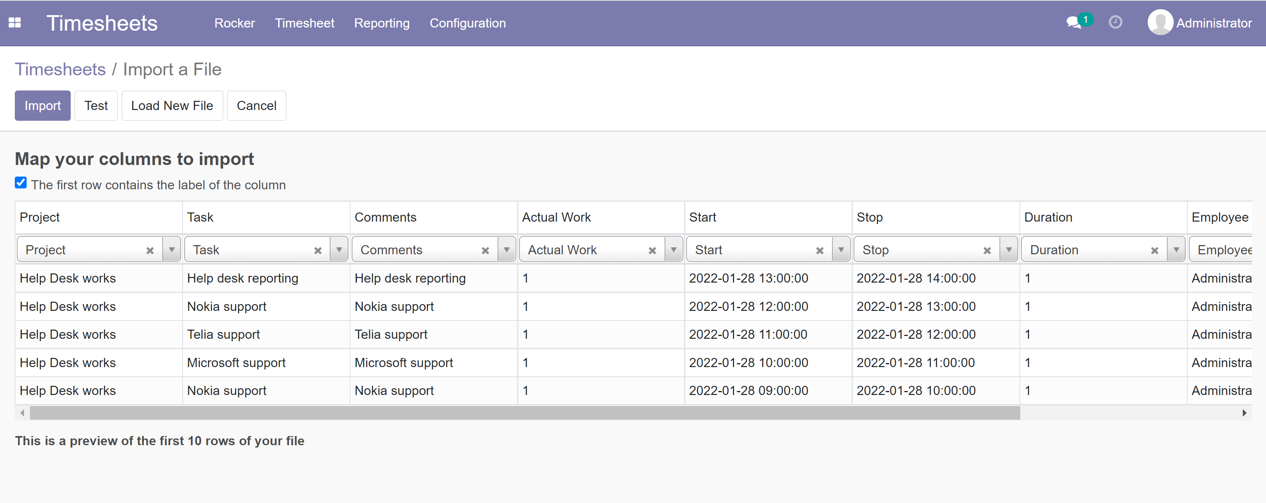
Excel import
Import in Favorites
Note that Project name, Task Name, User Name must be correct and exist in Odoo before import. Create excel template with dropdown lookup
Import creates new rows, does not update

Slide 16
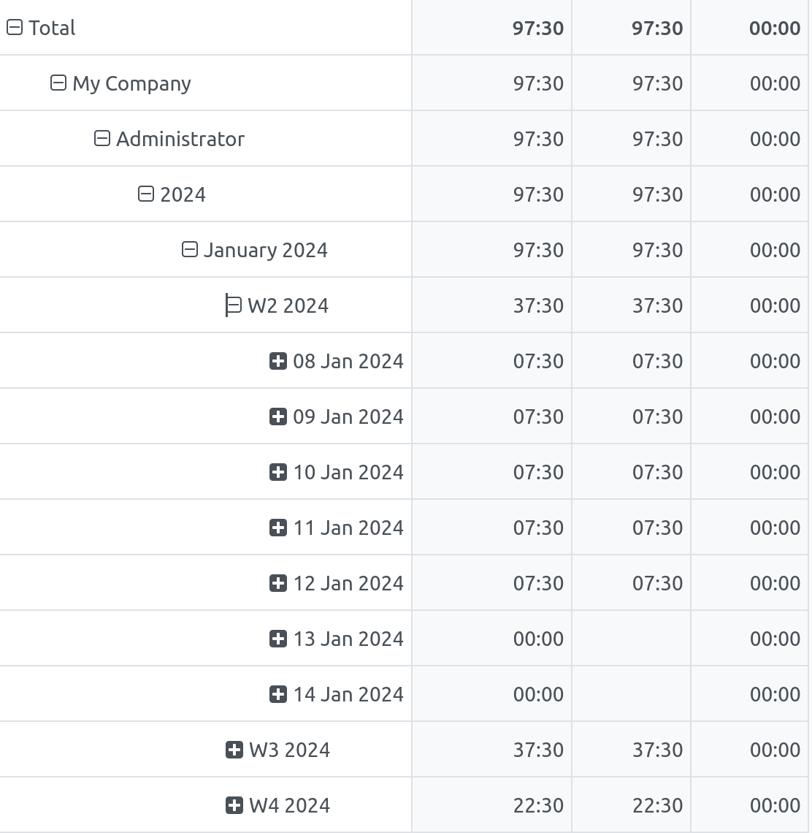
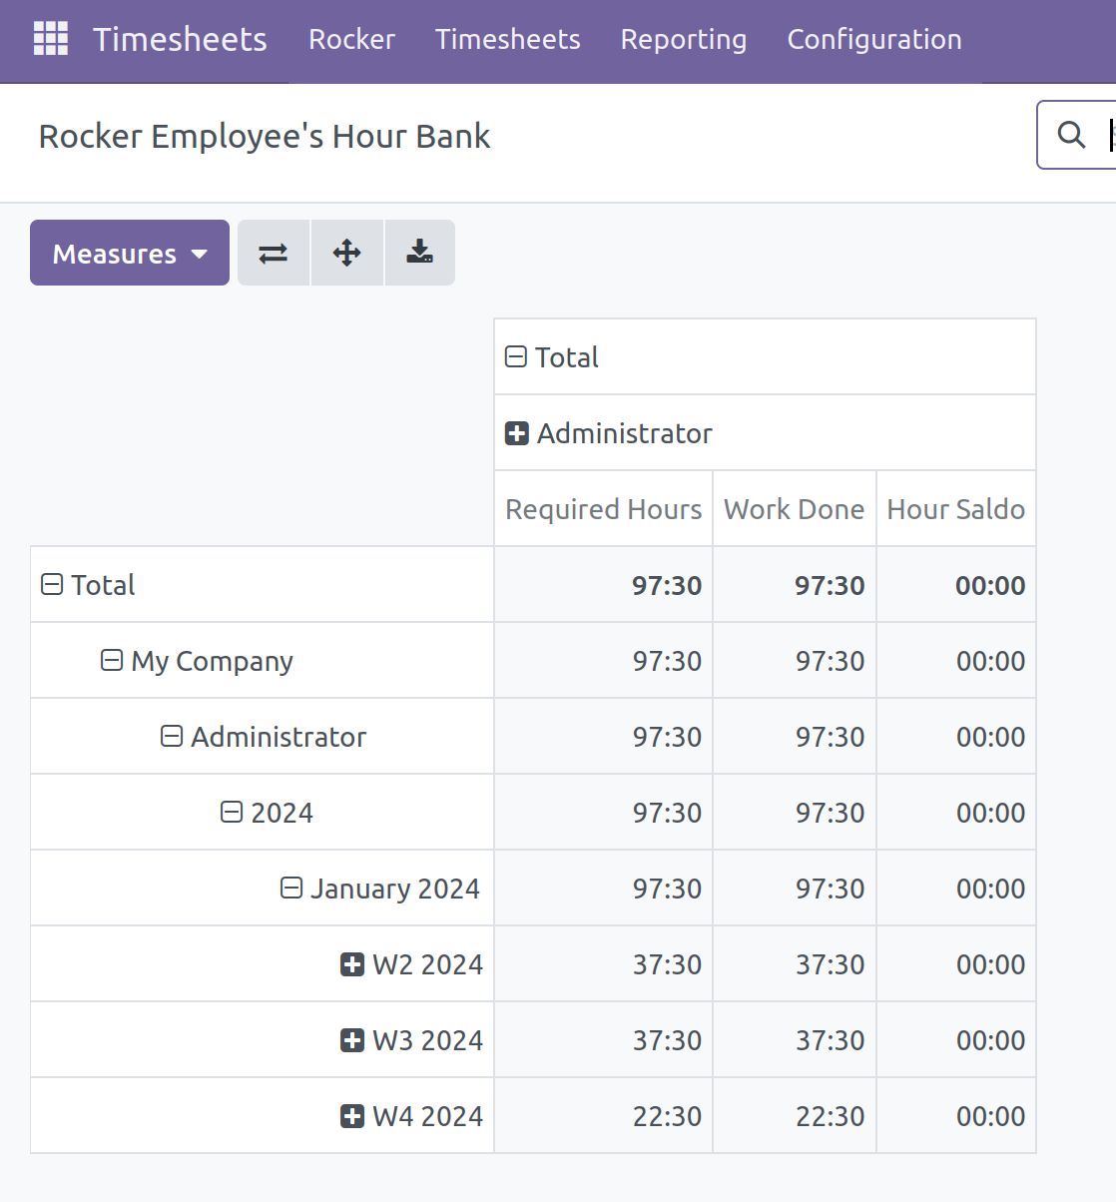
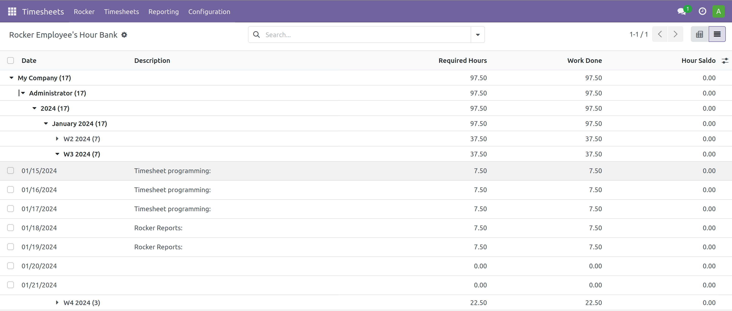
Hour Bank report

Slide 17
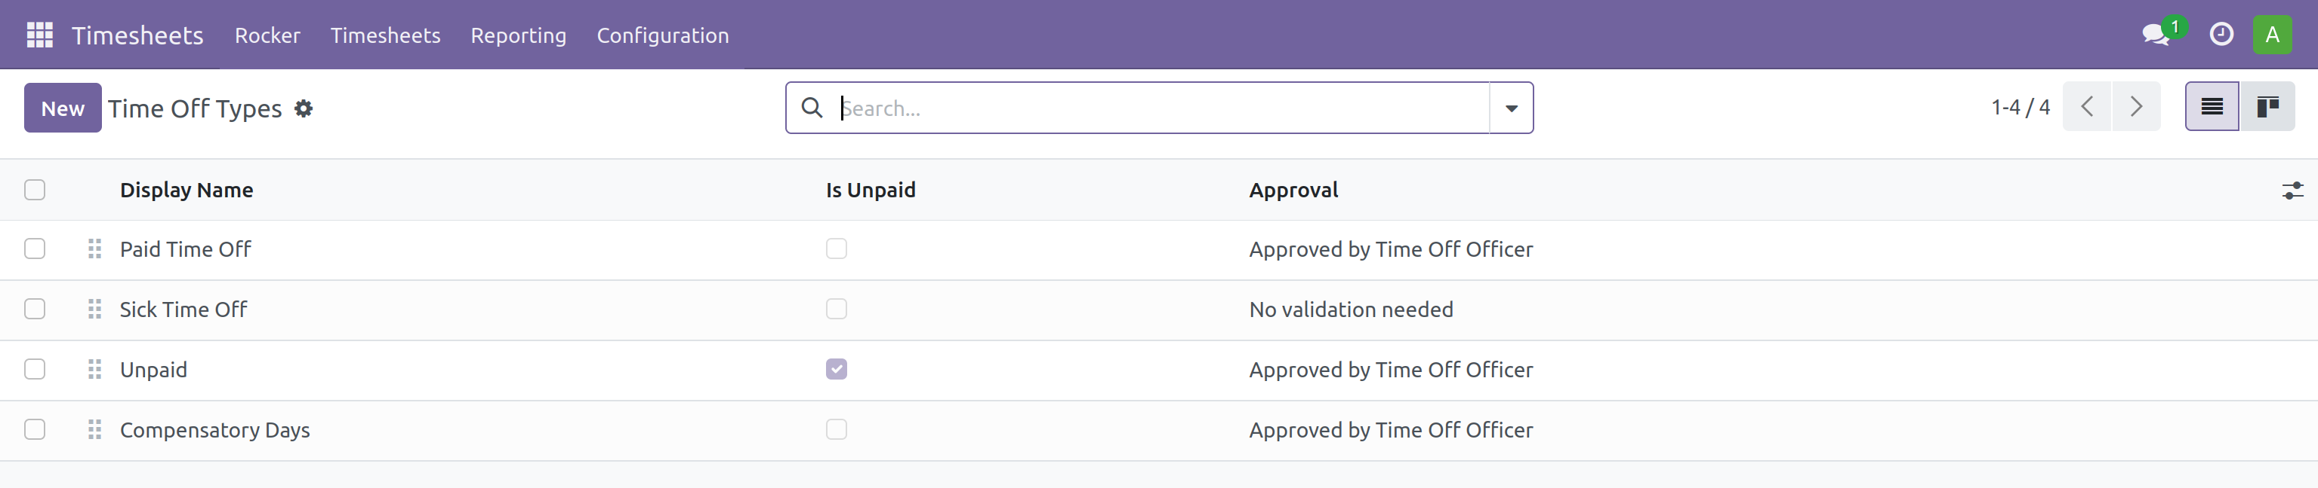
Edit Leave types

Slide 18
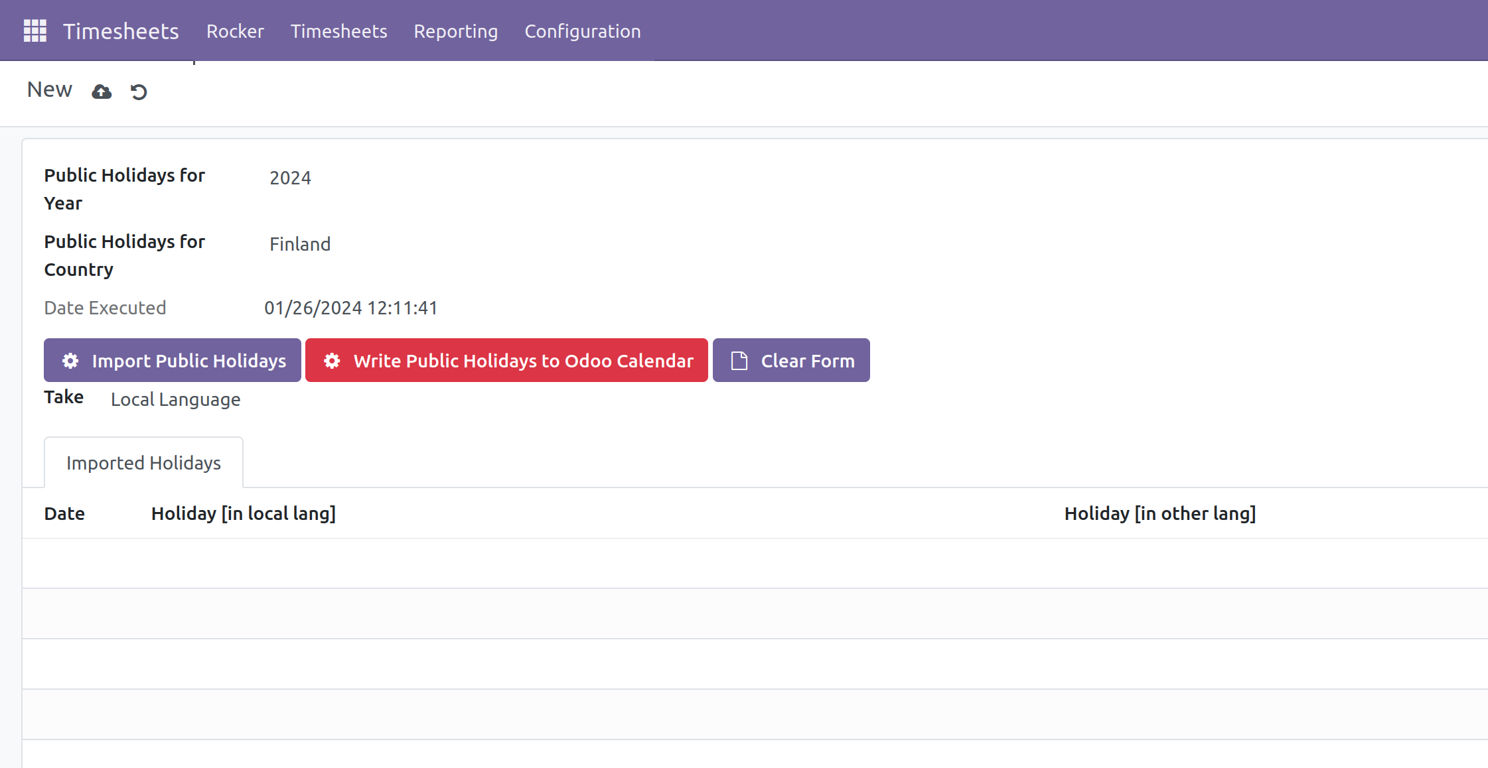
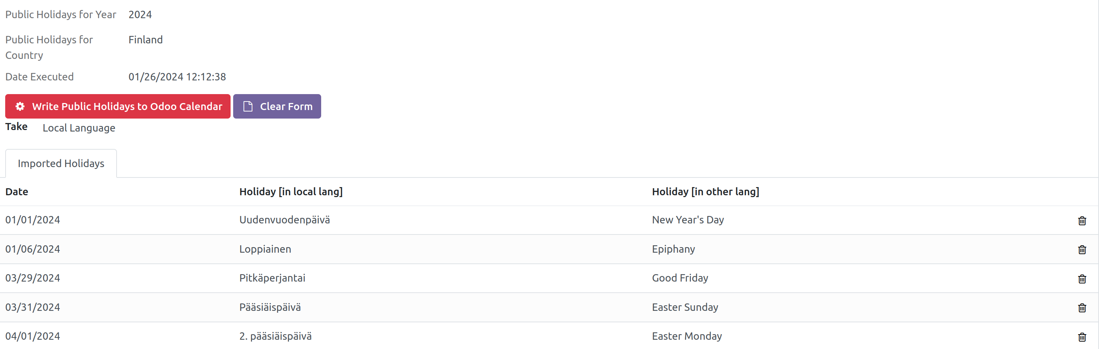
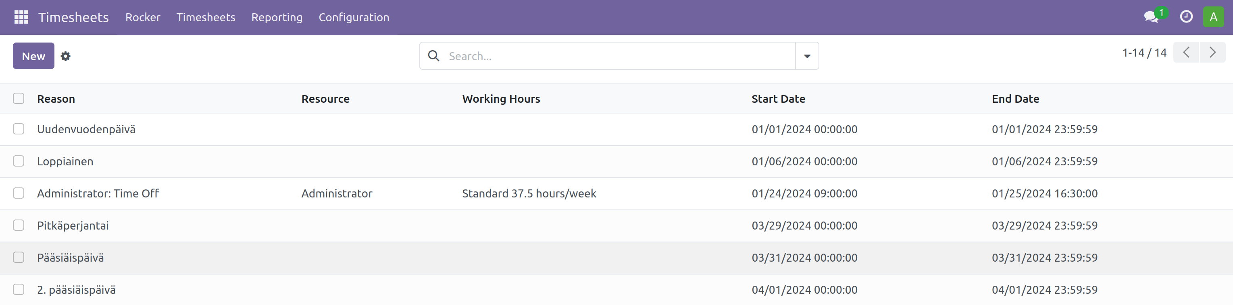
Import Public Holidays
Click Import Public Holidays
Edit Holidays and then click Write to...
Edit Holidays in Odoo setiings

Slide 19
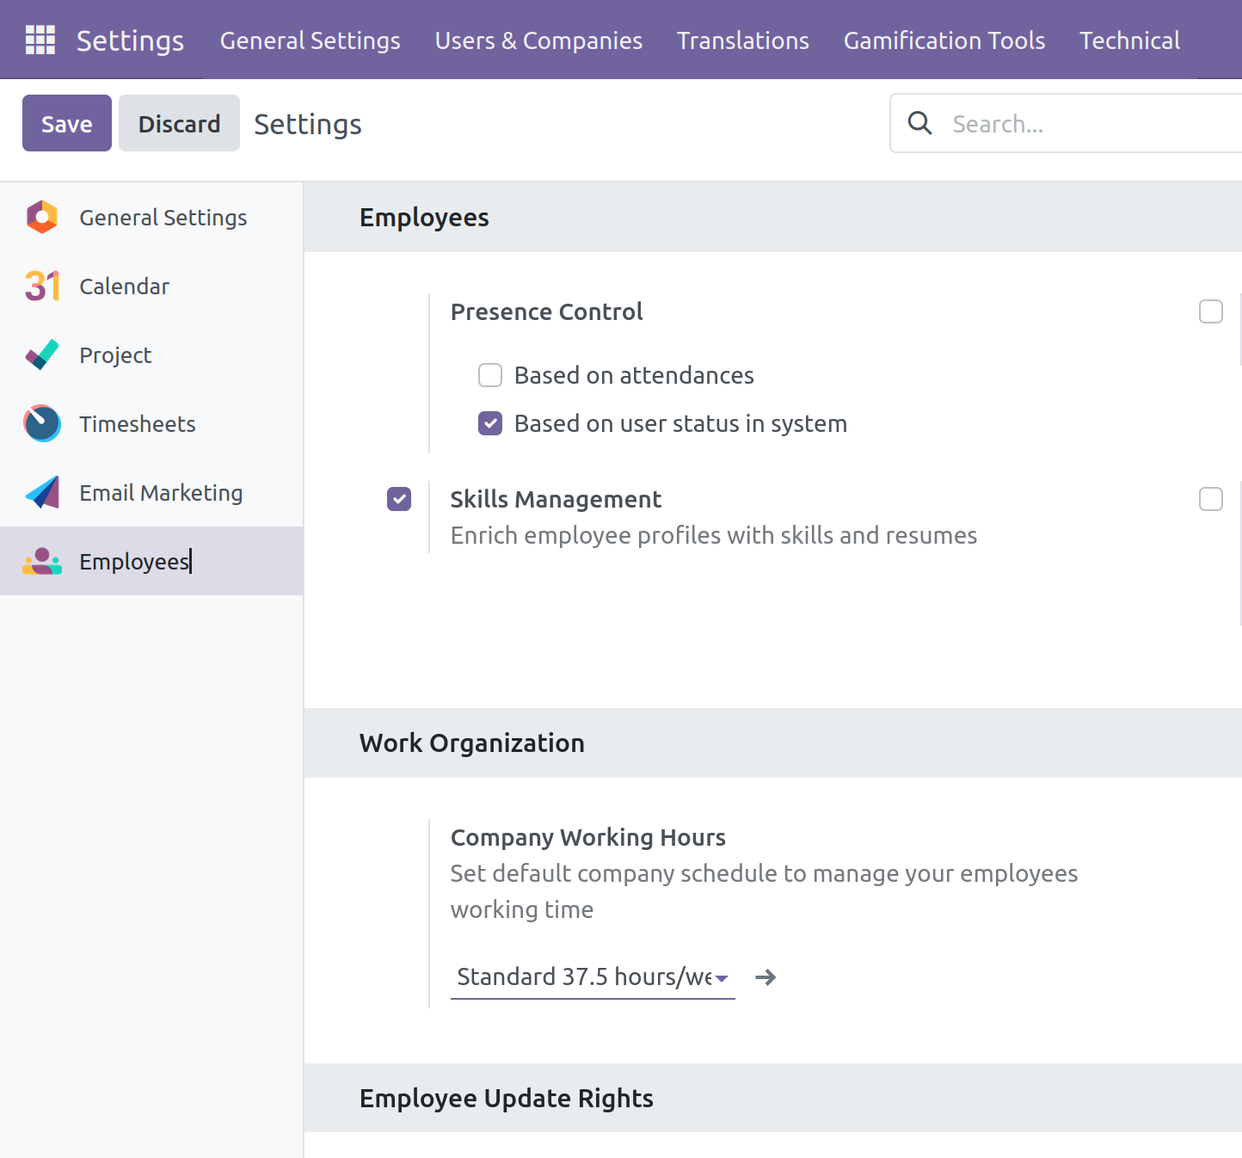
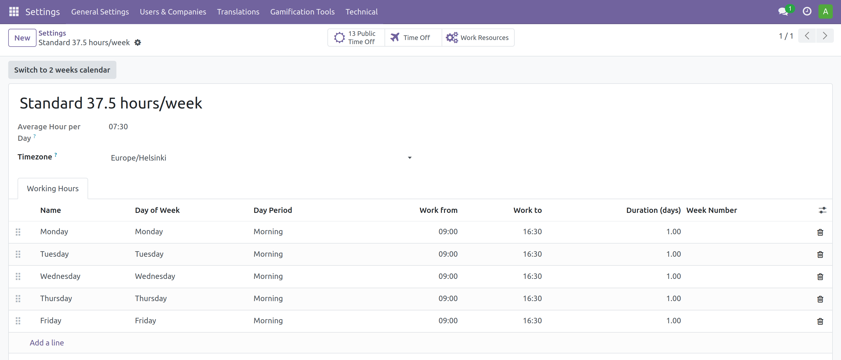
Modify company working calendar
Simplify your calendar, we use 37.5h/week, 7.5 h per day.
Click Calendar arrow to edit...

Slide 20
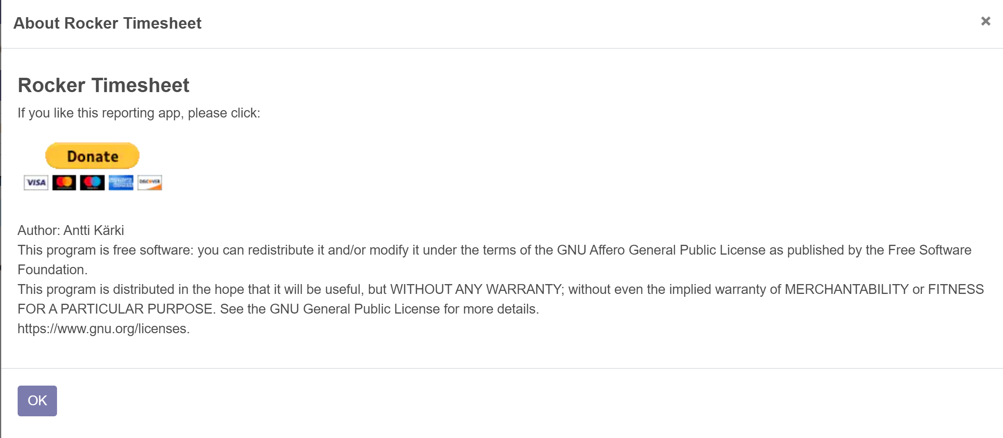
Remember to Click Donate

