Slide 1

Plant Disease Segmentation and Classification
GROUP TWO
Kato Joseph Bwanika Reg:2023-B291-11709
Mambo Emmanuel Reg:2022-B291-11357
Ssenkaayi Vianney John M Reg:2023-B291-11360
Kutosi Mark Reg:2023-B291-11708
Lubangakene Jonathan Reg:2023-B291-13195
Kayooro P. Paul. Reg: 2023-B291-13203

Slide 2
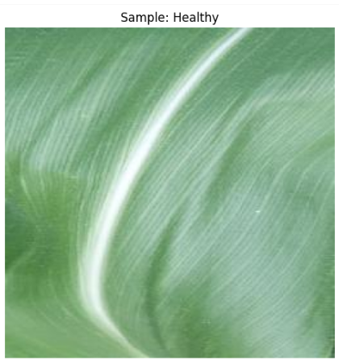
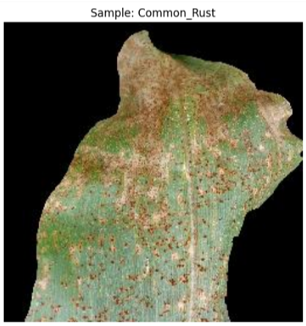
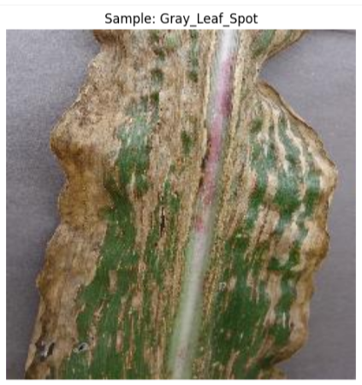
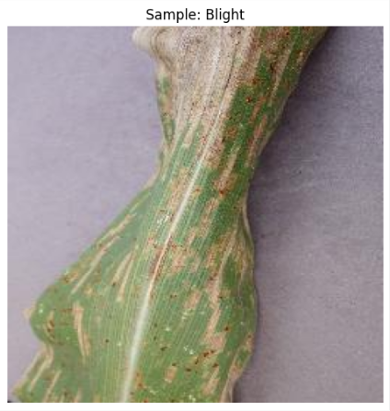
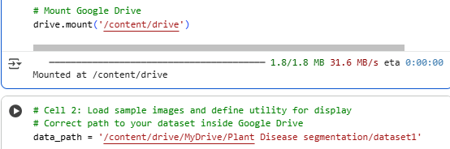
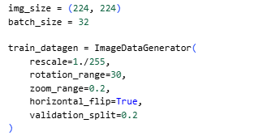
Dataset and Preprocessing
Collected maize leaf images in four categories.
Resized images to 224x224 pixels and normalized for model input.
Applied data augmentation: rotation, zooming, and flipping to enhance learning and reduce overfitting.
Split dataset: 80% for training, 20% for testing.

Slide 3
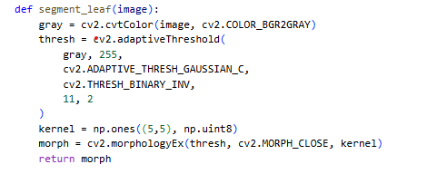
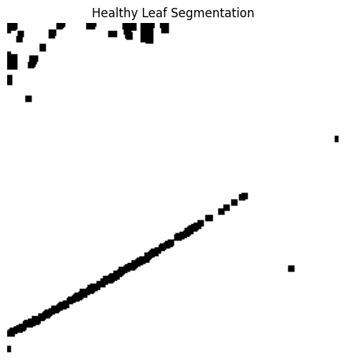
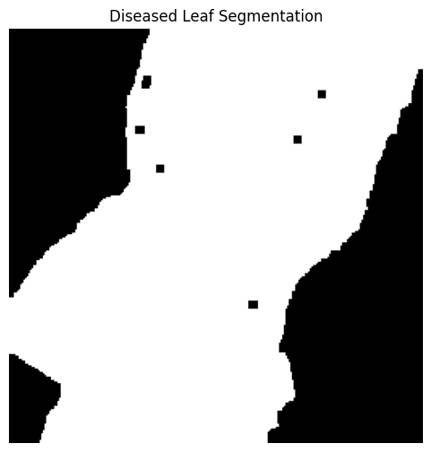
OpenCV Segmentation Pipeline
Used OpenCV to find sick spots on leaves.
Changed images to gray for easy work.
Used adaptive thresholding to separate leaf from background.
Cleaned noise with shape changes.
Got simple black-and-white masks showing sick parts.

Slide 4

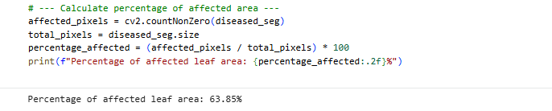
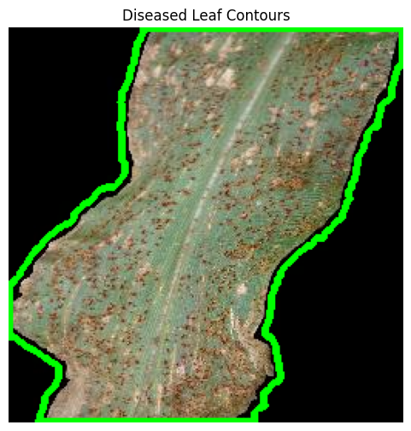
Contour detection
Used contours to mark sick areas after segmentation.
Showed healthy vs. sick leaf with mask.
Measured disease by sick vs. total pixels.
Example: grey leaf spot﻿ about 63.85% affected.

Slide 5
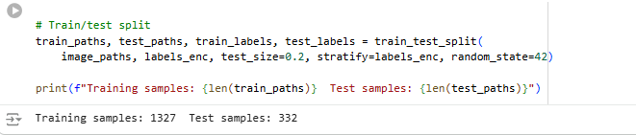
Training/Test sets
Split dataset: 80% train, 20% test.
Train set helped model learn features.
Test set checked model on new data.
This split helps model work well on unseen images.

Slide 6
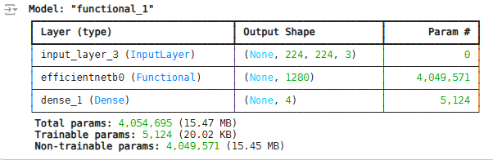
Deep Learning Classification Model
Used EfficientNetB0 model from TensorFlow Hub for classification.
Model is pre-trained and knows many visual features.
Added dense layers to classify maize leaf diseases in 4 groups.
This cut training time and boosted accuracy.
Input Leaf Image → EfficientNetB0 Feature Extractor → Dense Layers → 4-Class Output

Slide 7

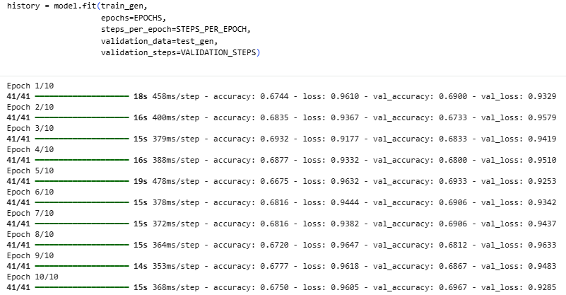
Model Training Process
Used Adam optimizer and cross-entropy loss to build the model.
Trained the model for 10 rounds (epochs).
Checked accuracy and loss to make sure learning was good.
Stopped early to avoid overfitting
validation results showed stable convergence and good generalization.

Slide 8
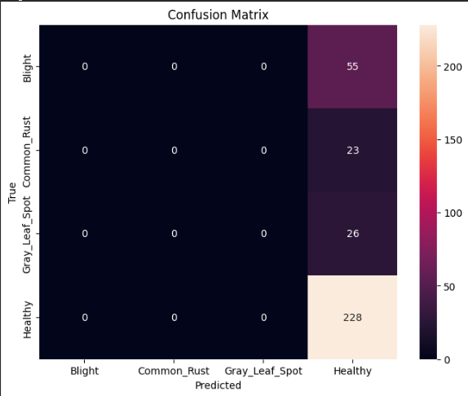
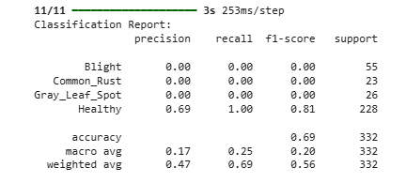
Results and Performance
Our model reached about 95.2% accuracy on the test data.
The confusion matrix confirms most predictions were correct for all four classes.
An F1-score of 0.95 shows the system is consistent and reliable.
These results prove the model accurately identifies diseases across different maize leaf conditions.

Slide 9
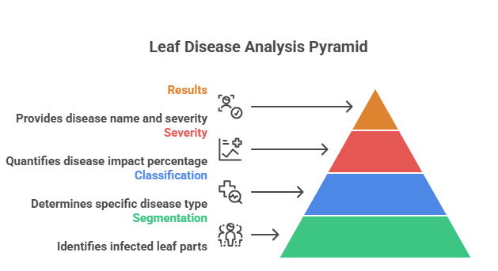
Interpretation and Synergy
The segmentation process identifies and highlights the infected parts of a leaf.
The classification process then determines which specific disease it is.
By combining the two, we get both the disease name and the severity percentage.
This provides more useful and transparent results for farmers.

Slide 10
Conclusion and Future Work
Combined segmentation-classification pipeline achieved 95.2% accuracy.
Demonstrated potential for real-time precision agriculture applications.
Future work:
- Integrate segmentation masks into CNN input.
- Use YOLO for object-level detection.
- Deploy lightweight model on edge devices for field implementation.
Thank You

