Slide 1
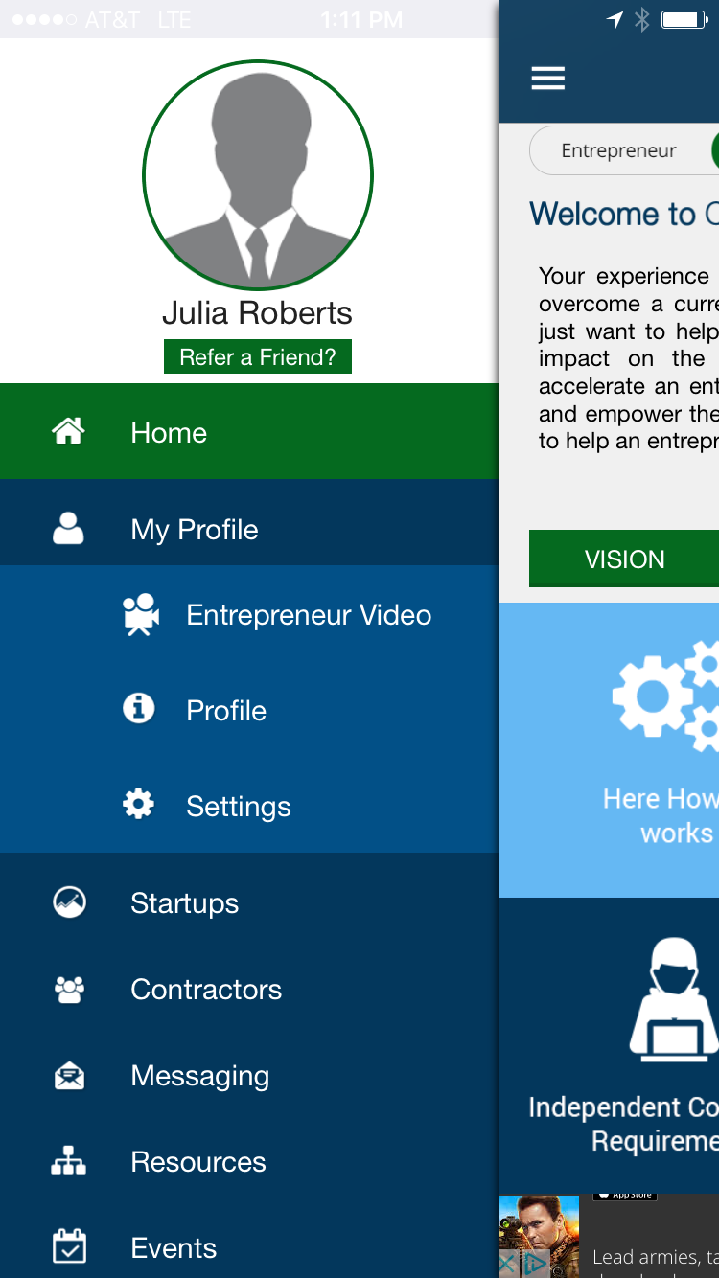
Example MVP Front End

