Slide 1
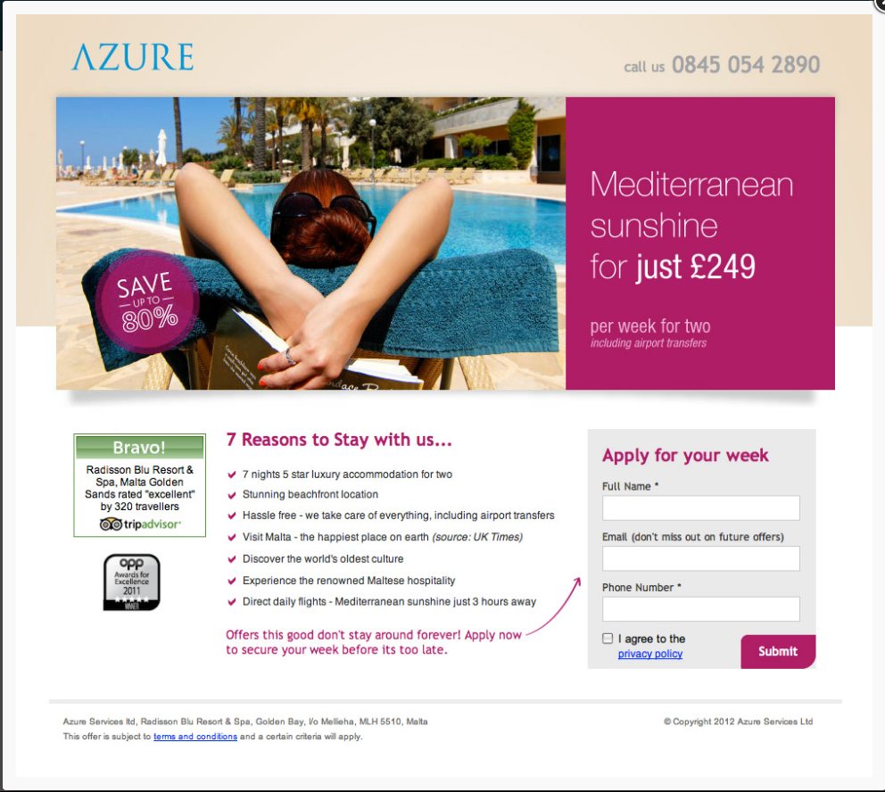
Example Landing Pages
http://unbounce.wpengine.netdna-cdn.com/photos/landing-page-gallery-151.jpg

Slide 2

Example Landing Pages
https://www.lyft.com/drive-for-lyft

Slide 3
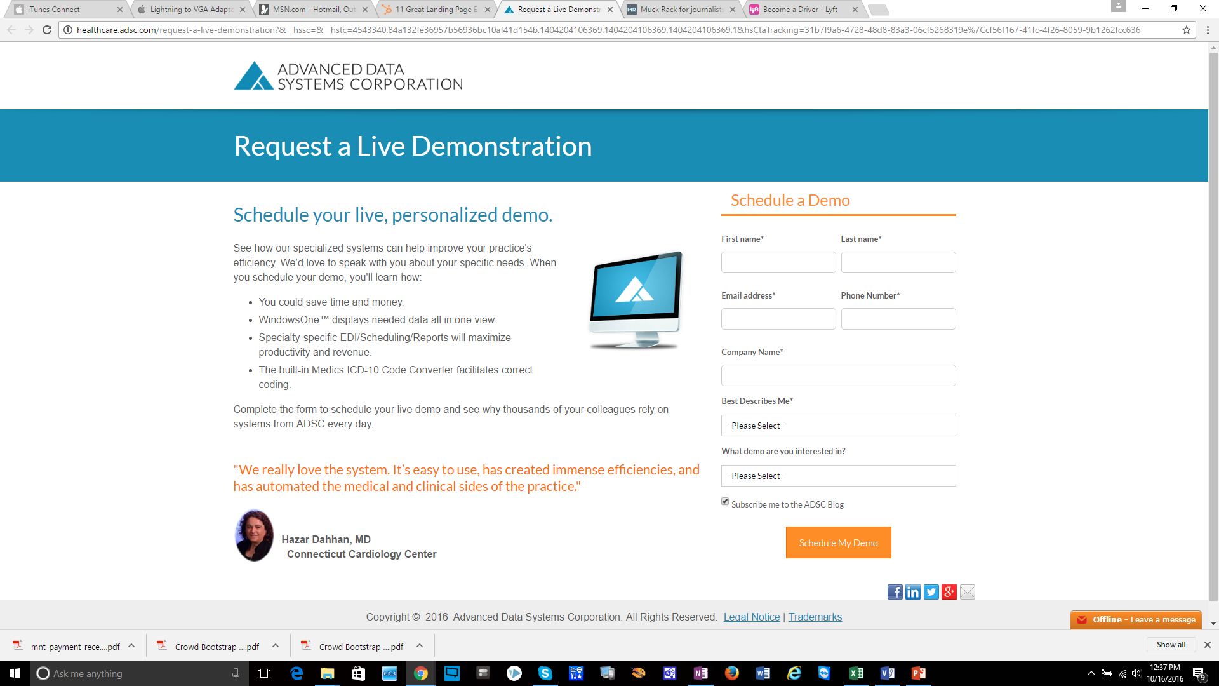
Example Landing Pages
http://healthcare.adsc.com/request-a-live-demonstration?&__hssc=&__hstc=4543340.84a132fe36957b56936bc10af41d154b.1404204106369.1404204106369.1404204106369.1&hsCtaTracking=31b7f9a6-4728-48d8-83a3-06cf5268319e%7Ccf56f167-41fc-4f26-8059-9b1262fcc636

Slide 4
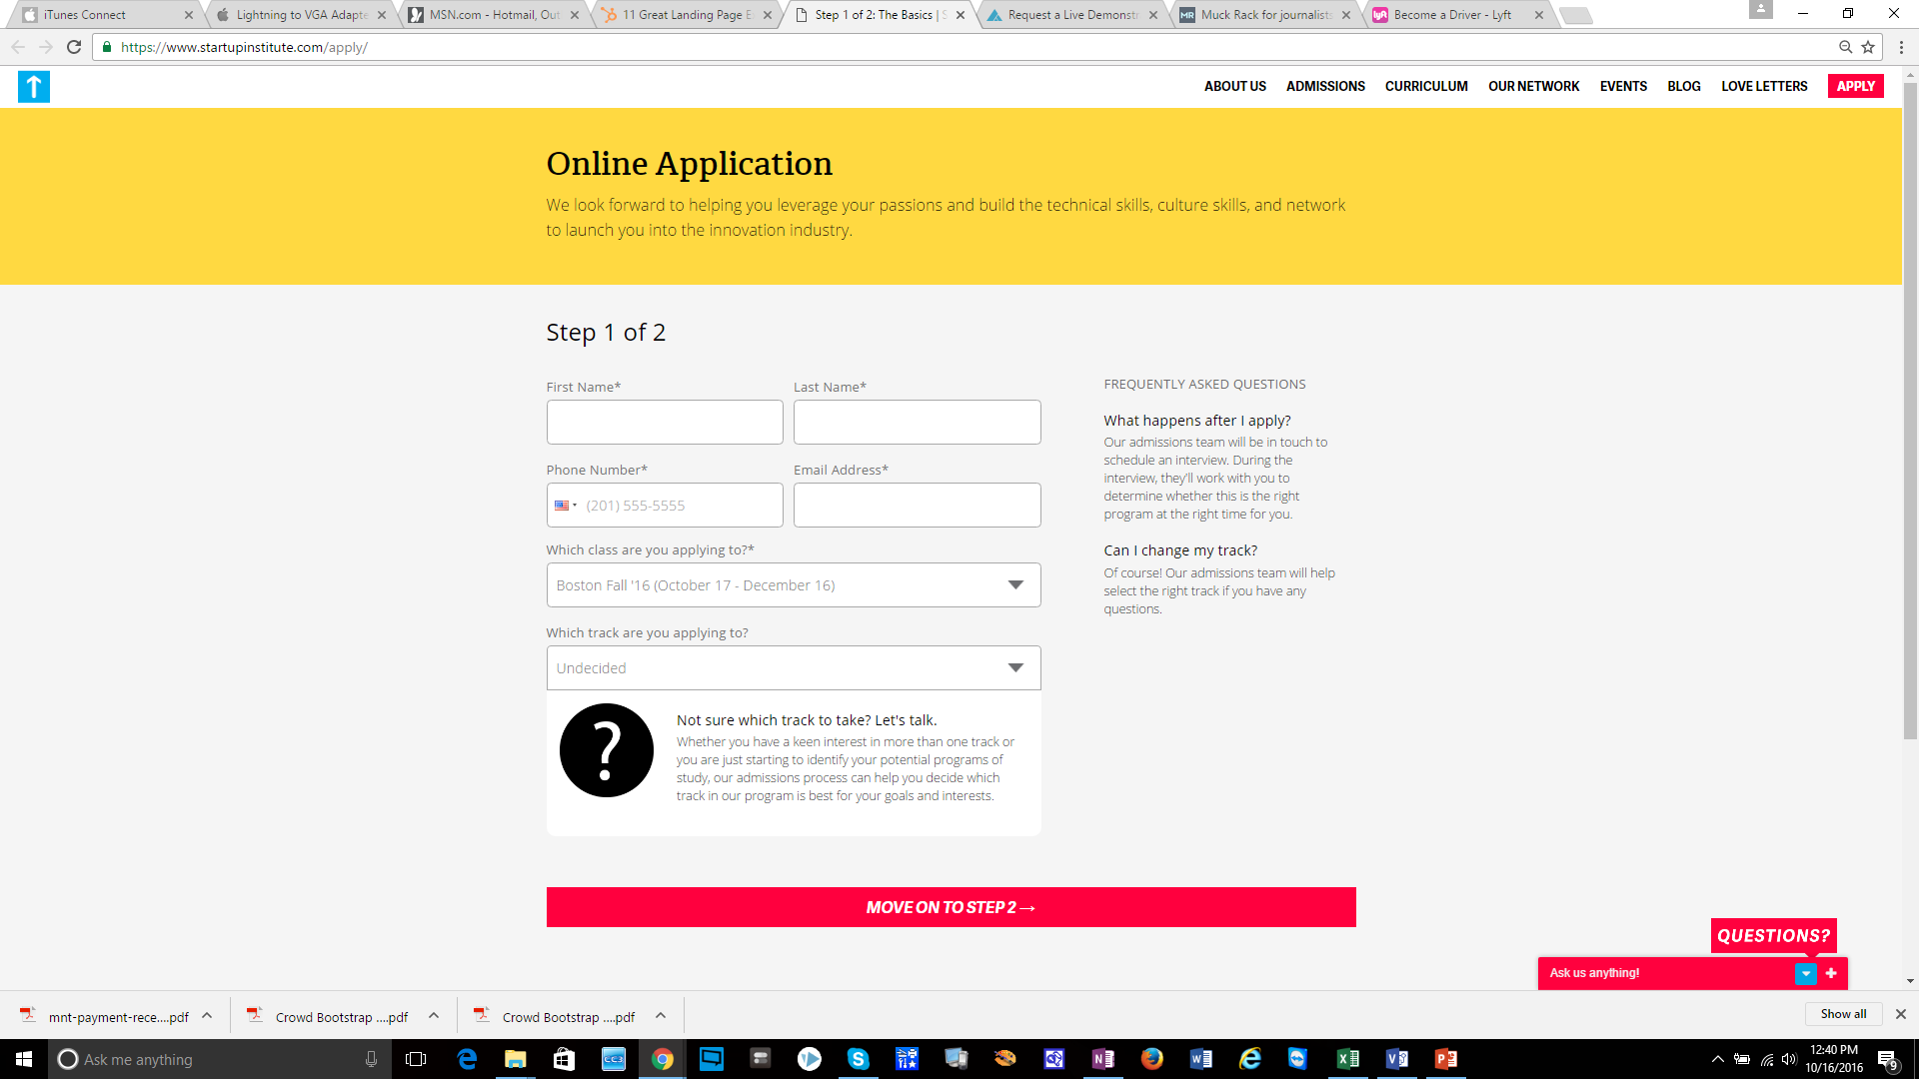
Example Landing Pages
https://www.startupinstitute.com/apply/

