Slide 1
CSC3002 Final Review
Jingyu Li
118010141

Slide 2
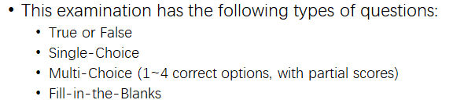
A few tips
Finish Review Questions selectively
Two hours is generally enough
Be careful
No care on memory things (grammar / methods / functions)
Don’t‘ worry!

Slide 3
True or False
01

Slide 4
True or False
C++, C, Java, Python are all Object-Oriented Programming language
Abstraction in C++ means displaying only essential information and hiding the details.
The main function can be declared as void main(){ … };
*&x and &*x will generate the same results if x is a pointer;
Global variables are stored in the static area in memory in C++

Slide 5

6. The default copy style for C++ is deep copy
7. In C++, user can overload the copy constructor
and assignment operator (=) for a stream
8. In the ring-buffer implementation of a queue, the queue is empty if and only if head == tail. When the queue is full, head > tail.
9. To declare a variable fn as a pointer to a function taking two integers and returning a Double value, we use:
double* (*fn) (int, int);
10. Multiple inheritance and garbage collection are both useful features in C++

Slide 6
Single Choice
02

Slide 7
What is the result of the following expression: 6 + 5.0 / 4 - 3 / 2 + (1 - 2) * (5 * 6 % 9 * 2)
0.25
0
-5.75
-0.25

Slide 8
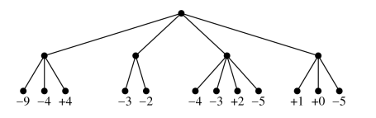
Suppose you are in a position in which the analysis for the next two moves shows the following rated outcomes from your original player’s point-of-view: If you adopt the minimax strategy, what is the best move to make in this position? What is the rating of that move from your perspective?
First cross, +4
Second cross, -3
Second cross, -2
Third cross, +2

Slide 9
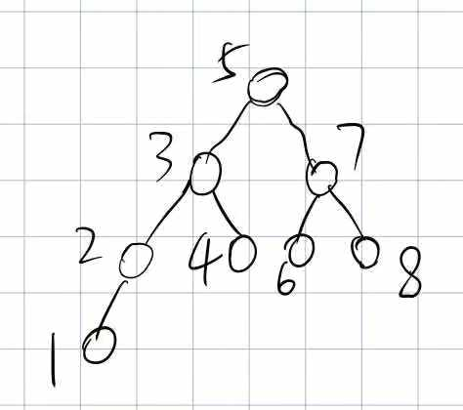
What is the preorder, inorder, and postorder traversal results for the following trees?
53214768, 12345678, 12436875
53214768, 53724681, 86754321
12345678, 53724681, 12436875
12345678, 12345678. 86754321

Slide 10
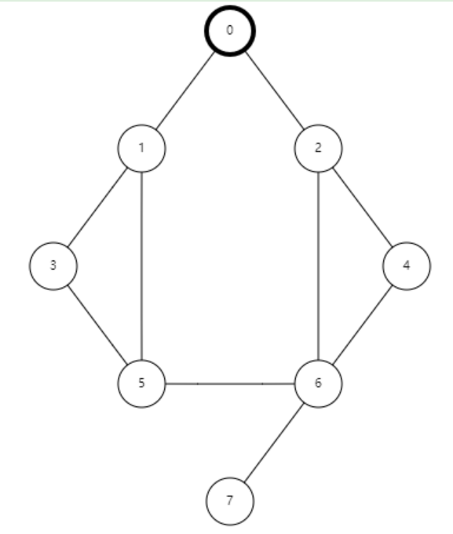
What is the DFS & BFS traversal order for the following graph? Assume the smaller number is prior at the same level. Start from 0
01356247, 01234567
01356247, 01235467
01356724, 01234567
02465137, 01235467

Slide 11
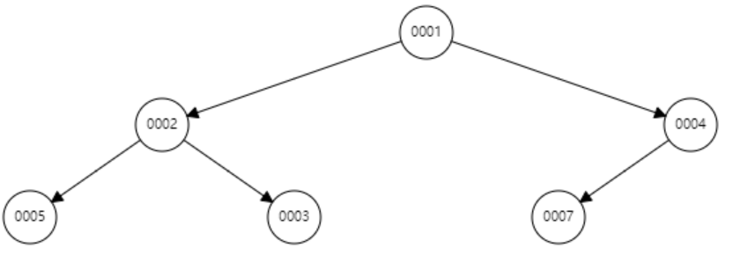
What is the resulting heap after performing the following operations: Dequeue, Enqueue(1)
124537
134537
132574
134572

Slide 12
Multiple Choice
03

Slide 13
Which of the following collection classes support the use of the range-based for loop?
Vector
Map
Stack
Priority Queue

Slide 14
Suppose that you are using a sorting algorithm to sort a vector of 250 values and find that it takes 100 milliseconds to complete the operation. What would you expect the sorting algorithm and running time to be to sort a vector of 2000 values on the same machine?
Selection Sort, 8000ms
Insertion Sort, 6400ms
Quick Sort, 2400ms
Merge Sort, 800ms

Slide 15

Which of the following expressions can compile successfully? (Under the following initialization)
cout << b[0] << endl;
cout << *b++ << endl;
cout << *++b << endl;
cout << *a++ << endl;

Slide 16
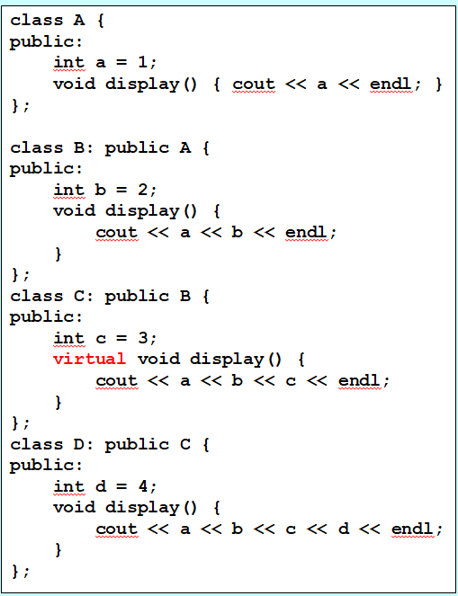

Which integers will be outputted in the following code?
1
2
3
4

Slide 17
Assume A is a super class of B. Which one(s) of the following is visible to A?
Public field of B
Private field of B
Protected field of B
Protected field of A

Slide 18
Space Filling
04

Slide 19


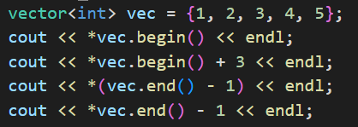
Write down the formatted output of the following code:

Slide 20
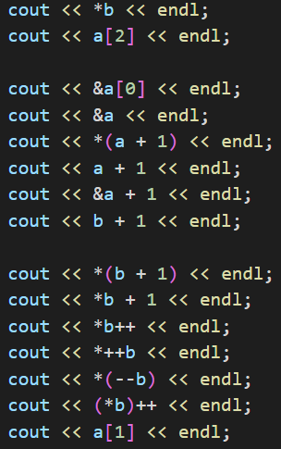

Write down the formatted output of the following code: Assume the address of the array is 0x61fe0c

Slide 21
Answer
05

Slide 22

True or False: FTFTT FFFFF
Single Choice: ABABC
Multiple Choice: AB BC ABC ABCD AD
Space Filling

Slide 23
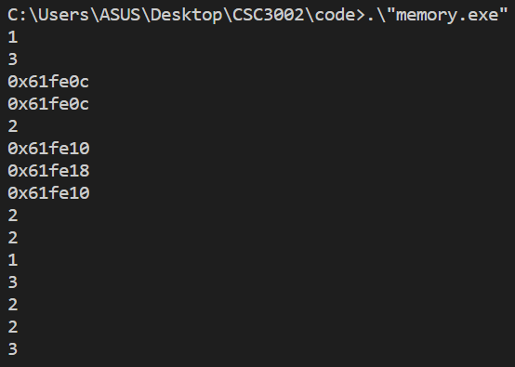
Space Filling

Slide 24
Thanks & Wish You Good Luck!

