Slide 1

Maximum Return
SMRMJ
高骏 120090240
刘鑫宇 120020128
申恒瑜 120090633
马可轩 120090651
张皓深 120090798

Slide 2
Table of Content
1.
Maxret: Background Analysis
2.
Maxret: Statistical Examination
3.
Investment Strategy

Slide 3

Maxret: Background Analysis
1

Slide 4

1. Maxret: Background Analysis
Definition
Maximum return:
Single maximum daily return
Average of multiple highest maximum daily return
Lottery-like stock:
Stocks that have a relatively small probability of a large payoff.

Slide 5
1. Maxret: Background Analysis
Characteristics
Potential investors:
Poorly diversified yet risk-averse investors who prefer lottery-like assets.
Stock Characteristics:
Stocks with extreme positive returns are small and illiquid on average.

Slide 6
1. Maxret: Background Analysis
Result & Explanation
There is a negative and significant relation between the maximum daily returns and expected stock returns.
Cumulative prospect theory(Barberis and Huang, 2008)
“Errors in the probability weighting of investors cause them to over-value stocks that have a small probability of a large positive return.”
Investors may be willing to pay more for stocks that exhibit extreme positive returns.
Optimal beliefs framework(Brunnermeier, Gollier and Parker, 2007)
“Agents optimally choose to distort their beliefs about future probabilities in order to maximize their current utility.”

Slide 7
Maxret: Statistical Examination
2

Slide 8
2. Maxret: Statistical Examination
Data Collection
 | P0 | P1 | P2 | P3 | P4 | P5 | P6 | P7 | P8 | P9
1980-01 | 376 | 378 | 375 | 380 | 391 | 357 | 371 | 381 | 370 | 375
1980-02 | 375 | 388 | 362 | 380 | 374 | 369 | 385 | 365 | 376 | 373
1980-03 | 386 | 378 | 381 | 385 | 379 | 381 | 382 | 384 | 379 | 382
1980-04 | 380 | 398 | 377 | 365 | 380 | 379 | 389 | 377 | 374 | 380
… | … | … | … | … | … | … | … | … | … | …
2021-07 | 365 | 365 | 365 | 365 | 365 | 365 | 365 | 365 | 365 | 365
2021-08 | 365 | 364 | 364 | 364 | 364 | 364 | 364 | 364 | 364 | 365

Slide 9
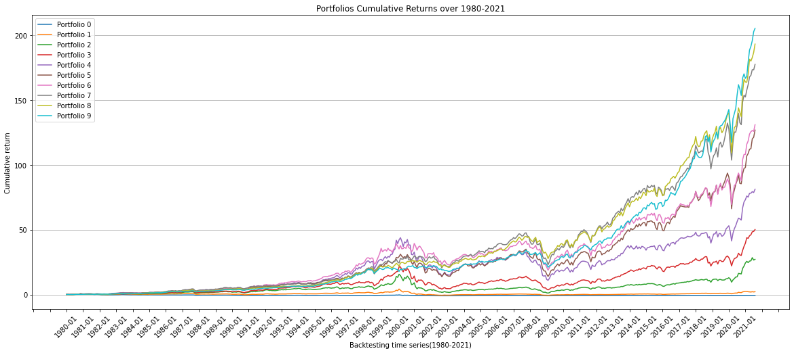
2. Maxret: Statistical Examination
Portfolio performance

Slide 10
2. Maxret: Statistical Examination
Monotonic Alpha
CAPM
 | 0 | 1 | 2 | 3 | 4 | 5 | 6 | 7 | 8 | 9
⍺ | -0.0125 (-4.640) | -0.0089 (-4.325) | -0.0046 (-2.787) | -0.003 (-2.224) | -0.0018 (-1.878) | -0.0006 (-0.705) | -0.0001 (-0.127) | 0.001 (1.671) | 0.002 (2.905) | 0.0031 (2.905)
β | 1.4972 (25.239) | 1.527 (33.829) | 1.4551 (40.462) | 1.3307 (44.768) | 1.2451 (57.722) | 1.1513 (64.463) | 1.0608 (68.457) | 0.9525 (66.576) | 0.8179 (53.382) | 0.6594 (53.382)

Slide 11
2. Maxret: Statistical Examination
Monotonic Alpha
Fama French 3 Factor
 | 0 | 1 | 2 | 3 | 4 | 5 | 6 | 7 | 8 | 9
⍺ | -0.0117 (-5.172) | -0.0077 (-4.792) | -0.0037 (-2.837) | -0.0025 (-2.215) | -0.0016 (-1.765) | -0.0007 (-0.883) | -0.0003 (-0.444) | 0.0007 (1.154) | 0.0015 (2.475) | 0.0026 (3.375)
β | 1.2983 (25.062) | 1.3446 (36.440) | 1.3192 (43.415) | 1.234 (46.205) | 1.1959 (57.026) | 1.1377 (62.436) | 1.0693 (66.716) | 0.9847 (70.162) | 0.868 (62.256) | 0.7135 (40.154)
S | 1.0562 (13.607) | 0.8312 (15.034) | 0.6405 (14.068) | 0.4674 (11.682) | 0.253 (8.051) | 0.1337 (4.897) | 0.017 (0.706) | -0.0882 (-4.198) | -0.1619 (-7.749) | -0.1889 (-7.095)
H | -0.2276 (-3.010) | -0.3595 (-6.675) | -0.2445 (-5.513) | -0.1607 (-4.213) | -0.066 (-2.157) | 0.0517 (1.944) | 0.0779 (3.329) | 0.1276 (6.228) | 0.1716 (8.431) | 0.1698 (6.546)

Slide 12
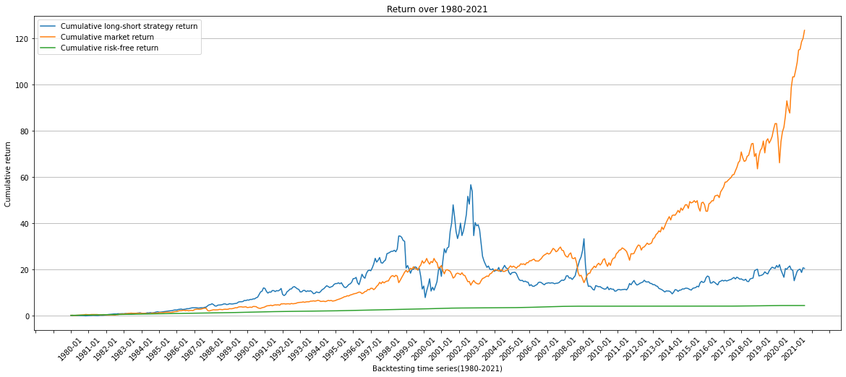
2. Maxret: Statistical Examination
Strategy Performance

Slide 13
Investment Strategy
3

Slide 14


3. Investment Strategy
Conclusion
Long the portfolio with smallest maximum return and short the portfolio with biggest maximum return.
$$r_{0}−r_{f}=α_{0}+β_{0}∗\left(r_{m}−r_{f}\right)+ε_{0}$$
$$r_{9}−r_{f}=α_{9}+β_{9}∗\left(r_{m}−r_{f}\right)+ε_{9}$$
Monthly rebalance given our data update frequency.

Slide 15
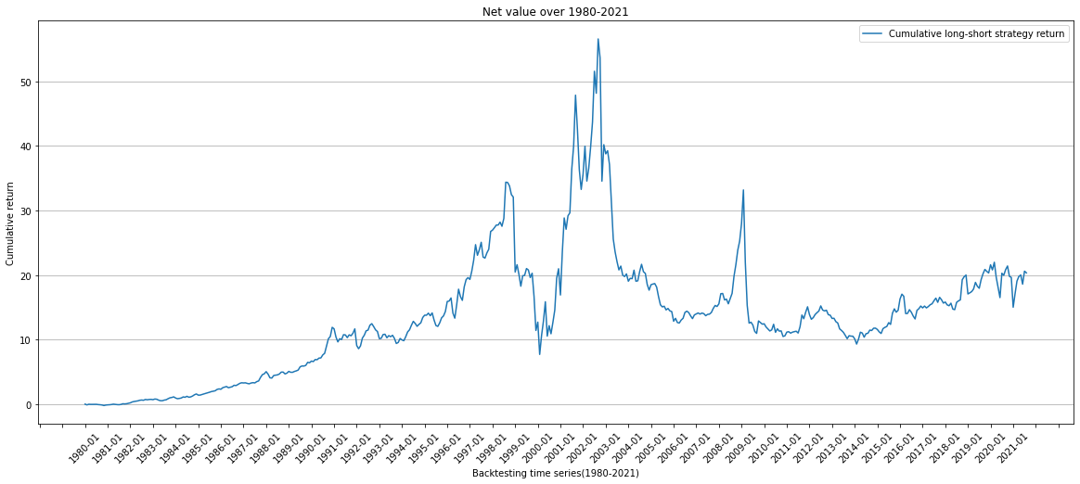
3. Investment Strategy
Net value of the portfolio

Slide 16
3. Investment Strategy
Interceptions of 10 portfolios

Slide 17
3. Investment Strategy
Condition
This strategy can generate high profits
when market volatility is large.

Slide 18
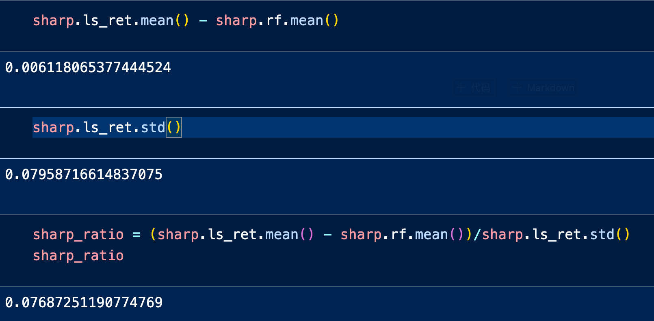
3. Investment Strategy
Index of the Strategy
Sharpe Ratio: 0.07687
Maximum Drawdown: 83.55%

Slide 19

3. Investment Strategy
Client Type
Wealthy individuals willing to take high risk for high pay-off.
Institutions who can evaluate proper entries for short-term payoff.

Slide 20

Q&A

