Slide 1

Unsupervised
Learning
jialong Li (Mark)
University of Illinois Urbana-Champaign
J
Notes:
版权声明：300套精品模板商业授权，请联系【锐旗设计】:https://9ppt.taobao.com，专业PPT老师为你解决所有PPT问题！

Slide 2
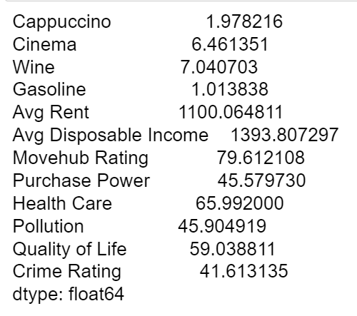
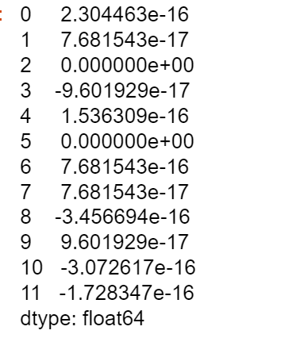
Intro
Dataset: Movehub City Rankings
Reference: Blitzer. (2017). Movehub City Rankings. https://www.kaggle.com/blitzr/movehub-city-rankings
There are 185 rows of data, and 14 columns
Scale the data

Slide 3
Variables
City (185)
Country (79)
-----------------------------
Cappuccino
Cinema
Wine
Gasoline
Avg Rent
Avg Disposable Income
------------------------------
Movehud Rating
Purchase Power
Health Care
Pollution (low)
Quality of Life
Crime Rating (low)
Cost of Living
Movehub
Rating
Quality of Life

Slide 4
Motivation:
The old way to choose the city
In reality
Numeric index:
--- A high score is not necessarily equal to suitable.
For example:
{Movehud Rating}
{Quality of Life}
--- Gives us limited information and ignore the influence of human factors. (Ruth & Franklin, 2014)
Individuals usually cannot obtain complete information, and their judgments largely rely on their own experiences.
If a person likes (or lives) in New York City, he or she will also more likely to prefer big cities like London, Hong Kong, etc.
Similarity matters!

Slide 5


Objects:
disposable income per capita (year 2021)
Data from Wikipedia
Use cluster analysis to support decision making.
Bình Dương,
Vietnam
(3950 $)
Pakhoi,
China
(4656 $)
Entrepreneurs open factories in similar cities
Texas,
U.S.
(54280 $)
Berlin
Germany
(19900 $)
Is disposable income per capita enough for decision-making?

Slide 6
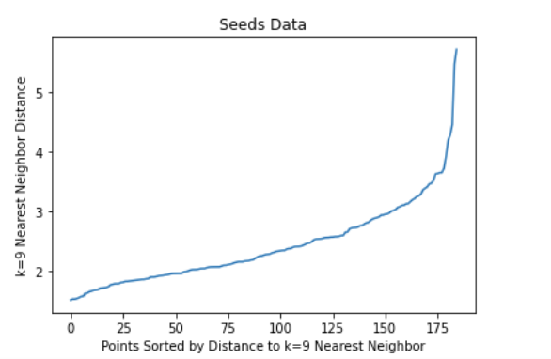
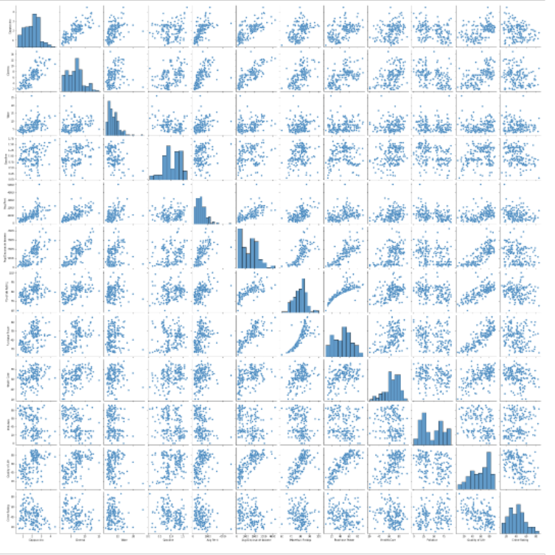
EDA
Nearly independent variables:
{wine, gos, pollution, crime}
Correlated variables:
{quality of life: income, purchase power, health care matters}
Outliers:
Yes.
Occurs in the right part of Avg Rent and Wine attribute.

Slide 7
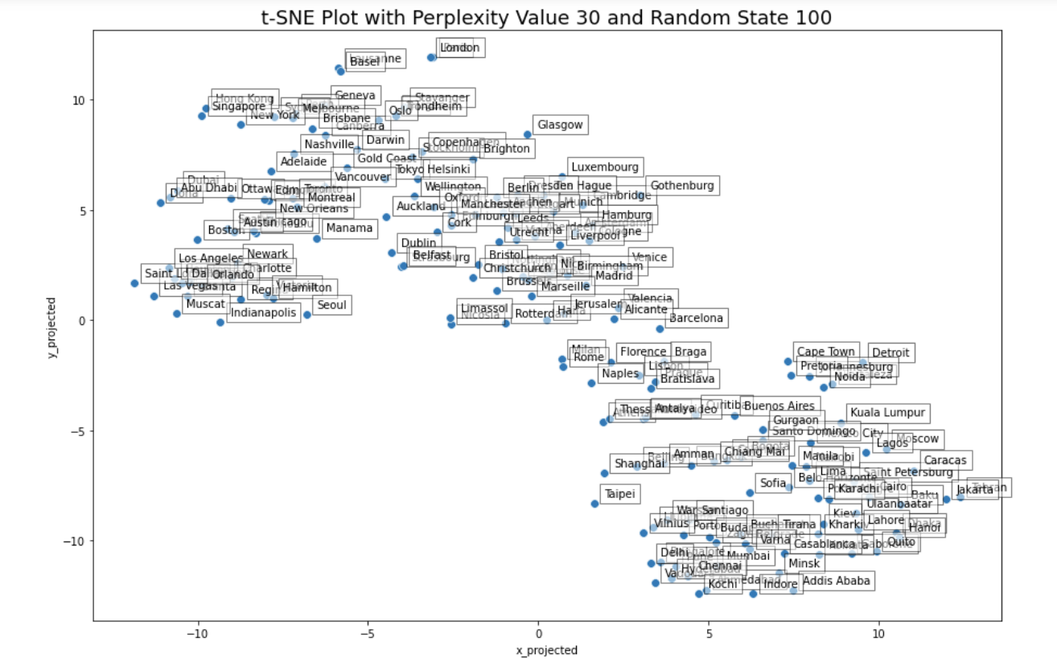
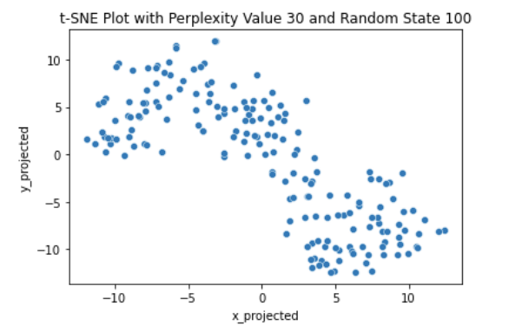
Clusterability
1. Hopkin's statistics:
Hopkin's statistics is closer to 0.25, which indicates there are maybe an underlying clustering relationship, but they are not well-separated.
2. t-SNE plot:
In the plots with perplexity values of 10, 20, and 30, we see that there may exist 2 or 3 overlapping clusters that are somewhat spherical in shape.

Slide 8
Algorithm Selection Motivation
1. Hierarchical Clustering
complete linkage and average linkage are not sensitive to outliers
What we know:
Outliers in the dataset
Clusters are highly overlapping
2. k-means + Fuzzy c-means
is able to identify the underlying clusters in the dataset,
is able to reflect the uncertain nature of which clusters "straddle nodes" should belong to, and
is able to reflect the more certain nature of which cluster highly cohesive objects belong to.

Slide 9
Outline detection
Parameter selection
Algorithm 1:
Hierarchical Clustering
Clustering Result
Silhouette plot
Boxplot Result

Slide 10
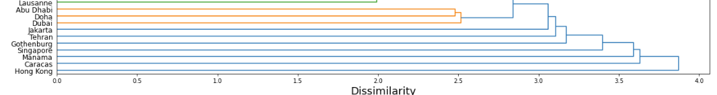
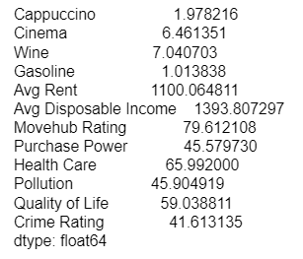
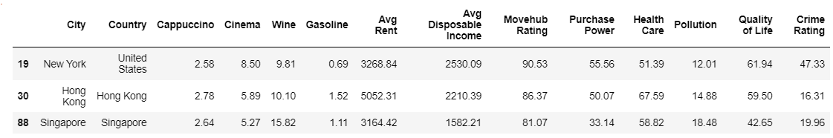
Outlier detection (linkage = single)
Attributions in average:
Here are all the cities with rents > 3000. It can be seen that Hong Kong may be an outlier because the rent is too expensive.

Slide 11
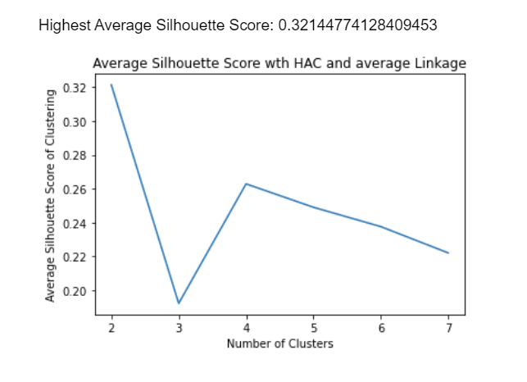
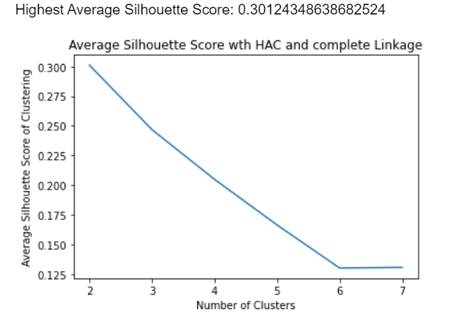
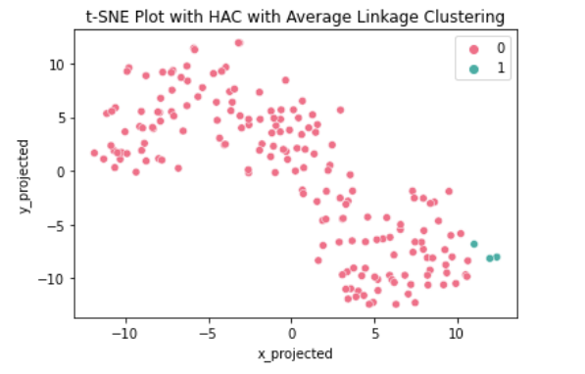
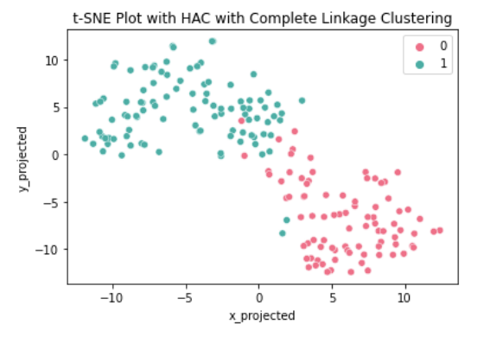
Parameter selection
Pick:
Complete linkage

Slide 12
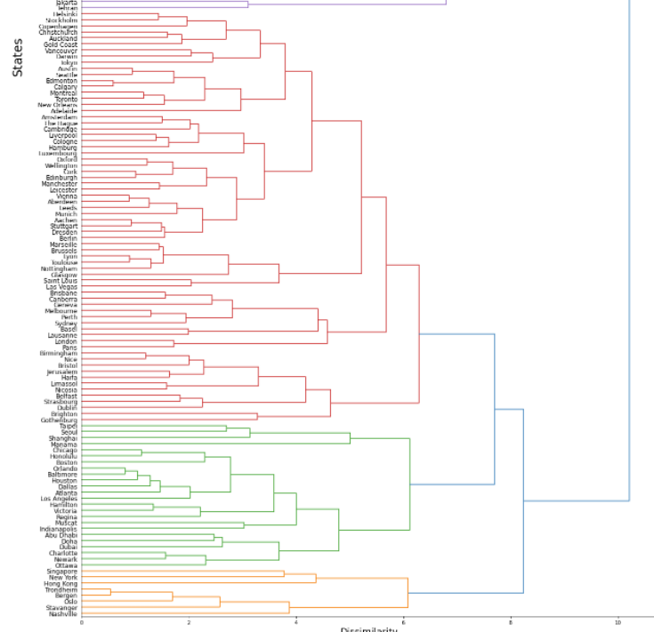
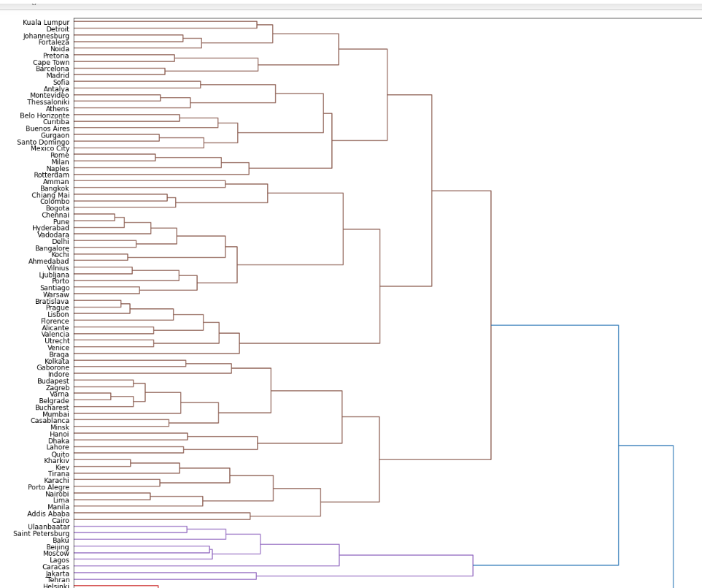
Clustering Result

Slide 13
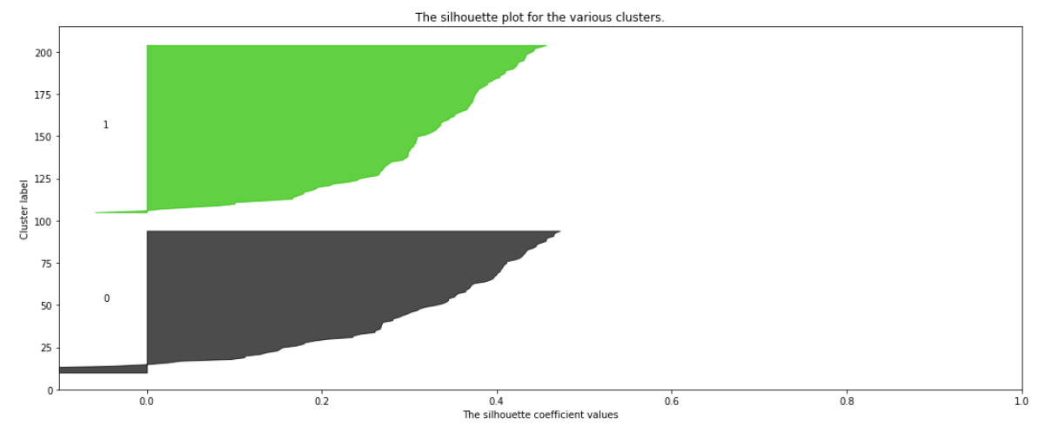
Silhouette plot
Overall, the structure is pretty weak and should be an artificial dataset.
Cluster 1 has more objectives.
Cluster 1 has lower amount of cohesion and separation on average.
Cluster 0 contains more objects closer to other clusters (cluster 1) - We can use fuzzy c-means to cluster the real structure of it.

Slide 14
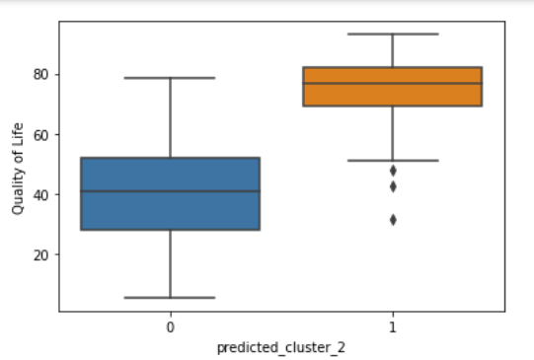
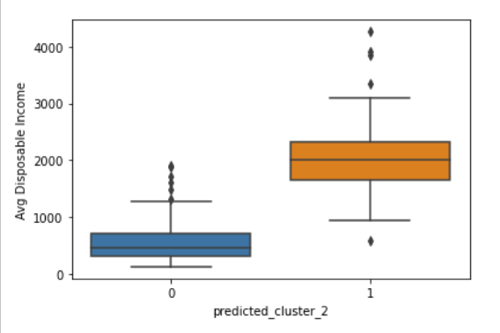
Describing Each of the Clusters
(a part of boxplots results)
cluster 0 do better on {Avg Rent}
cluster 1 do better on {Cappuccino, Cinema, Avg Disposable income, Movehub Rating, Purchase Power, Health Care, Pollution, Quality of Life, Crime Rating}
cluster 1 and 0 are samilar at {Wine, Gasoline}

Slide 15
Silhouette plot
Algorithm 2:
K-means and Fuzzy c-means
Insights beyond Algorithm 1
Insights beyond Algorithm 1

Slide 16
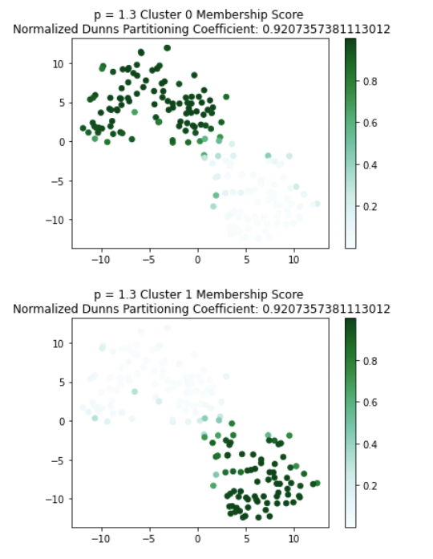
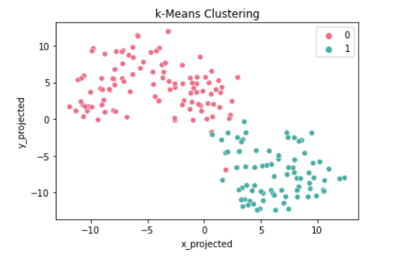
Clustering Result
The average silhouette score is : 0.32
Bigger the average silhouette score of algorithm1 (0.30)

Slide 17
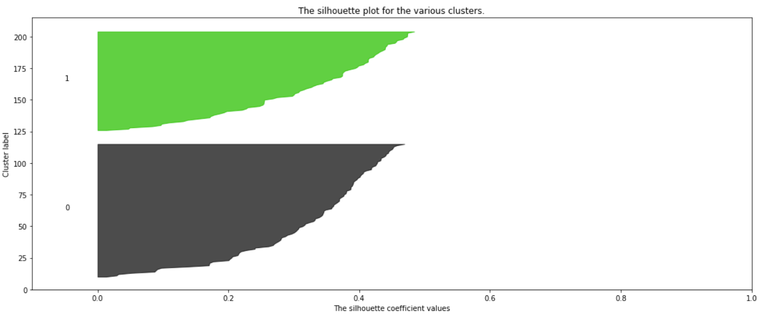
Silhouette plot
Overall, the structure is pretty weak and should be an artificial dataset.
Cluster 0 has more objectives.
Cluster 0 has lower amount of cohesion and separation on average.
Cluster 0 contains more objects closer to other clusters (cluster 1)

Slide 18
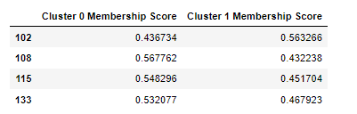
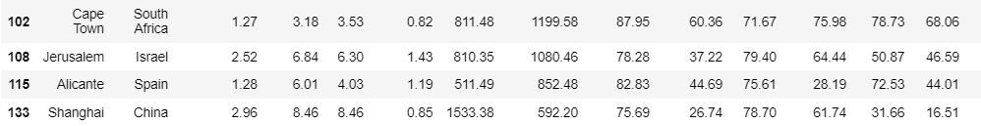
Insights beyond Algorithm 1
The final boxplot is very similar with the result in algorithm1.
Therefore, I will only talk about the newly acquired information
Fuzzy c-means can detect obscure data points.

Slide 19
Summary & Suggestions
It can be seen that cities in Cluster 0 do better on Avg Rent, but are bad at Cappuccino, Cinema, Avg Disposable income, Movehub Rating, Purchase Power, Health Care, Pollution, Quality of Life, Crime Rating. In addition, the two clusters all have similar performance in Wine and Gasoline.
k-means is a better algorithm because it has a higher silhouette score, and also has lower space complexity.
→ In future research, we can drop the two unimportant variables {Wine and Gasoline}, to simplify the model.
→ k-means is very sensitive to outliers, we can consider removing extreme values and get better results.

Slide 20
Solution to the question in Motivation
Finally, back to the "factory locations choosing question" that I mentioned in the motivation. After the analysis, I can conclude that Nike and other labor-intensive companies should choose cities in Cluster 0, while knowledge-intensive companies like Tesla and Apple should choose cities in Cluster 1. Relevant decision-makers can view the HAC diagram for more detailed information.

Slide 21
Reference:
Doel, Marcus; Hubbard, Phil (2002). Taking world cities literally: Marketing the city in a global space of flows. City, 6(3), 351–368. doi:10.1080/1360481022000037779
Von Luxburg, U., Williamson, R. C., & Guyon, I. (2012, June). Clustering: Science or art?. In Proceedings of ICML workshop on unsupervised and transfer learning (pp. 65-79). JMLR Workshop and Conference Proceedings.
Ruth, M., & Franklin, R. S. (2014). Livability for all? Conceptual limits and practical implications. Applied Geography, 49, 18-23.
Berlin. (2022). In Wikipedia. https://en.wikipedia.org/w/index.php?title=Berlin&oldid=1087219787
Bình Dương. (2022). In Wikipedia tiếng Việt. https://vi.wikipedia.org/w/index.php?title=B%C3%ACnh_D%C6%B0%C6%A1ng&oldid=68588155
Guangxi. (2022). In Wikipedia. https://zh.wikipedia.org/w/index.php?title=%E5%B9%BF%E8%A5%BF%E5%A3%AE%E6%97%8F%E8%87%AA%E6%B2%BB%E5%8C%BA&oldid=71324221
Texas. (2022). In Wikipedia. https://en.wikipedia.org/w/index.php?title=Texas&oldid=1086916911

