Slide 1
Introduction to Computer Vision
Michal Irani, Meirav Galun, Ronen Basri, Shai Bagon
Teaching Assistants
Yuval Golbari, Daniel Benaroya, Eliya Olkhovsky

Slide 2
A few announcements
Course website – on Moodle
(schedule, lesson slides, exercises, announcements, recordings, etc.)
Vision&AI Seminar: (not for credit, but highly recommended)
    Thursdays at 12:15-13:15
    To be added to mailing list – visit SEMINAR-SIGNUP page:
    https://www.weizmann.ac.il/math/seminar-subscribe
    1st meeting this year – on Thursday Oct 22 (this week).

Slide 3
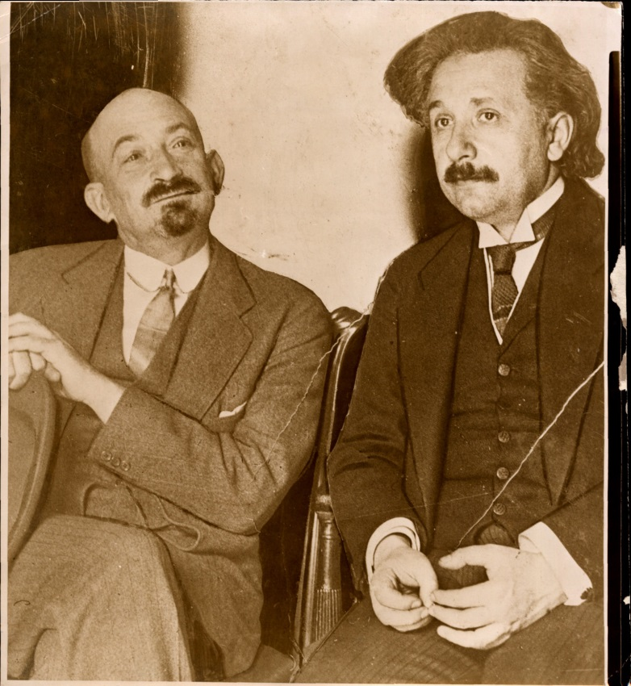
Digital Image
Pixels:
0 = Black
255 = White
137 74 52 16 128 217 207 221 220 179 188 193 195 189 188 193
73 64 23 68 228 243 225 120 94 138 140 116 210 173 162 142
29 59 43 246 246 151 99 74 185 188 214 205 127 138 203 186
65 19 187 244 170 37 153 255 233 245 255 236 252 182 123 197
30 72 255 118 20 232 235 218 184 50 41 9 55 147 207 110
19 139 108 42 244 253 130 75 5 207 40 73 31 81 11 181
42 147 69 235 187 81 222 236 59 62 4 55 0 141 81 9
33 111 231 139 67 217 255 240 20 119 155 158 39 91 84 15
76 251 160 71 195 255 241 255 255 55 54 80 176 188 245 231
255 155 103 237 224 240 255 253 250 255 248 243 247 227 194 137
237 239 255 222 220 219 205 191 203 206 180 168 147 140 96 85

Slide 4

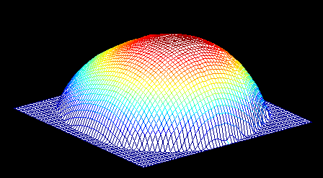
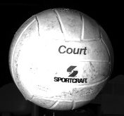
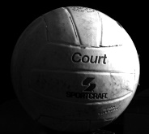
Topics covered in the course
Fourier Transform & Applications - Michal (2 lessons)
Geometry, Stereo, 3D Structure - Meirav (4 lessons)
Motion & Video analysis – Michal (2 lessons)
Lighting - Ronen (2 lessons)
Patch-based methods – Shai (1 lesson)
Boundaries & Segmentation – Shai (1 lesson)
2 programming exercises (Python) -- SUBMIT IN PAIRS
2 theoretical exercises -- SUBMIT INDIVIDUALLY
EXAM
Photometric Stereo
2-point Practical Deep-Learning course (online with hands-on exercises) ➔ given in parallel by Meirav Galun, Tali Dekel, Shai Bagon.
Both courses (“Intro-to-Computer-Vision” & “DL course”)
are prerequisites for taking the “ADLV course” (Semester2)

Slide 5
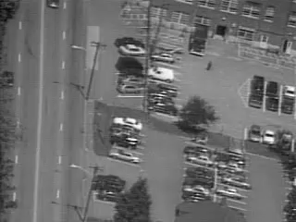
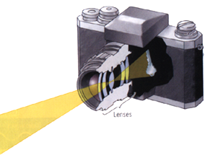
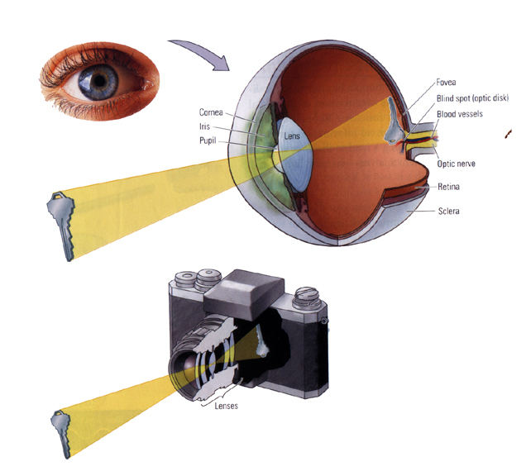
Structure from Motion
Stereo

Slide 6
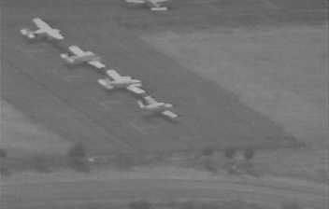
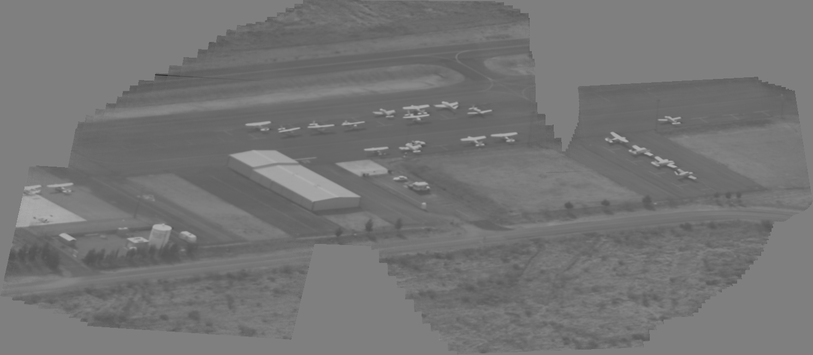
Panoramic Mosaic Image
Original video clip
Generated Mosaic image

Slide 7
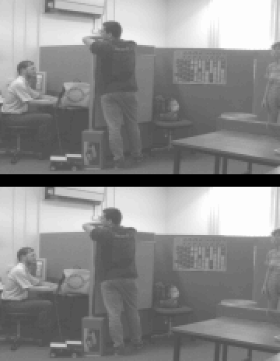
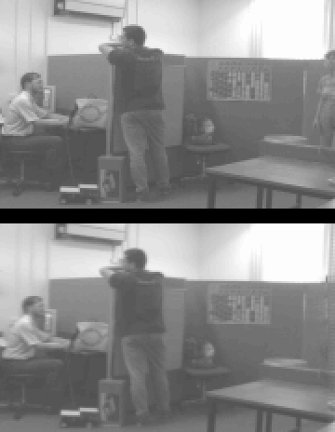
Video Removal
Original
Original
Outliers
Synthesized

Slide 8


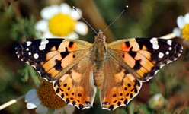

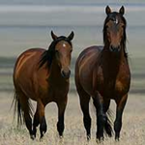
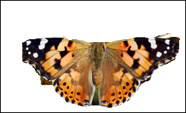


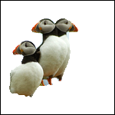
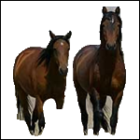
Segmentation and Boundaries

Slide 9
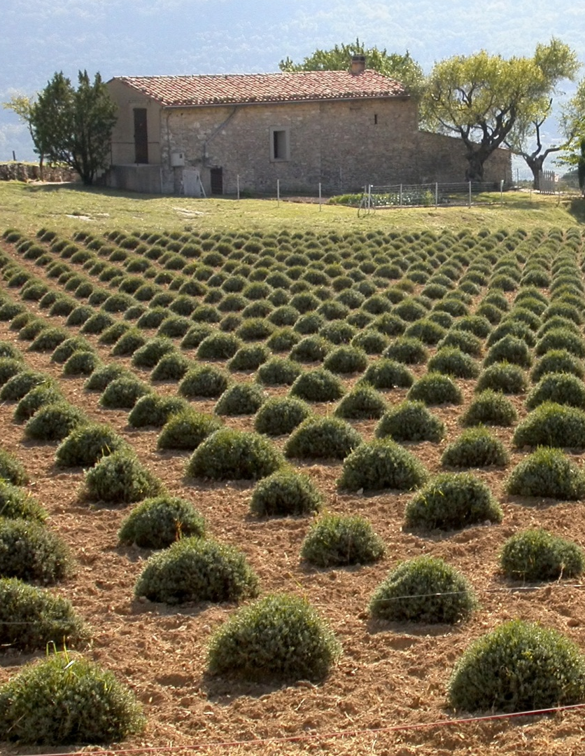

Input
Output
Learning ➔ Usually requires LOTS of training data
Exploit internal data redundancy
(inside a single image or video)
➔ Complex visual inference
No prior examples!
y
True for most 5x5 patches in any natural image
time
x
Video
  Image/video completion
  Image denoising
  Visual summaries
  Super-Resolution (in space & time)
  Image deblurring
  Image dehazing,
  Image compression …
INTERNAL LEARNING
Notes:
9

Slide 10

The Fourier Transform
Jean Baptiste Joseph Fourier
Notes:
qqqqqqqqq

Slide 11
A sum of sines and cosines
=
A
sin(x)
A
3 sin(x)
+ 1 sin(3x)
B
A+B
+ 0.8 sin(5x)
C
A+B+C
+ 0.4 sin(7x)
D
A+B+C+D
…

Slide 12
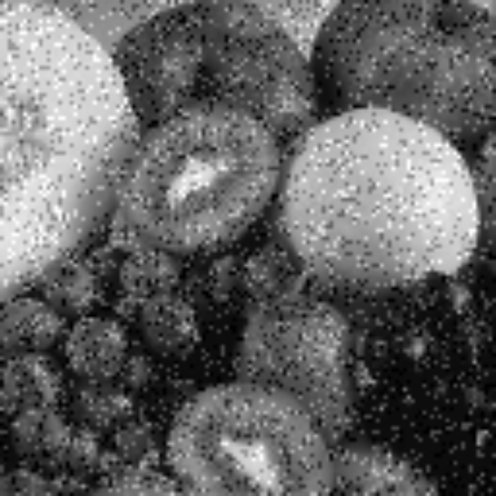
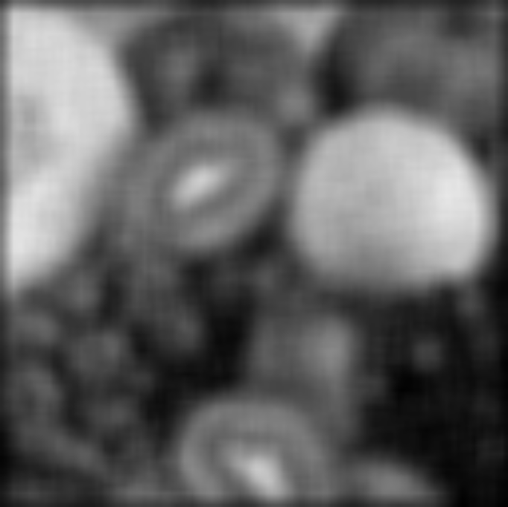
Higher frequencies due
to sharp image variations
(e.g., edges, noise, etc.)

Slide 13
Formulating the Fourier Transform
So how prominent is a frequency u in a function/image f ?
We will formulate it for:
The Continuous & Discrete functions f .
1D and 2D case.

Slide 14
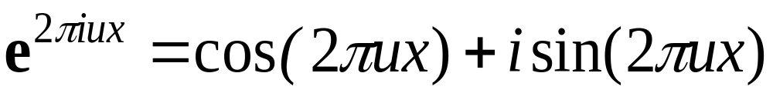
The Continuous Fourier Transform
Basis functions:

Slide 15
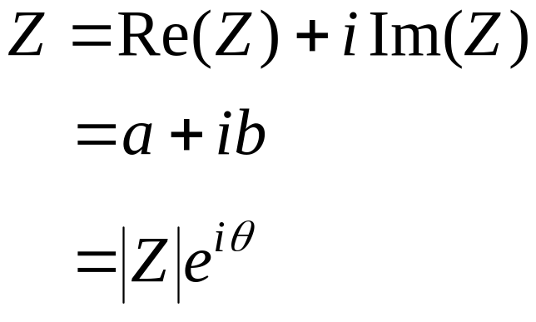
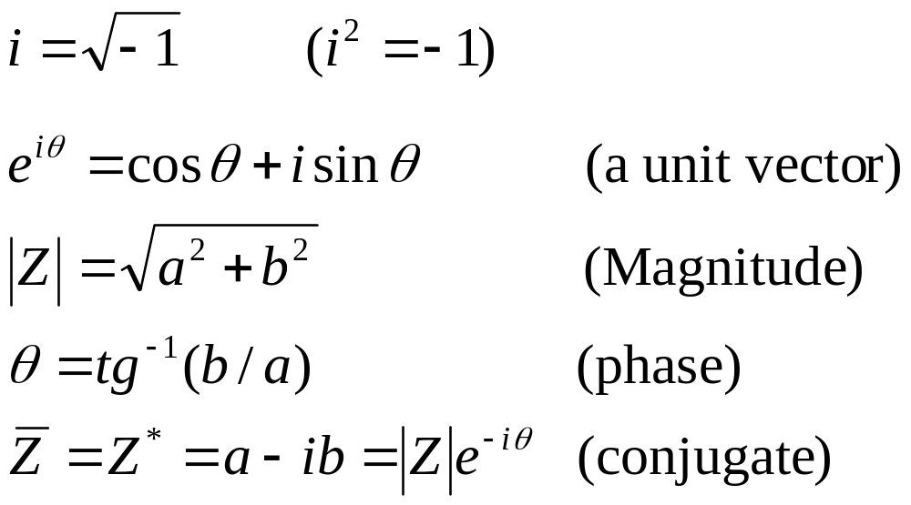

Complex Numbers
Imaginary
Z=(a,b)
b
|Z|
θ
-b
θ-
a
Real
$\overline{Z}$=(a,-b)
|Z|

Slide 16
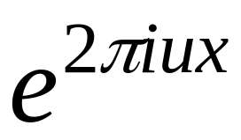
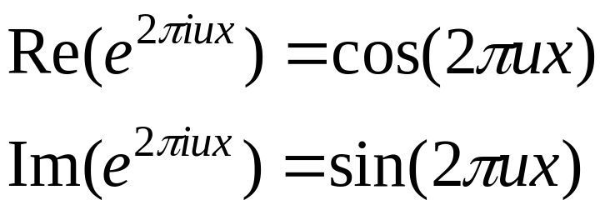

The 1D Basis Functions
1
x
1/u
The wavelength is 1/u .
The frequency is u .

Slide 17
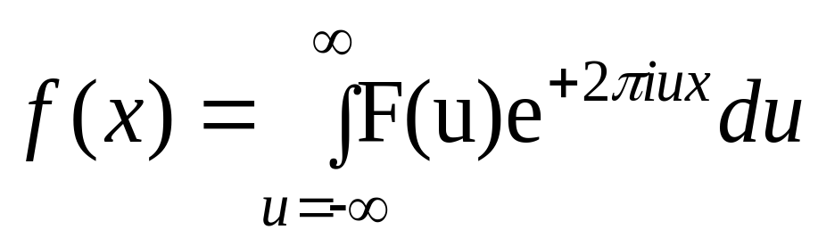
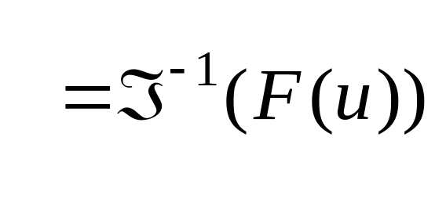
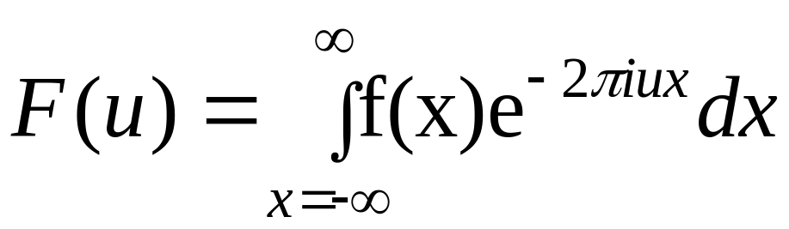
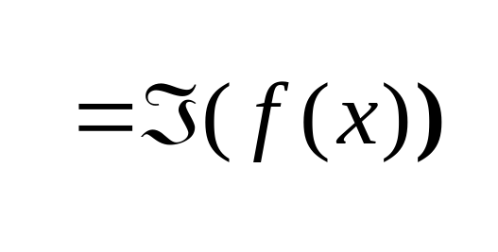
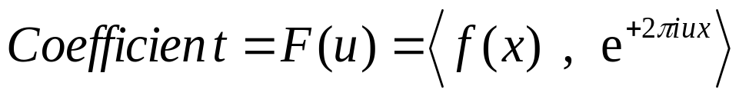
The Continuous Fourier Transform
1D Continuous Fourier Transform:
The Inverse
Fourier
Transform
Basis functions:
The Fourier
Transform
An orthonormal basis ➔
Coefficient

Slide 18
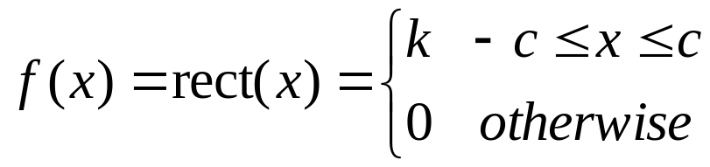



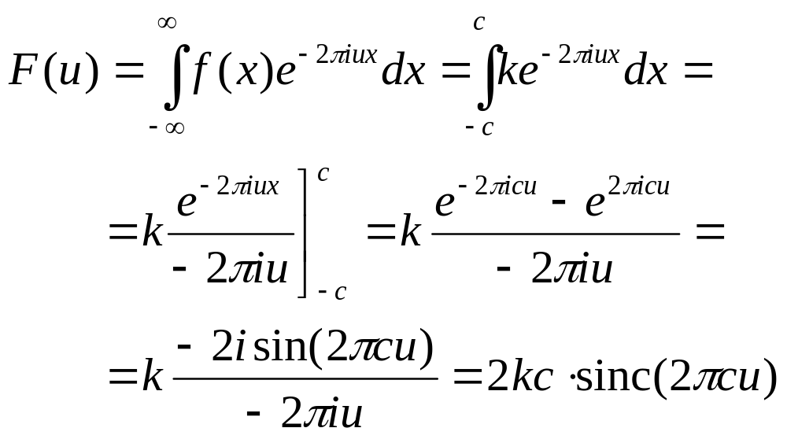

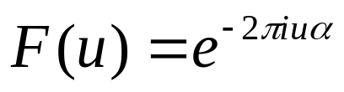
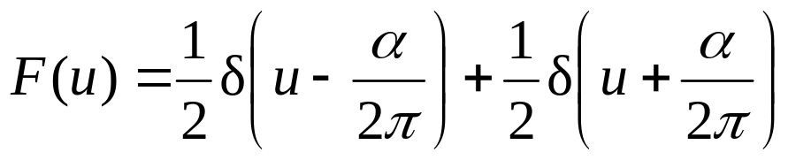

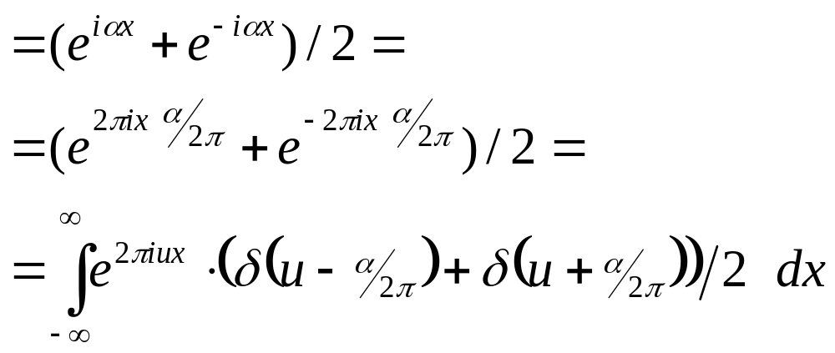
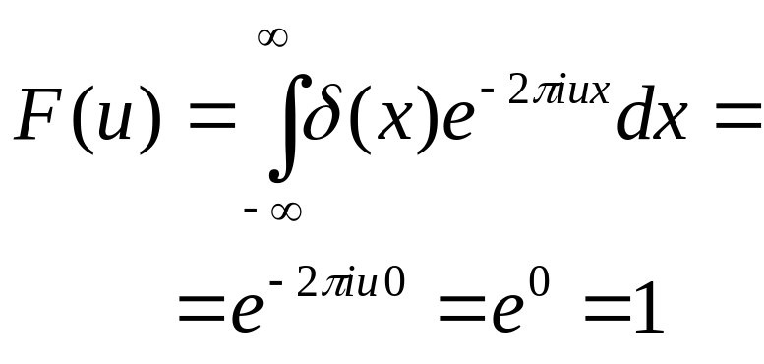

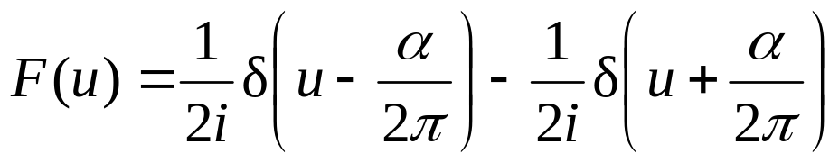
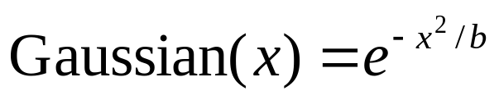
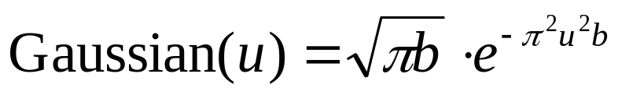
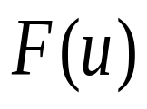
Some Fourier Transforms
Function
Fourier Transform

Slide 19
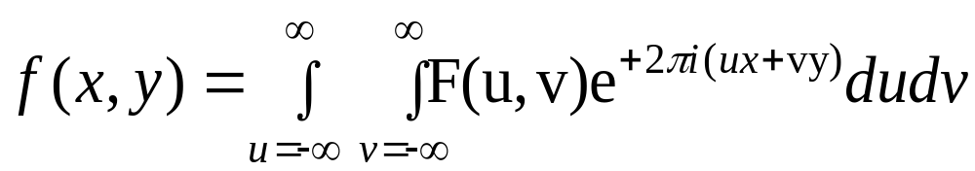
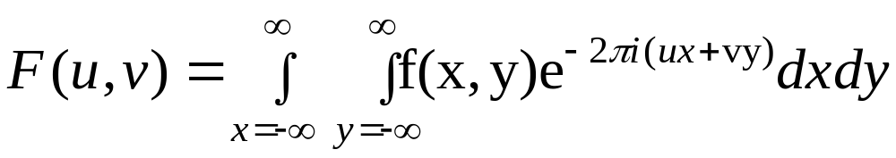
The Continuous Fourier Transform
1D Continuous Fourier Transform:
The Inverse
Fourier
Transform
The Fourier
Transform
2D Continuous Fourier Transform:
The Inverse Transform
The Transform

Slide 20
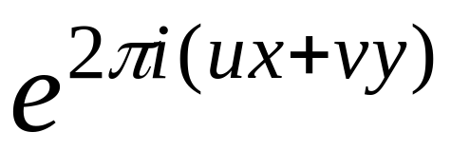
























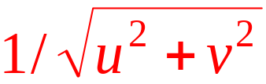
The 2D Basis Functions
V
u=-2, v=2
u=-1, v=2
u=0, v=2
u=1, v=2
u=2, v=2
u=-2, v=1
u=-1, v=1
u=0, v=1
u=1, v=1
u=2, v=1
U
u=-2, v=0
u=-1, v=0
u=0, v=0
u=1, v=0
u=2, v=0
u=-2, v=-1
u=-1, v=-1
u=0, v=-1
u=1, v=-1
u=2, v=-1
u=-2, v=-2
u=-1, v=-2
u=0, v=-2
u=1, v=-2
u=2, v=-2
The wavelength is . The direction is u/v .

Slide 21
Discrete Functions
f(x)
f(n) = f(x₀ + nΔx)
f(x₀+2Δx)
f(x₀+3Δx)
f(x₀+Δx)
f(x₀)
x₀
x₀+Δx
x₀+2Δx
x₀+3Δx
0 1 2 3 ... N-1
The discrete 1D function f:
{ f(0), f(1), f(2), … , f(N-1) }

Slide 22
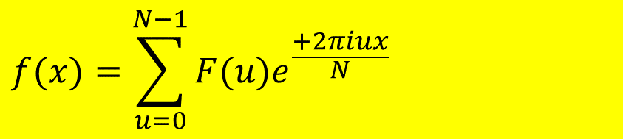
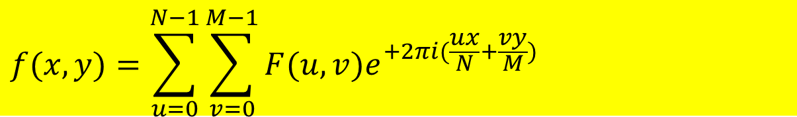
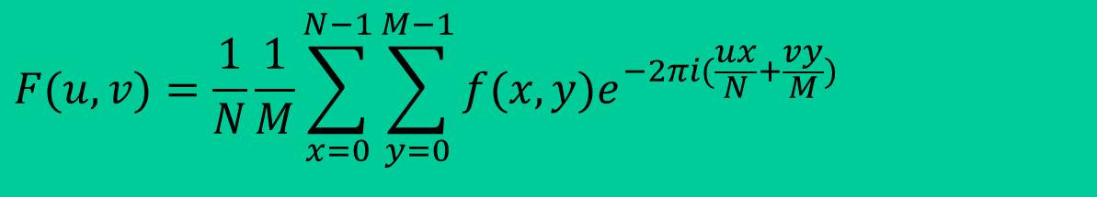
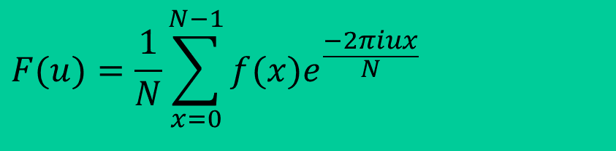
The Finite Discrete Fourier Transform
1D Finite Discrete Fourier Transform:
$$F(u)=\frac{1}{N}\sum_{x=0}^{N−1}{f(x)e^{\frac{−2πiux}{N}}}$$
(u = 0,..., N-1)
$$f(x)=\sum_{u=0}^{N−1}{F(u)e^{\frac{+2πiux}{N}}}$$
(x = 0,..., N-1)
2D Finite Discrete Fourier Transform:
$$F(u,v)=\frac{1}{N}\frac{1}{M}\sum_{x=0}^{N−1}{\sum_{y=0}^{M−1}{f(x,y)e^{−2πi(\frac{ux}{N}+\frac{vy}{M})}}}$$
(u = 0,..., N-1; v = 0,…,M-1)
$$f(x,y)=\sum_{u=0}^{N−1}{\sum_{v=0}^{M−1}{F(u,v)e^{+2πi(\frac{ux}{N}+\frac{vy}{M})}}}$$
(x = 0,..., N-1; y = 0,…,M-1)

Slide 23
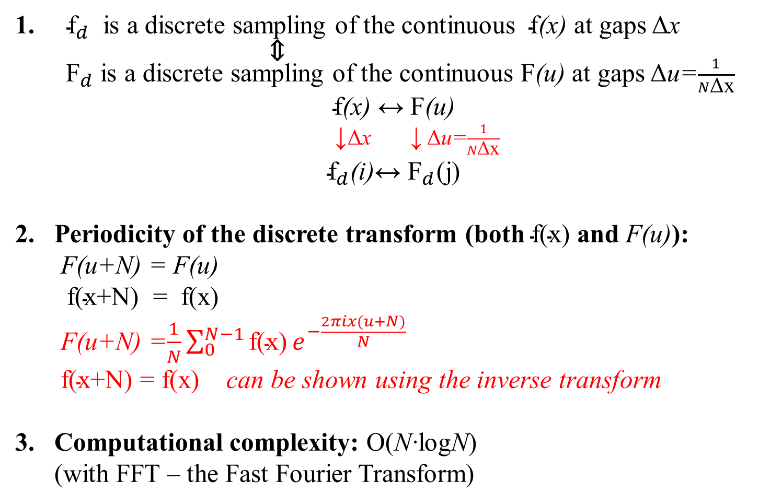
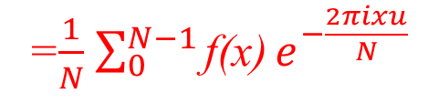

About the Discrete Transform
${\text{f}}_{d}$ is a discrete sampling of the continuous $\text{f}$(x) at gaps Δx
⇕
${ \text{F}}_{d}$ is a discrete sampling of the continuous $\text{F}$(u) at gaps Δu=$\frac{1}{N\text{Δ}\text{x}}$
$\text{f}$(x) ↔ $\text{F}$(u)
↓Δx ↓ Δu=$\frac{1}{N\text{Δ}\text{x}}$
${\text{f}}_{d}$(i)↔ ${\text{F}}_{d}\text{(}\text{j}\text{)}$
Periodicity of the discrete transform (both $\text{f(x)}$ and F(u)):
F(u+N) = F(u)
$\text{f(x+N) = f(x)}$
F(u+N) =$\frac{1}{N}\sum_{0}^{N−1}{\text{f(x)}}e^{−\frac{2πix(u+N)}{N}}$
$\text{f(x}\text{+N}\text{)}\text{ = }\text{f(x)}$ can be shown using the inverse transform
Computational complexity: O(N·logN)
(with FFT – the Fast Fourier Transform)
=$\frac{1}{N}$ $\sum_{0}^{N−1}{\text{f(x)}}e^{−\frac{2πixu}{N}}$
= F(u)
$$e^{−2πix}$$
= 1

Slide 24
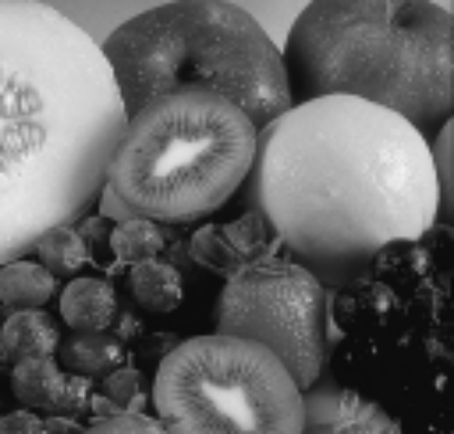


The Fourier Image
Image f
Fourier spectrum (magnitude)
log(1 + |F(u,v)|)
|F(u,v)|

Slide 25



Frequency Bands
Image
Fourier Spectrum
Percentage of image power enclosed in circles (small to large) :
90%, 95%, 98%, 99%, 99.5%, 99.9%
Low-Pass Filtering:

Slide 26

Low pass Filtering
90%
95%
98%
99%
99.5%
99.9%

Slide 27


Slide 28


Slide 29




Noise Removal
Noisy image
Inverse Fourier
$${(FFT}^{−1})$$
Fourier Spectrum (magnitude)
Noise-cleaned image

Slide 30





High Pass Filtering
Original
High Pass Filtered
$$FFT$$
Inverse Fourier
$${FFT}^{−1}$$
High-Pass Filtering:

Slide 31
High Frequency Emphasis
+
Original
High Pass Filtered

Slide 32

High Frequency Emphasis
Original
High Frequency Emphasis

Slide 33


Slide 34


High Frequency Emphasis
Original
High Frequency Emphasis

Slide 35


High Frequency Emphasis
Original
High Frequency Emphasis

Slide 36

Importance of Phase vs. Magnitude
Curious fact:
  All natural images have approximately the same Fourier magnitude;
  but images look very different from one another…
  How come….?
  ➔ phase seems to matter more than magnitude.
Demonstration:
  Take two pictures → FFT → swap their phase transforms → ${\text{FFT}}^{−1}$
  ➔ what does the result look like…?

Slide 37

Slide: Freeman & Durand

Slide 38

This is the magnitude transform of the cheetah pic
Slide: Freeman & Durand

Slide 39

This is the phase transform of the cheetah pic
Slide: Freeman & Durand

Slide 40

Slide: Freeman & Durand

Slide 41

This is the magnitude transform of the zebra pic
Slide: Freeman & Durand

Slide 42

This is the phase transform of the zebra pic
Slide: Freeman & Durand

Slide 43

Reconstruction with zebra phase, cheetah magnitude
Slide: Freeman & Durand

Slide 44

Reconstruction with cheetah phase, zebra magnitude
Slide: Freeman & Durand

Slide 45





Fourier Properties
Separability of the 2D transform:
2D Transform = successive applications of 1D transforms
Linearity: f+g $↔$ F+G
af $↔$ aF
Image average: F(0,0) = avg( f(x,y) )
Shift ⬄ phase-change: g(x)=f(x+a) $↔$ G(u)=F(u)$e^{2πiua}$
G(u)=F(u)$e^{2πiua/N}$
* Same magnitude; only phase shift.
* Can be used to recover shift (a,b) between two images f(x,y) & g(x,y):
G(u,v)/F(u,v)=$e^{2πi(\frac{ua}{N}+\frac{vb}{M})}$
$$\text{(continuous)}$$
$$\text{(}\text{discrete}\text{)}$$
$\left|\text{G(}\text{u}\text{)}\right|$= $\left|\text{F(}\text{u}\text{)}\right|$
$${FFT}^{−1}$$
δ(x+a,y+b)

Slide 46

Fourier Properties
Scaling/Shrinking: f(ax) $↔$ $\frac{1}{\left|\text{a}\right|}$ F$\left(\frac{\text{u}}{\text{a}}\right)$
Derivative: g(x)=$\frac{d}{dx}$ f(x) $↔$ G(u)= $2πi$u F(u)
* G(0)=0.
* Taking the derivative increases high frequencies (noise, edges)
* Behaves like a high-pass filter (HPF).
Rotation: rotation of f(x,y) by θ $↔$ rotation of F(u,v) by θ
(can be shown using polar coordinates)
Principle of Uncertainty: No meaning to “a frequency at a point” !
    every value f(x) contributes to all frequencies F(u)
    every frequency F(u) contributes to all values f(x)

Slide 47

Fast Fourier Transform - FFT
O(N²) operations,
if performed as is
u = 0, 1, 2, ..., N-1
FFT:
even x
odd x
Fourier Transform of
of N/2 even points
Fourier Transform of
of N/2 odd points
The Fourier transform of N inputs, can be performed as 2 Fourier Transforms of N/2 inputs each + one complex multiplication and addition for each value.
Thus, if F(N) is the computation complexity of FFT:
F(N)=F(N/2)+F(N/2)+O(N) ⇒ F(N)=N logN

Slide 48
F(0) F(1) F(2) F(3) F(4) F(5) F(6) F(7)
F(0) F(2) F(4) F(6)
F(1) F(3) F(5) F(7)
F(0) F(4)
F(2) F(6)
F(1) F(5)
F(3) F(7)
F(0) F(1) F(2) F(3) F(4) F(5) F(6) F(7)
2-point
transform
4-point
transform
FFT
FFT :
O(N log(N)) operations
FFT of NxN Image: O(N² log(N)) operations

