Slide 1
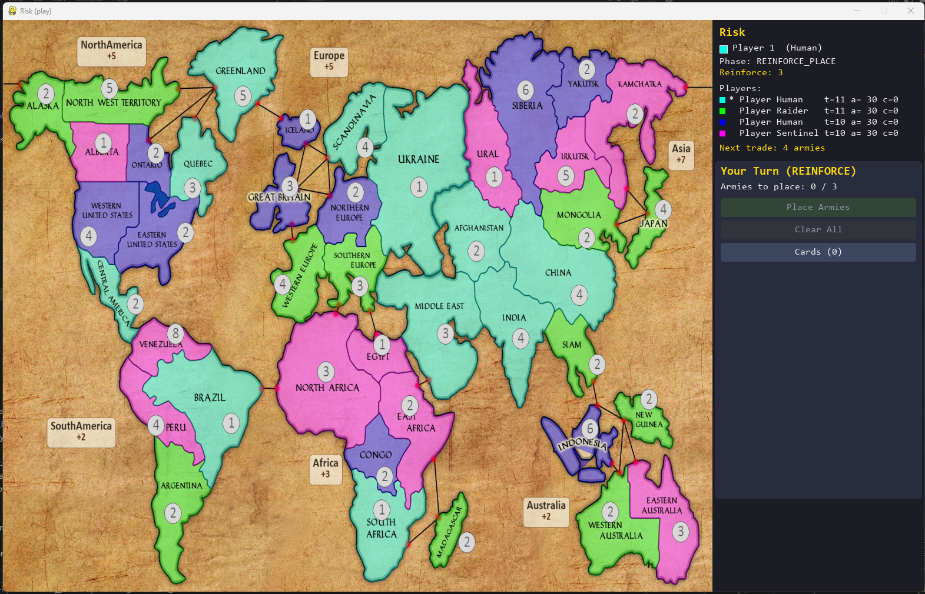

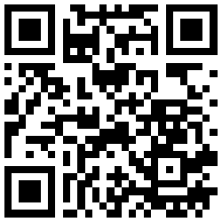

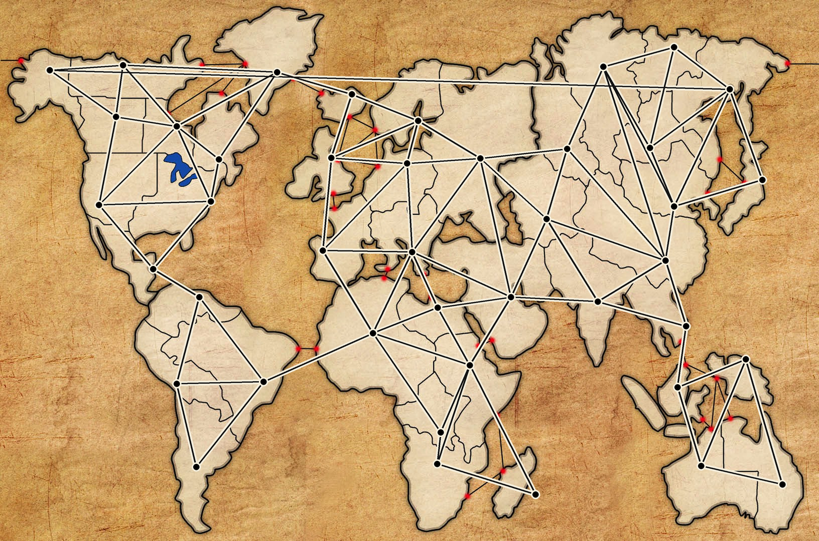
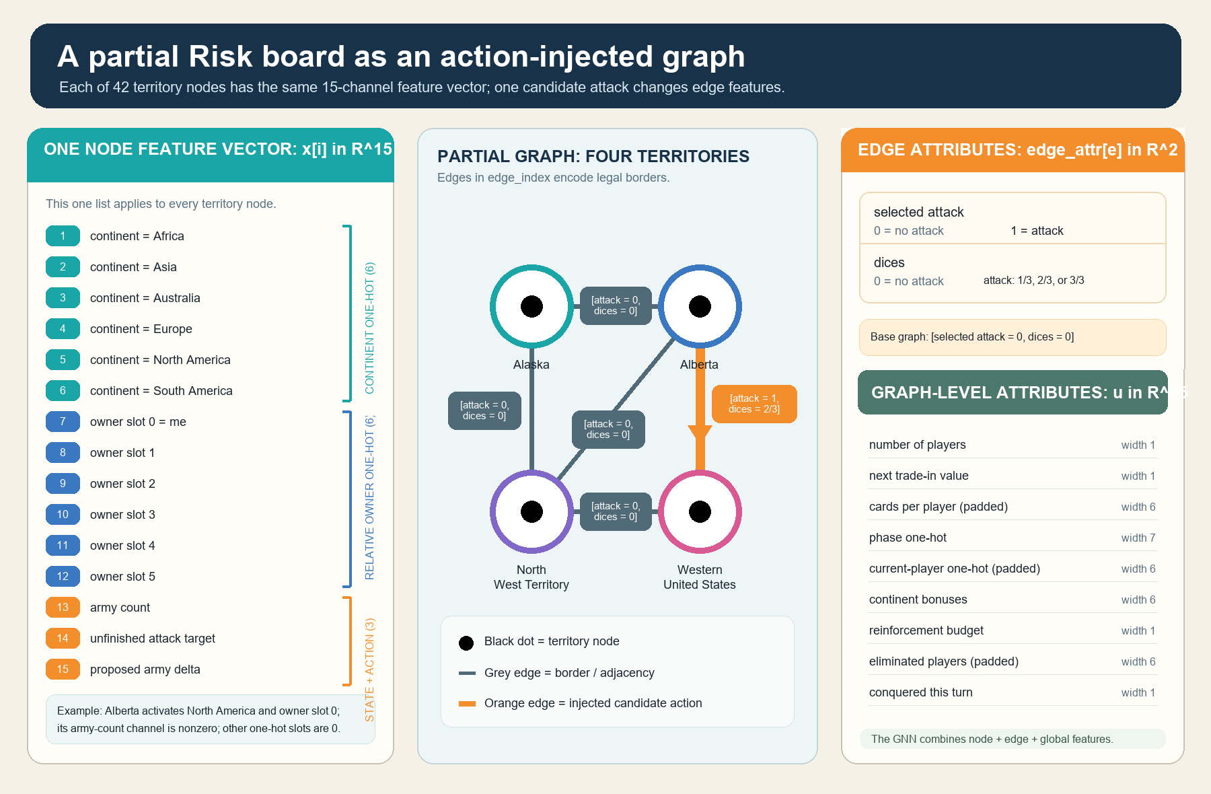
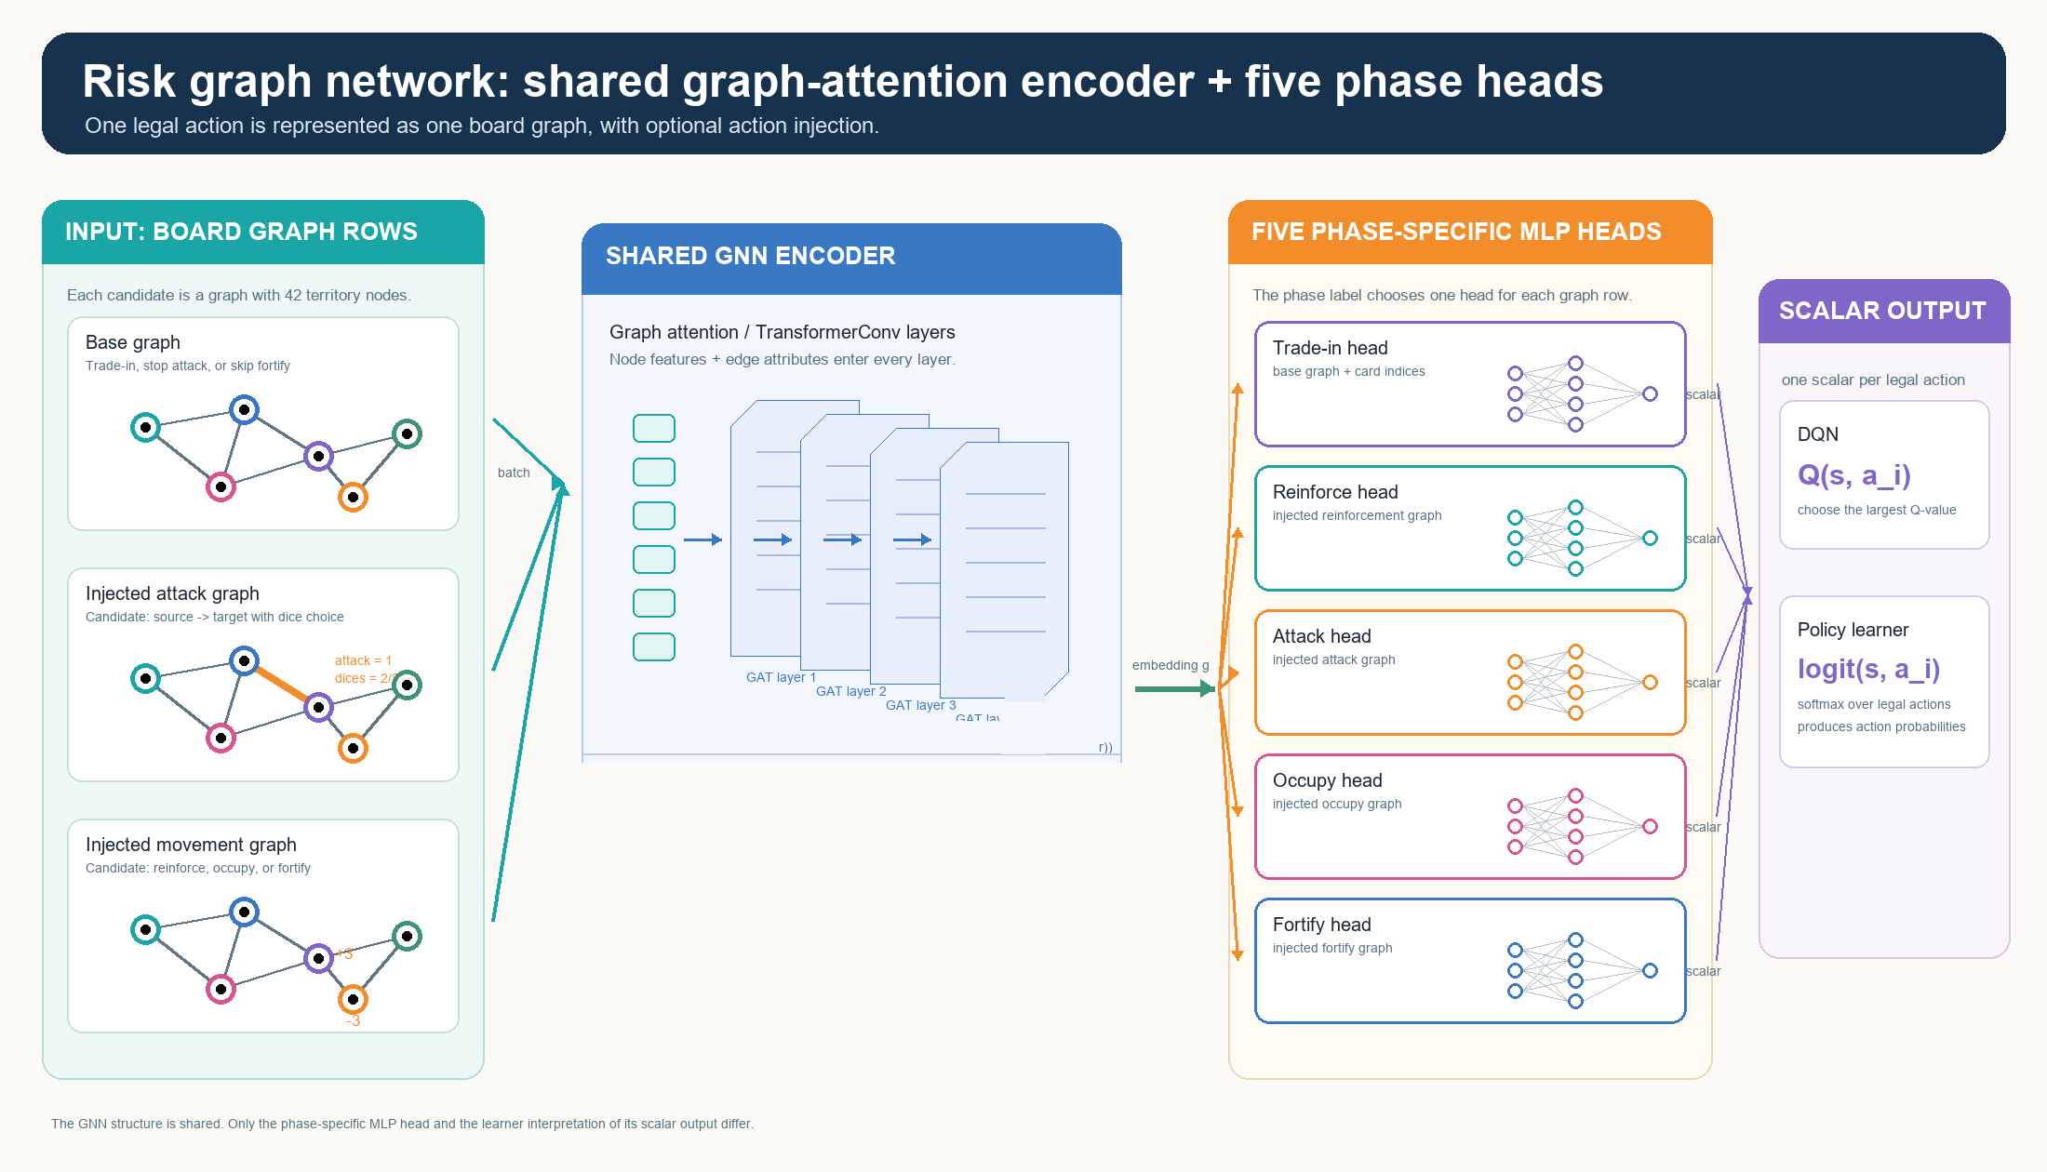
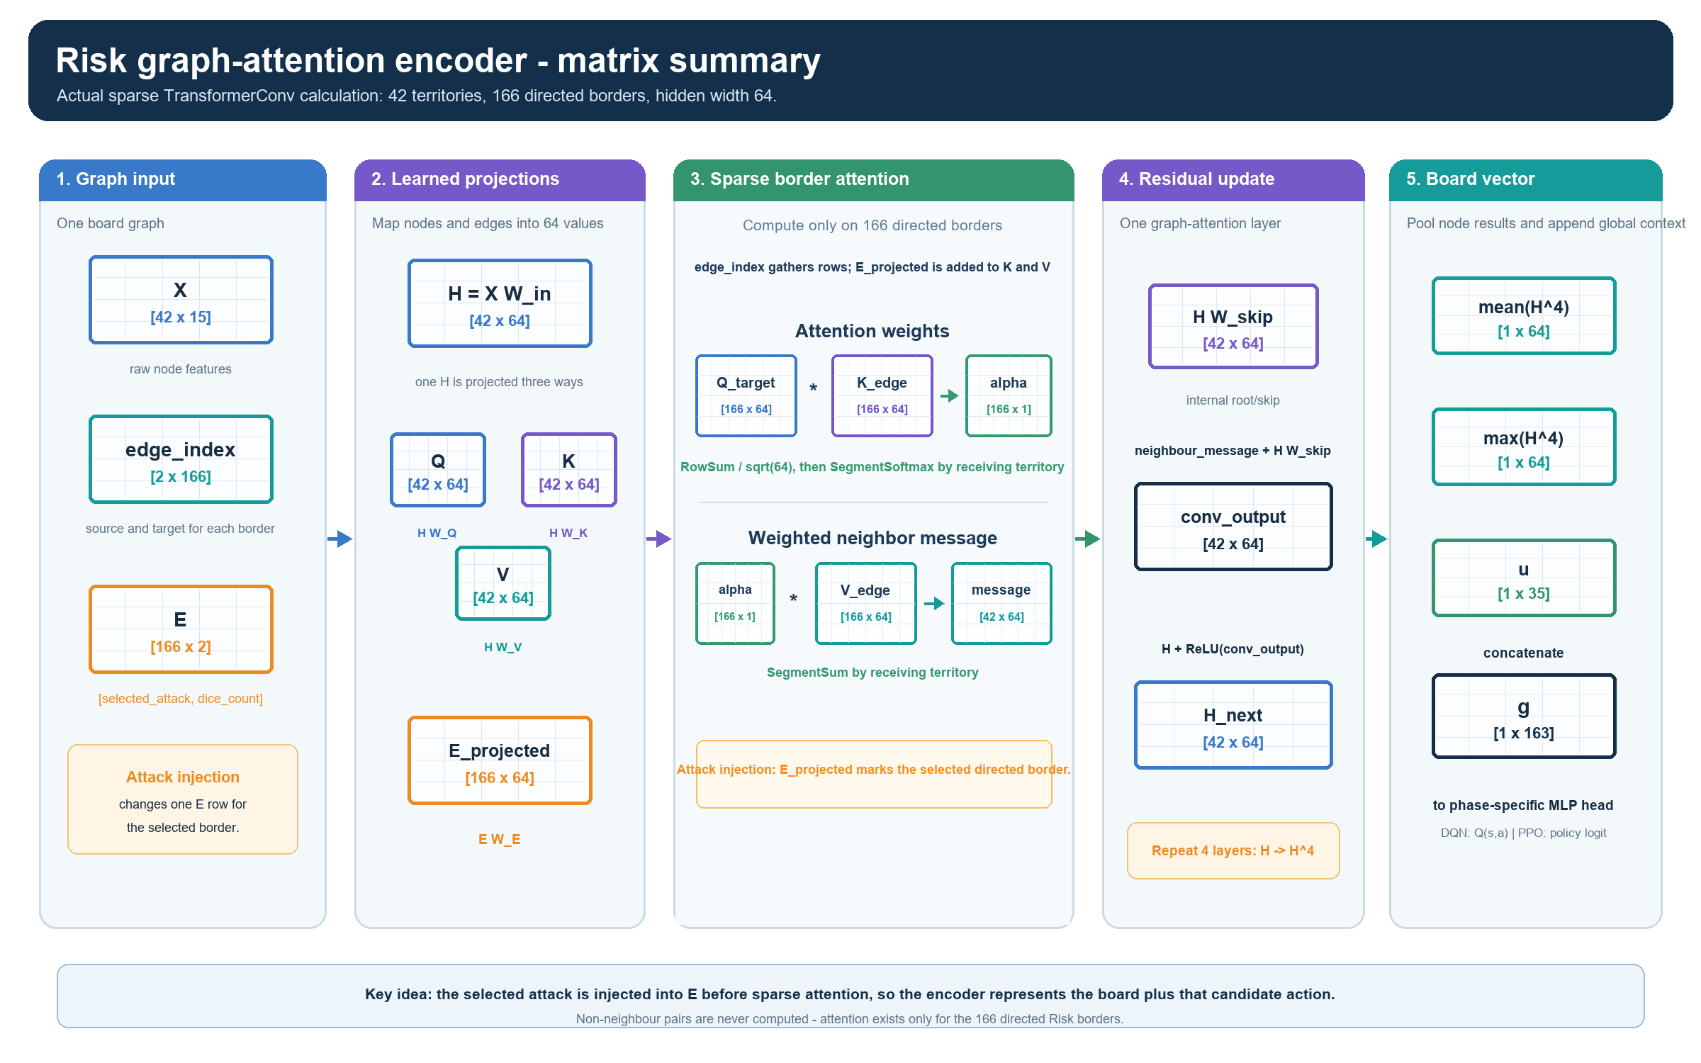
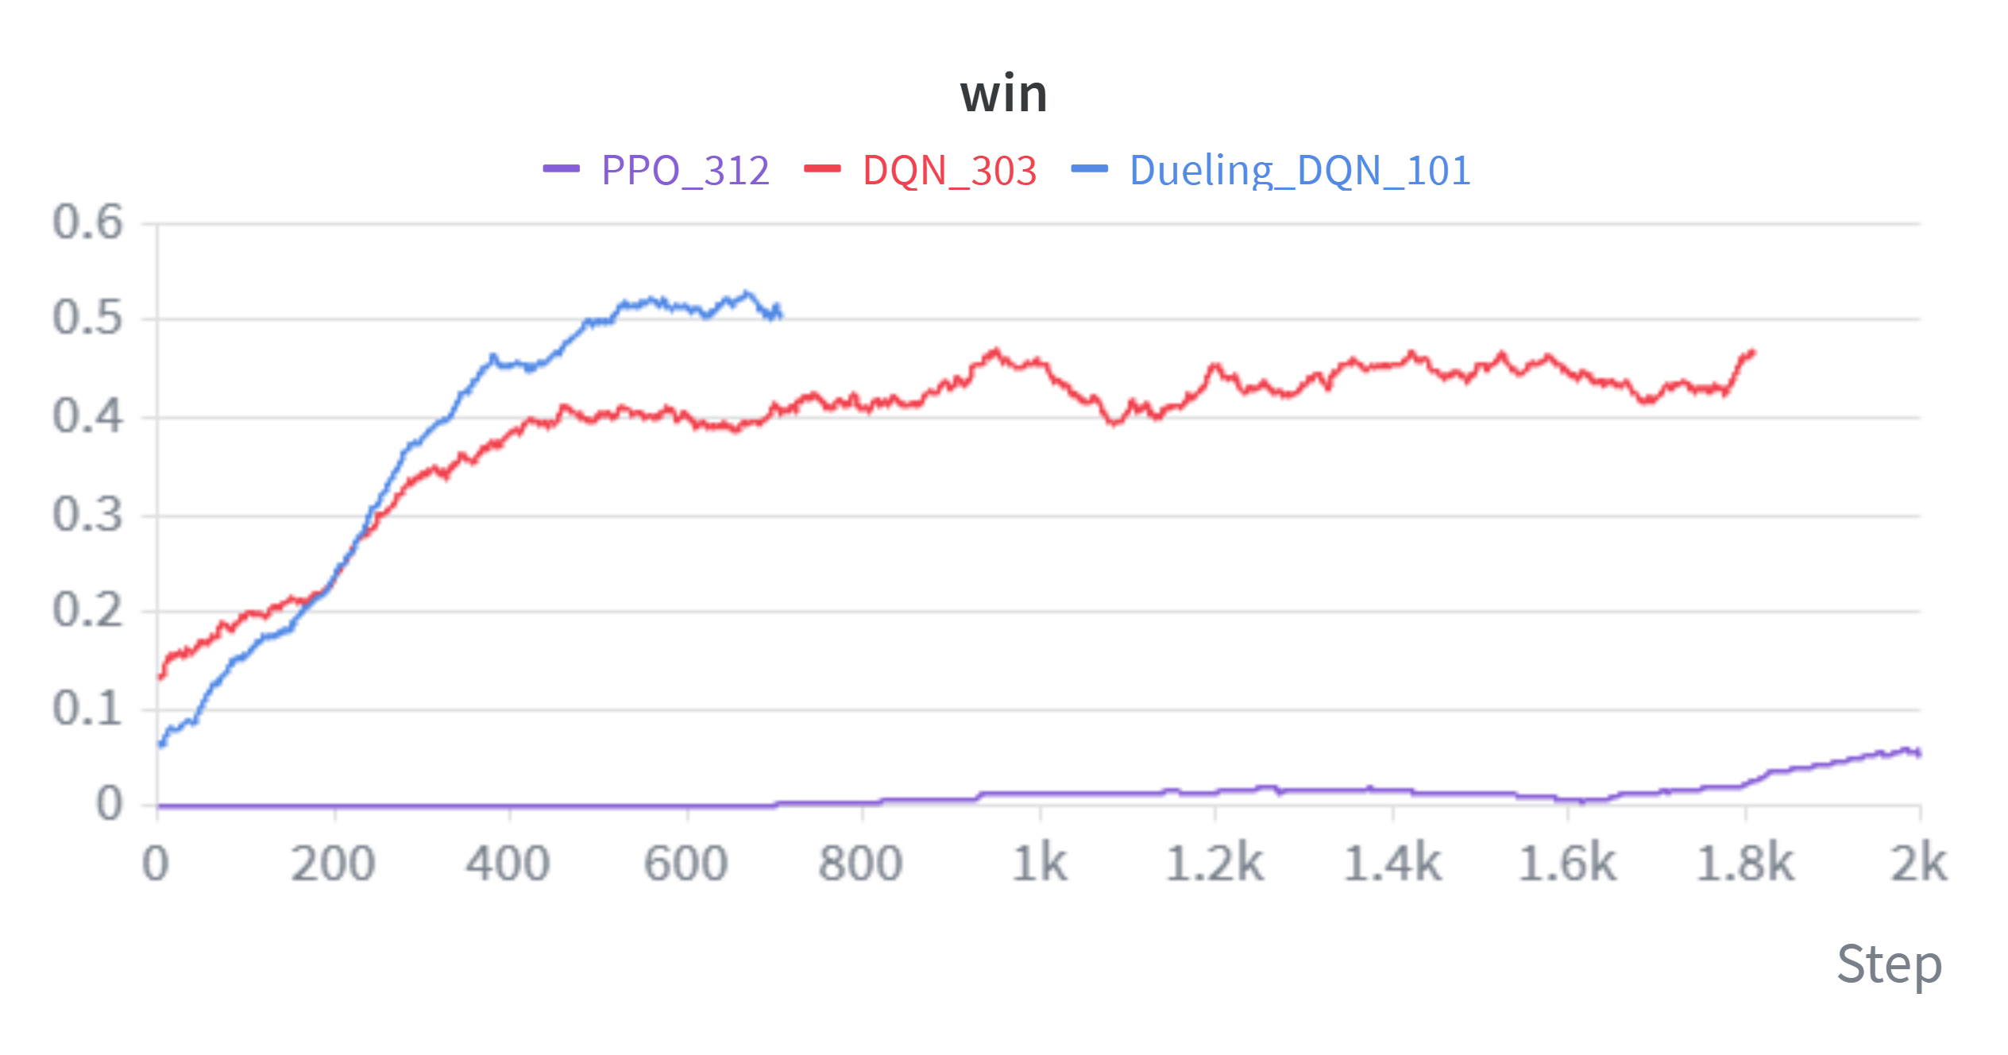
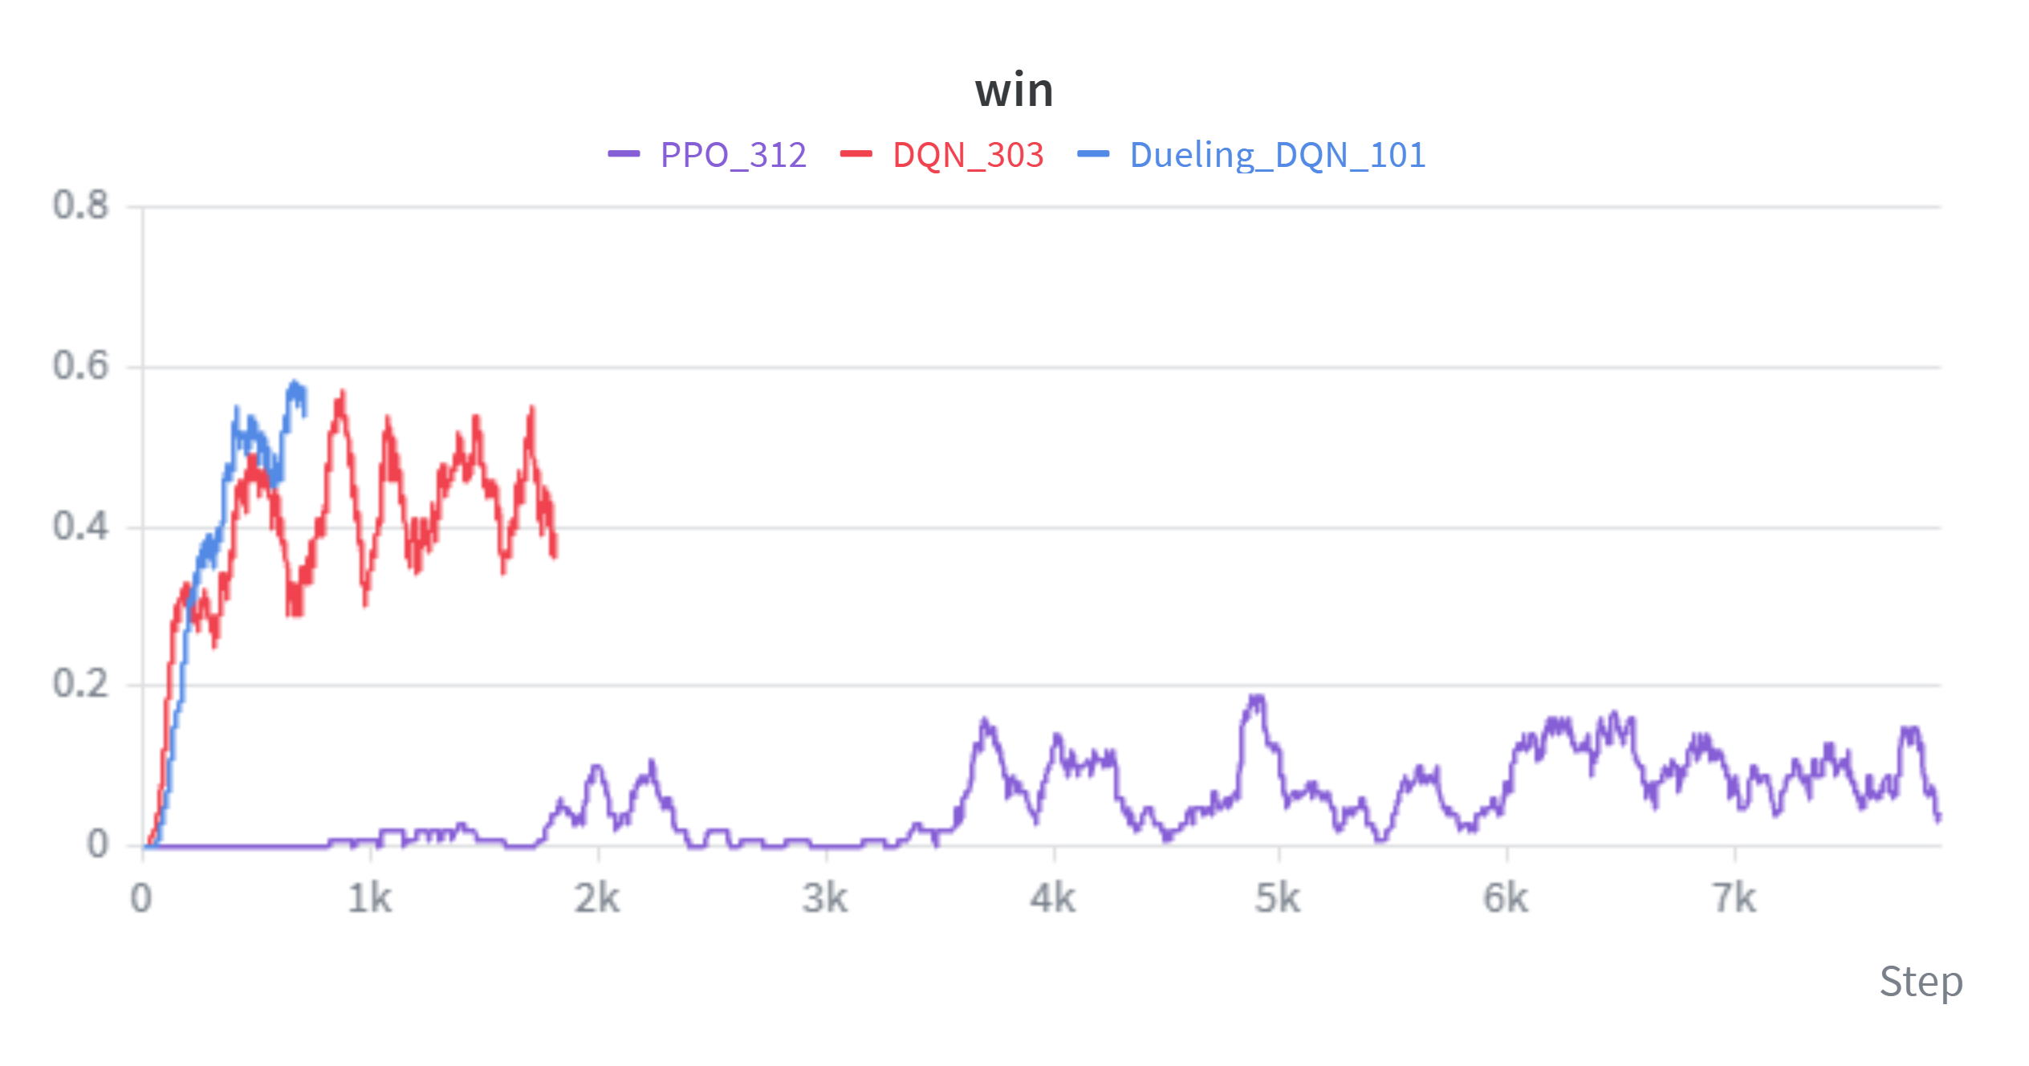
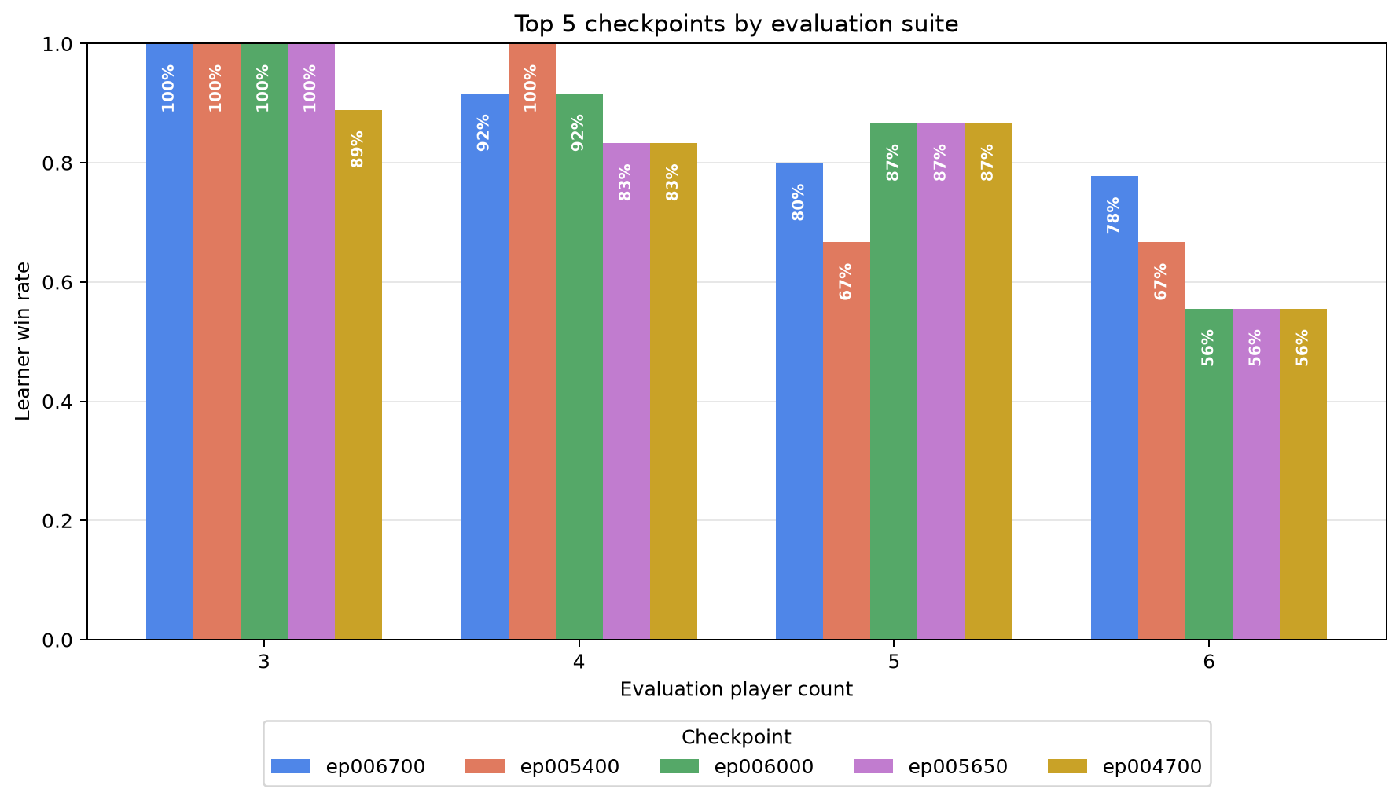
Learning to Play Risk with
Action-Injected Graph Neural Networks
A graph-attention reinforcement-learning approach, compared across DQN, Dueling DQN, and PPO
PROJECT REPOSITORY
Gilad Markman • 2026
Practical Deep Learning for Science • Prof. Eilam Gross
Each legal Risk move is injected into the board graph. One shared graph-attention encoder scores the resulting state–action graph.
1 Board as a graph
2 Inject each legal candidate action
3 Shared GATN encoder + phase heads
Risk's territories and borders are relational: move quality depends on neighbours, armies, and contested continents.
The action becomes part of the graph: an attack changes one border; other phases mark affected territory rows.
Injected state–action graph → four shared GATN layers → the active phase's scoring head.
42 territory nodes | 83 borders | 166 directed edges
X [42 x 15] E [166 x 2] u [1 x 35]
4 How GATN attention uses the injected action
Sparse attention on one directed border
5 Reward shaping
GATN attends only across neighbouring territories. Q represents the receiving territory; K determines how relevant each neighbour is; V is the information that neighbour sends. The injected action changes K and V on the affected border, changing its attention weight and message.
Q
receiving territory
×
K
neighbour relevance
→
α
attention weight
Reward = terminal (+100 / -100) + 0.1 x clip[-10,+10](local action terms) + 0.1 x board progress after opponents.
Q × K → α (attention weight)
Phase | Key DQN_103 signal | What it teaches
Terminal | +100 win / −100 loss (unscaled) | Winning remains the objective.
Trade-in | ±0.30 optional trade; +0.60 owned-territory card | Wait unless the trade creates value.
Reinforce | Enemy-border placement + strength vs. weakest neighbour; −0.8 safe interior | Build a border that can attack.
Attack | Good odds + army exchange; +1.2 conquest; +4 continent; elimination bonus | Use strong odds and profitable battles.
Occupy + fortify | Move armies into a capture / toward an enemy border; penalize weakening it | Keep force where opponents can attack.
Board progress | 20 Δ territory + 0.1 Δ army + 2.5 Δ continent; loss penalty | Reward gains that survive the full round.
V
neighbour message
×
→
message
sent to the receiving territory
Four graph-attention layers aggregate these weighted neighbour messages—never all territory pairs.
α × V → weighted neighbour message
Messages are summed by receiving territory, then passed to the next GATN layer.
Injected action: changes K and V on its selected border.
Action terms: clip then ×0.1. Board progress: separately ×0.1, not clipped, after opponents act.
E [166 x 2] -> E_projected -> K_edge / V_edge -> segment softmax
Results: training + held-out evaluation
DQN learning; learner comparison; DQN evaluated across 3–6 players.
DQN
Learner comparison
DQN evaluation
Current DQN data
DQN | Dueling DQN | PPO
Top 5 checkpoints · 54 games each
54 games / checkpoint
3 seeds · every learner seat
ε = 0 · 2,000-step cap
54 games / checkpoint
3 seeds · every learner seat
ε = 0 · 2,000-step cap
54 games / checkpoint
3 seeds · every learner seat
ε = 0 · 2,000-step cap
Latest ep006700
46 / 54 wins = 85.2% · 0 timeouts
Latest ep006700
46 / 54 wins = 85.2% · 0 timeouts
Latest ep006700
46 / 54 wins = 85.2% · 0 timeouts
Notes:
[Sources]
Poster narrative and local visual assets adapted from Docs/Poster.md.
Results:
- DQN card and temporary learner-comparison graphic: Assets/DQN Win.png.
- DQN_103 cross-player-count evaluation: Checkpoints/DQN_103/evaluations/top5_checkpoint_win_rates_all_player_counts.png; checkpoint_eval_ep006200_to_006700.json. Evaluation protocol: 54 games per checkpoint (3 seeds x learner seat x 3-6 total players), epsilon 0, 2,000-step cap.
Reward shaping behind DQN_103:
- Historical checkpoint configuration: wandb/run-20260801_170850-sad3393d/logs/debug.log (REWARD_SHAPING_SCALE=0.1; terminal +/-100).
- Historical implementation: commit 1411c0d (reward.py and train_constants.py). Dense learner-action terms were summed, clipped to [-10,+10], then multiplied by 0.1; terminal reward was unscaled. End-of-turn board progress was separately scaled by 0.1 and measured after opponents acted.
- The poster table summarizes terminal, trade, reinforce, attack, occupy/fortify, and board-progress terms in plain language. Docs/Reward.md contains the full current reward reference; it does not retroactively describe DQN_103's historical values.
Methods and architecture:
- Docs/NetworkArchitectures.md, Docs/DuelingDQN.md, Docs/PPO.md, Docs/Reward.md.
Branding and QR assets are local project assets; Weizmann logo was user-provided.

