Slide 1

Algorithms and AI Demo Session
19.12.2024
Marko Orasaari

Slide 2
Algorithms
Basic grid search
A*
Dijkstra with a heuristic for node prioritization
JPS
Improve A* by jumping over empty spaces
Dijkstra
Worst case O(E + V log V)
Worst case O(E + V log V)
Worst case O (E + V)
Good heuristics required: remaining distance may never be overestimated

Slide 3
Jump Point Search
Relatively new innovation: presented in 2011
Requires grid map with equal edge weights
Find jump paths over empty spaces
Algorithm
while nodes in priority heap
node ← pull from priority heap
if node == goal: path found
successors ← prune neighbours
for each successor
next node ← jump(node, direction)
next node priority = distance from start + heuristic (e.g. octile distance)
next node → push to priority heap
Pruning neighbours: unlike A*, Dijkstra, only relevant nodes towards moving direction need to be handled
Jump: continue towards moving direction until we finde a need to evaluate further
See: https://zerowidth.com/2013/a-visual-explanation-of-jump-point-search/

Slide 4
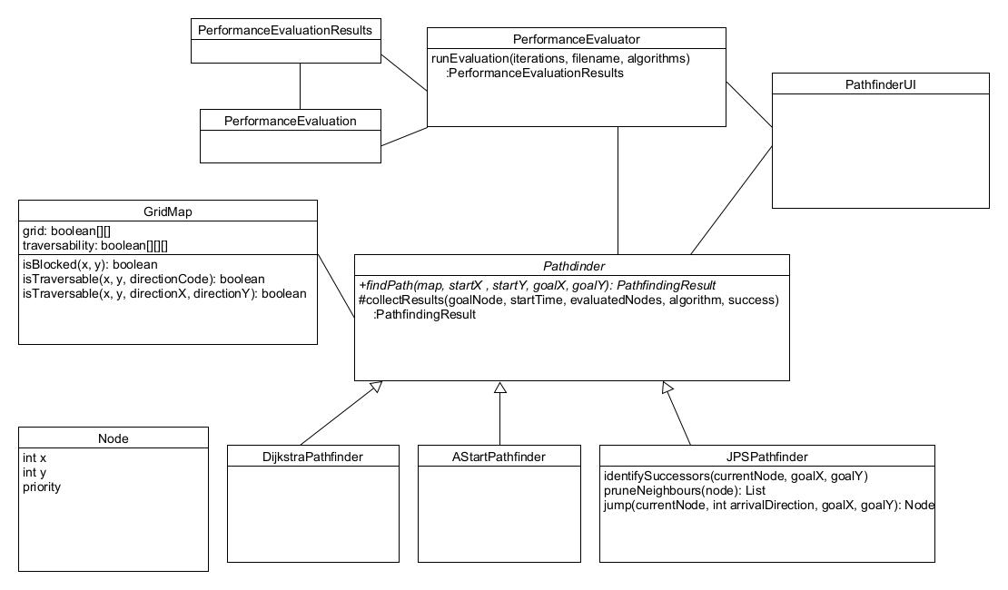
Implementation
Java (v.23)
UI: Swing, AWT, Java2D
Testing: JUnit, custom performance tester
Other tools: Maven (build), Java Flight Recorder & Java Mission Control (profiling)

Slide 5
Performance results
Maps used: Moving AI lab city maps, 1024*1024 pixels
30 maps, 300 scenarios
Algorithms | Average pathfinding time | Average nodes in route | Average evaluated nodes
Dijkstra | 99 | 1192 | 784872
A-Star | 48 | 1192 | 242140
JPS | 8 | 148 | 1327
Notes
JPS pathfinding time is 8% and 17% of A*
A* is almost half of Dijkstra time even if evaluated nodes is a third
Hypothesis: using a heuristic causes more sorting in the priority heap A* vs. Dijkstra
PriorityQueue operations take almost half of the CPU time in A*, Dijkstra

Slide 6
Thank you

