Slide 1
Compiler and Hybrid Model Implementation Using Python: A Comprehensive Overview of Compiler Phases and Design Presented By
Marko Sameh

Slide 2
Introduction
What is a Compiler?
Translates high-level code into machine-readable instructions.
Ensures code accuracy, efficiency, and optimization.
Phases of a Compiler:
Lexical Analysis, Syntax Analysis, Semantic Analysis, Intermediate Code Generation, Optimization, and Code Generation.

Slide 3
Types of Compilers
Compilation
Pure Interpretation
Hybrid Implementation Systems

Slide 4

Lexical Analysis
01
02
Definition
Key Tasks
Breaks the input into tokens (e.g., NUMBER, ID, OP).
Identifies tokens using patterns.
Detects lexical errors.

Slide 5
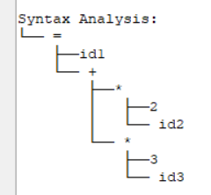
Syntax Analysis
01
02
Definition
Key Tasks
Validates the structure of tokens based on grammar rules.
Constructs a parse tree.

Slide 6
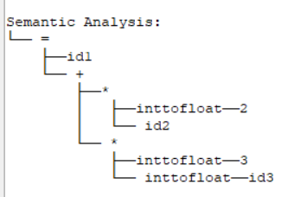
Semantic Analysis
01
02
Definition
Key Tasks
Ensures type consistency and logical correctness
add to parse tree.

Slide 7
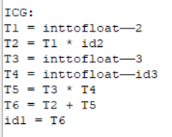
Intermediate Code Generation
01
02
Definition
Key Tasks
abstract machine-independent operations.
Temporary variables

Slide 8
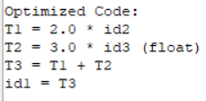
Code Optimization
01
02
Definition
Key Tasks
Improves the efficiency of intermediate code.
Removes redundant calculations.
Simplifies temporary variables.
Reduces memory and computational overhead.

Slide 9
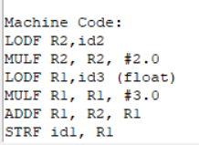
Code Generation
01
02
Definition
Key Tasks
Translates optimized intermediate code into machine-level instructions.
Allocates registers for operand storage.
Converts intermediate operations to machine instructions.
Ensures compatibility with the target hardware.

Slide 10
Conclusion
Thanks
This project demonstrates a comprehensive compiler workflow, integrating lexical, syntax, and semantic analyses with code generation and optimization. The inclusion of a hybrid phase highlights its flexibility, allowing runtime evaluation. The implementation showcases the practical applications of compiler theory.

