Slide 1
Parallel image processing using NVIDIA CUDA
Marko Haralović, Ita Poklepović, Lana Barić, Dino Babić, Anabel Dautović, Valeria Javornik
Zagreb, 2024.

Slide 2
Introduction
Overview of GPU architecture and CUDA
Importance of parallelization and its impact on performance
Brief introduction to Python libraries for GPU computing
Zagreb, 2024.

Slide 3
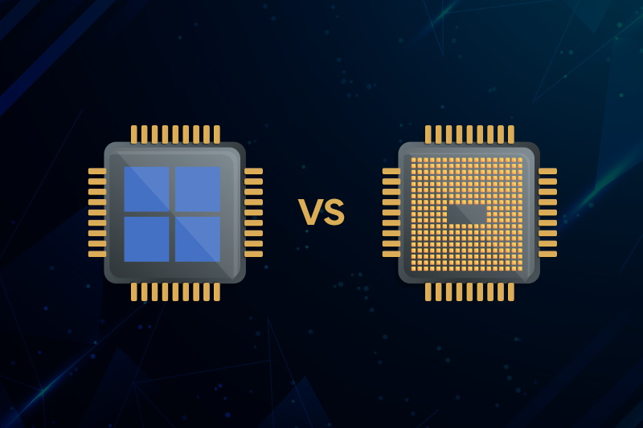
CPU vs GPU
Zagreb, 2024.

Slide 4
GPU
High number of cores enables parallelization
Beneficial when working with large amounts of data
NVIDIA
  GeForce
  CUDA
Zagreb, 2024.

Slide 5
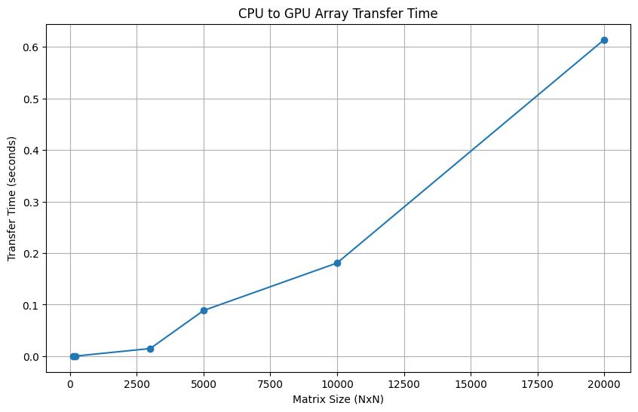
Transfer time
Zagreb, 2024.

Slide 6
Matrix multiplication
Sequential (CPU): Implement matrix multiplication using NumPy
Parallel (GPU): Use CuPy for parallel matrix multiplication
Zagreb, 2024.

Slide 7
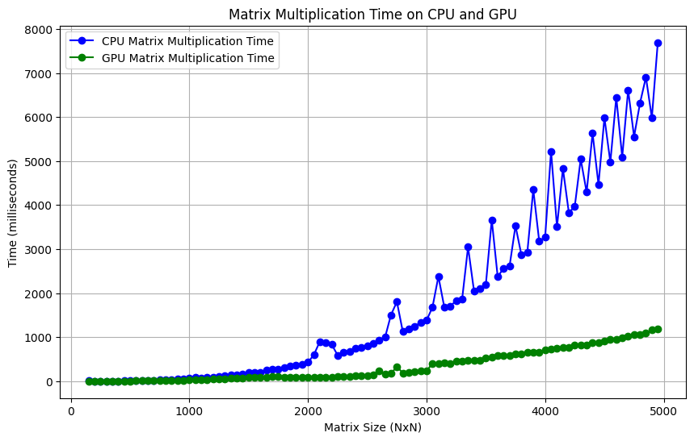
Matrix multiplication
Zagreb, 2024.

Slide 8
Linear transformations
Rotation
  Ideal example for parallelization
  The new position of a pixel can be calculated independently from the rest
  Drastic improvement when working with GPU
Zagreb, 2024.

Slide 9
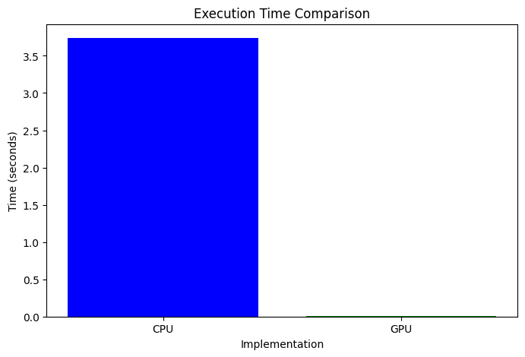
Linear transformations
Zagreb, ožujak 2004.

Slide 10
Edge-detection
Sequential (CPU): NumPy based Canny edge detector
Parallel (GPU): CuPy based Canny edge detector
Zagreb, 2024.

Slide 11
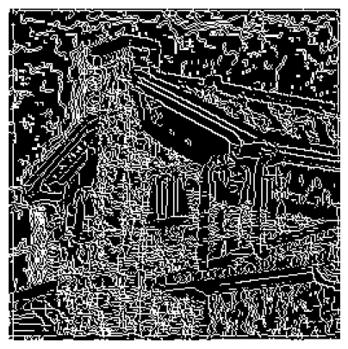
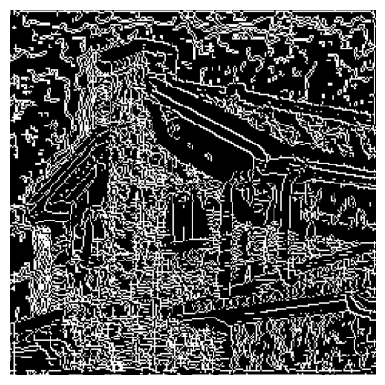
Comparing results
CPU
GPU
Zagreb, 2024.

Slide 12
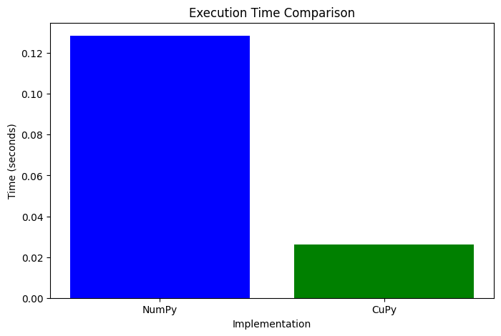
Time comparison for previous example
Zagreb, 2024.

Slide 13
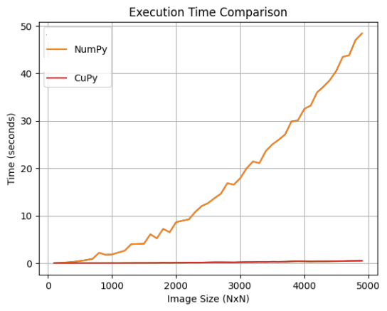
Time comparison depending on image size
Zagreb, ožujak 2004.

Slide 14
K-Means
Sequential (CPU): Implement the K-means algorithm for image segmentation
Parallel (GPU): Optimize the K-means algorithm using CuPy
Zagreb, 2024.

Slide 15
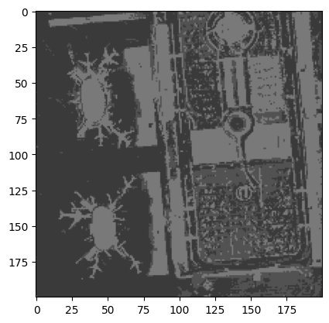
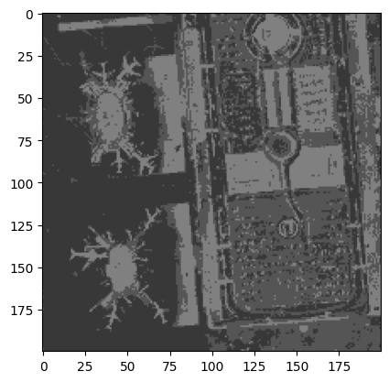
Comparing results
CPU
GPU
Zagreb, 2024.

Slide 16
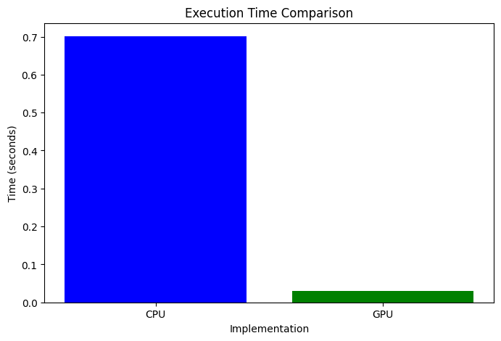
Time comparison
Zagreb, 2024.

Slide 17
Neural Networks
Sequential (CPU): Implement a neural network from scratch using NumPy
Parallel (GPU): Implement the same neural network using CuPy for GPU acceleration
Zagreb, 2024.

Slide 18
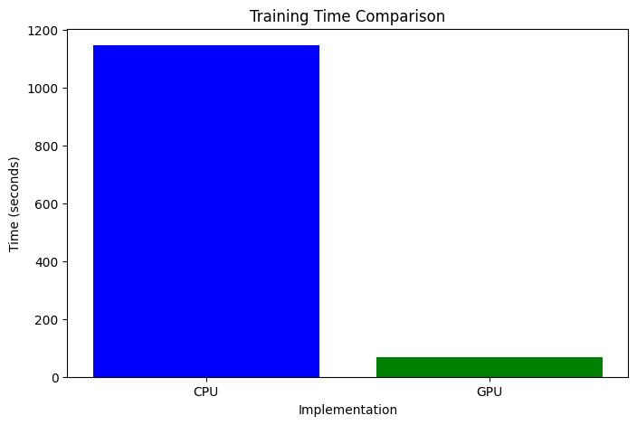
Training time comparison
Zagreb, 2024.

Slide 19
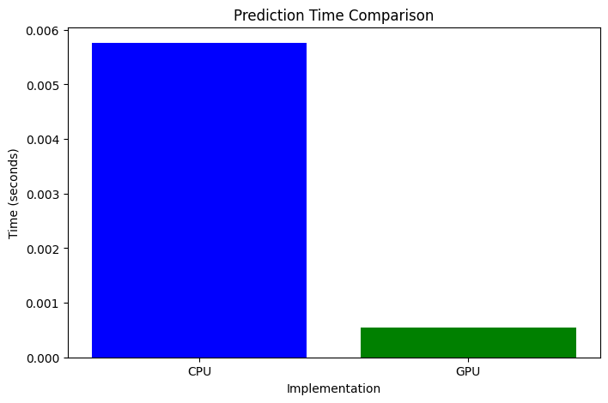
Prediction time comparison
Zagreb, 2024.

Slide 20
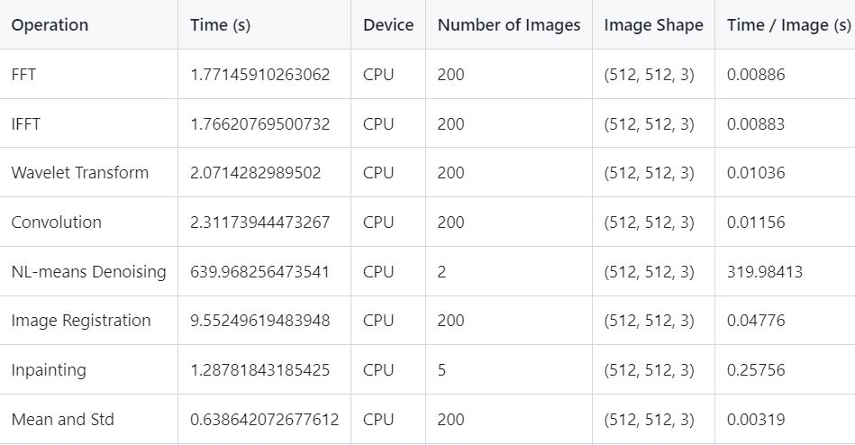
Other methods: CPU Time
Zagreb, 2024.

Slide 21
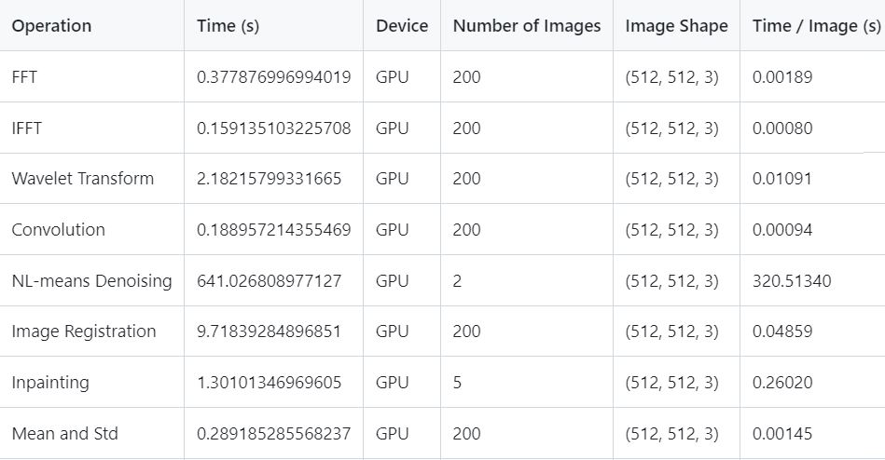
Other methods: GPU Time
Zagreb, 2024.

