Slide 1
Dear God not Object Mother
An exploration of good ways to generate test fixture data…
https://github.com/robdmoore/TestFixtureDataGenerationPresentation
http://robdmoore.id.au/blog/2013/05/26

Slide 2
Rob Moore, Senior Consultant, Readify
rob.moore@readify.net
http://robdmoore.id.au
@robdmoore

Slide 3
What’s the problem?
Tedious
Complex
Hard-to-maintain
Not DRY

Slide 4
Newing up all the things
Constructor refactoring is HARD
Inter/intra-fixture repetition and inconsistency
Verbose list building
Can’t use NBuilder easily
Lack of clarity

Slide 5
Enter Object Mother
More readable
More consistent
Still lots of constructor calls
God object
Awkward for data-driven tests

Slide 6
Test Data Builder Pattern to the rescue!
One constructor call
Easy to write (fluent)
Can express actions
Forms documentation
Reduced noise
Clearer intent
More code in some tests
Noise with builder ctors
Some repetition
More infrastructure code

Slide 7
Building lists of builders
Removes more noise
VERY powerful / expressive
Still some repetition

Slide 8
Adding me back some Object Mother!!
Terseness of Object Mother
Flexibility and maintainability of Test Data Builder
No more repetition!

Slide 9
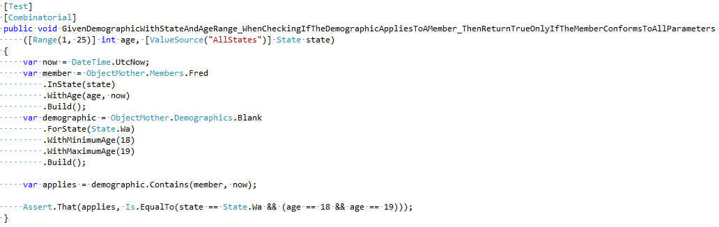
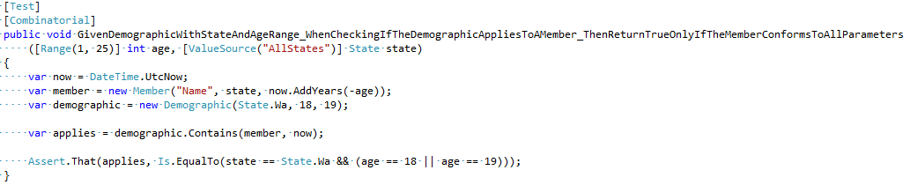
Simple unit test comparison

Slide 10
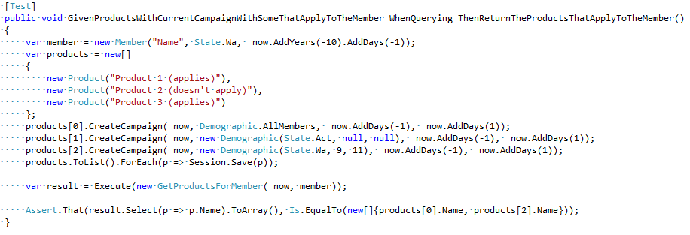
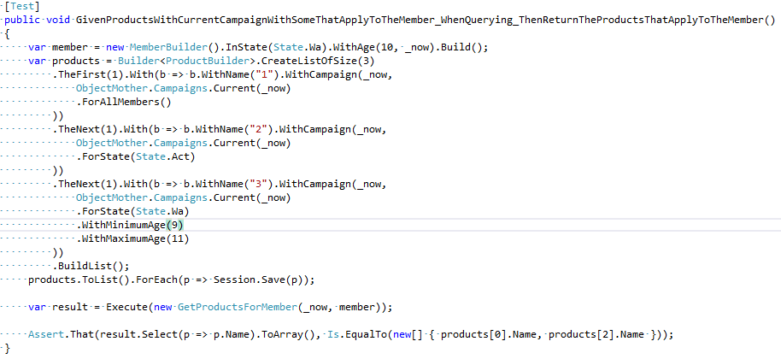
Complex integration test comparison

Slide 11
Thankyou…
rob.moore@readify.net
https://github.com/robdmoore/TestFixtureDataGenerationPresentation
@robdmoore

