Slide 1
SWEN 383 - Software Design Principles and Patterns Project: Wellness Manager Phase 1 Team members: Ivaylo Tassev, Marko Krznar, Adrian Cervantes

Slide 2

Project Overview
What is our app doing:
Track daily food intake
Manage foods and recipes
Calculate calories and macros
Monitor daily limits
Desktop wellness app to log daily food intake, track calories vs. a personal limit, and see macronutrient breakdowns (fat/carb/protein %).

Slide 3
Technology used and MVC architecture
We build our app with JavaFX for rich GUI components — TableView, Dialogs, and FXML-style event handling.
MVC - Model-View-Controller + Composite, Factory design pattern for a clean, extensible architecture.
How is our data stored: Persistent storage via CSV files — food data and daily logs are saved and reloaded between sessions.

Slide 4
MVC architecture
M
Model – business logic
V
View- what the user see
C
Controller-bridge between two
FoodComponent (interface)
JavaFX TableView
FoodController
BasicFood
Food Management Panel
DailyLogController
Recipe
→
Daily Log Panel
→
Handles user events
FoodCollection (LinkedHashMap) – store foods
Add/Edit Dialogs
Bridges Model & View
DailyLog / LogEntry
Macronutrient display
Validation logic
CSV persistence logic
Main application window
CSV load/save calls

Slide 5
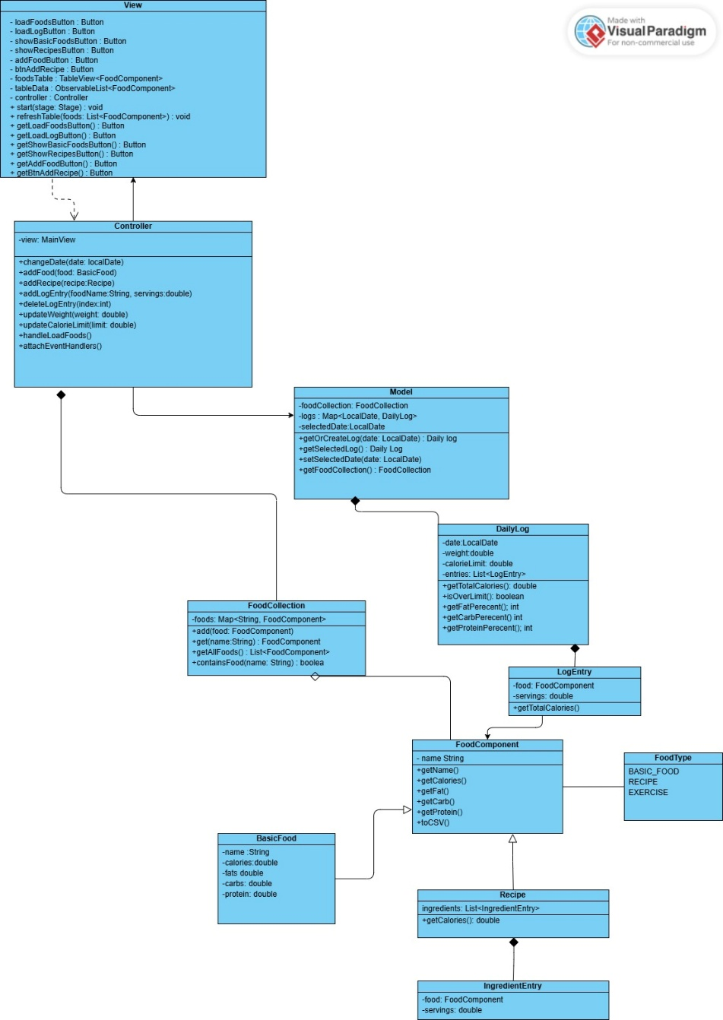
Class Diagram

Slide 6
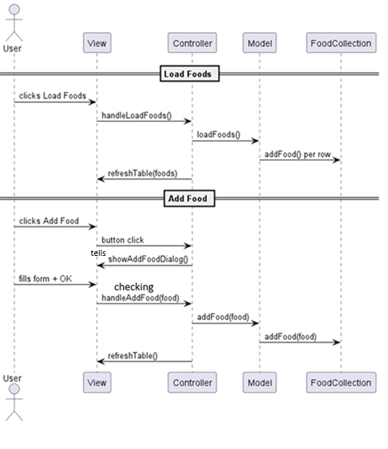
Sequence Diagrams User Interacts with Load Foods, add Foods

Slide 7
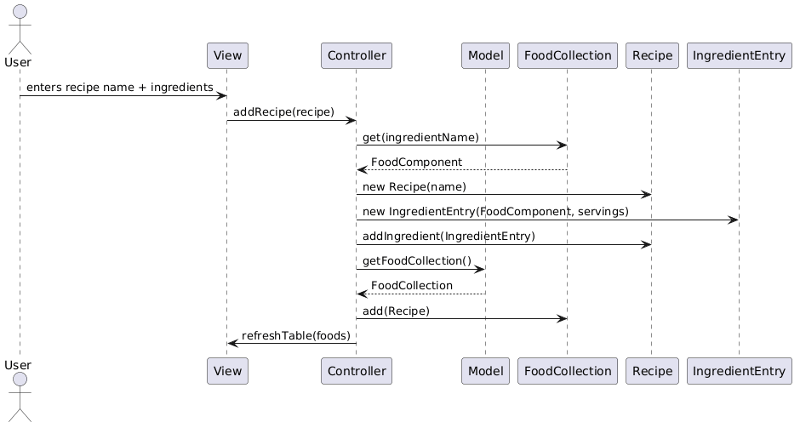
User adds a recipe

Slide 8
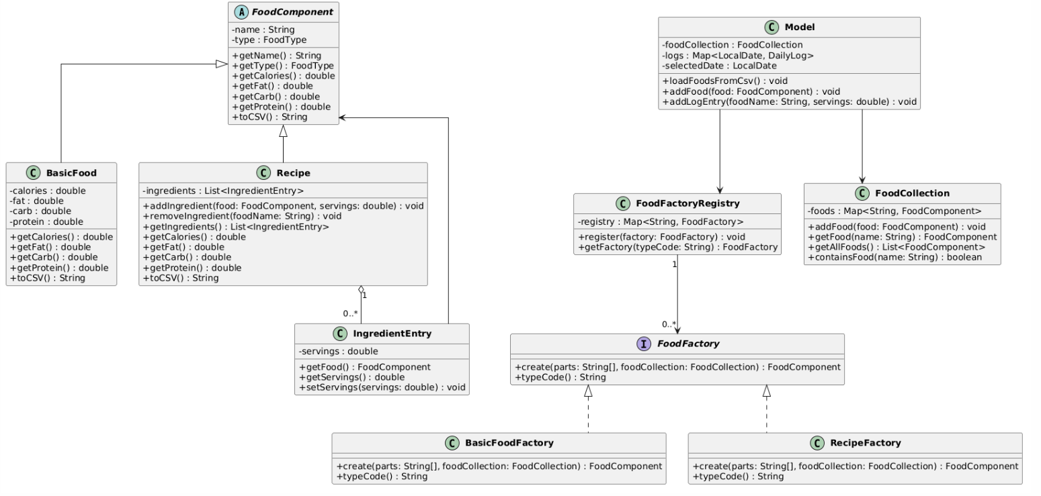
Factory Pattern Included

Slide 9
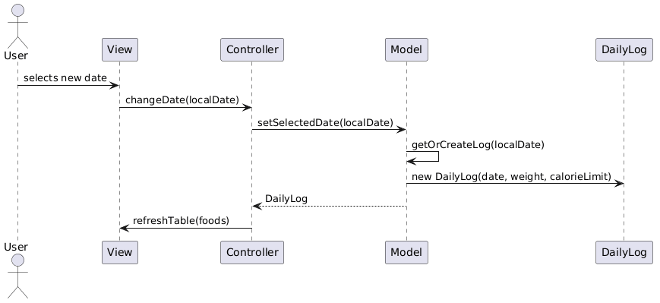
User selects a date

Slide 10
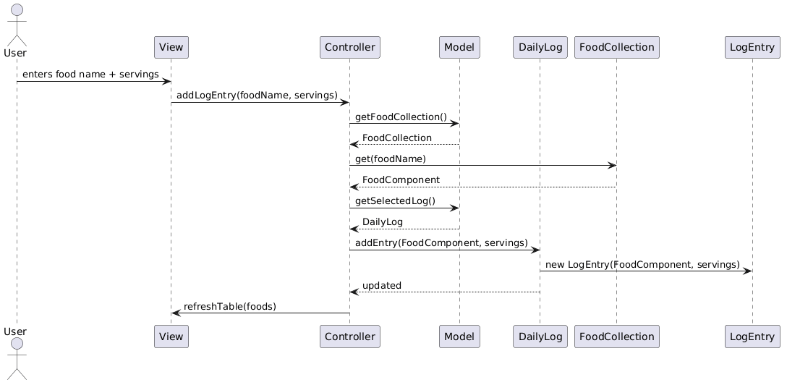
User adds a log entry

Slide 11
Challenges
Identifying the right classes from the problem description
Deciding responsibilities for each class
Avoiding too many or too few classes

Slide 12
What we can Improve in Future
Improve UI design
Add charts/graphs
Add more design patters

Slide 13
Thank you For YOUR Attention!!!

