Slide 1
SEASENSE
Marko Ribarić

Slide 2


PROBLEM
Navigating through ice-prone waters poses significant challenges to ships
Radar systems are a primary tool for navigation, but they are not infallible

Slide 3
OUR SOLUTION
A application that analyzes the best path based on the environmental data
Used as a contingency for primary solutions like radar
Application finds the optimal path based on different metrics

Slide 4
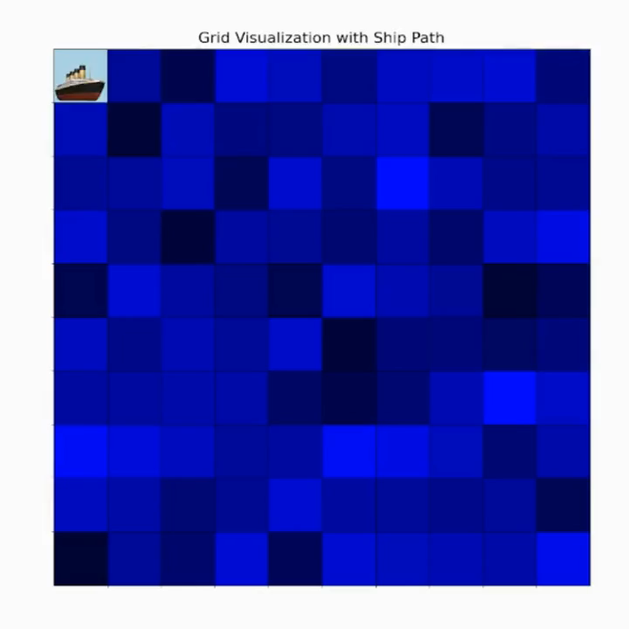
PROTOTYPE

Slide 5
THE REASONS FOR SUCCESS
Real-time Data Integration for Optimal Decision-Making
We compliment existing solutions rather than competing with them
Cost-effective since it doesn’t rely on physical components or hardware
Designed for effortless operation

Slide 6
ACTION PLAN
REFINING IDEA
TESTING PROTOTYPE
TESTING APPLICATION
CREATING PROTOTYPE
CREATING APPLICATION
PUBLIC RELEASE

Slide 7
Thank you for listening.
Questions?

