Slide 1
Demystifying memory: A Practical Tutorial on Managing & Optimizing memory in Zephyr
Marko Sagadin, IRNAS
Notes:
Motivation
Basic memory concepts
Useful tools for memory analysis
Memory management in Zephyr
Wi-Fi memory usage
Case study with nRF5340 SOC and nRF7002 Wi-Fi companion IC

Slide 2

About speaker
Electrical (electronics) engineer by education
Embedded systems engineer by profession
PCB designer / assembly line engineer -> firmware engineer
Consumer electronics, medical devices, IoT systems, TinyML...
Secondary areas: tooling, developer environment, CI, processes, etc.

Slide 3
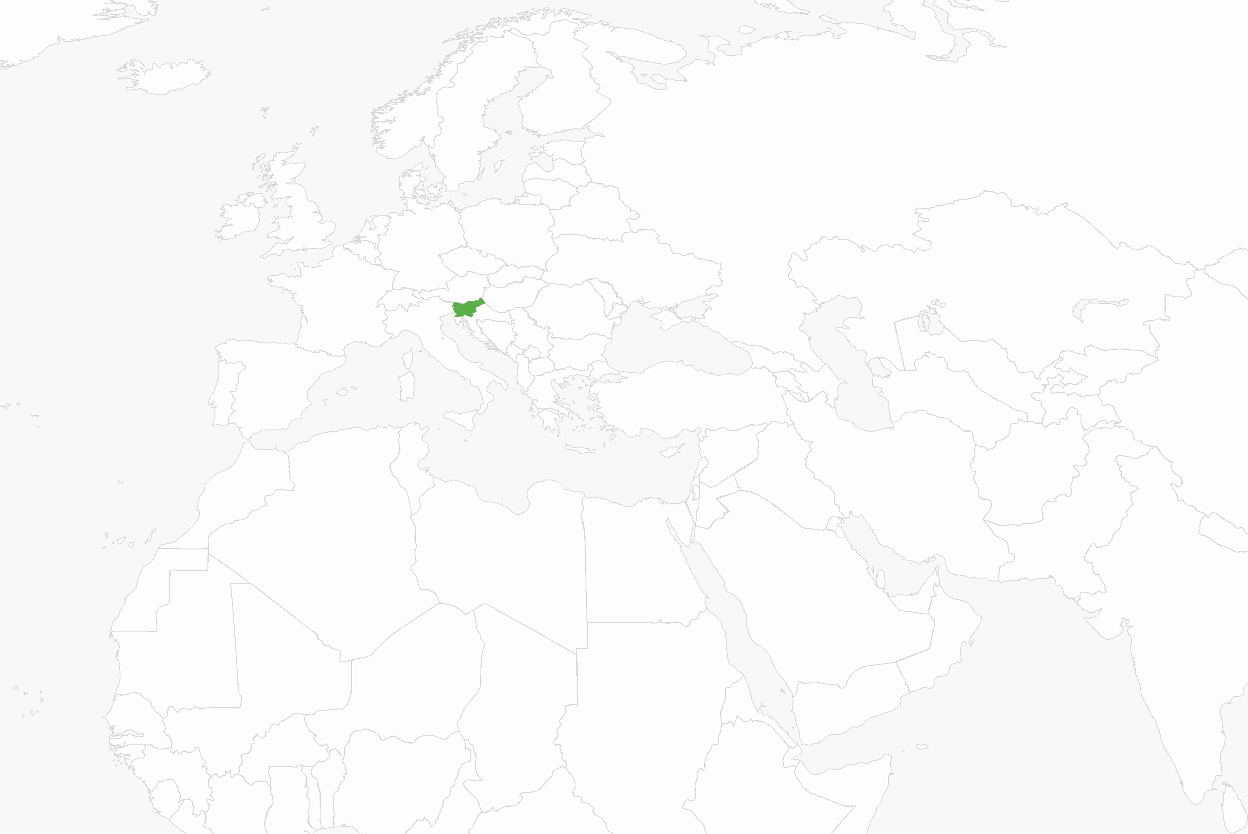






















Who is IRNAS?
Your connected solution development partner.
Maribor, Slovenia
Cross-disciplinary team of 18 experts in connected product design and production
10 years of development of connected hardware products
Full in-house infrastructure for innovating and manufacturing new products within days

Slide 4
Motivation
An IoT device sending data via Wi-Fi
PCB would contain nRF53 SOC, nRF7002 Wi-Fi companion IC and external flash chip.
Only UI are an eInk display and two buttons
On cloud side the Azure’s IoT Hub service (application protocol built on top of MQTT)
  Data is sent in strings, representing JSON objects
Provisioning of Wi-Fi credentials will use BLE
LVGL is used to render graphics
External flash chip used to store assets and second image slot
Code relocation and execute in place (XIP) were expected
Notes:
TODO: a lot of text is here, can you reduce it?
Expected way to communicate is to encode data into JSON and send string representations of it

Slide 5
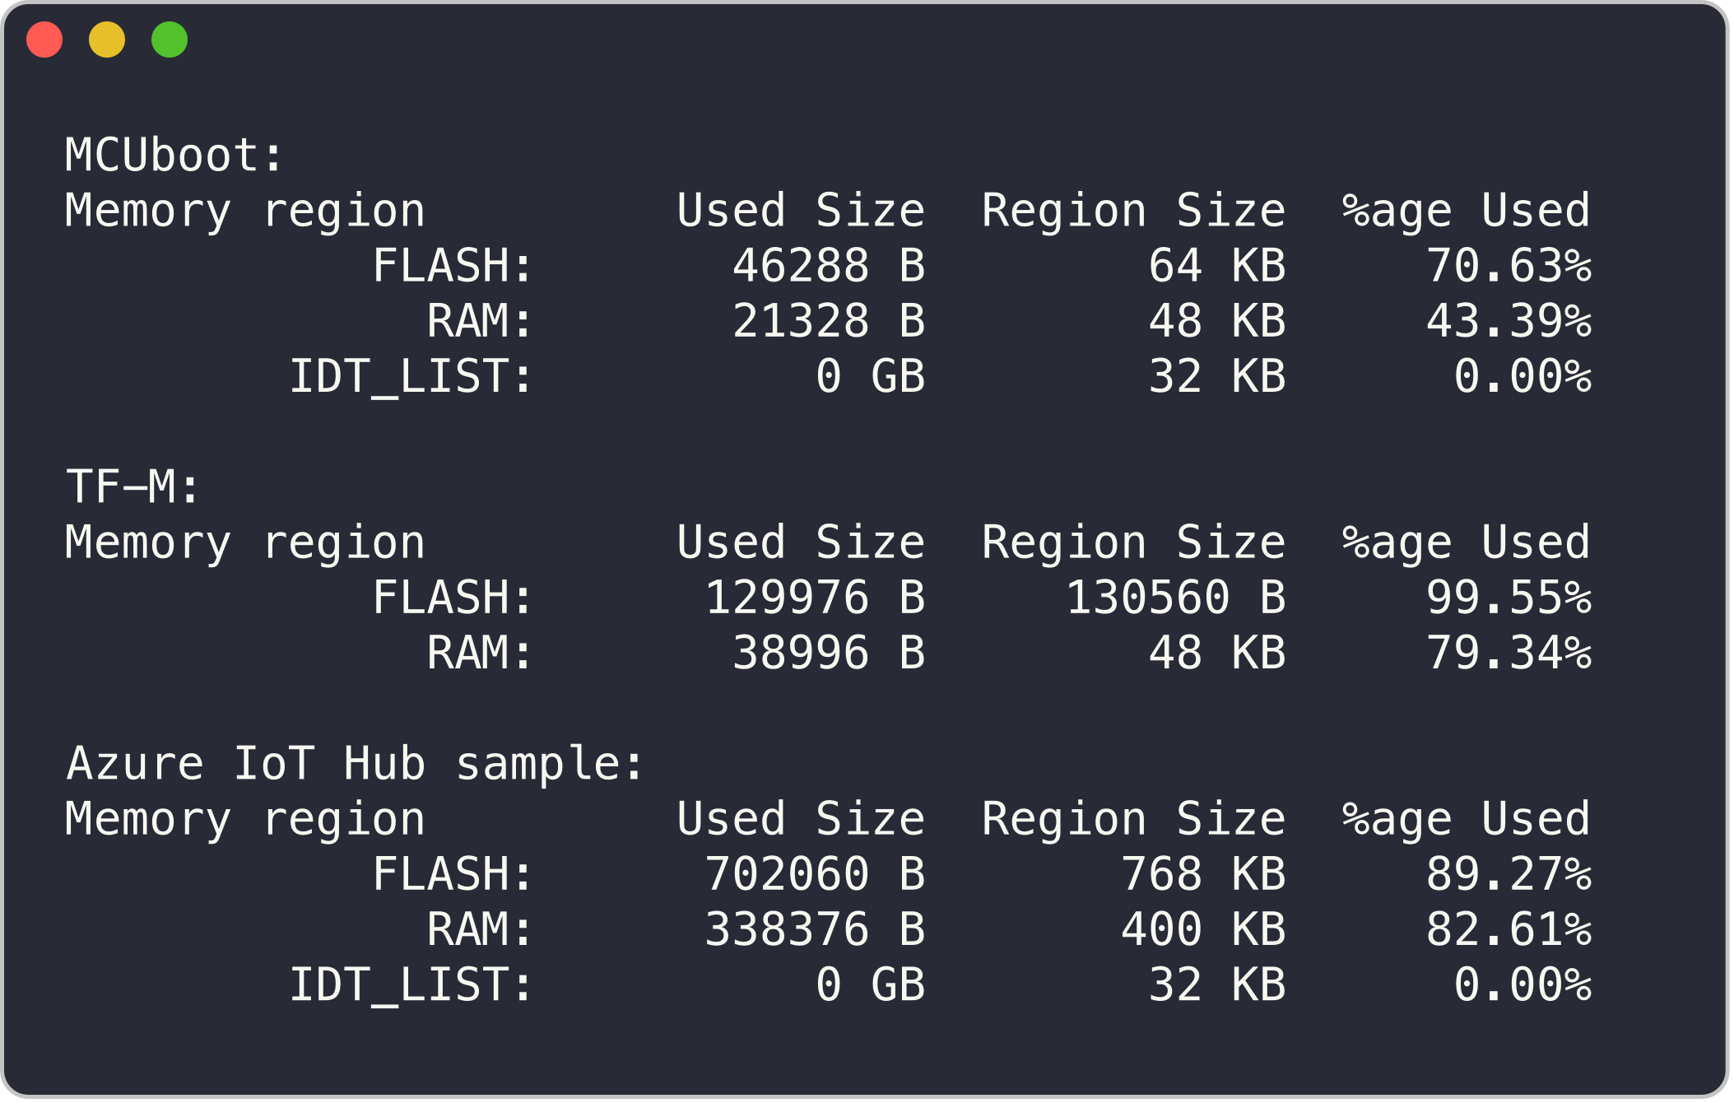
Motivation
Due to the number of features the higher memory usage was expected
But how much?
First good approximation was analysis of the nrf/samples/lib/azure_iot_hub sample.
61 KB FLASH and 69 KB RAM available
Second MCUboot partition was already on external flash
LTO was already enabled
Notes:
Due to the number of features the higher memory usage was expected
But how much? We wanted to know how much space will be available for the application code and we wanted to know that as soon as possible to minimise the risk.
Good first approximation was analysis of the nrf/samples/lib/azure_iot_hub sample.
This samples showcases the basic usage of communication with IoT Hub service:
* It registers to the cloud
* It periodically send dummy data
* It listens for the downlink messages
* It can even perform fota
We compiled the sample to check the memory consumption in the report that is printed in the end.
The initial numbers looked quite bad.
We weren’t so much worried about the Flash usage as we could relocate the parts of the image into the external flash and execute it from there, however the RAM usage didn’t look too promising. Altough we haven’t wrote any line of application code ourselfs, we only had about 70 KB of RAM available to us.
With that in mind we went into an exploration effort. We wanted to understand which components need a lot of memory, why they need it and is there something that we can do about it.
So, let’s talk about basics.

Slide 6
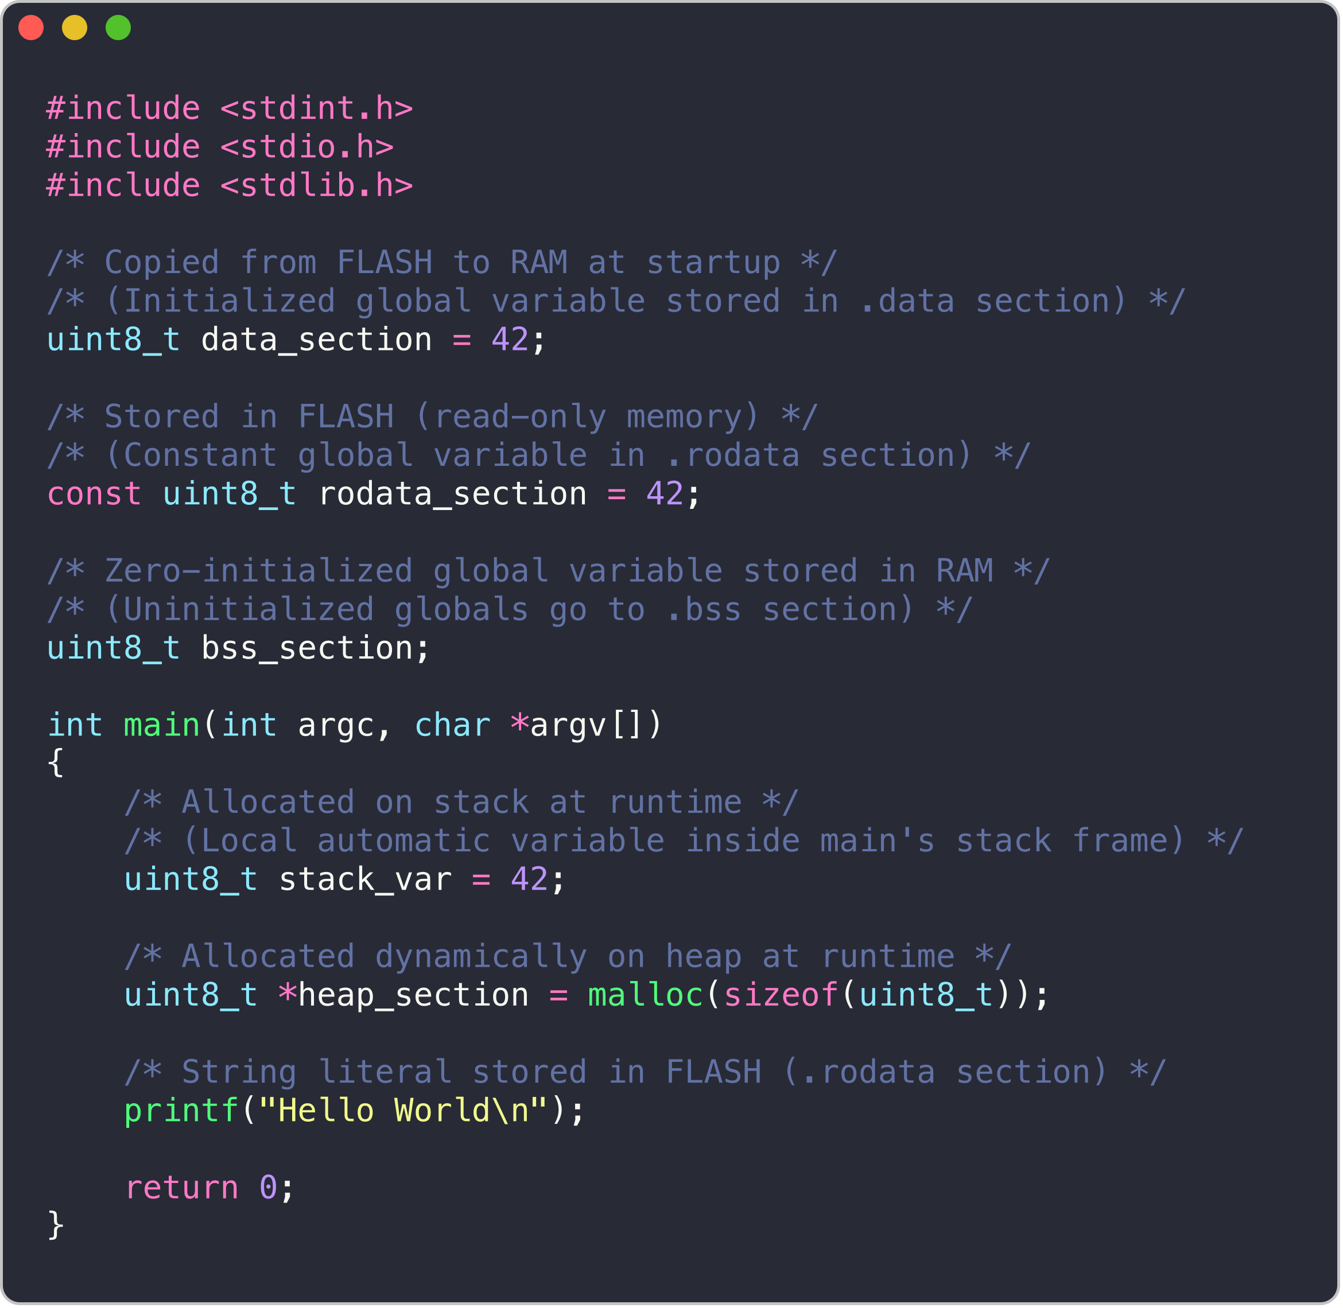
Flash and RAM
Memory regions, not specific memory device technologies!
FLASH
  Read-only memory
  Non-volatile — retains data after power loss
  Stores program code (.text), read-only data (.rodata), and initial values for initialized data (.data)
RAM
  Read-write memory
  Volatile — loses contents on power loss
  Holds initialized data (.data), zero-initialized data (.bss), dynamic memory (heap), and call stacks (stack)
Notes:
“Let’s clarify what I mean by Flash and RAM — these are memory regions in embedded systems, not t specific memory device technologies.
Flash is non-volatile read-only memory. It keeps its contents even without power. It stores program code in the .text section, read-only constants like strings in .rodata, and initial values for initialized global variables in .data. At startup, the system copies these initial values from Flash into RAM.
RAM is volatile, read-write memory that loses data on power loss. It holds initialized data (.data), zero-initialized data (.bss), the heap for dynamic allocations, and the stack for local variables and function calls.
I want to highlight that for .data section we pay the memory cost twice. First in the Flash size, then later at runrime, in the RAM, after the data is copied. The memory report that we saw in the previous slide accounts for that, but some tools, like the size tool that we get with the toolchain, doesn’t.
In this example:
data_section is an initialized global variable. Its initial value is stored in Flash’s .data and copied to RAM on startup.
rodata_section is a constant stored directly in Flash’s .rodata section.
bss_section is uninitialized, so it’s zeroed out in RAM’s .bss section at startup.
Inside main():
stack_var is a local variable stored on the stack in RAM. Its initial value is set by instructions at runtime, not stored in Flash.
heap_section points to memory dynamically allocated on the heap in RAM, though the pointer itself lives on the stack.
The string literal "Hello World\n" is stored in Flash’s .rodata section and accessed by the program.
So, Flash holds your program and constants, while RAM holds your modifiable data, dynamic allocations, and runtime stack.
This layout is key in embedded programming for understanding memory usage and behavior.”

Slide 7
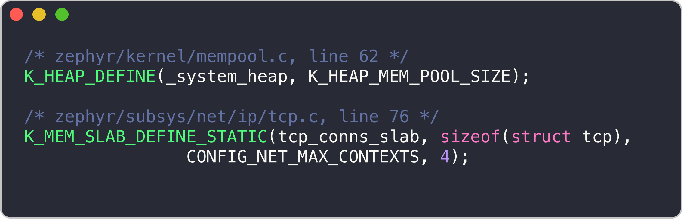
Memory managment in Zephyr
k_heap_* API
  Thread safe heap allocator
  Timeout arguments
  Built on top of sys_heap_*
k_mem_slab_* API
  Fixed-sized block allocator
System Heap
  heap allocator with libc-like API (k_malloc, k_free, etc.)
  Wrapper around k_heap
  It’s size is set with CONFIG_HEAP_MEM_POOL_SIZE
Notes:
Things I want to say:
There are several other APIs related to the memory management, but I will only focus on those that occur most often.
Zephyr has its own heap allocator.
Heaps can be defined via K_HEAP_DEFINE macro or k_heap_init and later used by the k_heap_* family of functions, such as k_heap_alloc.
k_heap_* functions are thread safe, and provide timeout argument to wait for the memory
In most cases we will be using System heap, for which we can use k_malloc to allocate from it. CONFIG_HEAP_MEM_POOL_SIZE sets it size.
All those heaps have an important property: they allocate memory from an array that was allocated at the compile time, meaning that their size is already accounted for in the memory report.
TODO: Explain why is this important
TODO: Show how this macro looks like after preprocessor runs over it.

Slide 8
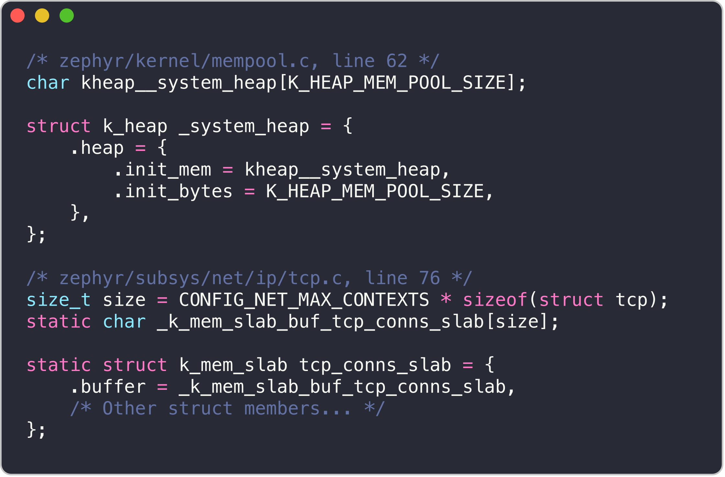
Memory managment in Zephyr
Both macros are expanded to an array and a structure that references it.
Prefixes: kheap__*, _k_mem_slab_buf_*
The size of arrays is determined at compile time, and the reserved space is included in the RAM usage report.
There are no “hidden” consumers, that are unaccounted for.
Caveat: where libc’s malloc allocates from depends on the choice of libc.
Very simplified code after pre-processor macro expansion
Notes:
Arrays are prefixed with a specific string
Same is true for the stack memory of threads (*_stack).
So this means two things:
Once we know how the macros modifies names we can much eaiser map the variable names to the Kconfig symbols that determine their size.
Also, as the reserved spaces are included in the RAM usage report there are no hidden consumers that we would have with conventional heap.

Slide 9
Useful tools and approaches for memory analysis

Slide 10
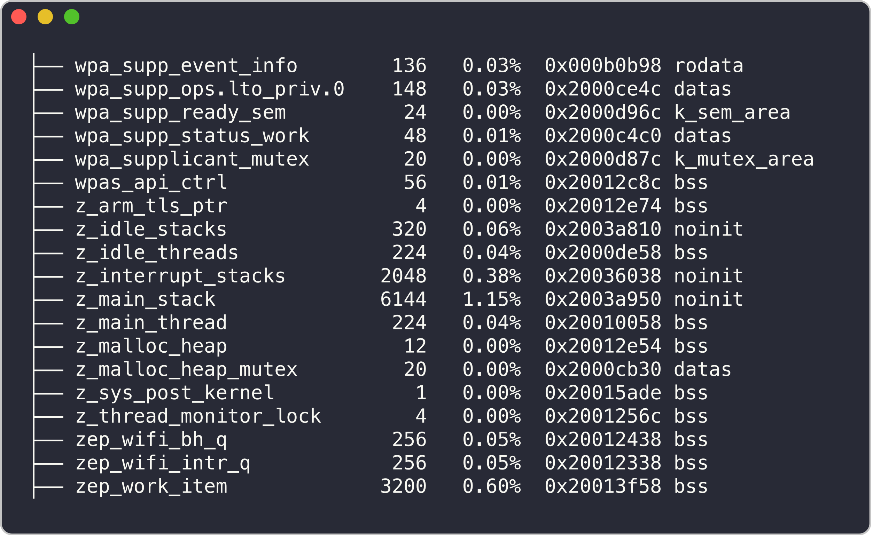
ROM and RAM report
west build -t rom_report
west build -t ram_report
Sysbuild: add -d build/<app dir>
Notes:
TODO: write down what you want to say

Slide 11
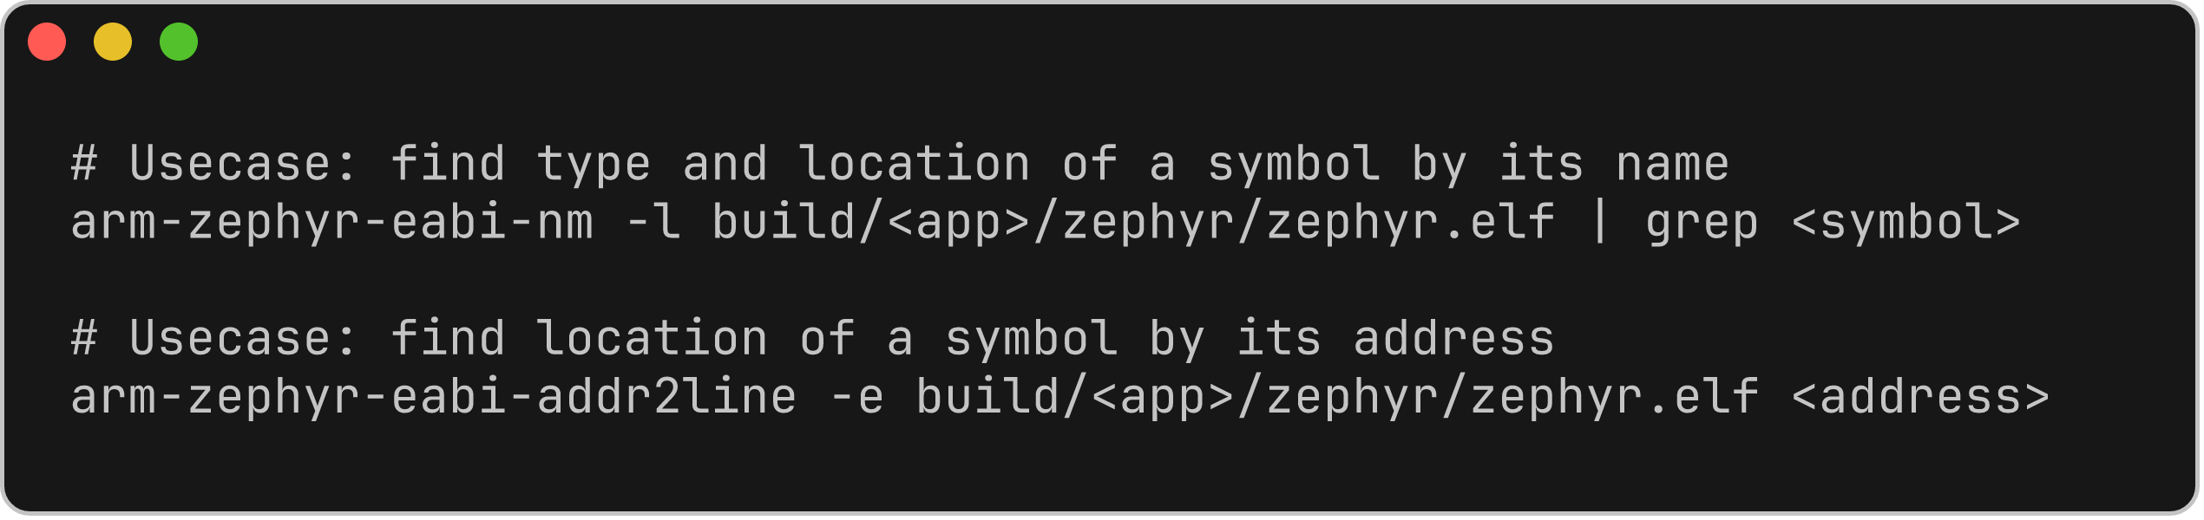
Binutils
nm and addr2line
They work most of the time
Notes:
TODO: write down what you want to say

Slide 12
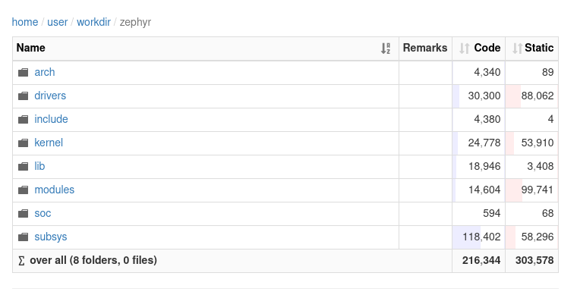
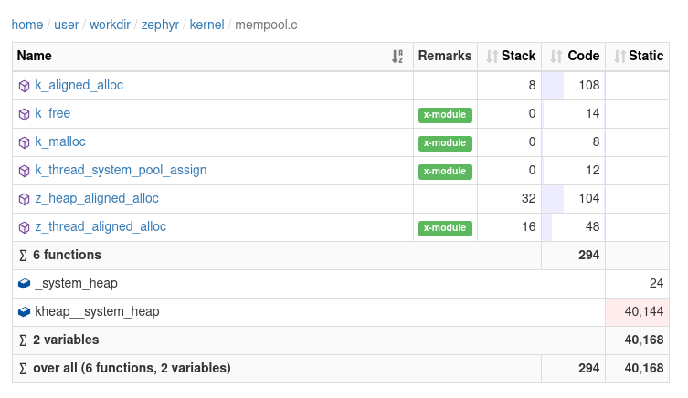
Puncover
Creates report in Web GUI
  Code size
  Variable size
  Worst case statck analysis
west build -t puncover
  If using Sysbuild add -d build/<app dir>
  CONFIG_STACK_USAGE
What do the headers mean?
  Remarks:
    x-module – function is called from another file
    float – function eventually calls a fp function
  Code: .text section
  Static: .data, .rodata, .bss
Notes:
Correct way to track
Mention that heap listener doesn’t account for the memory structures that allocator itself needs to keep track of allocated memory.
- TASK: IS THERE SOME OTHER WAY TO DETERMINE MAX USAGE FOR SOME HEAP?? FIND OUT.

Slide 13
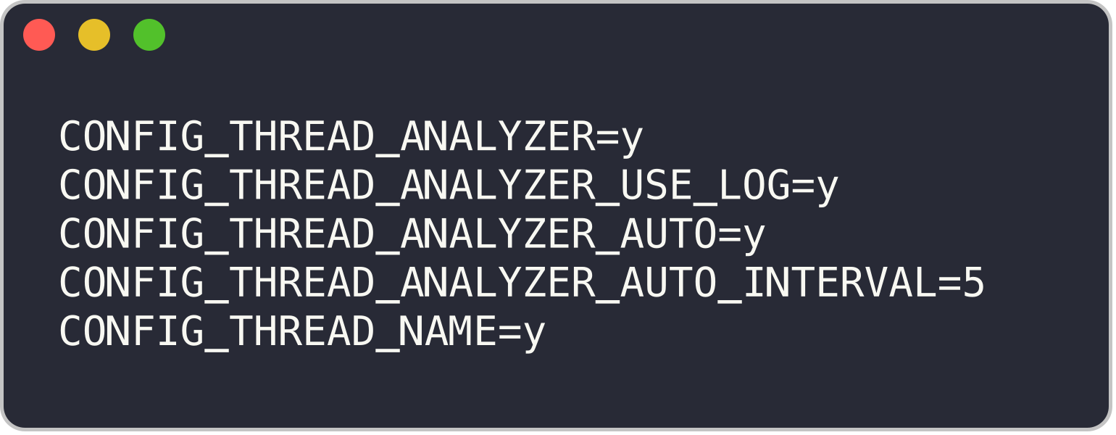
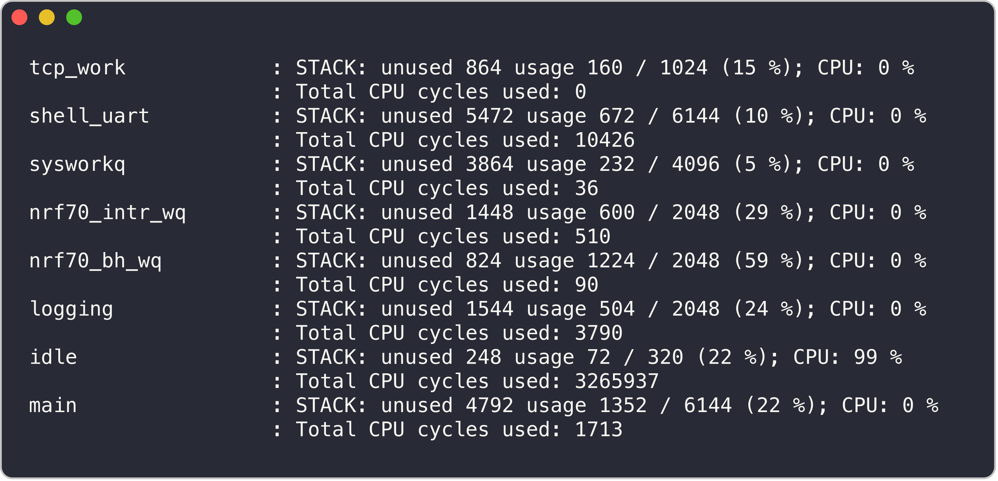
Thread analyzer
Shows maximum stack usage for each thread at runtime
Very versatile and easy to setup
Notes:
Vrsatile in the sense that you can either enable it to periodicly output report, or via shell or via thread_analyzer_print() function.

Slide 14
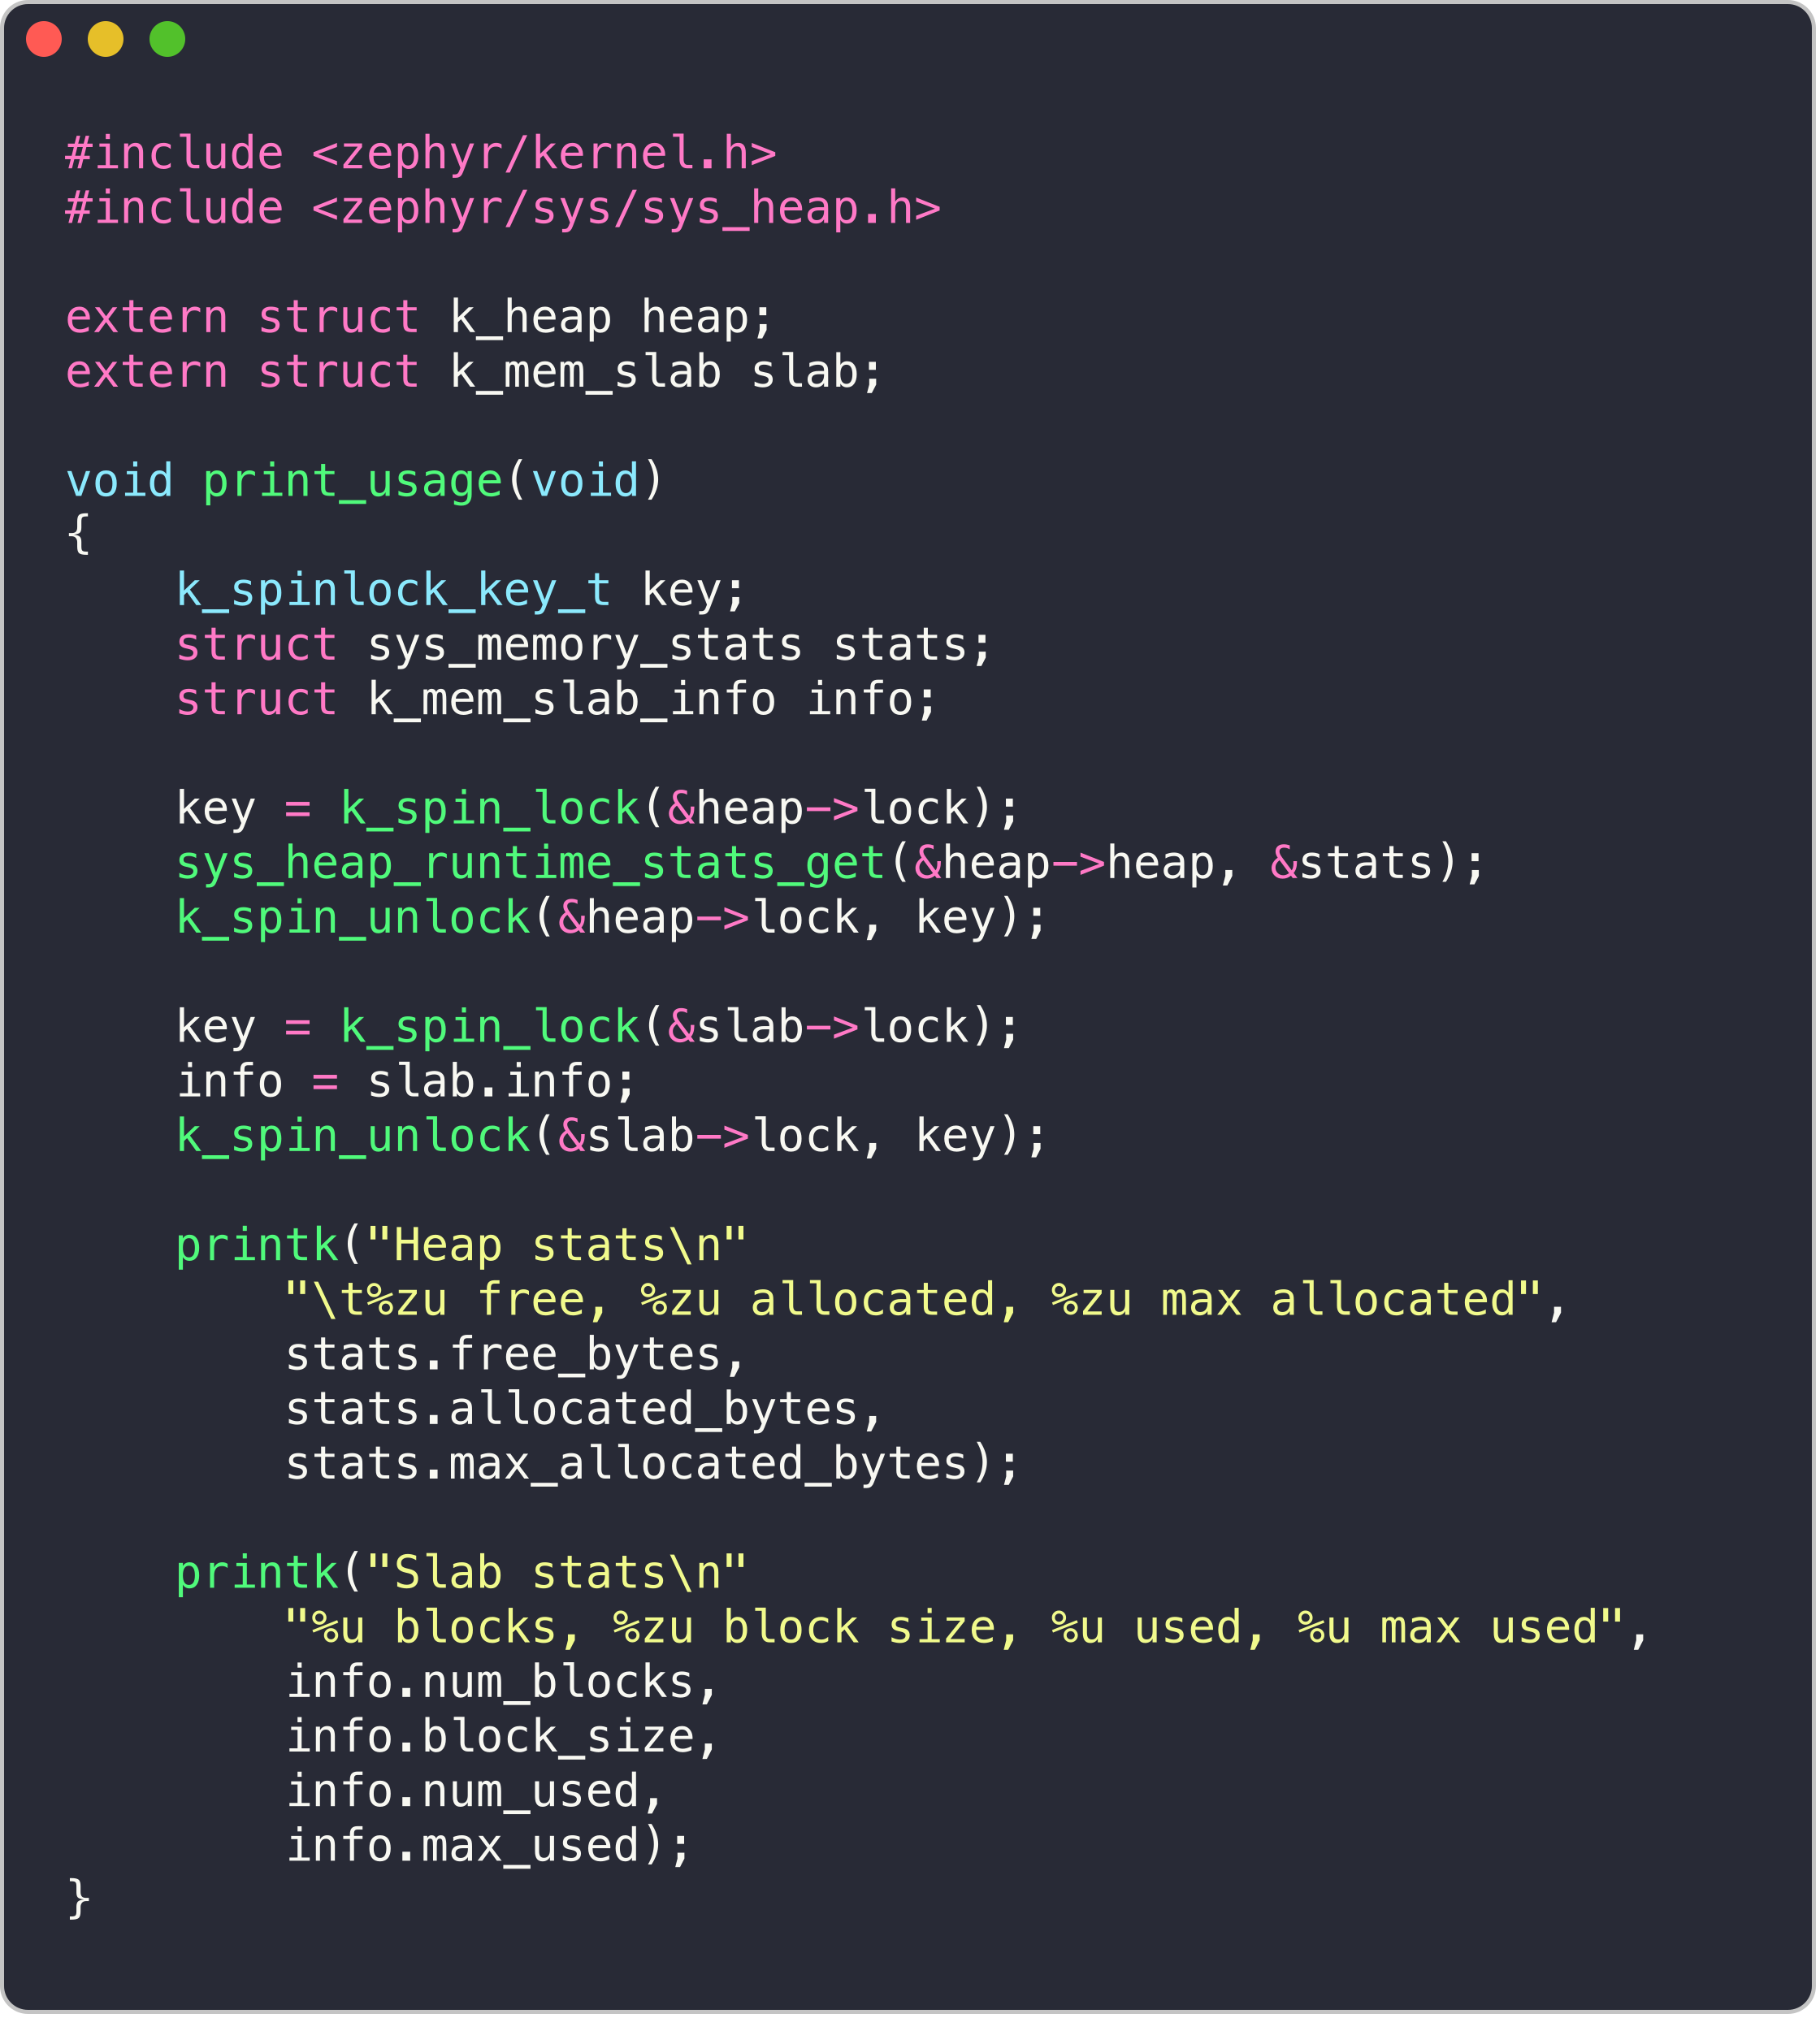
Heap and memory slab analysis
System heap run time statistics
  CONFIG_SYS_HEAP_RUNTIME_STATS
  sys_heap_runtime_stats_get
  Can also be used with k_heap
  Shell command: kernel heap
Memory slab’s info member
  num_blocks, block_size, num_use, max_used
  CONFIG_MEM_SLAB_TRACE_MAX_UTILIZATION
Notes:
Correct way to track
CONFIG_MEM_SLAB_TRACE_MAX_UTILIZATION
Mention that heap listener doesn’t account for the memory structures that allocator itself needs to keep track of allocated memory.
Sys_heap_runtime_stats_get can be used to track heap usage for both sys_heap and k_heap. For the k_heap just do k_heap->heap.

Slide 15
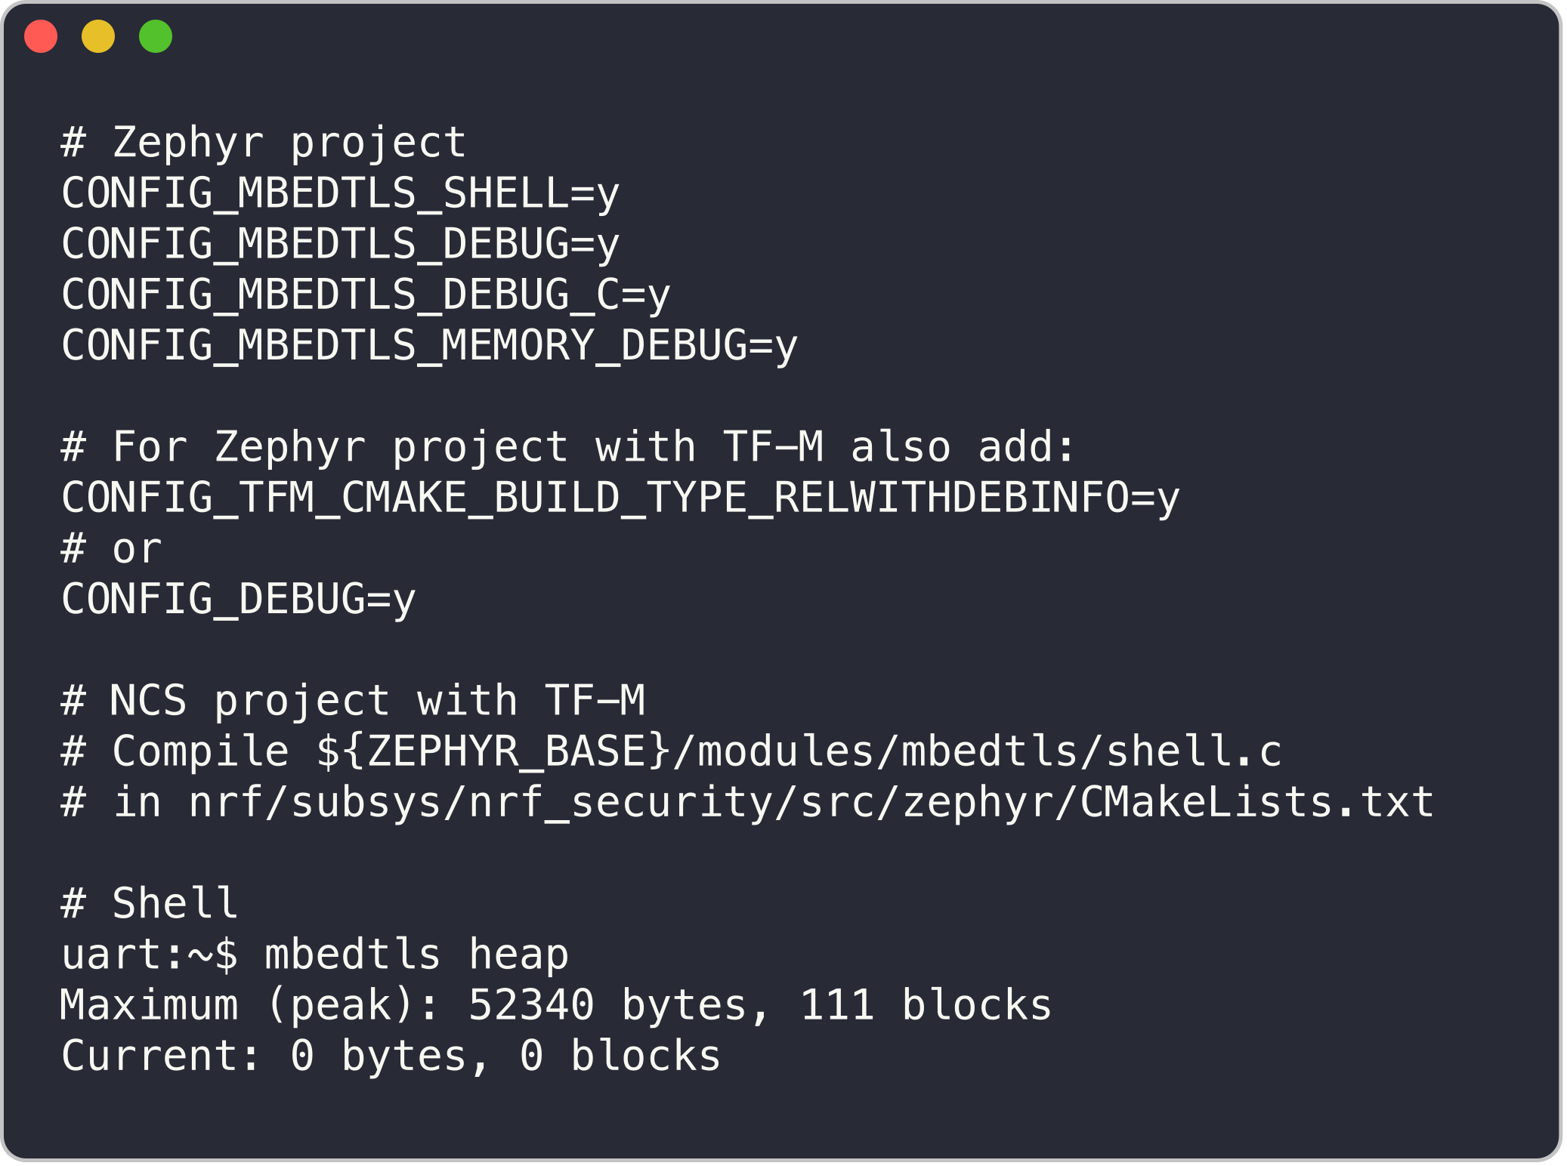
Mbed TLS heap analysis
Allocates from a static buffer.
CONFIG_MBEDTLS_HEAP_SIZE controls size.
Uses it’s own memory allocator with it’s own usage tracking logic.
Depending on the type of Zephyr application you will need to configure different options.
Notes:
Explanation of the second part:
* As soon the CONFIG_MBEDTLS_MEMORY_DEBUG is added the libc will expect that all images have heap section. TF-M doesn’t have it by default, one of the suggested options add it.

Slide 16
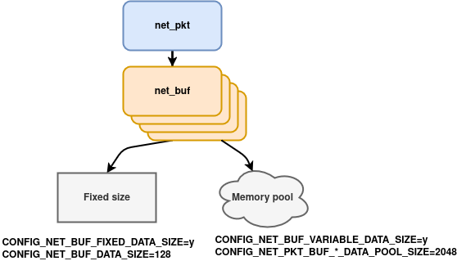
Network stack and nRF70 Wi-Fi
Many “knobs” to turn, all affect memory consumption and throughput in different ways.
RX and TX path are separately configurable
net_pkt holds one or more net_bufs
Driver for nRF7002 uses variable size.
Interesting heaps to watch:
  net_buf_mem_pool_rx_bufs
  net_buf_mem_pool_tx_bufs
  wifi_drv_ctrl_mem_pool
  wifi_drv_dat_mem_pool

Slide 17
Optimization strategy
Locate big spenders with the static tools.
  Determine symbols that enable or tune them.
  Determine if you even need them.
  Tackle them first.
Many subsystem have constrained variants
Decide what you can miss and what is mandatory to have.
Define what are your device workflows and possible code paths.
Determining correct sizes of threads, heaps and mem slabs:
1st estimation: Run your code through all possible code paths and then check report tools for maximum values.
2nd estimation: keep device running for several days.
3rd estimation: run several devices in the field and have them report back statistics.
Notes:
Determine if you need them – if you are basing your application on some sample, double check if you need all Kconfigs that come with it.
Many subsystems have constrained variants: shell, logs, asserts

Slide 18
Memory analysis demo
https://github.com/MarkoSagadin/demistifying-memory-project

Slide 19
Azure IoT Hub memory results
Test conditions:
- Sending 1kB of data (hard-coded string) 10 times every 20 sec,
- Received 1kB data sporadically, CJSON parses it
- Disconnection (sudden removal of the access point)
- No FOTA, no direct methods, little CJSON use.
Build variant | Used Flash | Max Flash | Free Flash | Used RAM | Max RAM | Free RAM
Original | 707 KB | 768 KB | 61 KB | 331 KB | 400 KB | 69 KB
Optimized 1 | 684 KB | 768 KB | 84 KB | 226 KB | 400 KB | 174 KB
Optimized 2 | 668 KB | 768 KB | 100 KB | 226 KB | 408 KB | 182 KB
Notes:
Determine if you need them – if you are basing your application on some sample, double check if you need all Kconfigs that come with it.
Many subsystems have constrained variants: shell, logs, asserts

Slide 20
What I learned?
How to find things in the Zephyr.
General rule: FLASH usage is “hard” feature bound , but RAM is “soft” feature bound (more tunable).
External flash and execute in place (XIP) are essentially required for nRF7002 (STA applications). Nordic documents well how this can be done.
If you can, keep heaps separate. Although they can waste RAM space, they make it mach easier to reason about the system.
Notes:
Determine if you need them – if you are basing your application on some sample, double check if you need all Kconfigs that come with it.
Many subsystems have constrained variants: shell, logs, asserts

Slide 21
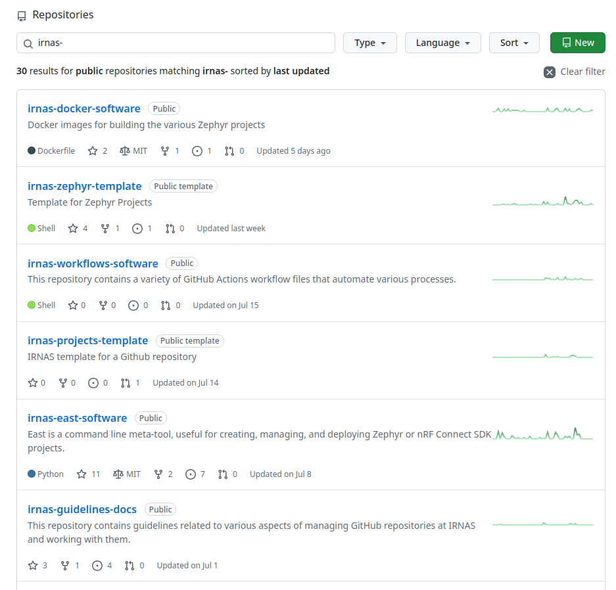
IRNAS’s resources
Found at: https://github.com/irnas
To speed up our own development we made many different project templates, reusable scripts, documentation. They are public and free to use. Search for “irnas-” prefix.
Contents:
  Docker images
  CI infrastructure
  Zephyr project template
  Custom East tool
  Project and Development guidelines

