Slide 1
Energy efficient system for detection of elephants with Machine Learning
Author: Marko Sagadin
Mentor: Dr. Iztok Kramberger
Co-mentor: MECE. Vojislav Milivojević
23.12.2020

Slide 2
Overview
Introduction
Machine Learning
Neural Network design
Hardware and firmware implementation
Measurements and results
Conclusion
Notes:
In this presentation I will describe the early warning system for detection of elephants and how Machine Learning can be used with it.
I will briefly decribe neural network design process, and how I implemented hardware and firmware parts of the system.
I will follow up with description of measurements and results and end with the conclusion.

Slide 3
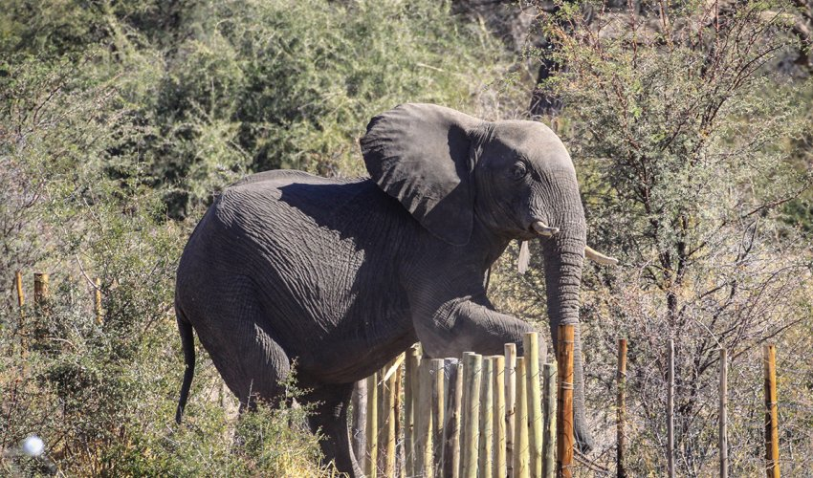
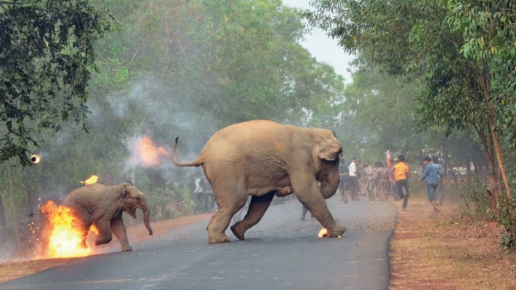
Human – Elephant Conflicts (HEC)
Major threat to elephant conservation
Every year, around 400 people and 100 elephants are killed in India because of HEC.
Current solutions for minimising HEC do not work well.
A reliable early detection system is needed.
Notes:
Human-elephant conflicts have become increasingly common in recent decades, especially in India, where increasing human population and habitat loss, are forcing elephants to search for food on nearby fields and plantations.
A single elephant can quickly trample a field of rice crops in a few hours, causing big financial problems to already Impoverished farmers.
In turn, these farmers often retaliate and set dangerous electrical or poisonous traps that kill elephants.
According to WWF, around 400 people and 100 elephants are killed every year in India, alone.
A lot of work was put into minimising the human elephant conflicts.
Current approaches include electric fences, watch towers, regular patrols and camera traps.
These solutions do not work well or they are too expensive to maintain.
A reliable early warning system is needed that is cheap, easy to maintain, and capable of detecting elephants and warning local communities of their presence in the area.

Slide 4
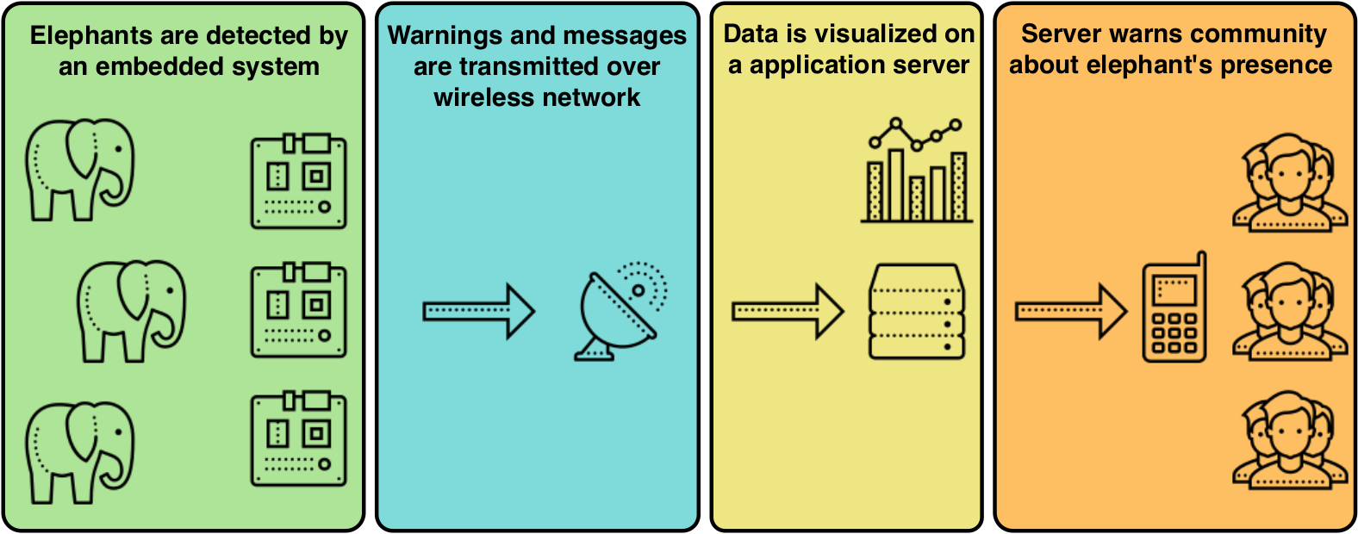
Early warning system
Key qualities
Low power
Reliable
Responsive
Notes:
On the diagram you can see the structure of the
early warning system.
The system consists of several small,
deployed devices with mounted thermal cameras and a gateway that also acts as a server.
…
Because devices will be deployed in the wild, with no access to electricity, they need to be battery powered, which means that they need to conserve with energy.
Device should also be reliable and responsive, as their job is to protect human lives and their property.
Ideally, this system should replace human watchers.
For that we had to learn how to use Machine learning to recognise elephants from thermal images.
The main focus of this thesis was designing neural network capable of that and deploying it on a embedded device.

Slide 5

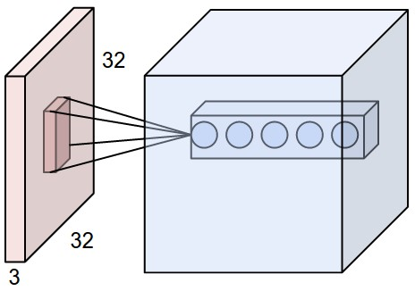

What is Machine Learning?
ML algorithms are not programmed, they are trained.
ML algorithms (models) learn from data how to predict or recognise specific trends or phenomenons.
Used in many products that we use daily.
Examples: email sorting, recommending next video/song, detecting wake words, classifying images.
My focus was on Convolutional Neural Networks.
Notes:
But, before we can go on we have to answer the quiestion, what is Machine Learning?
According Arthur Samuel, on of the pioneers of Artificial Intelligence, Machine learninig is a field of
study that gives computers the ability to learn without being programmed explicitly.
…
There exits a large number of various Machine learning algorithms, however we were most interested in Convolutional Neural Networks, as these type of networks work best with image data.

Slide 6


Machine Learning on embedded devices
Field is experiencing a rise in popularity in last two years.
Advantages over conventional IoT device without ML capabilities:
  Smaller power consumption
  Shorter latency time
  Increased privacy
Challenges when compared to conventional ML:
  No training, only inference
  Constrained processing power
  Small memory space
Notes:
Running Machine Learning algorithms on microcontrollers was recently made possible thanks to various advancements in the field.
It is a perfect addition to the ongoing IoT expansion.
Iot devices with added Machine learning capabilities would benefit in many different aspects.
For example, instead of sending all collected data to the server for processing, device could directly process data and only send results.
This means that we would be sending less information overall, which means that
Tensorflow library was used to implement ML algorithms on the microcontroller.
We also used Edge Impulse, a commercial software that is based on Tensorflow, but does few things differently

Slide 7
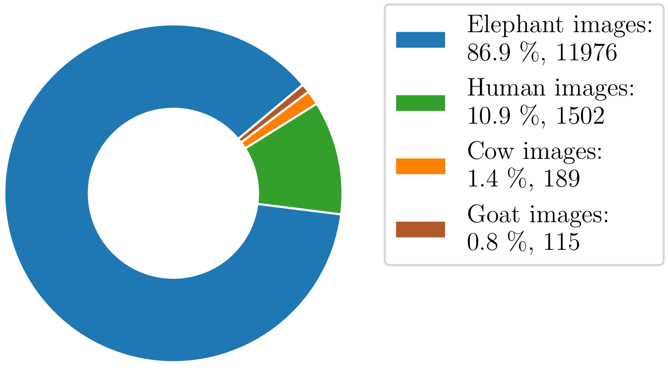
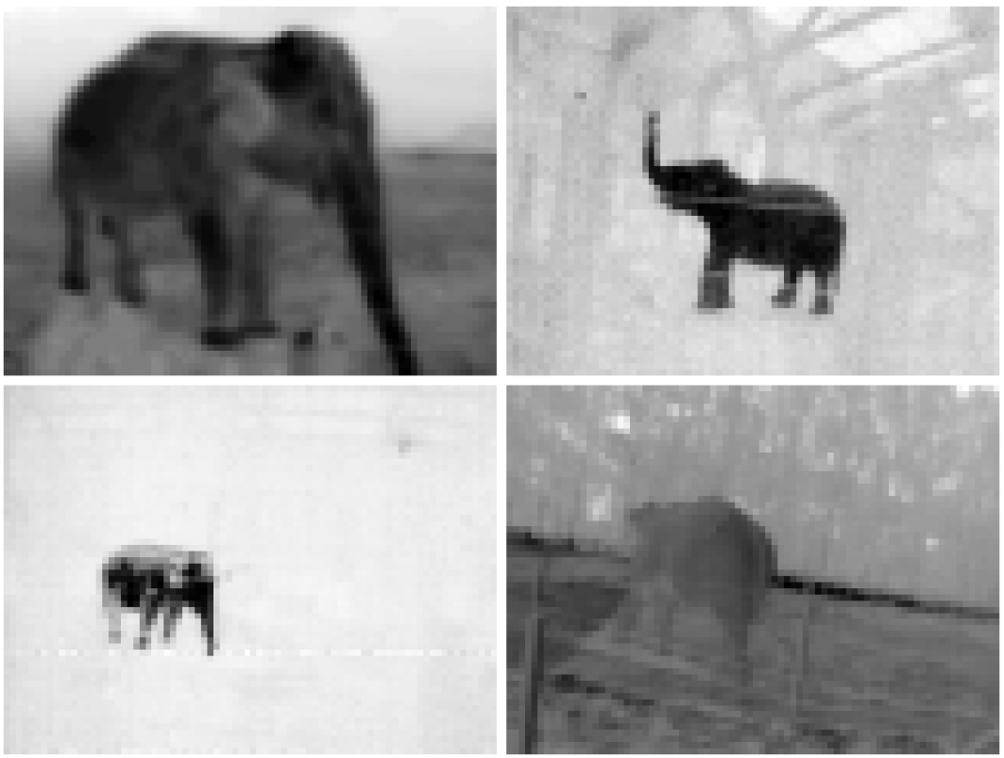


Analysing thermal image dataset
Large class imbalance.
Goat images were not usable for classification.
Different image resolutions.
13667 images were used.
4 classes: elephant, human, cow and nature/random.
Notes:
I started the neural network design with analysis of thermal image dataset, that was collected by the Arribada Initiative.
Dataset contained images of elephants, humans, cows and goats that were sorted into labeled folders.
After intial analysis I made several observations:

Slide 8
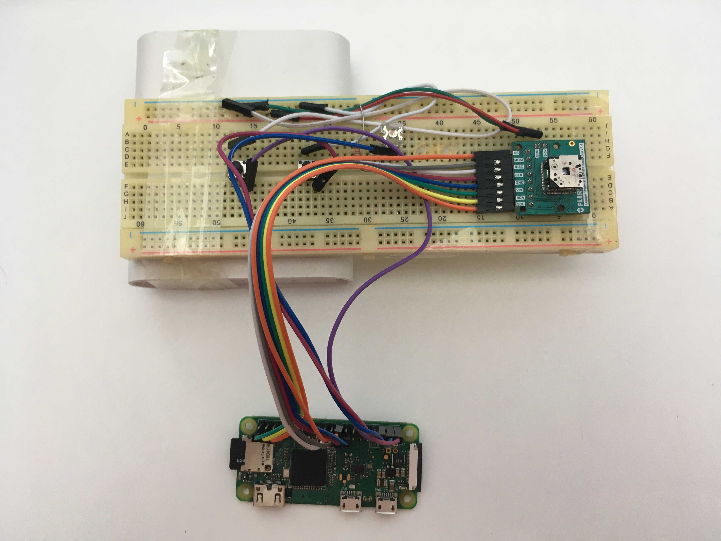


Quick thermal camera solution
Notes:
With this setup, we made 365 images of cows in varying conditions, 308 images of nature, and 124 images of humans.

Slide 9
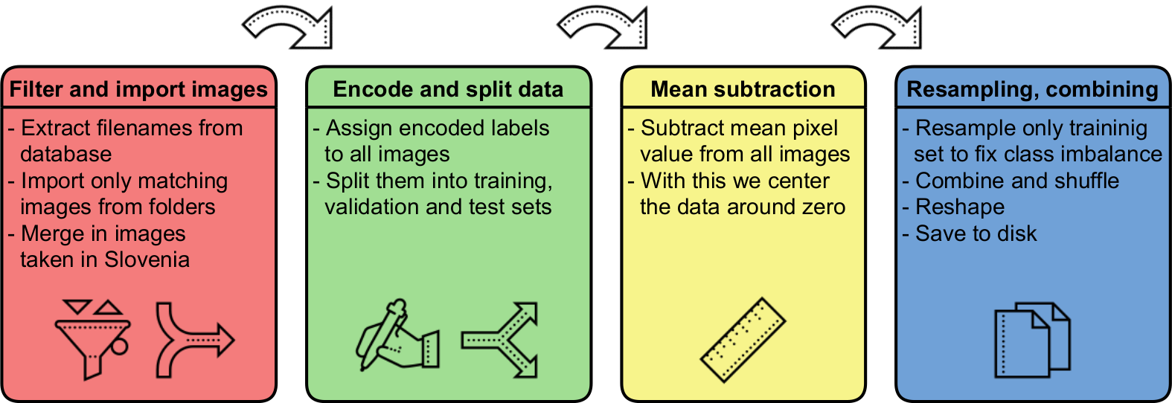
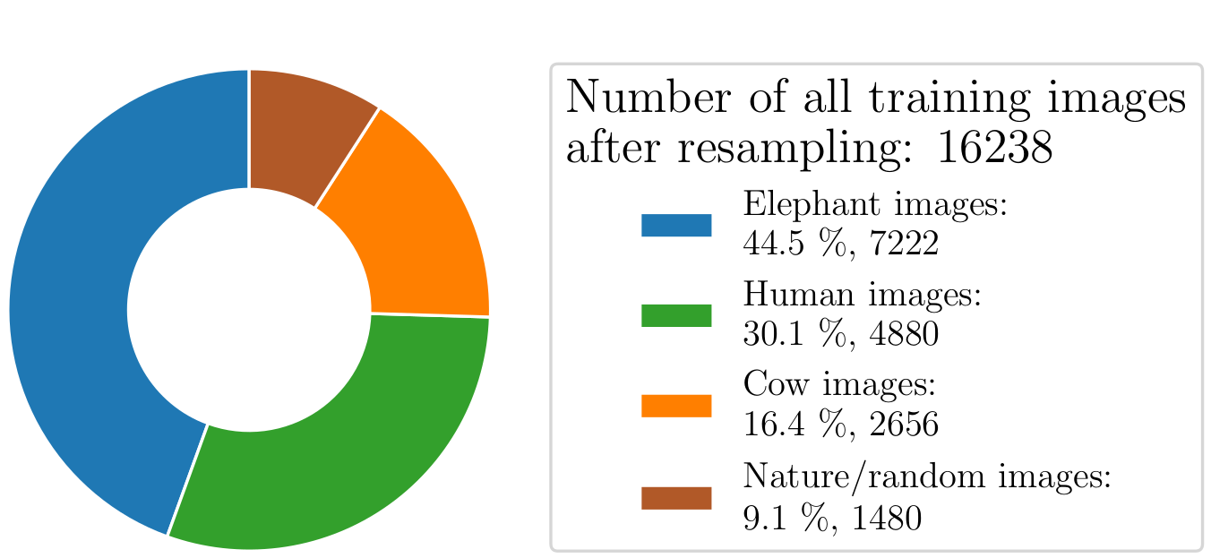
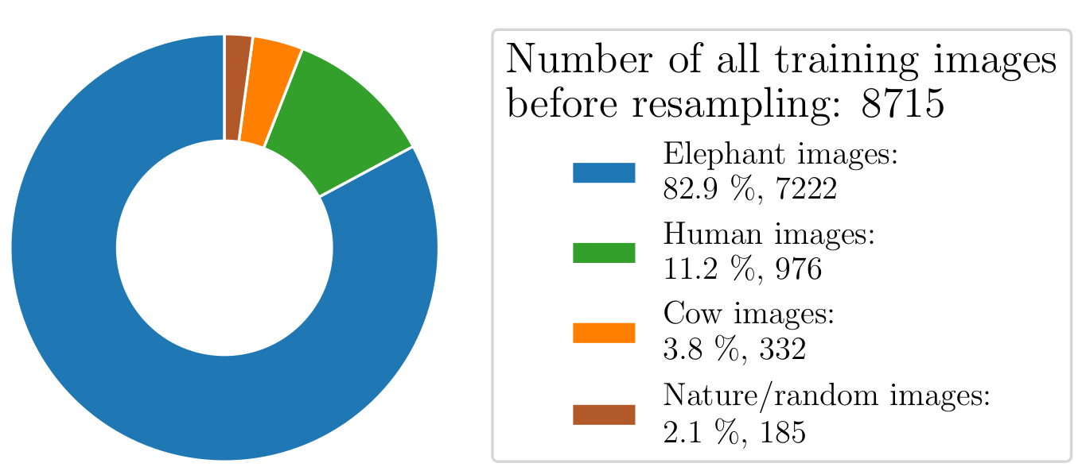
Image preprocessing pipeline
Notes:
After image selection I imported the images into a Python script and prepared them for the model training.
That meant down sampling higher resolution photos, assinging a labels based on folder names, splitting them into training, validation and test sets, performing mean substraction.
We then resampled all images from minor classes to fix imbalance problem and then saved them as numpy arrays to the disk for the later use.

Slide 10
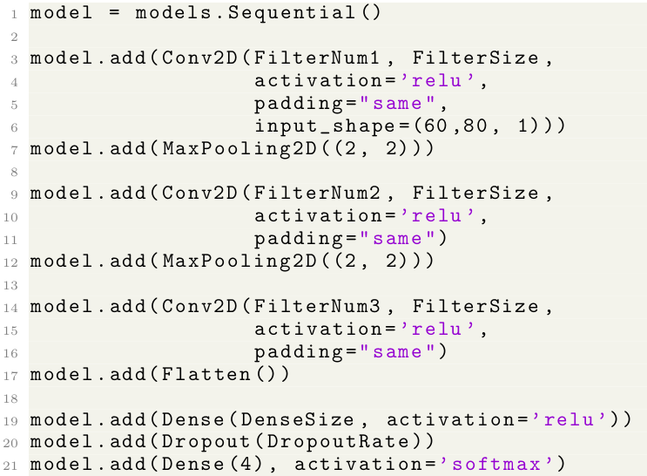
Model architecture
Keras Sequential API
Each line corresponds to one layer.
Exact hyperparameters were not defined.
Notes:
To design model architecture I used Keras library, which hides low level parts of neural network design and provides easy to understand API.
You can see that each line corresponds to one neural network layer.
Structure that I used consisted of two convolutional-polling pairs, followed by another convolutional layer, output of which is flattened and fed into fully connected layer. At the end we have the last fully connected layer with four outputs, corresponding to our four classes.
You can see that I did not hardcode hyperparameters to certain constants, but I left them as variables. Mention Keras Tuner, choosing hyperparameters is hard.

Slide 11
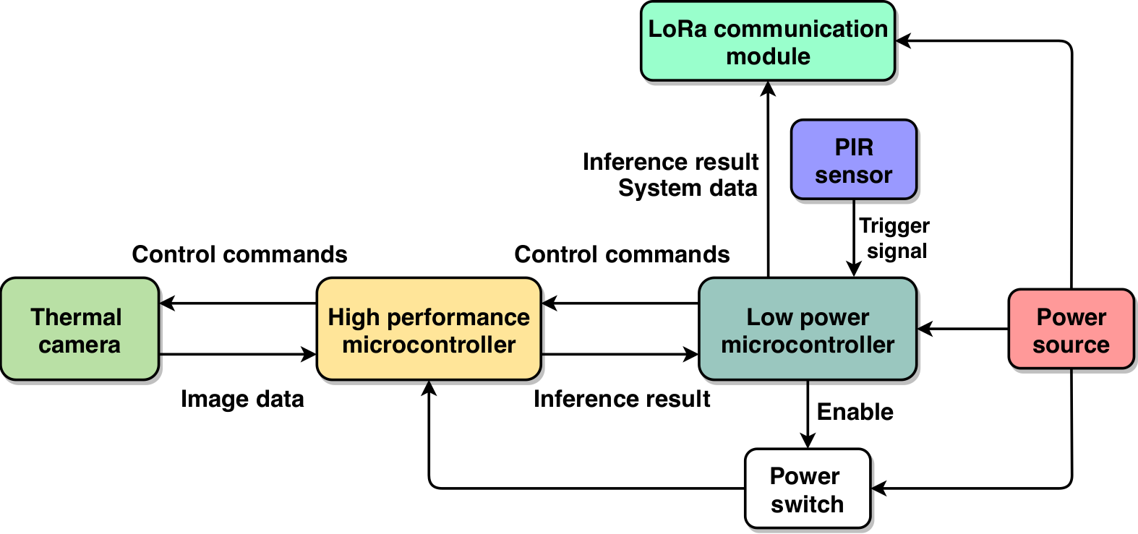
System block diagram
Notes:
Human-elephant conflicts have become increasingly
common in recent decades, especially in India,
where increasing human population and habitat
loss, are forcing elephants to search for food on
nearby fields and plantations. A single elephant can
quickly trample a field of rice crops in a few hours,
causing big financial problems to already
Impoverished farmers. In turn, these farmers often
retaliate and set dangerous electrical or poisonous
traps that kill elephants. According to WWF, around
400 people and 100 elephants are killed every year
in India, alone. A lot of work was put into minimising
the human elephant conflicts, current approaches
include electric fences, watch towers, regular
patrols and camera traps. These solutions do not
work well or they are too expensive to maintain.
A reliable early detection system is needed that is
cheap and easy to maintain, which is capable of
detecting elephants and warning local communities
of their presence in the area.

Slide 12
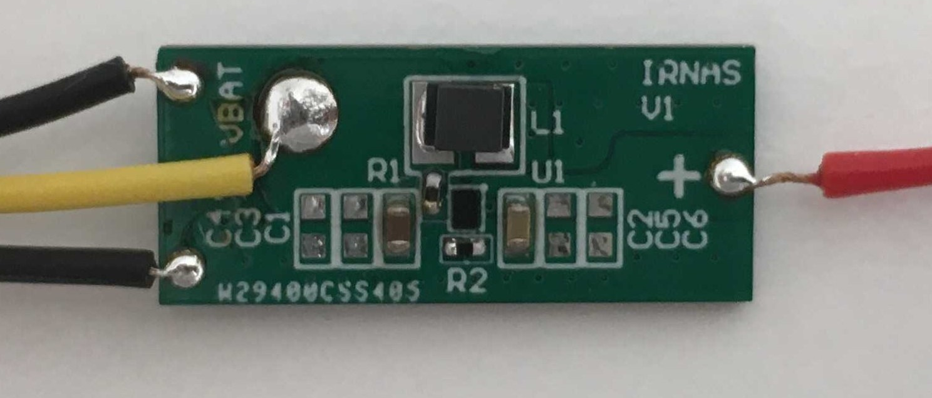
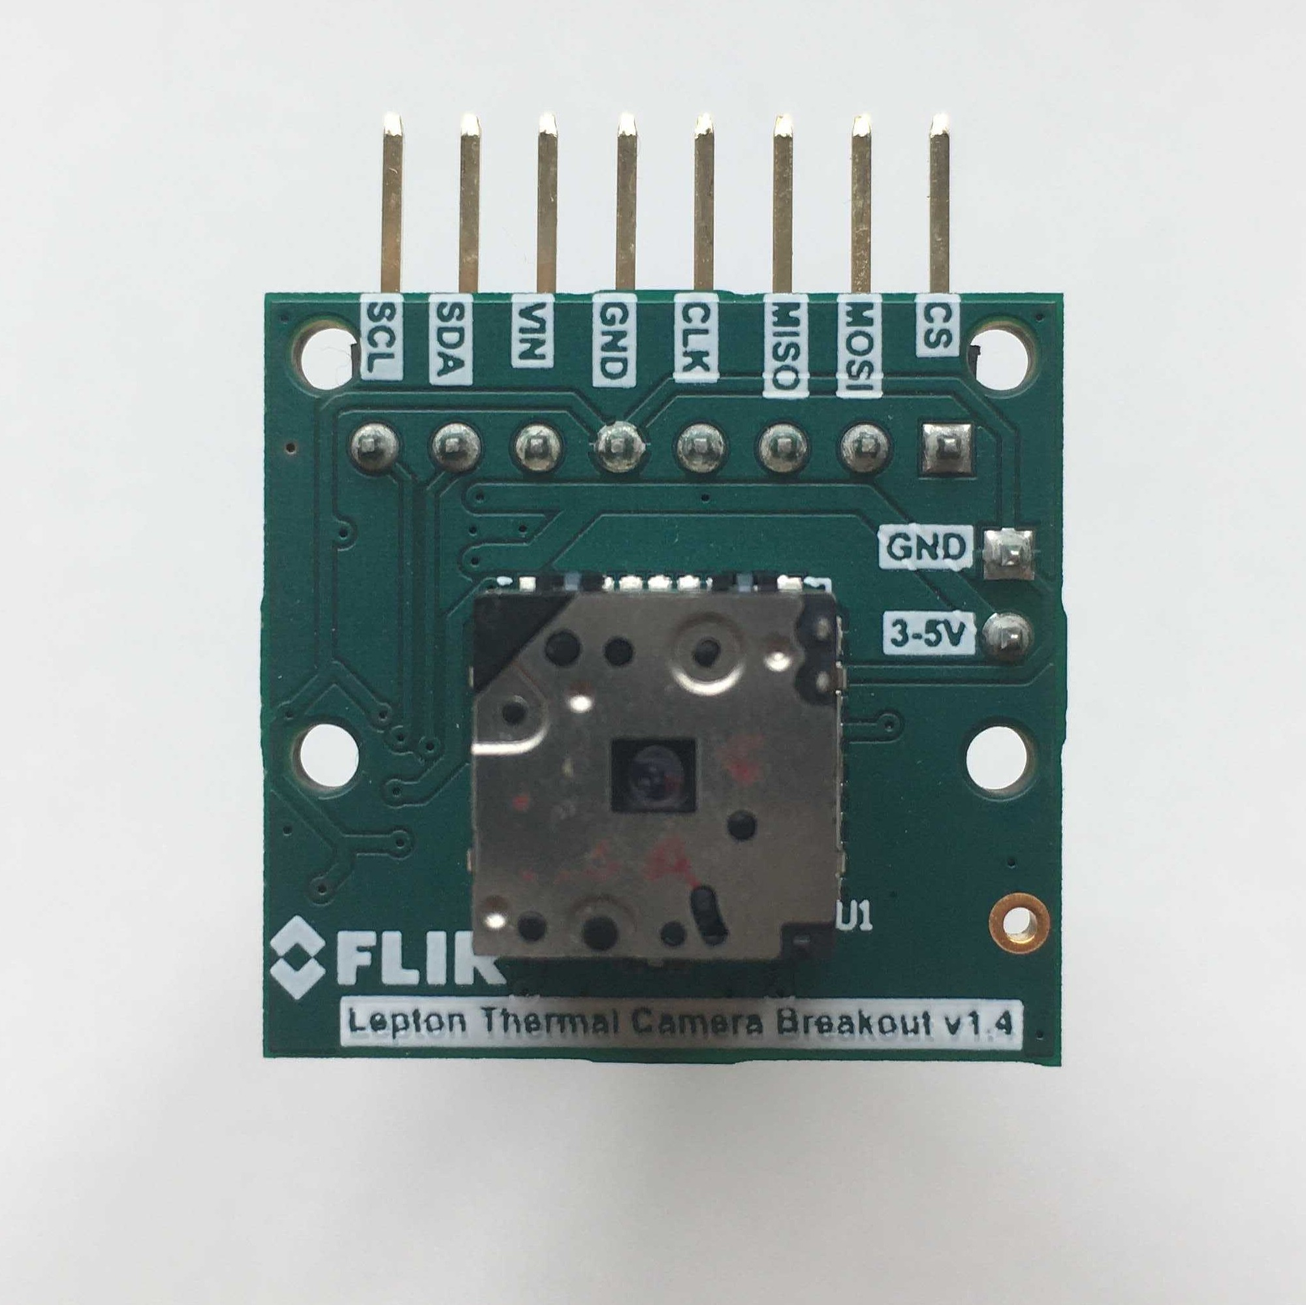
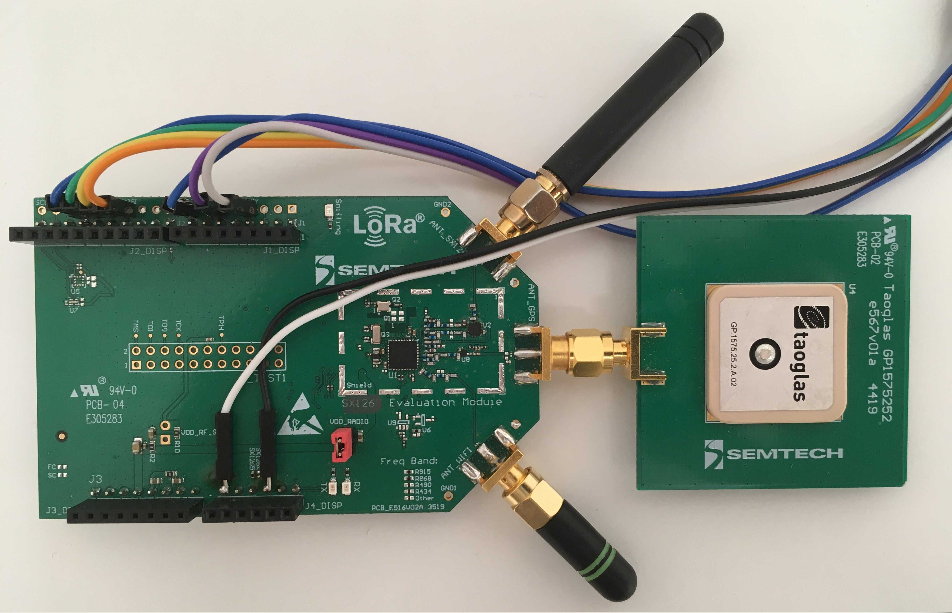
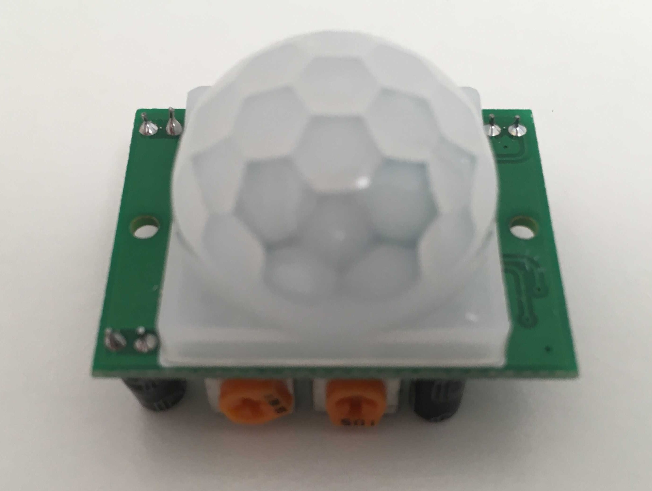
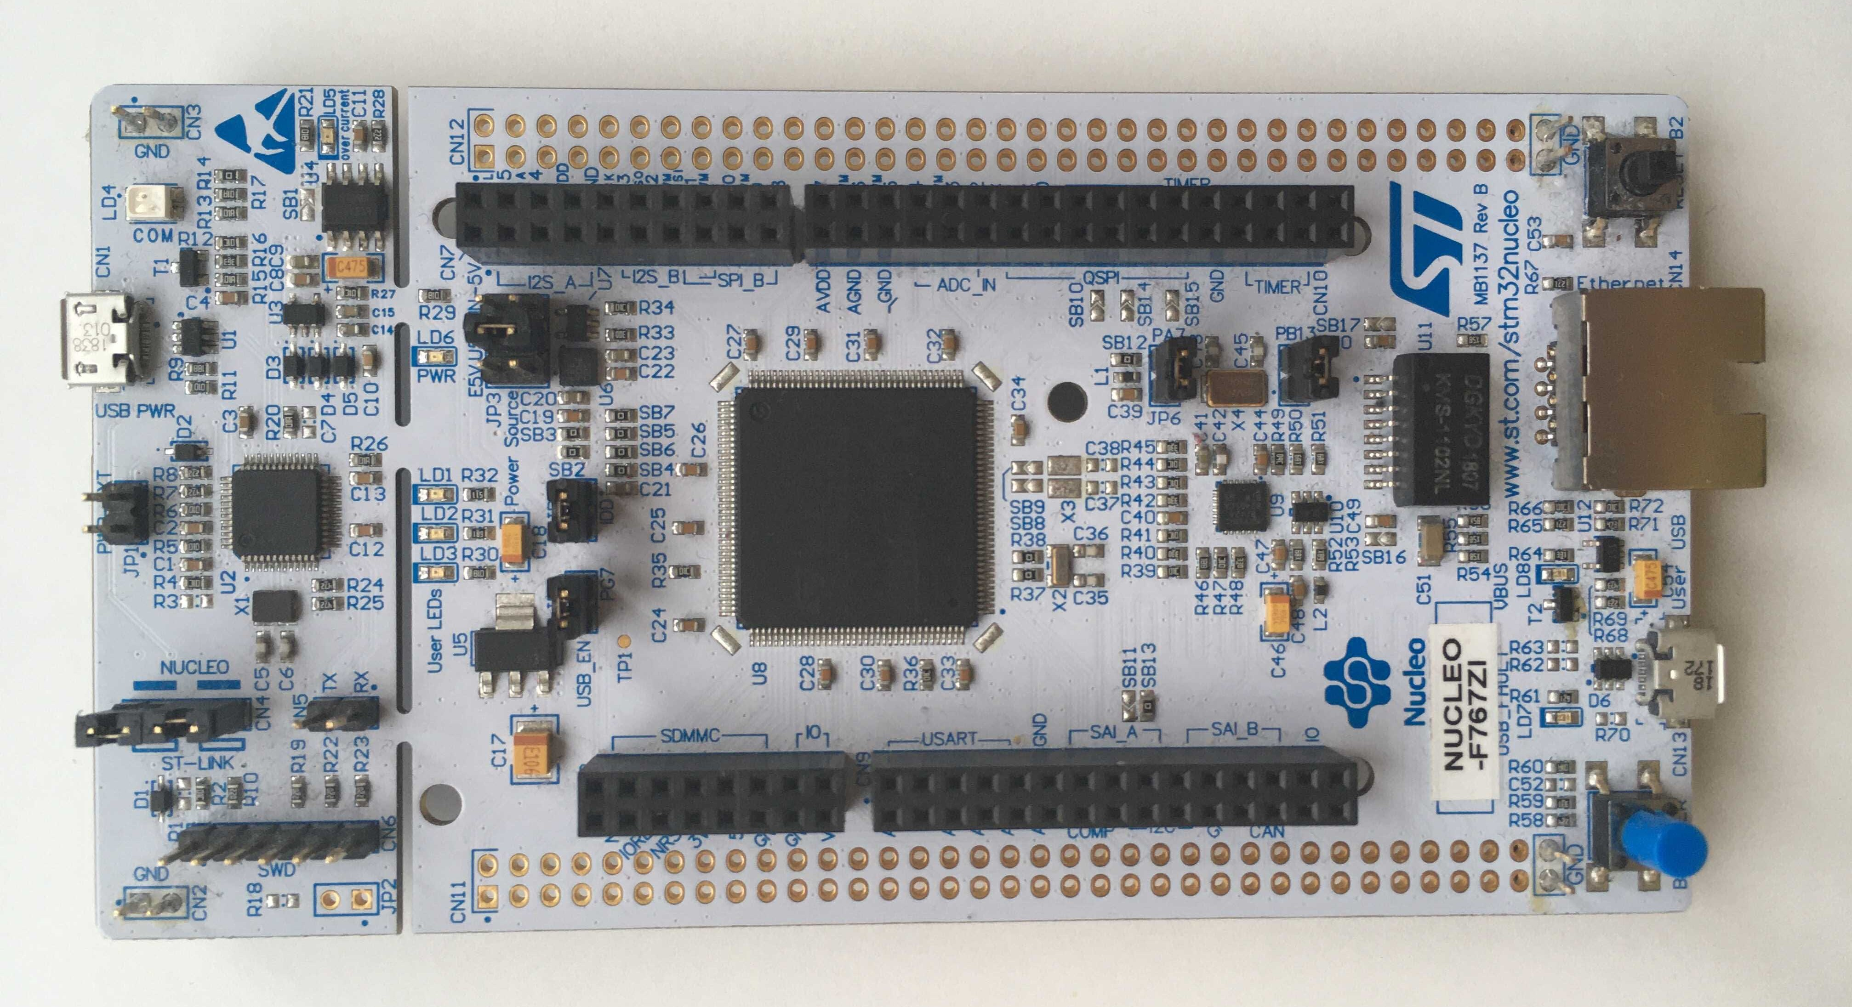
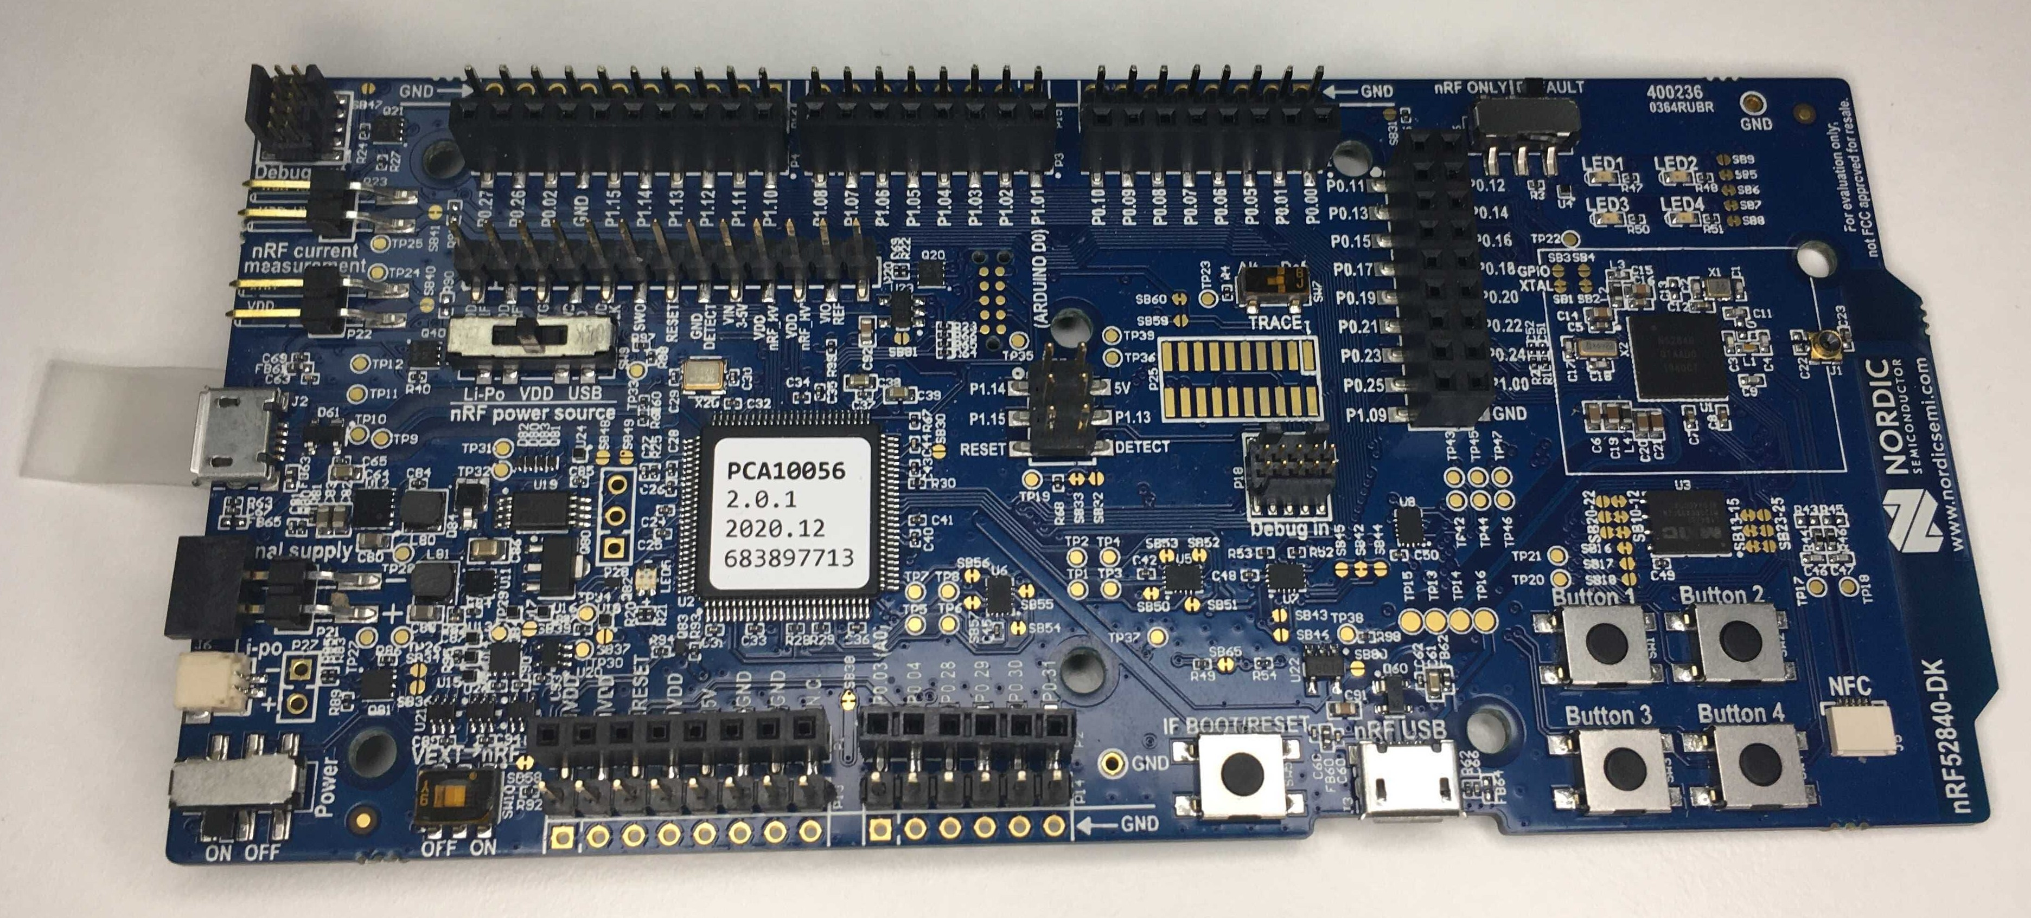
Used components
Development
environments
STM32767ZI:
Bare metal approach
Zepyhr
GNU Make
Arm embbedded version of GCC
OpenOCD & STLINK
NRF52840:
Zephyr
RTOS approach
West, Cmake
Jlink
Notes:
Human-elephant conflicts have become increasingly
common in recent decades, especially in India,
where increasing human population and habitat
loss, are forcing elephants to search for food on
nearby fields and plantations. A single elephant can
quickly trample a field of rice crops in a few hours,
causing big financial problems to already
Impoverished farmers. In turn, these farmers often
retaliate and set dangerous electrical or poisonous
traps that kill elephants. According to WWF, around
400 people and 100 elephants are killed every year
in India, alone. A lot of work was put into minimising
the human elephant conflicts, current approaches
include electric fences, watch towers, regular
patrols and camera traps. These solutions do not
work well or they are too expensive to maintain.
A reliable early detection system is needed that is
cheap and easy to maintain, which is capable of
detecting elephants and warning local communities
of their presence in the area.

Slide 13
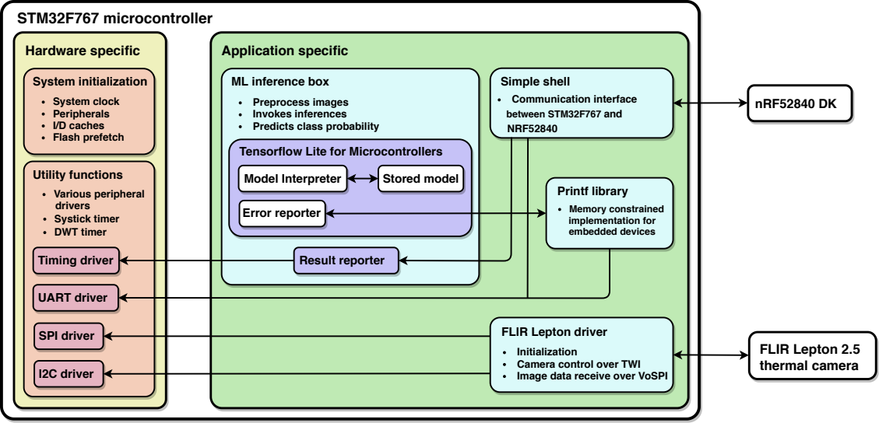
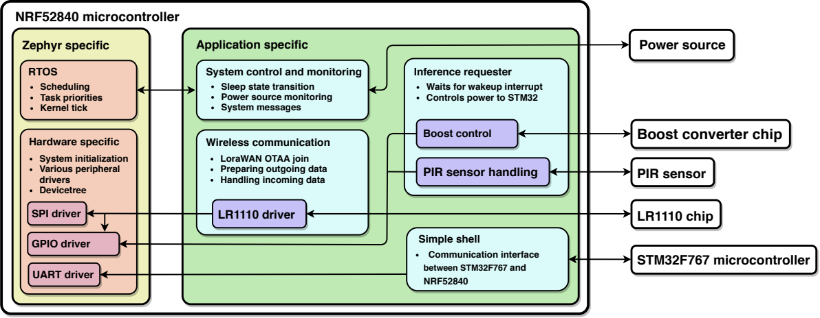
Firmware
Written modules:
Hardware initialisation for STM32
Flir Lepton driver
LR1110 driver
Simple shell over Uart
Notes:
Human-elephant conflicts have become increasingly
common in recent decades, especially in India,
where increasing human population and habitat
loss, are forcing elephants to search for food on
nearby fields and plantations. A single elephant can
quickly trample a field of rice crops in a few hours,
causing big financial problems to already
Impoverished farmers. In turn, these farmers often
retaliate and set dangerous electrical or poisonous
traps that kill elephants. According to WWF, around
400 people and 100 elephants are killed every year
in India, alone. A lot of work was put into minimising
the human elephant conflicts, current approaches
include electric fences, watch towers, regular
patrols and camera traps. These solutions do not
work well or they are too expensive to maintain.
A reliable early detection system is needed that is
cheap and easy to maintain, which is capable of
detecting elephants and warning local communities
of their presence in the area.

Slide 14
Porting TensorFlow to libopencm3
Observations:
Many example projects for many different platforms.
Build firmware with one main makefile.
Static library approach.
Problems:
Main makefile is big and hard to understand, needs long arguments to build examples.
Platform specific files are scattered all over the project.
Hard to include new platform using existing infrastructure.
What we wanted from our system:
Separate the project-specific code, libopencm3 code and TensorFlow code.
Easy to change microcontroller specific settings.
Keep static library approach.
Notes:
Human-elephant conflicts have become increasingly
common in recent decades, especially in India,
where increasing human population and habitat
loss, are forcing elephants to search for food on
nearby fields and plantations. A single elephant can
quickly trample a field of rice crops in a few hours,
causing big financial problems to already
Impoverished farmers. In turn, these farmers often
retaliate and set dangerous electrical or poisonous
traps that kill elephants. According to WWF, around
400 people and 100 elephants are killed every year
in India, alone. A lot of work was put into minimising
the human elephant conflicts, current approaches
include electric fences, watch towers, regular
patrols and camera traps. These solutions do not
work well or they are too expensive to maintain.
A reliable early detection system is needed that is
cheap and easy to maintain, which is capable of
detecting elephants and warning local communities
of their presence in the area.

Slide 15
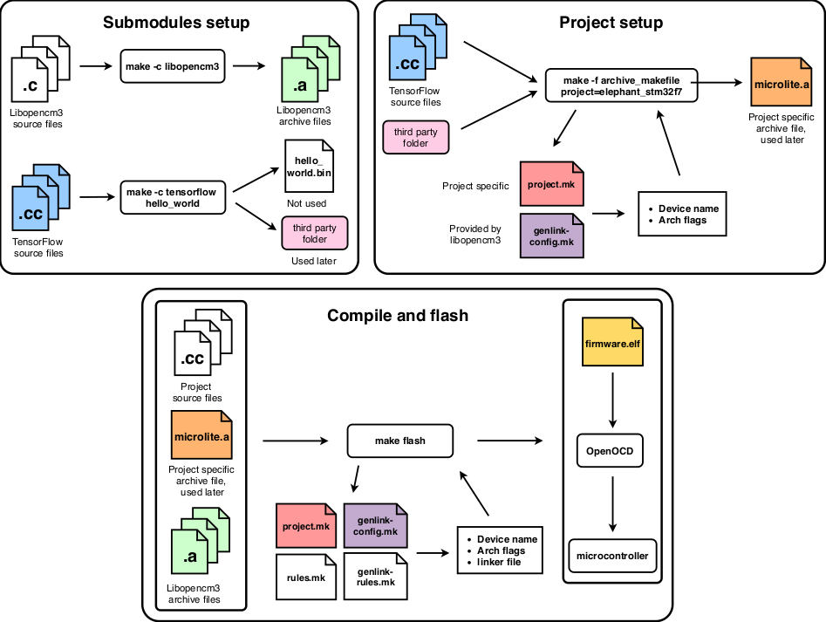
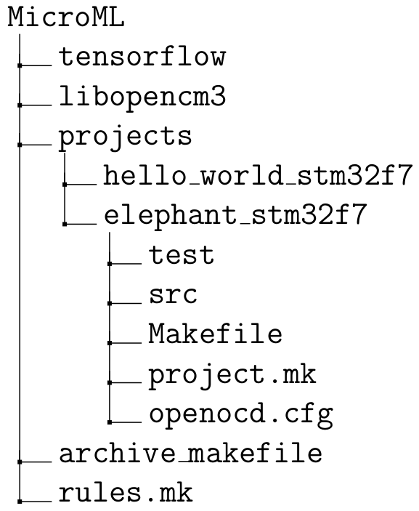
MicroML
Reuses part of libopencm3’s makefile.
Libopencm3 and TensorFlow are Git submodules.
Each project has its own folder with its specific settings.
Can be also used for non ML applications.
Three phase compilation.
Notes:
Human-elephant conflicts have become increasingly
common in recent decades, especially in India,
where increasing human population and habitat
loss, are forcing elephants to search for food on
nearby fields and plantations. A single elephant can
quickly trample a field of rice crops in a few hours,
causing big financial problems to already
Impoverished farmers. In turn, these farmers often
retaliate and set dangerous electrical or poisonous
traps that kill elephants. According to WWF, around
400 people and 100 elephants are killed every year
in India, alone. A lot of work was put into minimising
the human elephant conflicts, current approaches
include electric fences, watch towers, regular
patrols and camera traps. These solutions do not
work well or they are too expensive to maintain.
A reliable early detection system is needed that is
cheap and easy to maintain, which is capable of
detecting elephants and warning local communities
of their presence in the area.

Slide 16
Evaluating accuracy of the trained models
Set hyperparameter search space
Conducted two random search algortihms
Compared to similiar Edge Impulse models
Some Edge Impulse models were trained with Transfer Learning techniquie
Notes:
Human-elephant conflicts have become increasingly
common in recent decades, especially in India,
where increasing human population and habitat
loss, are forcing elephants to search for food on
nearby fields and plantations. A single elephant can
quickly trample a field of rice crops in a few hours,
causing big financial problems to already
Impoverished farmers. In turn, these farmers often
retaliate and set dangerous electrical or poisonous
traps that kill elephants. According to WWF, around
400 people and 100 elephants are killed every year
in India, alone. A lot of work was put into minimising
the human elephant conflicts, current approaches
include electric fences, watch towers, regular
patrols and camera traps. These solutions do not
work well or they are too expensive to maintain.
A reliable early detection system is needed that is
cheap and easy to maintain, which is capable of
detecting elephants and warning local communities
of their presence in the area.

Slide 17
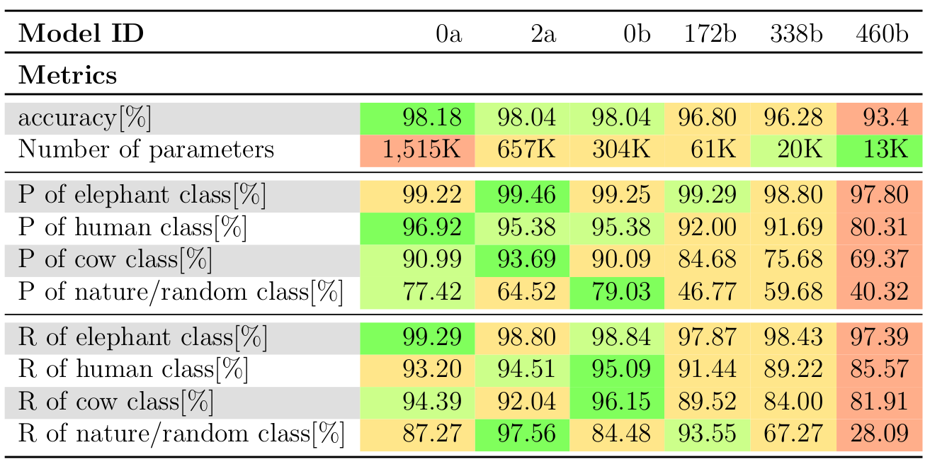
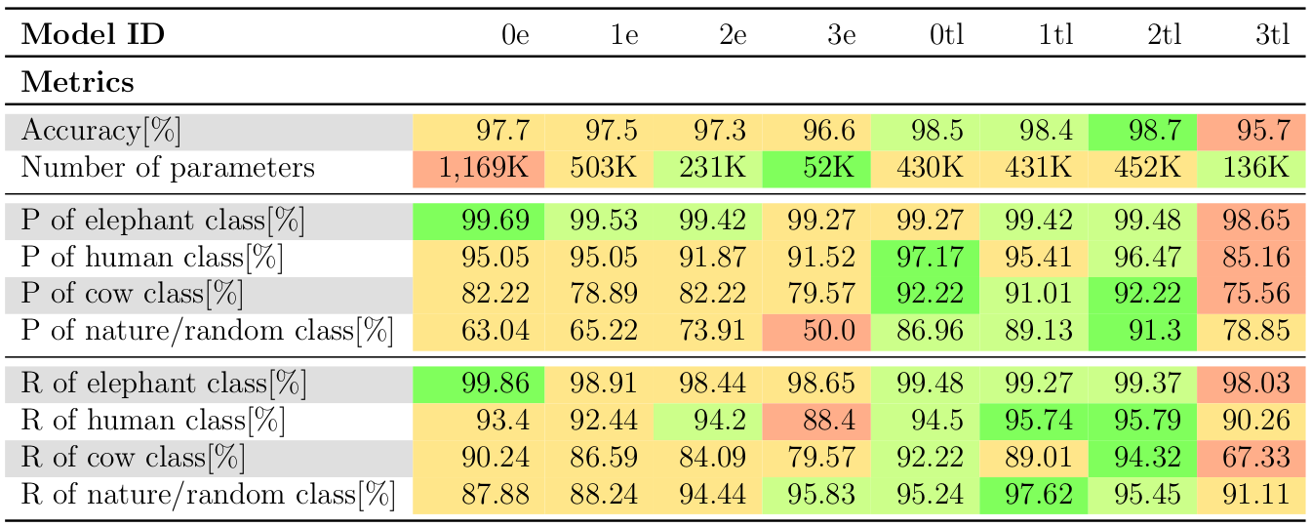
Model comparisons
Observations:
Choosing optimal hyperparameters is a non-heuristic task.
Bigger model ≠ greater accuracy
Transfer learning models outpreformed other models, highest accuracy was 98.7 %
Notes:
Human-elephant conflicts have become increasingly
common in recent decades, especially in India,
where increasing human population and habitat
loss, are forcing elephants to search for food on
nearby fields and plantations. A single elephant can
quickly trample a field of rice crops in a few hours,
causing big financial problems to already
Impoverished farmers. In turn, these farmers often
retaliate and set dangerous electrical or poisonous
traps that kill elephants. According to WWF, around
400 people and 100 elephants are killed every year
in India, alone. A lot of work was put into minimising
the human elephant conflicts, current approaches
include electric fences, watch towers, regular
patrols and camera traps. These solutions do not
work well or they are too expensive to maintain.
A reliable early detection system is needed that is
cheap and easy to maintain, which is capable of
detecting elephants and warning local communities
of their presence in the area.

Slide 18
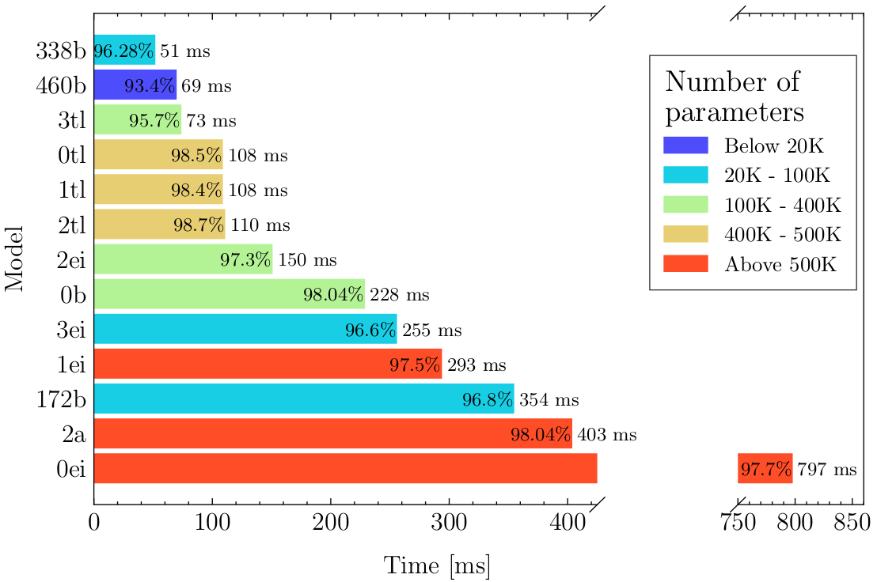
Comparison of inference times
Notes:
Human-elephant conflicts have become increasingly
common in recent decades, especially in India,
where increasing human population and habitat
loss, are forcing elephants to search for food on
nearby fields and plantations. A single elephant can
quickly trample a field of rice crops in a few hours,
causing big financial problems to already
Impoverished farmers. In turn, these farmers often
retaliate and set dangerous electrical or poisonous
traps that kill elephants. According to WWF, around
400 people and 100 elephants are killed every year
in India, alone. A lot of work was put into minimising
the human elephant conflicts, current approaches
include electric fences, watch towers, regular
patrols and camera traps. These solutions do not
work well or they are too expensive to maintain.
A reliable early detection system is needed that is
cheap and easy to maintain, which is capable of
detecting elephants and warning local communities
of their presence in the area.

Slide 19
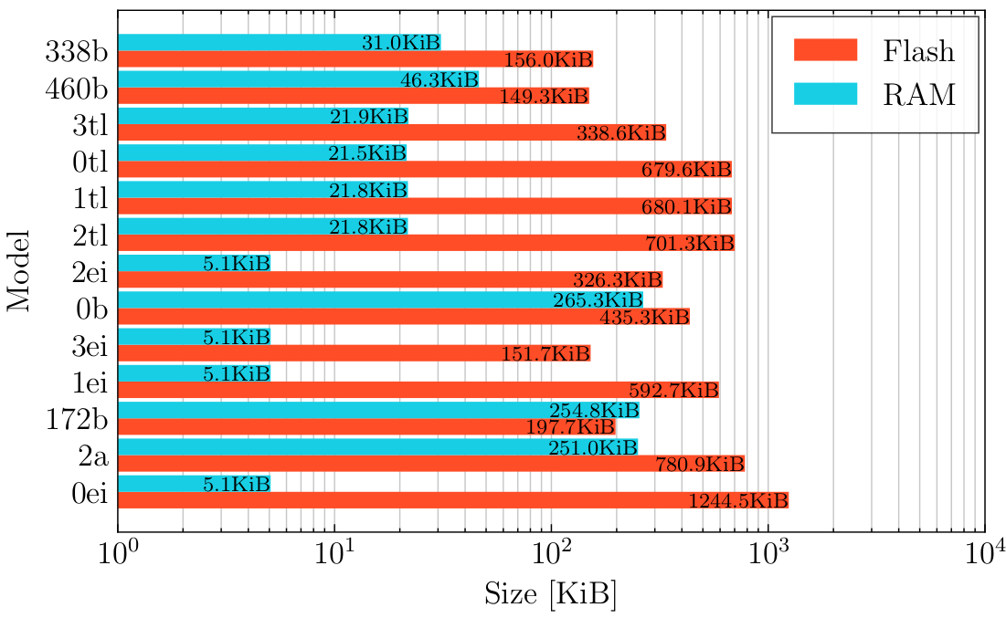
Comparison of code sizes
Notes:
Human-elephant conflicts have become increasingly
common in recent decades, especially in India,
where increasing human population and habitat
loss, are forcing elephants to search for food on
nearby fields and plantations. A single elephant can
quickly trample a field of rice crops in a few hours,
causing big financial problems to already
Impoverished farmers. In turn, these farmers often
retaliate and set dangerous electrical or poisonous
traps that kill elephants. According to WWF, around
400 people and 100 elephants are killed every year
in India, alone. A lot of work was put into minimising
the human elephant conflicts, current approaches
include electric fences, watch towers, regular
patrols and camera traps. These solutions do not
work well or they are too expensive to maintain.
A reliable early detection system is needed that is
cheap and easy to maintain, which is capable of
detecting elephants and warning local communities
of their presence in the area.

Slide 20
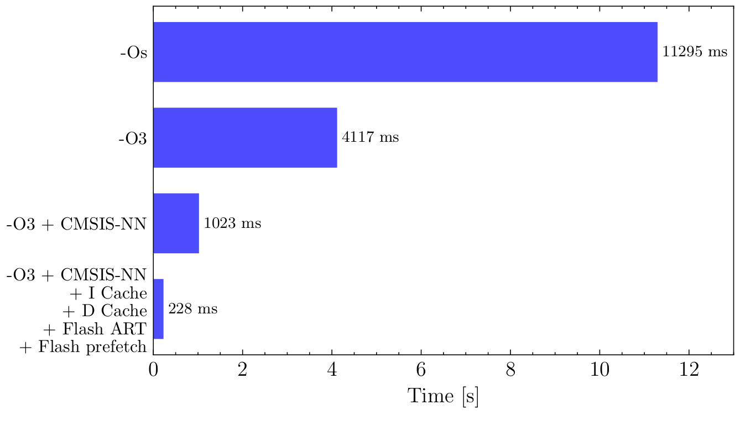
Comparison of different optimisations
Notes:
Human-elephant conflicts have become increasingly
common in recent decades, especially in India,
where increasing human population and habitat
loss, are forcing elephants to search for food on
nearby fields and plantations. A single elephant can
quickly trample a field of rice crops in a few hours,
causing big financial problems to already
Impoverished farmers. In turn, these farmers often
retaliate and set dangerous electrical or poisonous
traps that kill elephants. According to WWF, around
400 people and 100 elephants are killed every year
in India, alone. A lot of work was put into minimising
the human elephant conflicts, current approaches
include electric fences, watch towers, regular
patrols and camera traps. These solutions do not
work well or they are too expensive to maintain.
A reliable early detection system is needed that is
cheap and easy to maintain, which is capable of
detecting elephants and warning local communities
of their presence in the area.

Slide 21
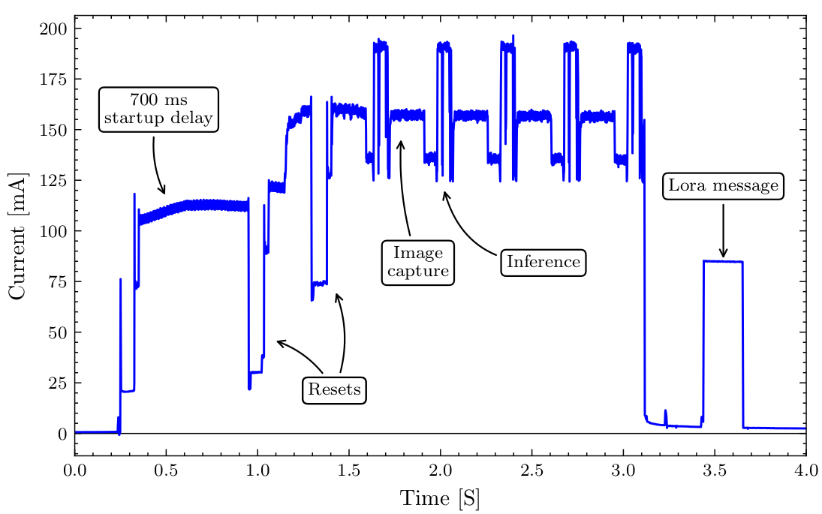
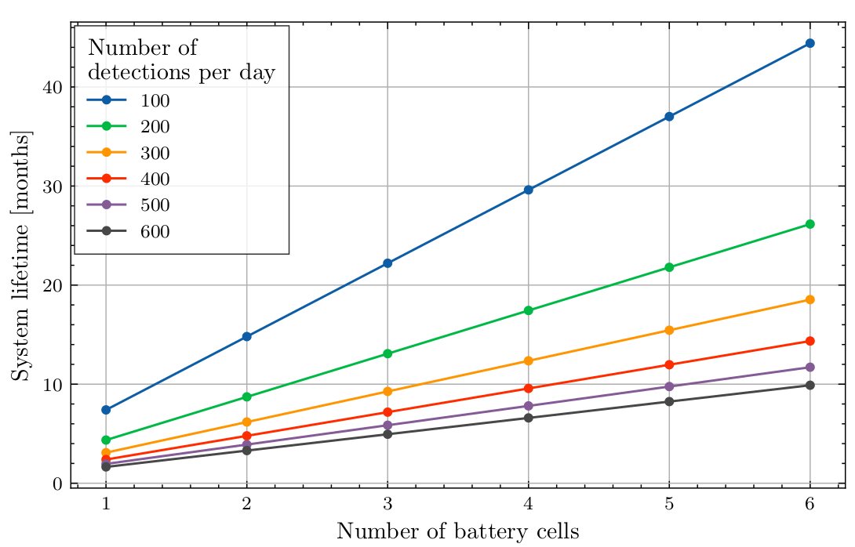
Current consumption evaluation
PIR and low-power state, 207 uA
Detection sequence, 52 mA for 8 s
LoRaWan message, 80 mA for 230 ms
Panasonic NCR 18650B, 3350 mAh
Worst case – lifetime of 10 months
Notes:
Human-elephant conflicts have become increasingly
common in recent decades, especially in India,
where increasing human population and habitat
loss, are forcing elephants to search for food on
nearby fields and plantations. A single elephant can
quickly trample a field of rice crops in a few hours,
causing big financial problems to already
Impoverished farmers. In turn, these farmers often
retaliate and set dangerous electrical or poisonous
traps that kill elephants. According to WWF, around
400 people and 100 elephants are killed every year
in India, alone. A lot of work was put into minimising
the human elephant conflicts, current approaches
include electric fences, watch towers, regular
patrols and camera traps. These solutions do not
work well or they are too expensive to maintain.
A reliable early detection system is needed that is
cheap and easy to maintain, which is capable of
detecting elephants and warning local communities
of their presence in the area.

Slide 22
Summary
Embedded ML has become viable.
Running inference on the device is prefered.
Many fields, not only Animal Conservation, can benefit from it.
Future Improvements
Gather more image data.
Test system on field.
Design custom hardware and optimise detection sequence.
Notes:
Human-elephant conflicts have become increasingly
common in recent decades, especially in India,
where increasing human population and habitat
loss, are forcing elephants to search for food on
nearby fields and plantations. A single elephant can
quickly trample a field of rice crops in a few hours,
causing big financial problems to already
Impoverished farmers. In turn, these farmers often
retaliate and set dangerous electrical or poisonous
traps that kill elephants. According to WWF, around
400 people and 100 elephants are killed every year
in India, alone. A lot of work was put into minimising
the human elephant conflicts, current approaches
include electric fences, watch towers, regular
patrols and camera traps. These solutions do not
work well or they are too expensive to maintain.
A reliable early detection system is needed that is
cheap and easy to maintain, which is capable of
detecting elephants and warning local communities
of their presence in the area.

