Slide 1


National and Technical University
Of Athens
School of Electrical
and Computer Engineering
Measuring & Analysing Race Data
Diomataris Markos
Prometheus Team
Notes:
ΕΘΝΙΚΟ ΜΕΤΣΟΒΙΟ ΠΟΛΥΤΕΧΝΕΙΟ

Slide 2
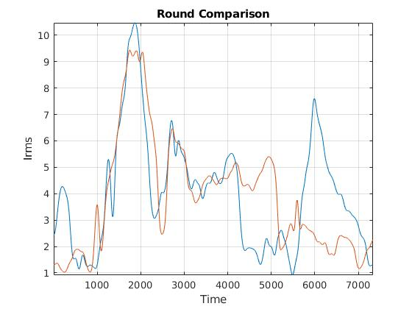
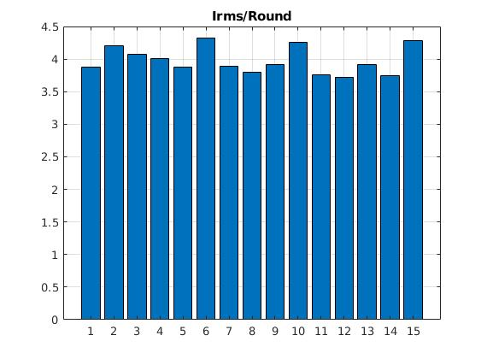
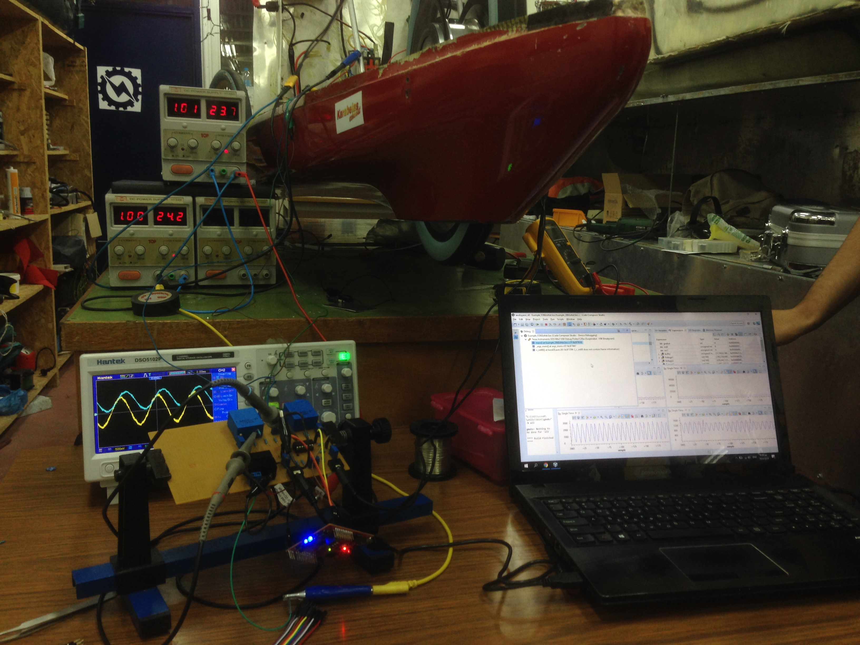
Goal
Better understanding of vehicle’s behaviour in race conditions.
Design the best on track strategy possible
Generate vehicle model

Slide 3
Requirements
We wanted a system the measures and logs data:
What data?
Motor’s input electric power
Current Rms
Location

Slide 4
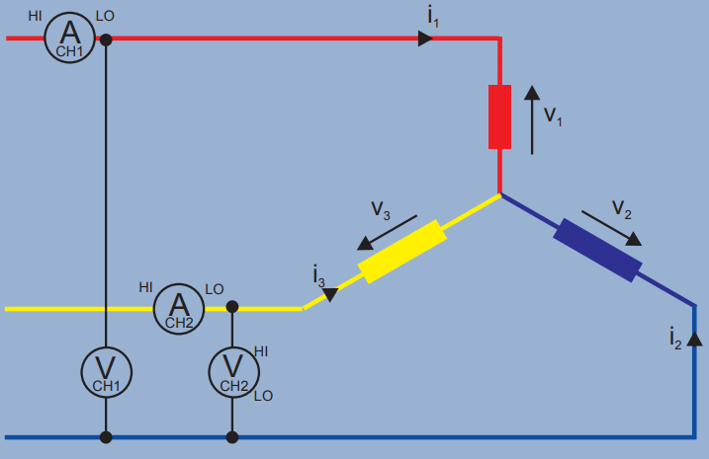
Measuring Power on a 3-phase Motor
Wattmeter 1 : i₁ (v₁ - v₃)
Wattmeter 2 : i₂ (v₂ – v₃)
W1 + W2 = ... = i₁v₁ + i₂v₂ - (i₁ + i₂) v₃
(Kirchoff’s law, i₁ + i₂ + i3 = 0 => i₁ + i₂ = -i₃)
W1 + W2 = i₁v₁ + i₂v₂ + i₃v₃ = Total instantaneous watts.

Slide 5





System overview
Data/Display Management
Storage
GPS
i₁
@10 Hz
Lcd display
i₂
@2.5 kHz
v₁
v₂
Real-time on-board signal processing

Slide 6
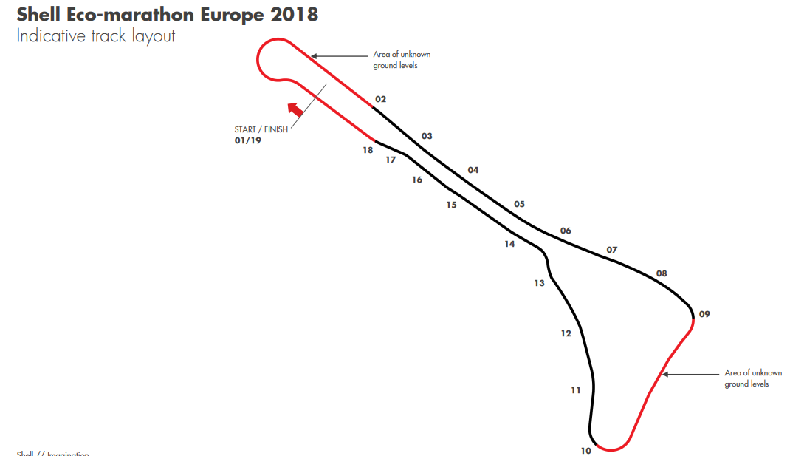
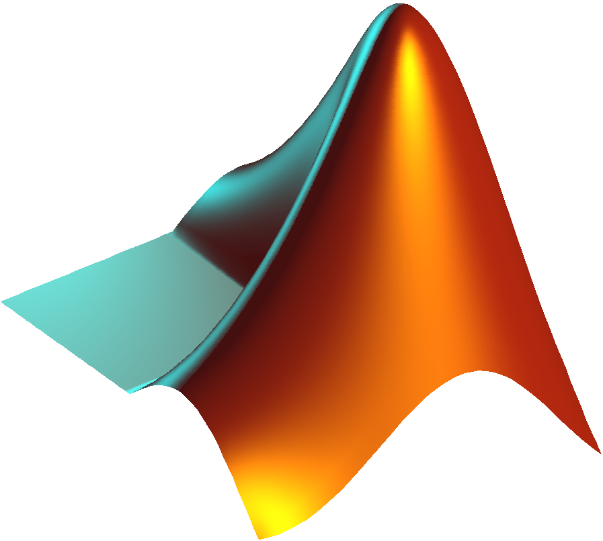
Data processing
1. Noise rejection.
2. Automatic lap counting.
3. Automatic data mapping.
4. Visualisation of results.

Slide 7
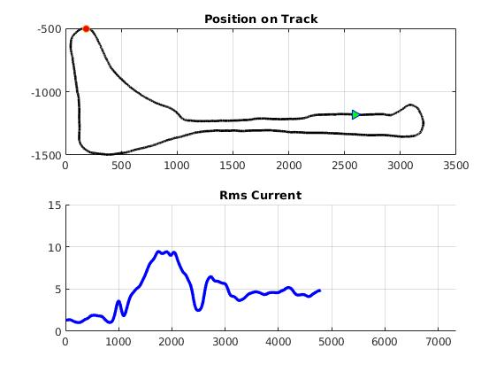
Round evaluation
Correlation between consumption and race condition factors (e.g. driver’s psychology)

Slide 8
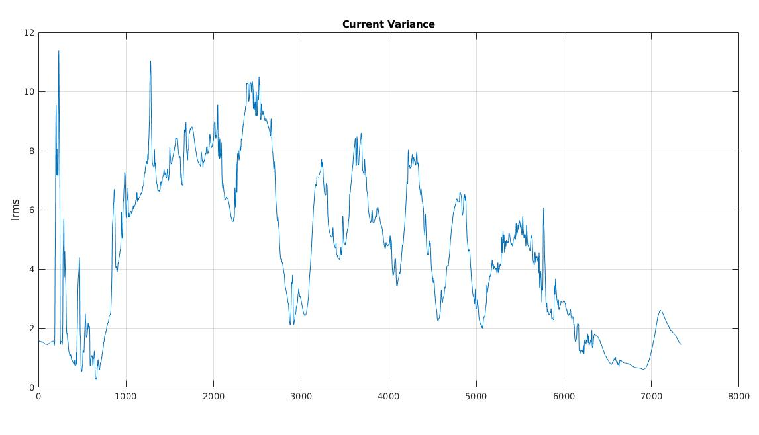
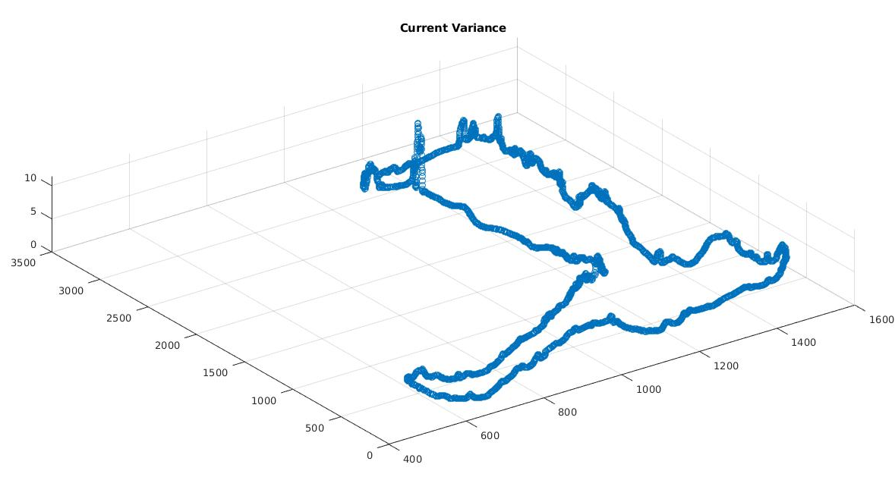
Useful conclusions
Localization of the most inconsistent (in the driving sense) part of the track using the motor’s current variance at each pont of the track throughout the race
Current Variance / point

