Slide 1
Markov-Grammatical-Inferencer/shiny-computing-machine
by Avi Weinstock, Alex White, and Hayleigh Sanders

Slide 2
Project goals
Learn OCaml (a functional language in the ML family)
Implement/play with various NLP algorithms, ostensibly to make some sort of grammar checking library/application

Slide 3
GLR Parser
Efficient, parallelizable parsing algorithm for arbitrary context-free grammars
With added tracking of probabilities, should be able to handle parsing of natural language text
Our implementation sort of works for simple grammars (but seems to have some subtle bugs), but visualizes the resulting trees fairly nicely
<Demo of parse tree displayer>

Slide 4
Markov-chain based generator
Scans over an input text to get a table for some parameter W that answers “Given the last W characters, what are the probabilities of each character occurring next?”.
Generator uses that table as the sizes for a weighted roulette wheel to generate pseudorandom text that is superficially similar to the input text (and has the same statistical profile, modulo sampling error).
<Demo of generator>

Slide 5
Markov-chain based recognizer
The recognizer is an attempt to use the table from the previous slide to see if some text matches the data found in the input.
Works by scanning across the text to be tested, keeping a window of context, and for each character it sees, “operating on” the probability of that character given the context.

Slide 6
Markov-chain based recognizer
The “correct” operation for each step is multiplication (ANDing the probabilities together), but with floats this always gets 0, and with arbitrary-precision rationals it's too slow on even small text samples
Averaging the probabilities gets nontrivial output, but it's probably not a meaningful metric (average probability of a character, given the context?)

Slide 7
Qlearning Overview
- Q-Learning is a machine learning technique that selects the optimal policy for any given Markov decision process
- The algorithm is trained over a body of test data to obtain the optimal policy
- It is composed of an agent, a set of states and a set of actions per state.
- In the learning phase, the algorithm performs simple value iteration updating to make corrections based on new information

Slide 8
Implementation with Grammar Inferencer
As the q-learning algorithm was being written and tested, it became apparent that grammatical inferencing is not a finite markov process – and thus the algorithm wouldn't work
Instead, I implemented a standalone q-learning algorithm but unrelated to the inferencer

Slide 9
Prisoner's Dilemma and Results
Prisoner's Dilemma is a logic puzzle that can be solved with q learning

Slide 10
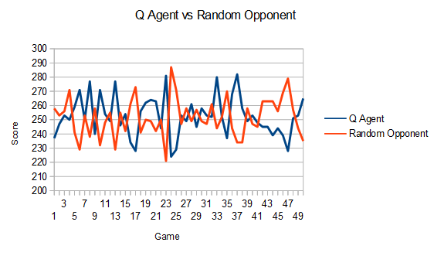

Slide 11
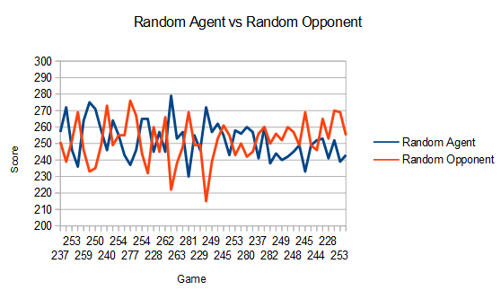

Slide 12
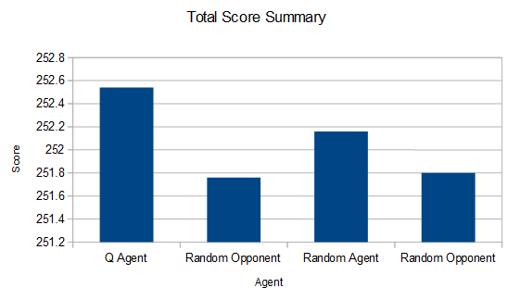

Slide 13
Questions?

Slide 14
Thanks to:
Professor Goldschmidt
Professor Moorthy
RCOS
Sean O' Sullivan

