Slide 1
Video Game Data Analysis
Team: Mark Levine, Richa Singh, John Yun, Miguel Gomez Data source "Kaggle.com" https://www.kaggle.com/gregorut/videogamesales

Slide 2
Motivation & Summary
Define the core message or hypothesis of your project
Describe the questions you asked, and why you asked them
Describe whether you were able to answer these questions to your satisfaction, and briefly summarize your findings

Slide 3
Questions & Data

Slide 4
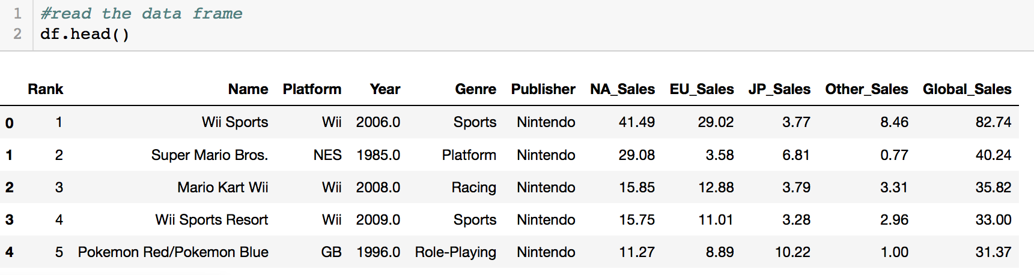
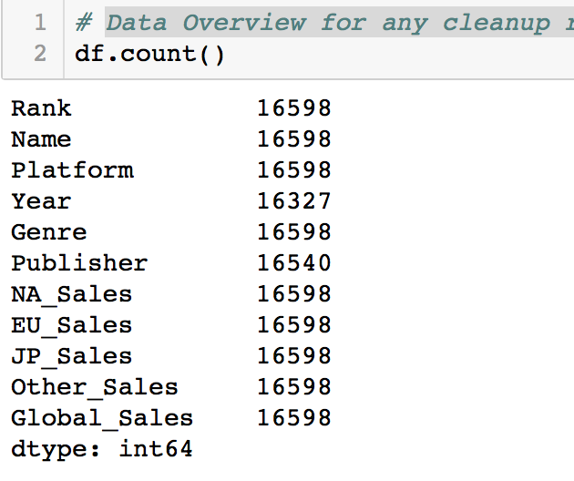
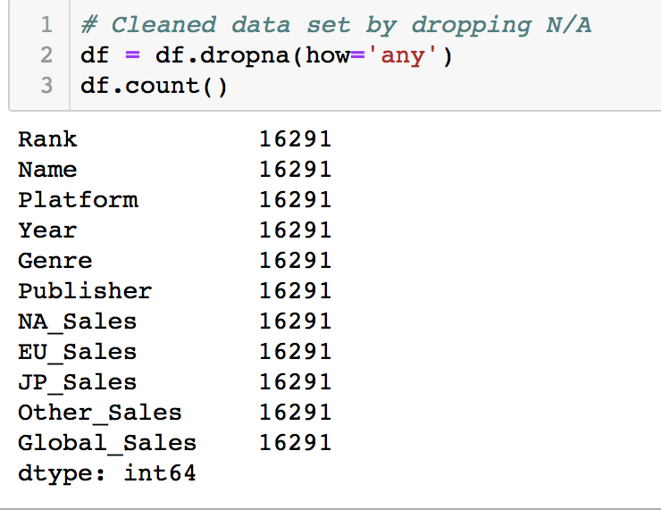
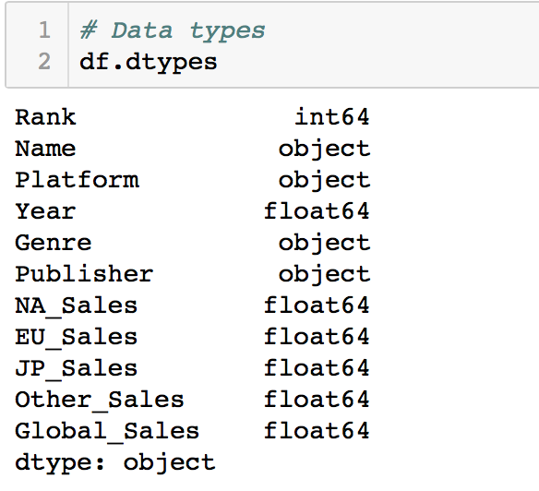
Data Cleanup & Exploration
Data Overview for any cleanup requirements was done by an initial count to determine discrepancies
Counts for Year and Publisher column did not match up.
Dropped the N/A
Checked the datatype
Link to jupyter notebook on githib
https://github.com/MarkovCredit/Project_1_Team6/blob/master/VG_Analytics_RS/T6_P1.ipynb
Notes:
Year column has 271 entries with N/A
2. Publisher column has 58 entries with N/A

Slide 5
Data Analysis

Slide 6
Discussion

Slide 7
Post Mortem

