Slide 1
Video Game Data Analysis
Team: Mark Levine, Richa Singh, John Yun, Miguel Gomez Data source "Kaggle.com" https://www.kaggle.com/gregorut/videogamesales

Slide 2
Motivation & Summary
Define the core message or hypothesis of your project
Does region play a role in the revenue of video games based upon various factors?
Describe the questions you asked, and why you asked them
Are North American sales vs EU/JP/Other sales different
Does genre play a role in this result?
Does platform play a role?
Describe whether you were able to answer these questions to your satisfaction, and briefly summarize your findings
Yes, they were answered to our satisfaction, and corroborated assumptions that we already had regarding the industry.

Slide 3
Questions & Data
Elaborate on the questions you asked, describing what kinds of data you needed to answer them, and where you found it
Due to the regional releases of games, their differing genres, changing platforms, and independent tastes we needed representative data that encompassed all these different attributes. Out data was a web scrape featuring Year, Genre, Platform, and Regional Sales.
The data was constructed using a web scrape utilizing Beautiful Soup and scraping VGCHARTZ.com

Slide 4
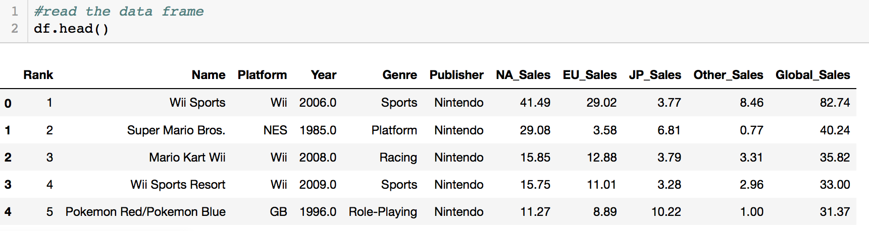
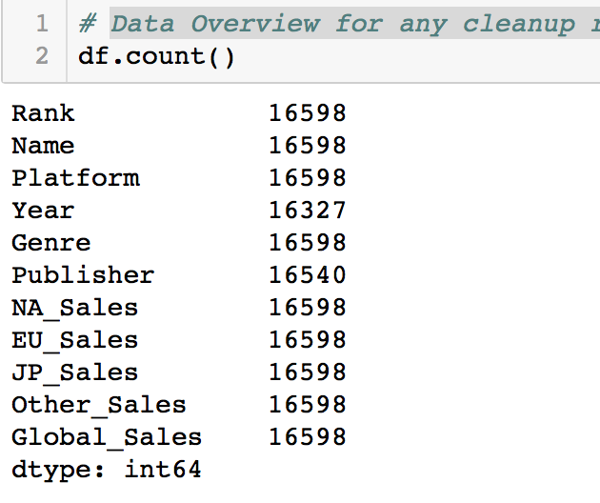
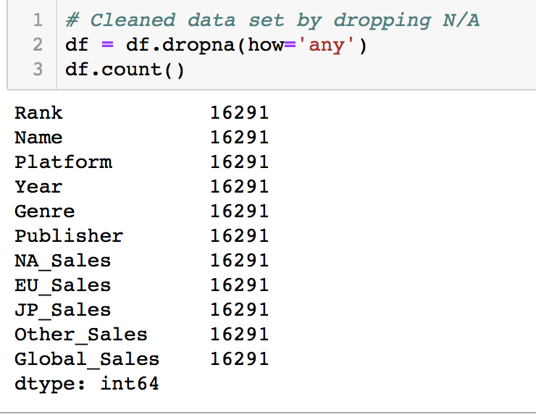
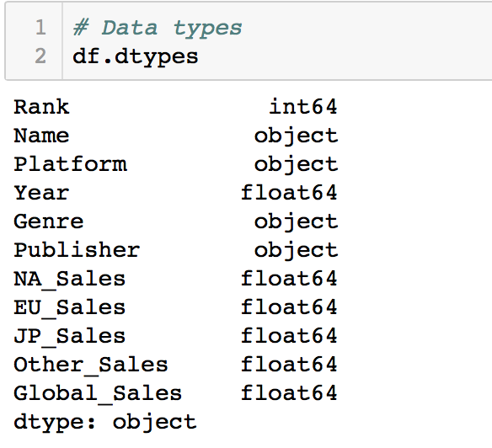
Data Cleanup
Data Overview for any cleanup requirements was done by an initial count to determine discrepancies
Counts for Year and Publisher column did not match up.
Dropped the N/A
Checked the datatype
https://github.com/MarkovCredit/Project_1_Team6/blob/master/Final%20Code/Team%206%20Video%20Game%20Analytics.ipynb

Slide 5
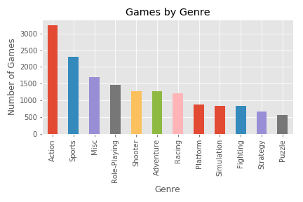
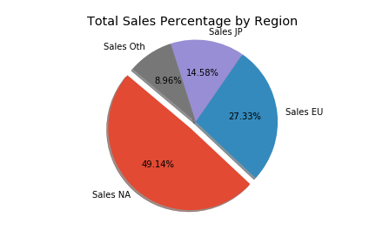
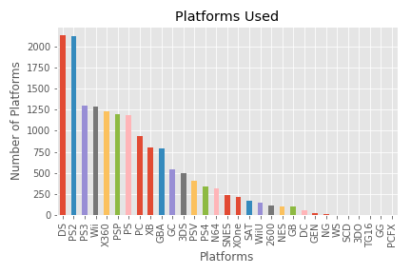
Visualizations
From the cleaned data the following graphs were created:
Pie graph to compare total sales percentage by Region.
Bar chart to show games by Genre.
As well as the distribution of platforms used.

Slide 6
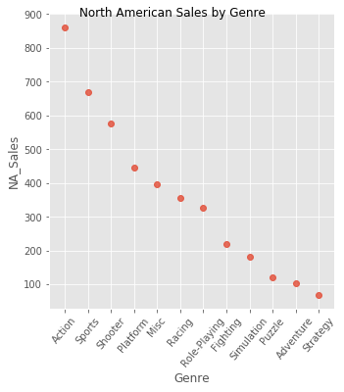
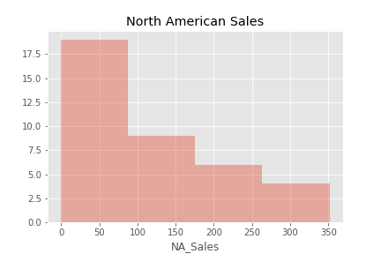
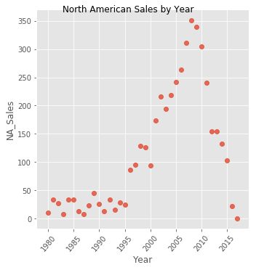
North America Data Visualizations
These graphs show North American specific graphs:
The scatter plot shows video game sales by year.
The histogram depicts North American sales
North American Sales by genre shows favored genres.

Slide 7
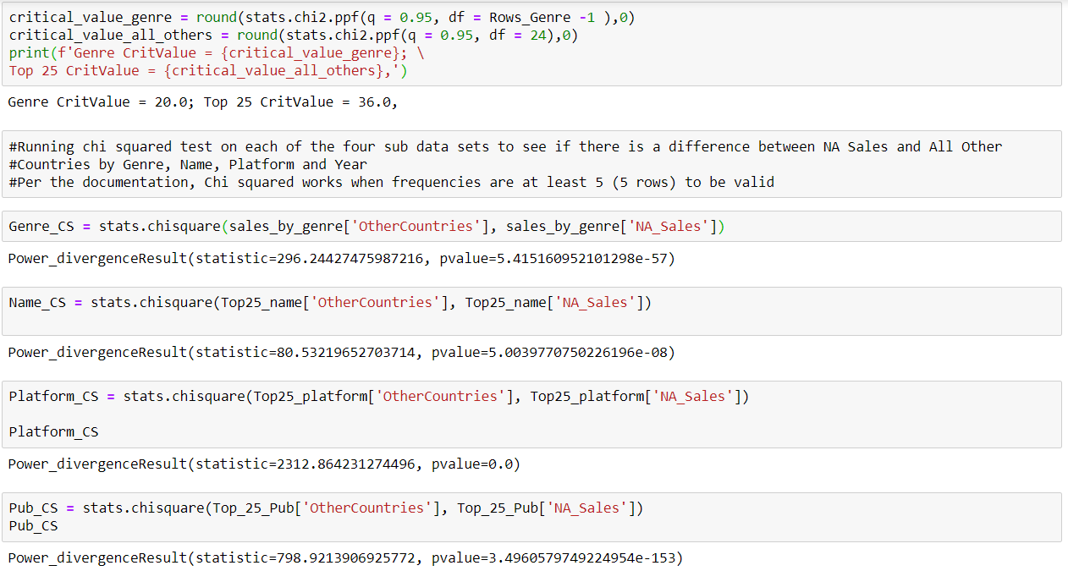
Analysis
Chi Squared
Generally, chi-square tests are useful when looking at differences within categorical variables and testing differences in populations. In our analysis, we are using one-way Goodness of Fit (discussed during lecture).
NULL hypothesis is that video game sales are the same when specifically comparing North America versus the Rest of the World.
Roadblock: divide by zero error. Make sure that very small values and 0s are removed from data.
Results from running chi square on each of the four sub data sets confirm rejection of the NULL hypothesis: video game sales are different when analyzing by Name, Platform, Genre and Publisher.
Notes:
Year column has 271 entries with N/A
2. Publisher column has 58 entries with N/A

Slide 8
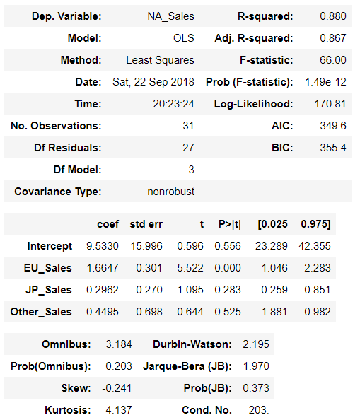
Analysis
Linear Regression by Platform
Linear Regression using Stats Models (Ordinary Least Squares: y = mx1+…mxN + B
Our dependent variable, North American sales; independent variables are all other countries’ sales in USD million. This data is specifically looking at Platform
Interpreting our results:
Intercept $9.53 million
Slope for EU = 1.66; for every $1 million in EU sales, US sales will go up by $1.66 million (data set adjusts all sales to USD)
Slope for Japan = 0.30; for every $1 million dollars in Japanese sales, US sales for this platform will go up by ~ $296k
Slope for All Other Countries = -0.45; for every $1 million in sales, US sales are expected to drop by $450k. Sales cannot be negative, but our intercept (starting point) at $9.53M prevents sales being negative.
R-squared = 0.88: this denotes the linear relationship fits our data well
Notes:
Year column has 271 entries with N/A
2. Publisher column has 58 entries with N/A

Slide 9
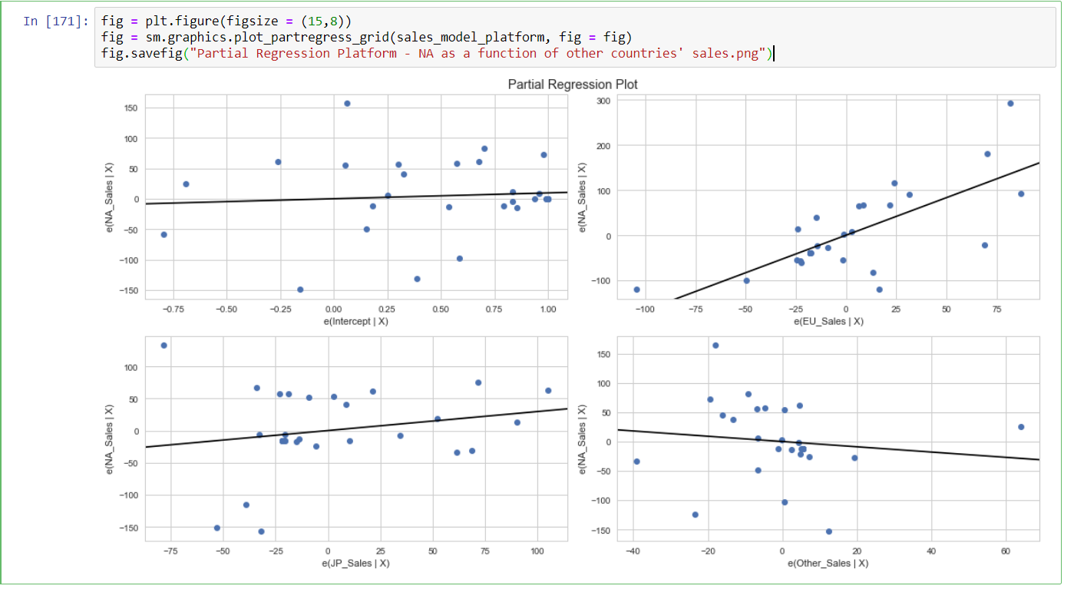
Analysis
Linear Regression by Platform
Plotting the existing relationships between countries’ sales before making any predictions;
Upper left-hand plot is intercept only
EU and US (top right) sales depict a strong positive relationship
Japan and US (bottom left) sales are positive but much lower vis-à-vis EU
Other Countries and US (bottom right) sales have a negative relationship
Notes:
Year column has 271 entries with N/A
2. Publisher column has 58 entries with N/A

Slide 10
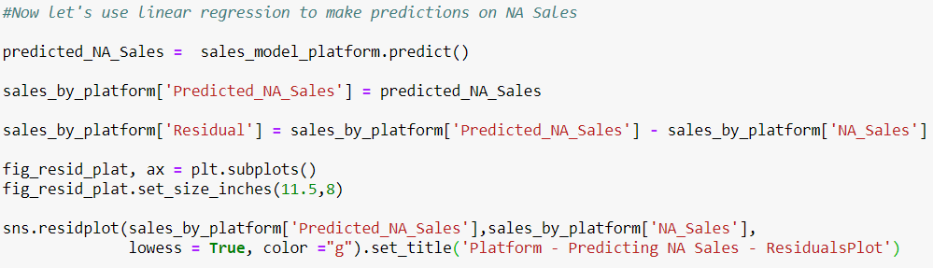
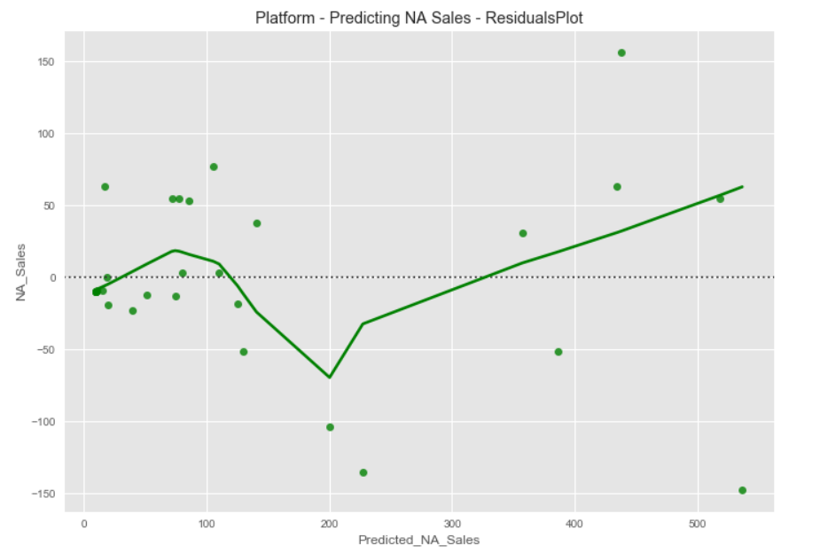
Analysis
Linear Regression by Platform
Next, we actually predict North American sales using sales from the other regions (EU, Japan and Other countries). X-axis is our prediction and Y-axis is the actual NA Sales.
As we can see from the plot of the residuals, we were off on quite a few predictions but we also got some right.
Notes:
Year column has 271 entries with N/A
2. Publisher column has 58 entries with N/A

Slide 11
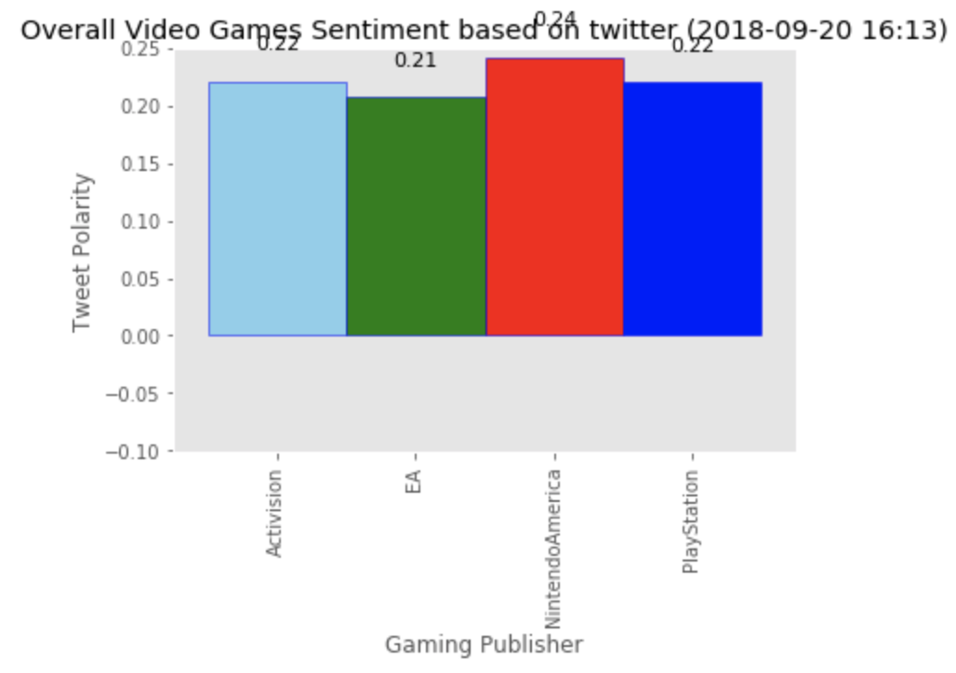
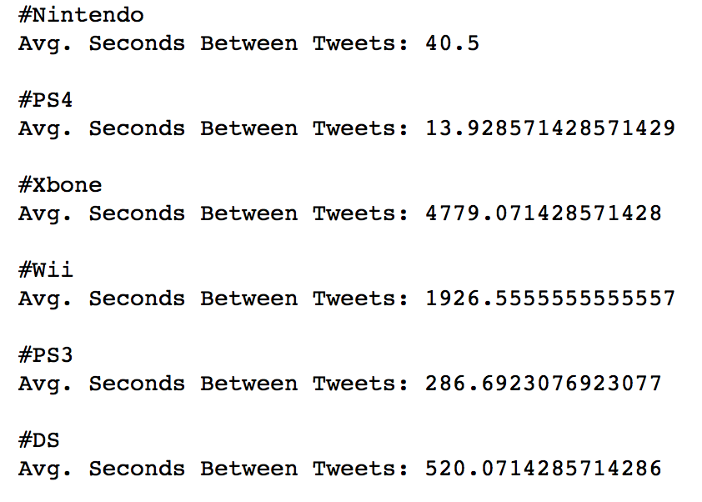
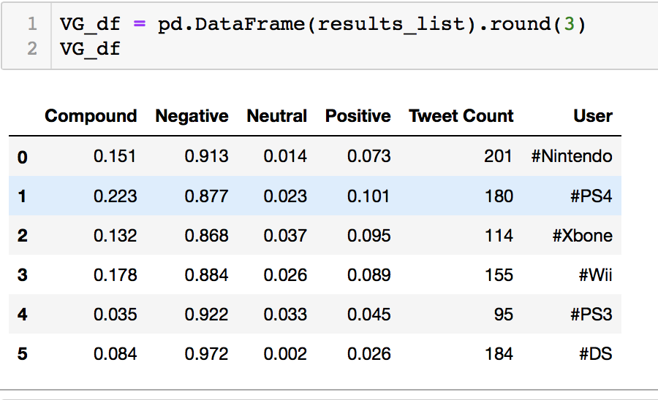
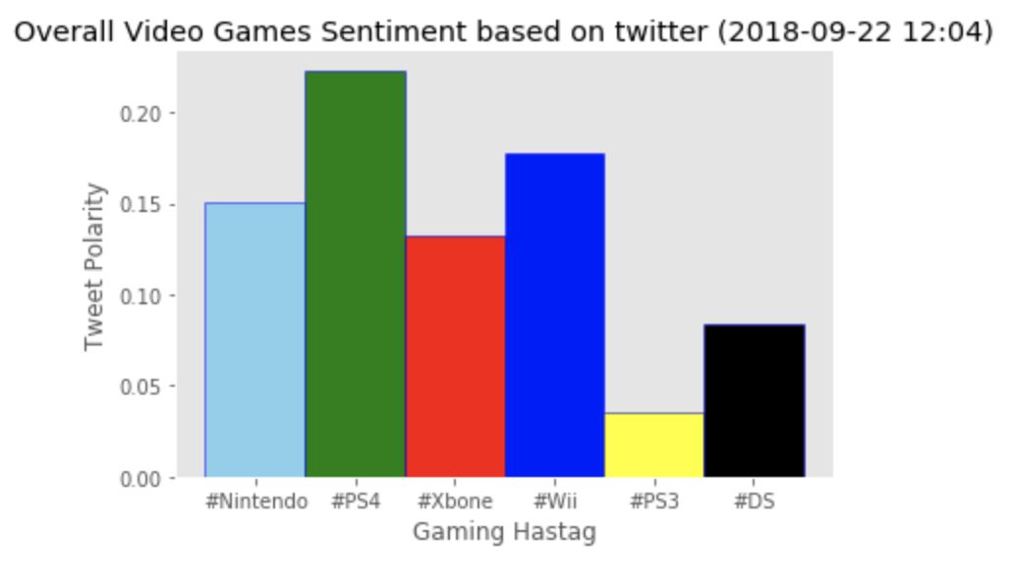
Twitter / Sentiment Analysis
VADER sentiment analysis of tweets from the top four publishers "@PlayStation", "@Activision", "@NintendoAmerica", "@EA.” The sentiment score from the top publishers is very close in scores showing its largely positive and similar.
Hashtag Analysis of tweets about the top video games "#Nintendo", "#PS4", "#XBone", "#Wii", "#PS3", "#DS"
Time between tweets for the top selling Video games
PS4 has the shortest interval between tweets of 3.5 seconds followed by Nintendo
XBone has the highest gap between tweets followed by Wii
VADER analysis of Tweets regarding the top selling Video games
Average compound figure is positive for all the video games
PS3 has the lowest compound with Wii and PS4 higher compound scores
Link to Jupyter Notebook on Github
https://github.com/MarkovCredit/Project_1_Team6/blob/master/Final%20Code/VG_Hashtag.ipynb
https://github.com/MarkovCredit/Project_1_Team6/blob/master/Final%20Code/VG_Twitter_analysis.ipynb
Citation:
VADER (Valence Aware Dictionary and sEntiment Reasoner) Sentiment Analysis "Hutto, C.J. & Gilbert, E.E. (2014).
VADER: A Parsimonious Rule-based Model for Sentiment Analysis of Social Media Text. Eighth International Conference on Weblogs and Social Media (ICWSM-14). Ann Arbor, MI, June 2014."

Slide 12
Discussion / Q&A
Findings qualify the general understanding that regional tastes can drive sales.
This qualifies the argument that North Americans consume different genres of games, than their Japanese/European counterparts
Also proves why publishers release specific games in certain areas (Action/Shooters in America & RPG/Puzzle in Japan)
Additional data gathered through Twitter’s API and sentiment analysis also qualifies the assumptions we made during our research
Publishers sending outgoing tweets show similar values, while tweets about platforms show varying degree of “time between tweets”
Interesting Fact: Wii Sports is the greatest selling game of all time, doubling the performance of Super Mario Bros. Wii Sports Resort also takes 4th place just behind Mario Kart

