Slide 1

Django/ CSS/Bootstrap/HTML5/Linode
START: 25.01.2024
Kurs Notları

Slide 2
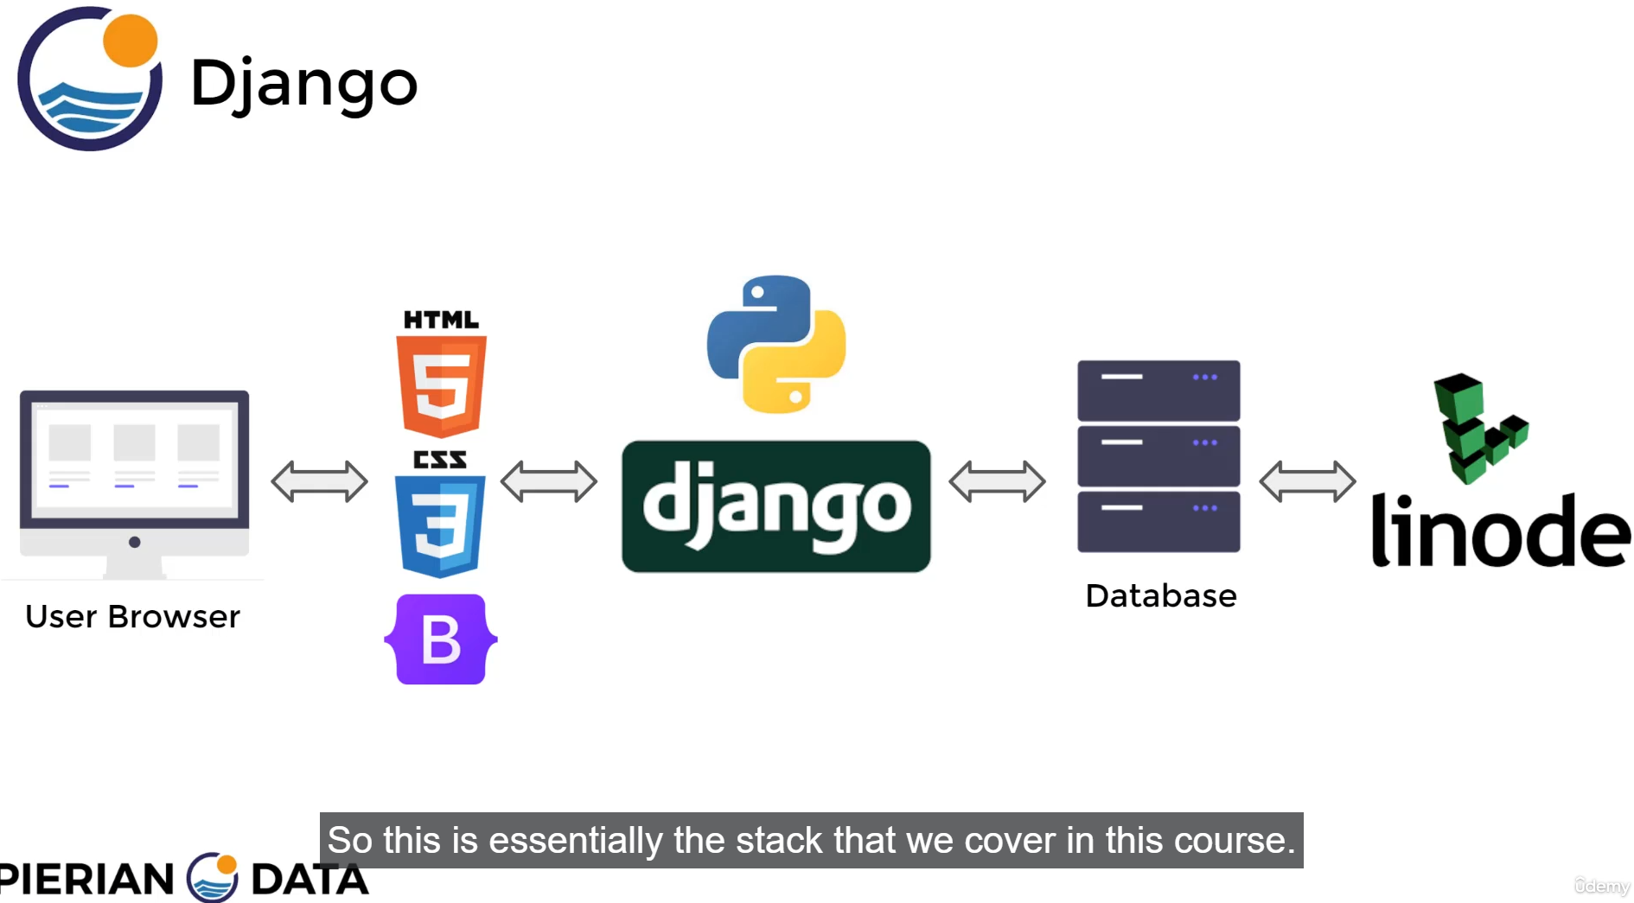

Slide 3
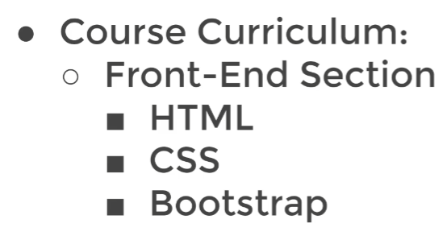
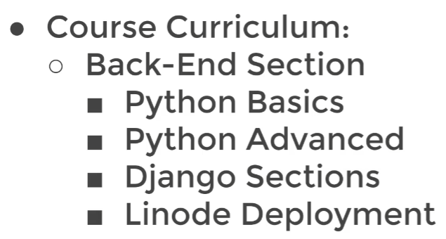

Slide 4
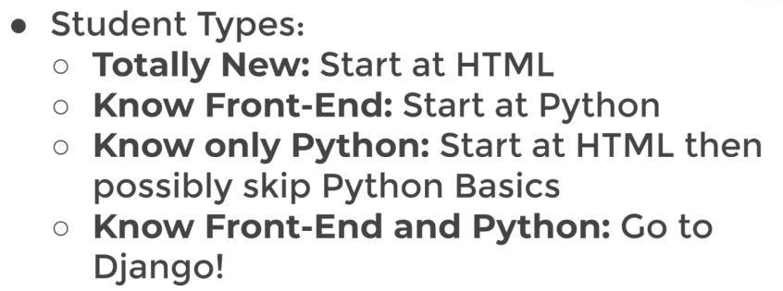

Slide 5
Log Book
25.01.2024: Visual Studio Code yüklendi (V1.85.2)
Command prompt aç
C:\ALL_FILES\CODING\GitHub\MarkovMarkowitz\DJANGO>pip install django

