Slide 1

Django/ CSS/Bootstrap/HTML5/Linode
START: 25.01.2024
Kurs Notları

Slide 2
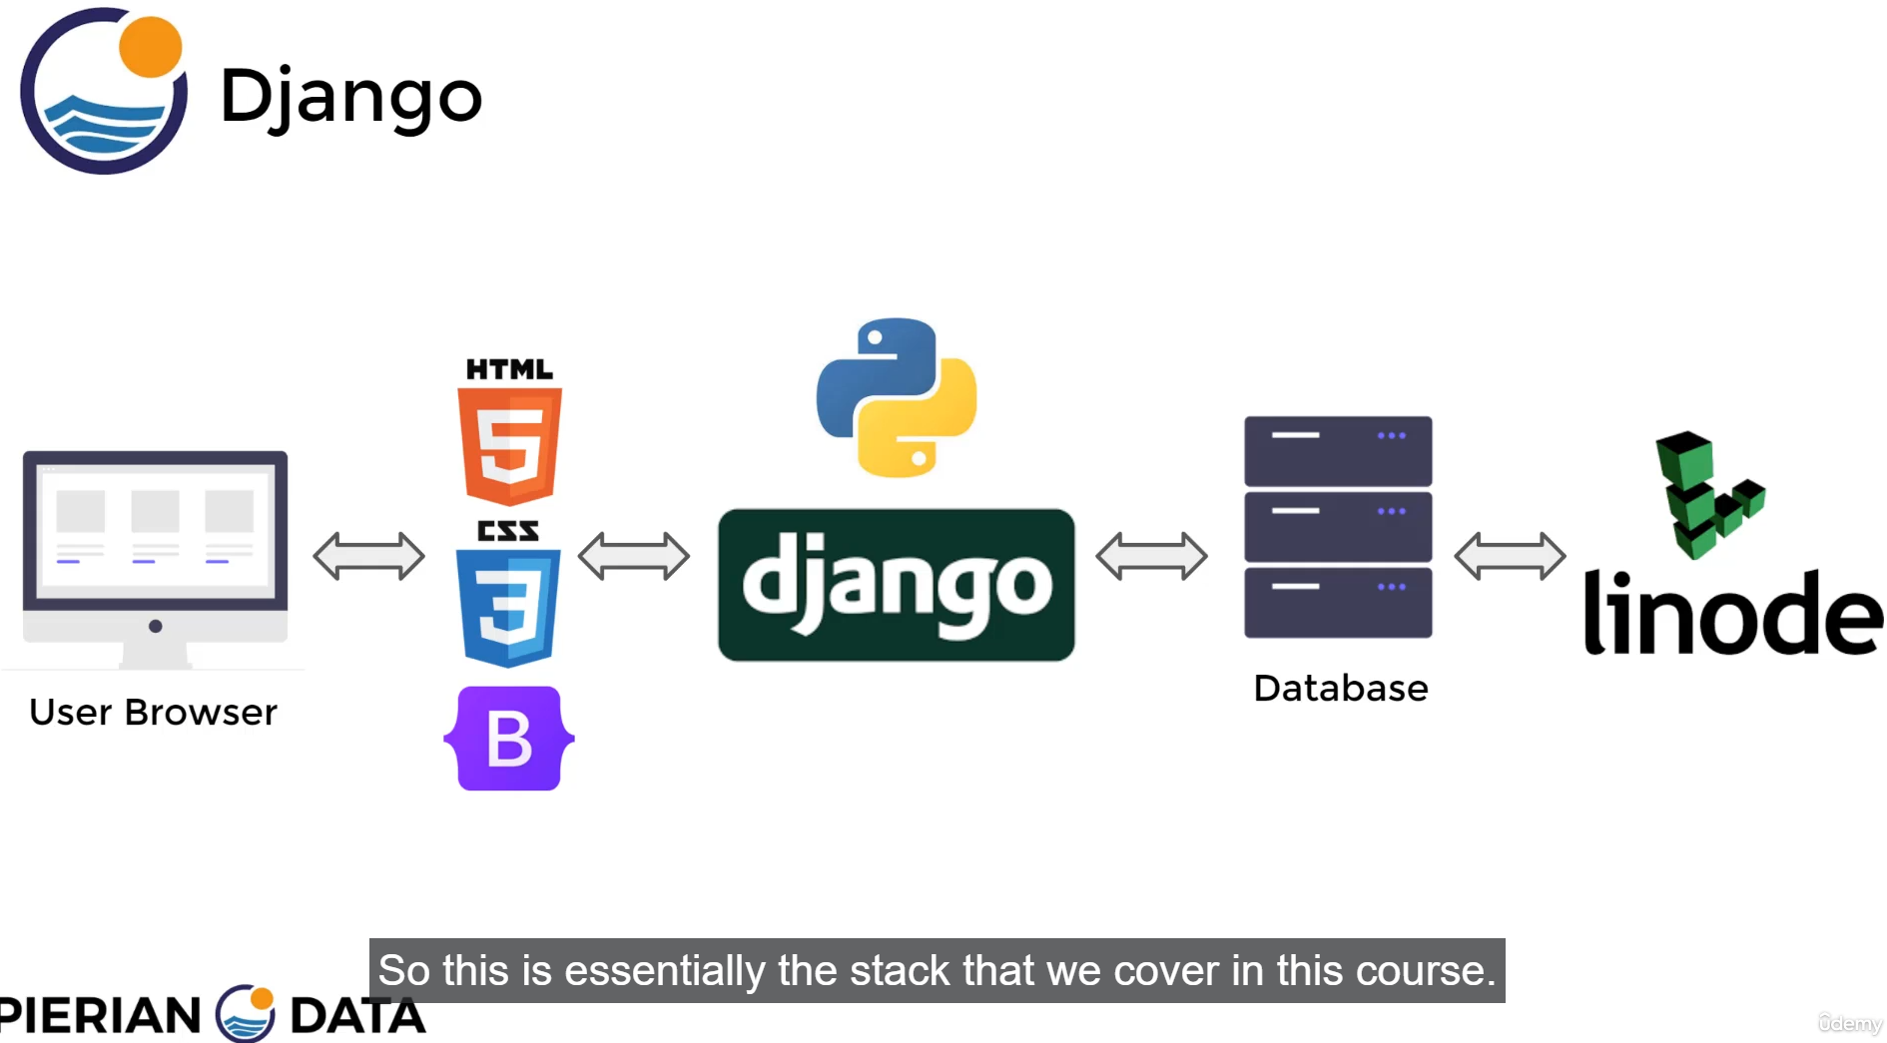

Slide 3
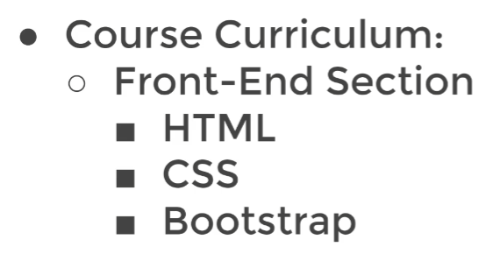
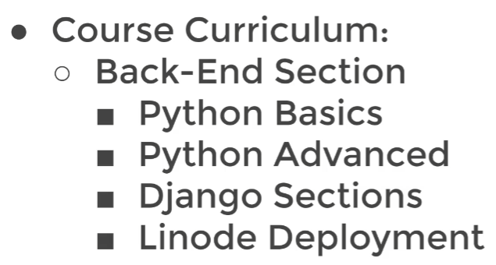

Slide 4
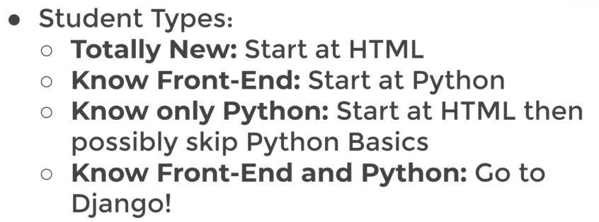

Slide 5
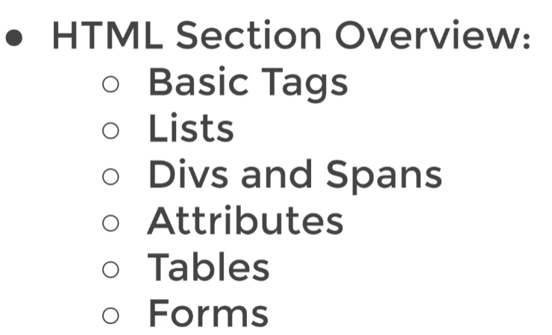

Slide 6
Log Book
25.01.2024: Visual Studio Code yüklendi (V1.85.2)
Command prompt aç
C:\ALL_FILES\CODING\GitHub\MarkovMarkowitz\DJANGO>pip install django
Create new file myfile.py
Django ile HTML tagler ve içerikler yaratacağız.

Slide 7
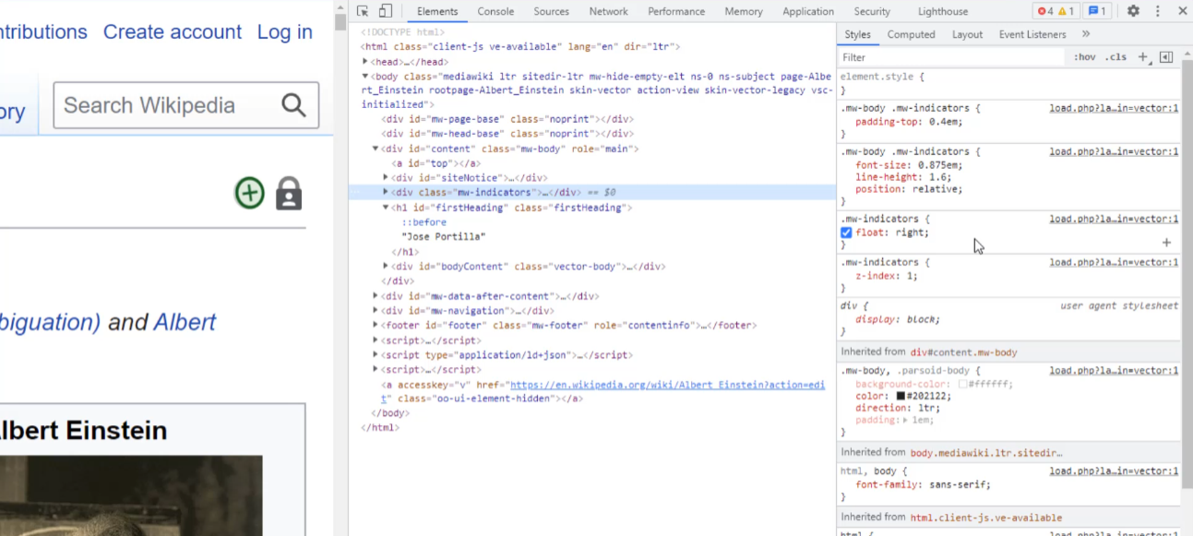
Web page
HTML
CSS
ile styling

Slide 8
Log Book
25.01.2024: Visual Studio Code yüklendi (V1.85.2)
Command prompt aç
C:\ALL_FILES\CODING\GitHub\MarkovMarkowitz\DJANGO>pip install django
Create new file myfile.py
Django ile HTML tagler ve içerikler yaratacağız.
30.01.2024 Bu kurs zor django 3 kursuna geri dönüp Netflix benzeri uygulamayı geliştireceğiz. Udemy’de

Slide 9
Django 3 - Full Stack Websites with Python Web Development
C:\ALL_FILES\CODING\GitHub\MarkovMarkowitz\DJANGO>django-admin startproject Password_Generator
CHEAT SHEET FOR DJANGO: https://zappycode.com/posts/1/django-cheat-sheet

Slide 10
C:\ALL_FILES\CODING\GitHub\MarkovMarkowitz\DJANGO>cd Password_Generator
C:\ALL_FILES\CODING\GitHub\MarkovMarkowitz\DJANGO\Password_Generator>python manage.py runserver
Watching for file changes with StatReloader
Performing system checks...
System check identified no issues (0 silenced).
You have 18 unapplied migration(s). Your project may not work properly until you apply the migrations for app(s): admin, auth, contenttypes, sessions.
Run 'python manage.py migrate' to apply them.
January 31, 2024 - 01:20:32
Django version 5.0.1, using settings 'Password_Generator.settings'
Starting development server at http://127.0.0.1:8000/ # buradakini Chrome a copy paste edersen uygulama sayfası açılır.
Quit the server with CTRL-BREAK.
[31/Jan/2024 01:20:51] "GET / HTTP/1.1" 200 10629
[31/Jan/2024 01:20:51] "GET / HTTP/1.1" 200 10629
Not Found: /favicon.ico
[31/Jan/2024 01:20:53] "GET /favicon.ico HTTP/1.1" 404 2122 # CTRL- C ile çıkış
C:\ALL_FILES\CODING\GitHub\MarkovMarkowitz\DJANGO\Password_Generator>

