Slide 1
Blazor Introduction
Miroslav Popović
Technical Lead, Seavus Group
@miroslavpopovic
https://miroslavpopovic.com
Notes:
So what is .NET?

Slide 2
What is Blazor?

Slide 3

Blazor framework
A new framework for building interactive web UI with .NET
Created by Steve Sanderson
Open source - part of ASP.NET Core
Uses C# instead of JavaScript
Full-stack C#
Components and hosting model
Client-side or server-side

Slide 4
Blazor Benefits
C# instead of JavaScript
Existing .NET ecosystem
Share logic between client and server
Development with Visual Studio 2019 and VS Code
Alternative to SPA frameworks like Aurelia, Angular, React, Vue…

Slide 5
Basics

Slide 6
Components
Element of UI - page, dialog, data entry form…
Define rendering logic
Handle user events
Can be nested and reduced
Can be shared as class libraries or NuGet packages
.razor files

Slide 7
Sample component - Dialog.razor
<div>
<h1>@Title</h1>
@ChildContent
<button @onclick="@OnYes">Yes!</button>
</div>
@code {
[Parameter]
private string Title { get; set; }
[Parameter]
private RenderFragment ChildContent { get; set; }
private void OnYes()
{
Console.WriteLine("Write to the console in C#! 'Yes' button was selected.");
}
}

Slide 8
Sample component usage - Index.razor
@page "/"
<h1>Hello, world!</h1>
Welcome to your new app.
<Dialog Title="Blazor">
Do you want to <i>learn more</i> about Blazor?
</Dialog>

Slide 9
Client-side Blazor
WebAssembly - wasm standard
Wide browser support
Based on work done by Mono team
How it works
C# code and Razor get compiled into .NET assemblies
The assemblies and .NET runtime downloaded to browser
Client-side Blazor bootstraps runtime and loads the assemblies for the app
JavaScript interop used for DOM manipulation and browser API calls

Slide 10
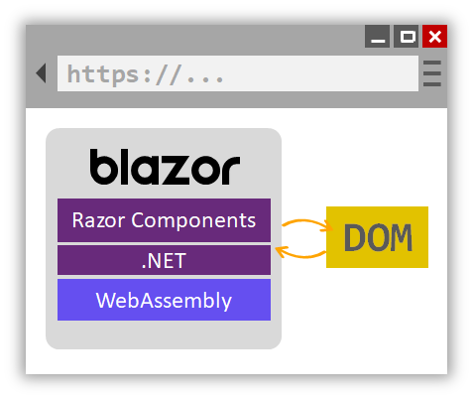
Client-side Blazor

Slide 11
Server-side Blazor
Blazor components hosted on server
UI updates handled over SignalR connection
Event handling logic runs on server
JavaScript interop also done via SignalR connection

Slide 12
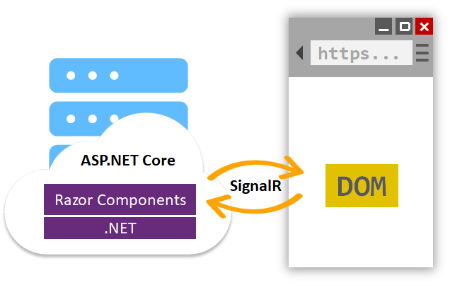
Server-side Blazor

Slide 13
Resources and future

Slide 14
Blazor resources
https://blazor.net/
https://dotnet.microsoft.com/apps/aspnet/web-apps/client
https://docs.microsoft.com/en-us/aspnet/core/blazor/?view=aspnetcore-3.0
https://github.com/AdrienTorris/awesome-blazor

Slide 15
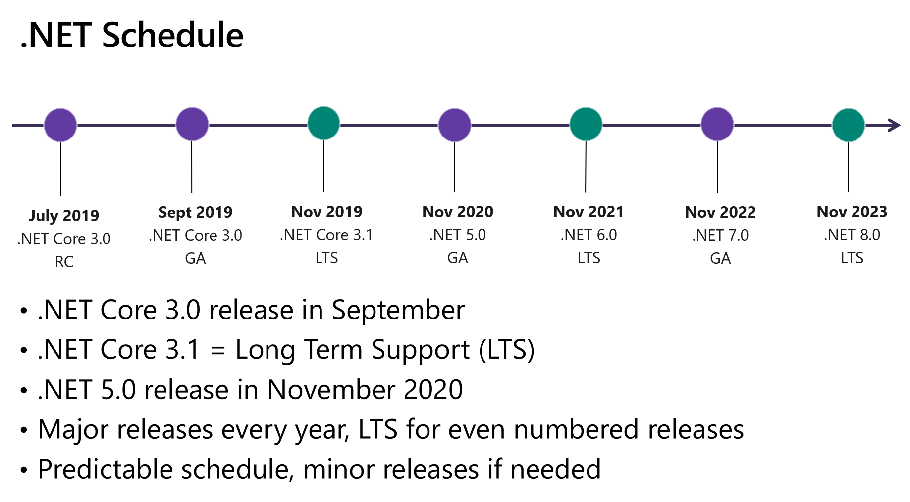
Future
Server-side Blazor is part of ASP.NET Core 3.0
September 2019.
Client-side Blazor will be out-of-band release
First quarter of 2020.?

Slide 16
Thanks! Questions?
@miroslavpopovic
https://miroslavpopovic.com

