Slide 1
School system 2020
Made By:
Mark Ruzinov 4187
Mateja Miteva 4255
Marko Stojmenovski 4193

Slide 2
The idea
The topic chosen represents a typical education center’s record system. One that they might use to keep track of students’ details and payment status. This is meant to provide the staff and employees with one central system that lets all staff members access and update records from one location and one database.
The goal here is to give everyone a unified and synchronized experience when keeping track of students in an educational setting. By giving everyone accounts and access to a central online system that can be accessed in a web browser, staff can simply log in anywhere and access their records easily.
The idea is to provide a central and unified platform that can be accessed using a web browser instead of having local records on a computer that have to be used with special software.
This software’s purpose is to give a university’s staff and employees/administration access to their student’s records, regardless of where they are accessing it on-site, and regardless of the device they are accessing it from.

Slide 3
The system
System is composed of two parts:
Frontend - Consisting of a webserver that serves webpages consisting of HTML and CSS;
Backend - Consisting of a database server and PHP to process the data on the webpages.

Slide 4
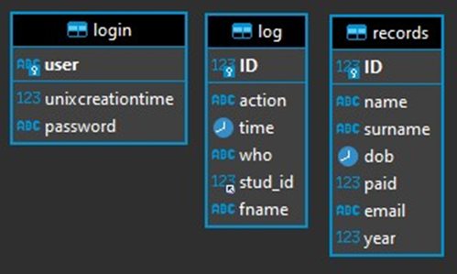
The database
MariaDB is used for the server, although the system is compatible with MySQL as well
Database is consisted of three tables:
“login” - Table contains the login records for each user of the system, two fields:
“user”, varchar(100)
“unixcreationtime”, bigint(20)
“password”, longtext
“log” - This is a logging table that holds log entries for actions that are performed on students in the records table, six fields:
“action”, varchar(100)
“time”, datetime
“who”, varchar(100)
“stud_id”, int(11)
“ID”, int(11)
“fname”, varchar(100)

Slide 5
The database
“records” - This table holds all student records present in the system, seven fields:
“name”, varchar(100)
“surname”, varchar(100)
“dob”, date
“ID”, int(11)
“paid”, tinyint(1)
“email”, varchar(100)
“year”, int(11)

Slide 6
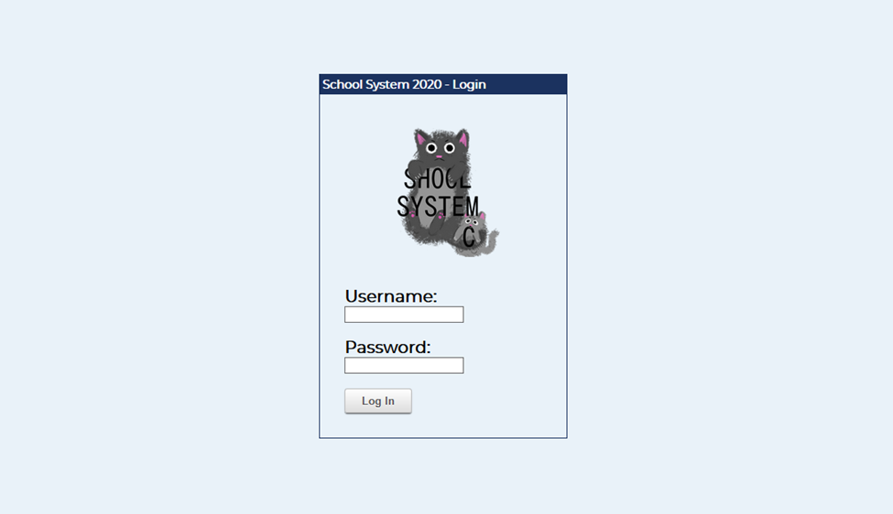
The website login
The Login page - Here you have to enter your login credentials which are previously added by server admin
From here, you can also enter the administrative panel by entering the admin credentials, considering they have been given to you

Slide 7
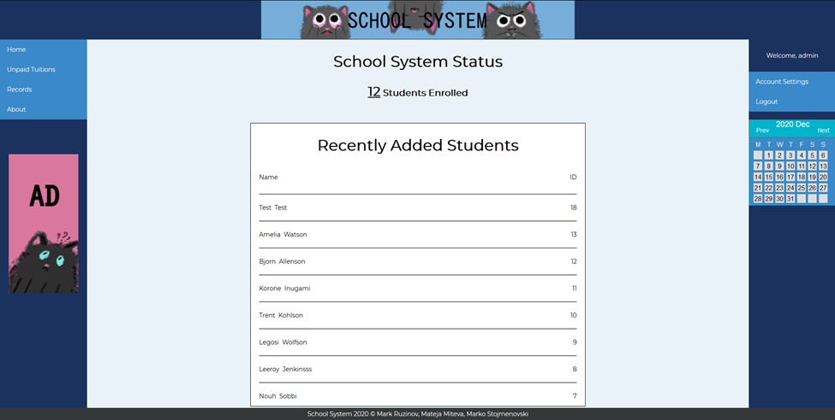
THE website design
On the left sidebar there is a menu containing all of the places one would need to go to perform actions on a student’s record
Home - Starting page that displays recently added students
Unpaid Tuitions - Takes you to a page where all students with an unpaid tuition can be seen easily
Records:
Add Record: Add a new record to the system
Edit Record: Edits an existing record already present in the system
Remove Record: Removes a record from the system (permanent deletion)
View All: Shows you all records present in the system in a single table
About - Opens the about page

Slide 8
THE website design
The menu options provide the user with the main features of the website, which is to view records, update records and edit records
The right-hand sidebar contains a couple of additional features:
Account Settings: Provides settings for the currently logged in account, as well as a way to enter the admin panel.
Logout: Logs the current user out from their session
Calendar: A calendar view of the current month (months can be cycled through with the Prev and Next buttons)

Slide 9
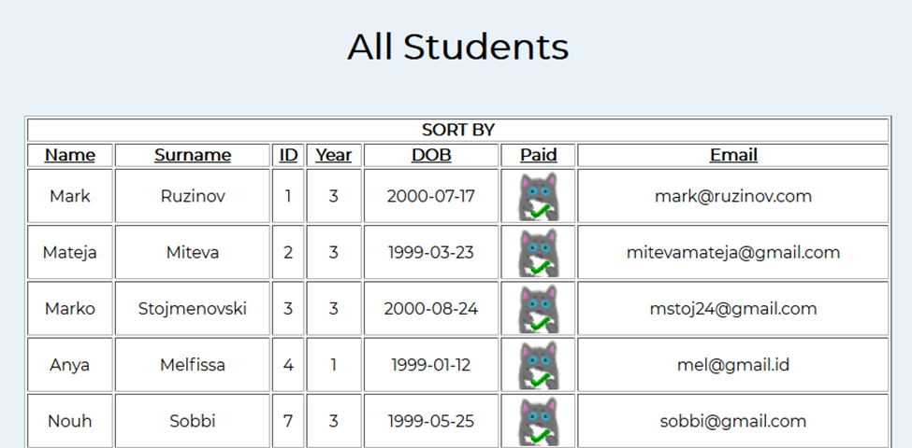
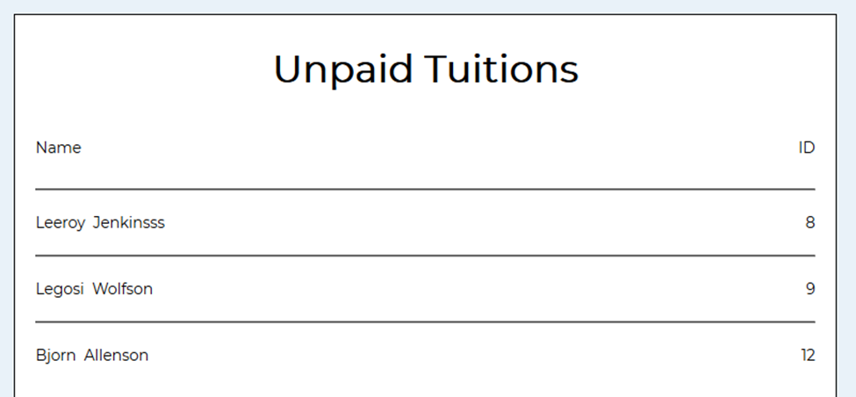
The website
All Students page - Currently enrolled students, easy way to view and sort your student records to something that works best for you
Unpaid Tuitions page - Gives you an insight on which students still need to pay for their tuition

Slide 10
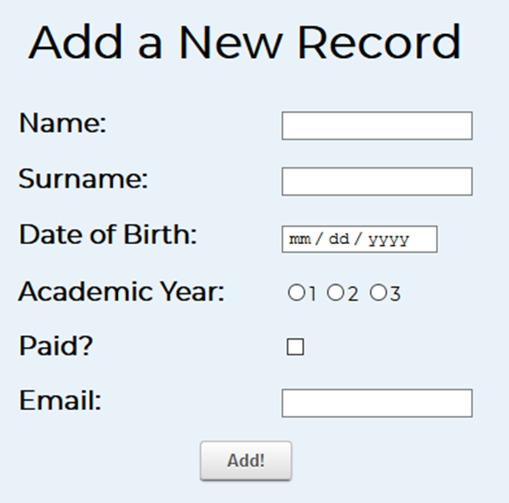
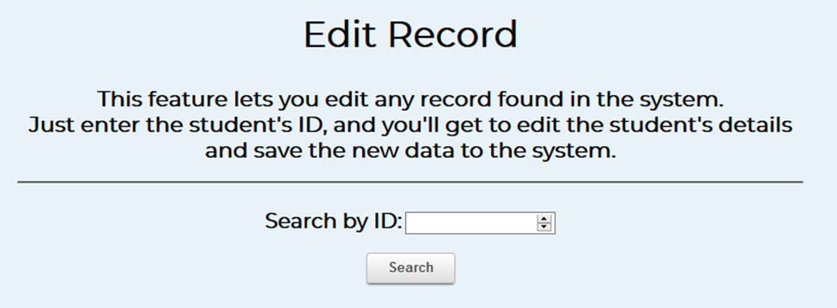
The website
Add Record page - Gives you the ability to add a record to the system. Each field is validated and checked before adding the record to the system
Edit Record page - Gives you a textbox where you can enter the ID of the student you wish to edit

Slide 11
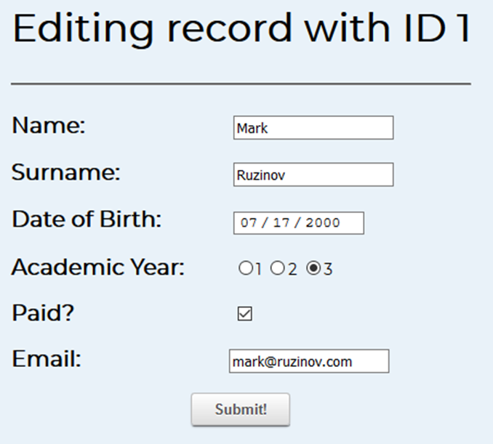
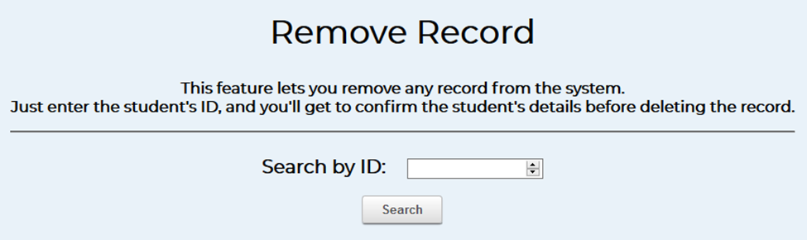
The website
Edit Records page - All of the existing details are pre-entered for you. You can now edit them, and then click on Update
Remove Records page - Allows you to remove a student record by only entering the ID of that student

Slide 12
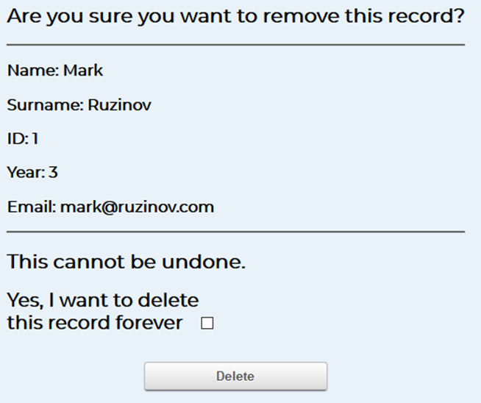
The website
The confirmation page appears after the Remove Record page when you enter the ID of the student you wished to have it’s record removed
Here, you will be able to see that student’s details that are currently present in the database

Slide 13
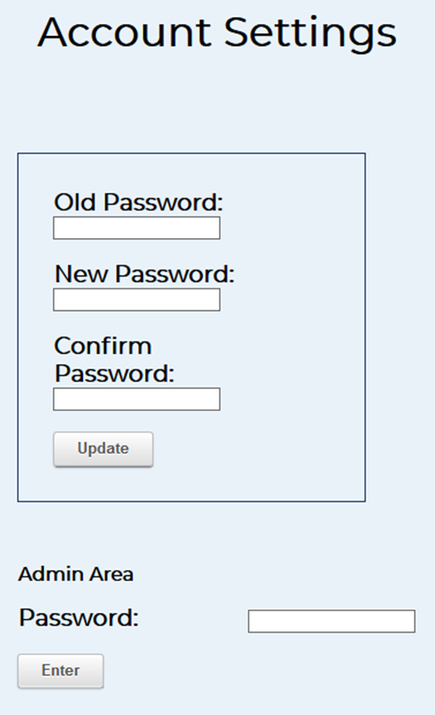
The website
Account settings page - Over here the users are able to change their passwords
In order to change your password as a regular user, you must know your existing password
As an extra feature, you can log into the administrative panel here if you know the admin account’s password

Slide 14
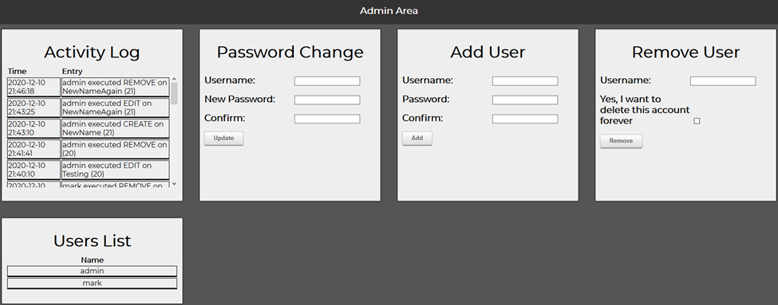
THE website
The Administrative panel - gives the administrator control over the inner workings of the system.
Activity Log: Shows you the 50 most recent entries in the log table.
Password Change: Provides the ability to change the password of any registered account without needing to know the existing password.
Add User: Lets you add a new user to the system.
Remove User: Remove any existing user from the system
Users List: Shows a list of all currently registered users on the system.

