Slide 1

Introduction to the Command Line
Mark Gross
Slides available →
https://raw.githubusercontent.com/MarkusG/UCI-Slides/master/CLI.pdf

Slide 2
About Me
Mathematics student at Saddleback College
Software Developer at Roland DGA
Programming since 2016
Using Linux since 2018
In the top 10% of ranked Tetris players worldwide

Slide 3
Purpose of this Presentation
Showcase the power of the command line
Give you an introductory knowledge of how to use it

Slide 4
Why Use the Command Line?
It’s powerful
  “Graphical user interfaces make easy tasks easy, while command line interfaces make difficult tasks possible.” (TLCL xvii)
It’s everywhere

Slide 5
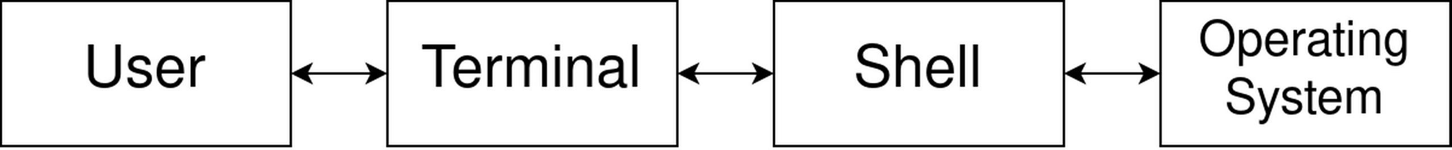
Some Quick Terminology
Terminal – displays text and receives keystrokes from the user
Shell – interprets and runs commands
Operating system – handles the computer’s resources
  Responsible for spawning new programs

Slide 6
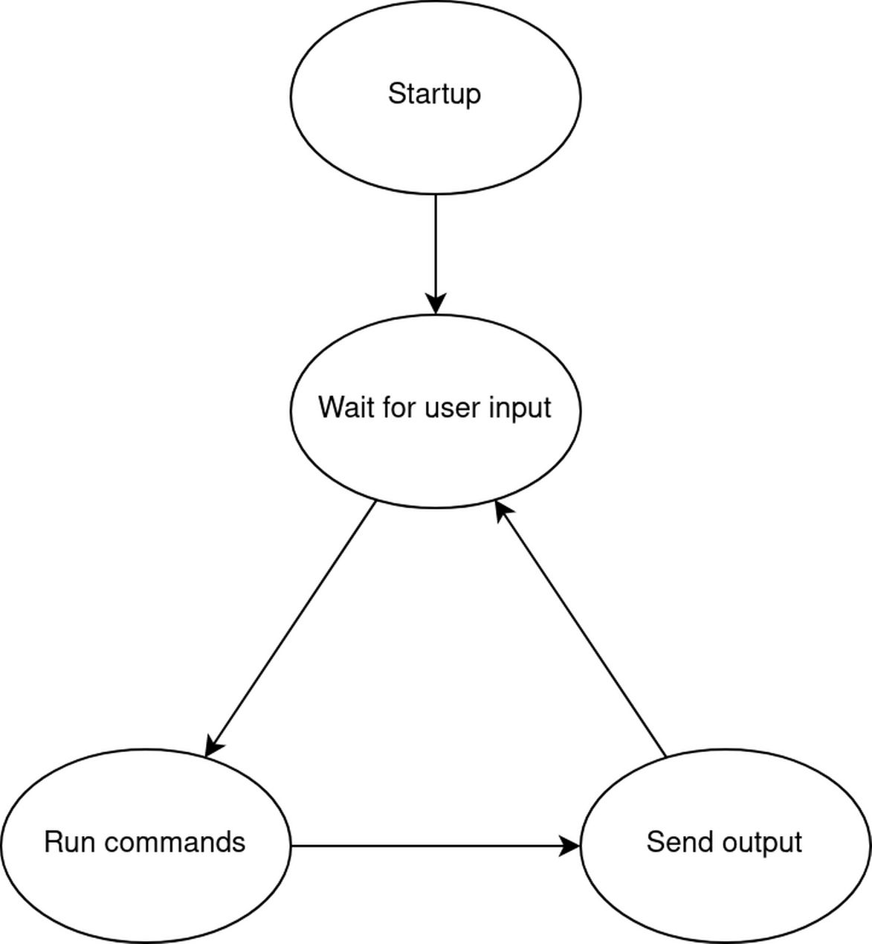
From the Shell’s Perspective

Slide 7
Shells Across Operating Systems
Windows
  Command Prompt/Windows Terminal
  PowerShell
  Windows Subsystem for Linux → bash
Linux and OSX
  bash, zsh, fish, and countless others

Slide 8
Anatomy of a Shell Command
[jdoe@linux ~]$ ls -la --color=always some_directory
Prompt – Tells you who and where you are
  Current directory
Command – The application to run
Short/long options – One-time application settings
Argument(s) – Tells the application what to operate on

Slide 9
Getting Help
man – “manual” pages for commands (and more!)
whatis – short, one-line help information

Slide 10
Working with the File System
ls – “list” files/directories in the current directory
cd – “change directory”
mkdir – “make directory”
mv – “move” a file/directory
rm – “remove” - delete
ln – “link” – shortcuts
Let’s try it!

Slide 11
Kicking Things up a Notch with Expansions
The shell can evaluate/expand expressions
  * - “wildcard” expansion – matches files in the current directory
  {a..b} – range expansion – {0..3} expands to 0 1 2 3
  {a,b,c} – set expansion – expands to a b c
  $((expr)) – arithmetic expansion - $((1 + 1)) expands to 2
    Not too useful outside of scripts
Let’s try it!

Slide 12
Input/Output
cat – “concatenate” files
echo – “echo” the argument back to you
grep – “it’s a long story” – search for a pattern in a file
  Regular expressions coming up in the next presentation!
wc – “word count”
head – view the first few lines of a file
tail – view the last few lines of a file
Let’s try it!

Slide 13
Redirection
The Unix Philosophy
  Each program should do one thing
  The output of one program can be the input to another
How do we do it?
  cmd1 | cmd2 – “pipes” output of cmd1 to the input of cmd2
  cmd > somefile.txt – writes the output of cmd to somefile.txt
  cmd < somefile.txt – runs cmd, taking input from somefile.txt
  cmd1 | cmd2 | cmd3 | cmd4 | cmd5 ad infinitum

Slide 14
Scripting
The shell is a program like any other, so it can take input like any other!
This allows us to write a sequence of shell commands and then tell the shell to execute them
The shebang
  Describes what program to run, taking the rest of the file as input
/bin/someprogram is equivalent to echo <stuff> | someprogram
<stuff>

Slide 15
Scripting - Variables
We can save the output of commands with variables
Variables are accessed using $ or ${}
my_name=”Mark”
greeting=”Hello, ${my_name}!”
ls_output=”$(ls)”

Slide 16
Scripting – Control Flow
if – runs based on whether or not a condition is true
case – works like a series of if statements
for – a “for each” loop; runs once for everything in a given set
while – runs while a certain condition is true

Slide 17
Scripting - test
if works based on exit codes
We need a command to output exit codes based on what we want to compare!
test expression
or
[[ expression ]]

Slide 18
Further Reading
The Linux Command Line – William Shotts
  https://www.linuxcommand.org/tlcl.php
https://explainshell.com

