Slide 1

Introduction to Git
Mark Gross
Slides available →
https://github.com/MarkusG/UCI-Slides

Slide 2
About Me
Mathematics student at Saddleback College
Software Developer at Roland DGA
Programming since 2016
Using Linux since 2018
In the top 10% of ranked Tetris players worldwide

Slide 3
What is Git?
Version control system
Distributed version control system
Created by Linus Torvalds in 2005 to develop the Linux kernel

Slide 4
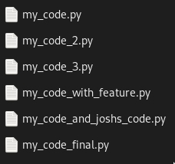
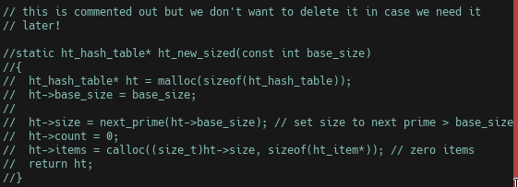
Why use it?
To avoid this:

Slide 5
Commits
Git tracks the state of your repository via commits
A commit is a snapshot of your code at a given time
Committing a change to git takes 3 steps:
  Change the file
  “Stage” the file in git – git add
  Commit the change – git commit

Slide 6
Command Reference
git init – create a new git repository in the current directory
git clone <url> - clone an existing repository from <url> into a new directory
git add <file> – add <file> to the index (staging area)
git rm –-cached <file> - remove <file> from the index
git commit – create a commit with all the changes in the staging area
git log – view history

Slide 7
What can we do with history?
Reset the project to a previous state
Reset a single file to a previous state
Explore a snapshot of the project at any commit

Slide 8
Command Reference
git checkout – resets a file to a given state (can also check out commits and branches, more on that later)
git reset – resets the project to a previous state

Slide 9
Branching
Branching allows us to keep different tasks separate from each other
Critical to collaboration
https://git-school.github.io/visualizing-git/

Slide 10
Merging
Merging is how we incorporate changes from a branch into another branch
Merging “replays” the changes made on the divergent branch onto the main branch
This sometimes results in conflicts

Slide 11
Rebasing
Rebasing is the other way we can apply the changes from one branch onto another
Where merging creates a new commit who’s parents are the two branches, rebasing “moves” the commits from one branch onto the other
Interactive rebasing

Slide 12
Diffs
Diffs in general show the differences between two files
We can use git diff to show the differences between two commits

Slide 13
Remote Repositories
Git branches can be set up to “track” branches on other repositories
GitHub/GitLab
The “distributed” part of “distributed version control”
git fetch, git pull and git push

