Slide 1
A Deep Learning Framework for Proteomics ???
Summer School Details here ???
Prof. Dr. Mathias Wilhelm
16th September 2021

Slide 2




Agenda
Overview and Motivation
Assumptions and Design
Example Use-case
Task

Slide 3
Overview and Motivation
Deep Learning
Robust in supervised settings
Outperformed classical ML (e.g. Vision, NLP)
Enablers
Better processing units (incl. GPUs)
Lower hardware costs
Advances in ML research
Availability of datasets

Slide 4
Overview and Motivation
Plethora of Models and Methods
Where to Start?
Which Architecture?
Problem Formulation
Data Format
Task Definition
DL Concepts
Programming Skills
Python Stack
PyTorch/TensorFlow

Slide 5
Overview and Motivation
Abstract: build a framework abstracting out lower-level details wrapping TensorFlow (Abadi et al. 2016) or PyTorch (Paszke et al. 2019)
Domain-specific: oriented toward a subset of models, tasks, or applications implied by proteomics
Objectives:
Wrap domain-specific models and pipelines
Introduce toy datasets and benchmarks
Higher adoption in the domain
Faster prototyping
Better reproducibility of research results

Slide 6
Assumptions and Design
Inspired by the workflow presented by Raghu/Schmidt 2020, our plan is to cover the following aspects of workflow:
Data | Learning |  | Validation + Analysis
 | Model | Training
Toy datasets Available | Implementation of common architectures | Training/Validation pipelines | Evaluation metrics
 |  |  | Baseline comparison
Larger datasets downloadable | Pre-trained models (for inference, fine-tuning)
 |  | Optimizers, schedulers | Analysis of performance
Preprocessing (Typing, scaling, encoding) |  | Regularization techniques
 |  | Implementation of loss functions | Report generation based on tasks
Exploratory Data Analysis
 |  | Inference pipelines for raw data
Data splitting and loading | Easily configurable models
Data augmentation

Slide 7
Assumptions and Design
Start with a Keras-TensorFlow backend since it is the most popular for fast prototyping, later integrate PyTorch
Maintain compatibility with Keras APIs as much as possible due its wide adoption when breaking into deep learning:
Use of Optimizers, Schedulers
Model training API (compile, fit, predict)

Slide 8
Assumptions and Design
Current Architecture
Package is still in very early phases of development
MLomix
pipelines
eval
layers
constants
data
reports
utils
models
classes for representing dataset, wrappers around TensorFlow Dataset
constants to be used in the framework (e.g. Aminoacid alphabet mapping)

Slide 9
Assumptions and Design
Current Architecture
MLomix
pipelines
eval
layers
constants
data
reports
utils
models
custom evaluation metrics implemented in Keras/TF to work as metrics for model training
custom layer implementation required for the models - different model implementations (currently for Retention Time Prediction)

Slide 10
Assumptions and Design
Current Architecture
MLomix
pipelines
eval
layers
constants
data
reports
utils
models
complete pipelines to run a task (e.g. Retention Time prediction)
Modules for generating reports and plots
Helper modules

Slide 11
Example Use-case
Task: Peptide retention time prediction
Regression task
Input: peptide sequence (unmodified, modification to be introduced later)
Output: predicted index retention time
Model: we will use an implementation of Prosit by Gessulat et al. (2019)

Slide 12
Example Use-case
Task: Peptide retention time prediction
Regression task
Input: peptide sequence (unmodified, modification to be introduced later)
Output: predicted index retention time
Model: we will use an implementation of Prosit by Gessulat et al. (2019), a common architecture for retention time prediction

Slide 13
Example Use-case
Solution Steps:
Load and create dataset
Create model
Train model
Predict and evaluate
Report

Slide 14
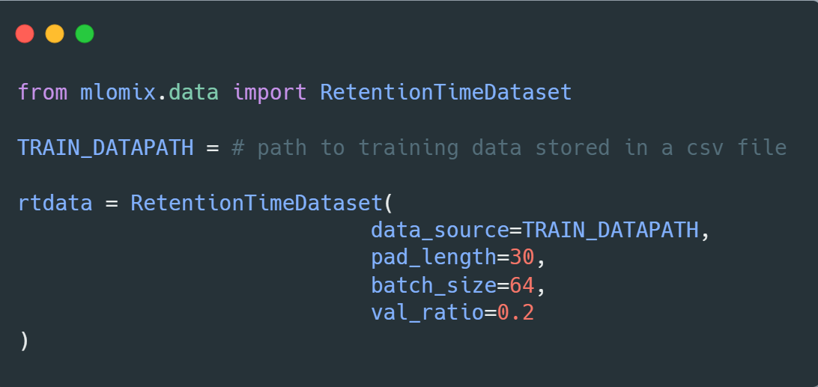
Example Use-case
Dataset:
Load data
Padding
Train-val split
tf.Dataset

Slide 15
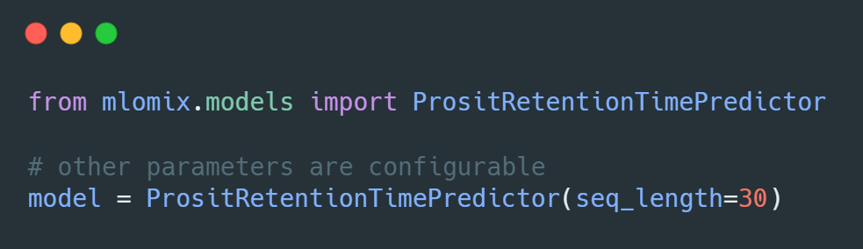
Example Use-case
Model:
Model implementation
Compatible with tf.keras Model API

Slide 16
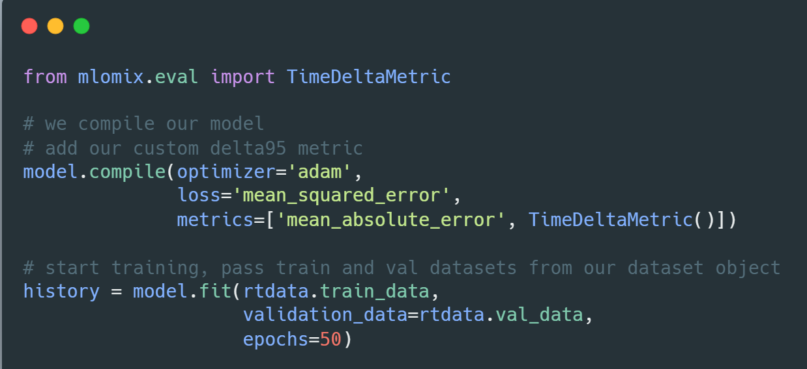
Example Use-case
Training:
Add optimization parameters - add loss and metrics
Train model

Slide 17
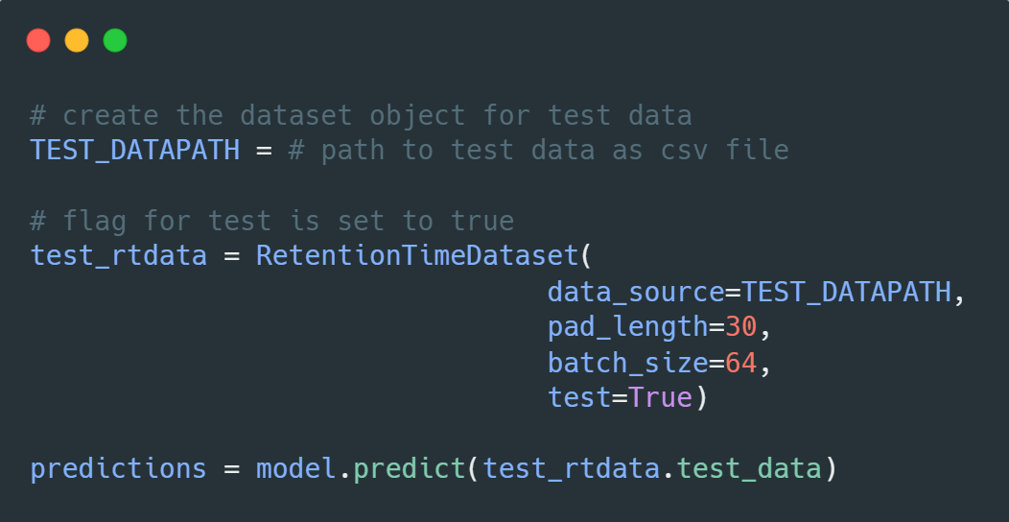
Example Use-case
Evaluation:
Predict on test data

Slide 18
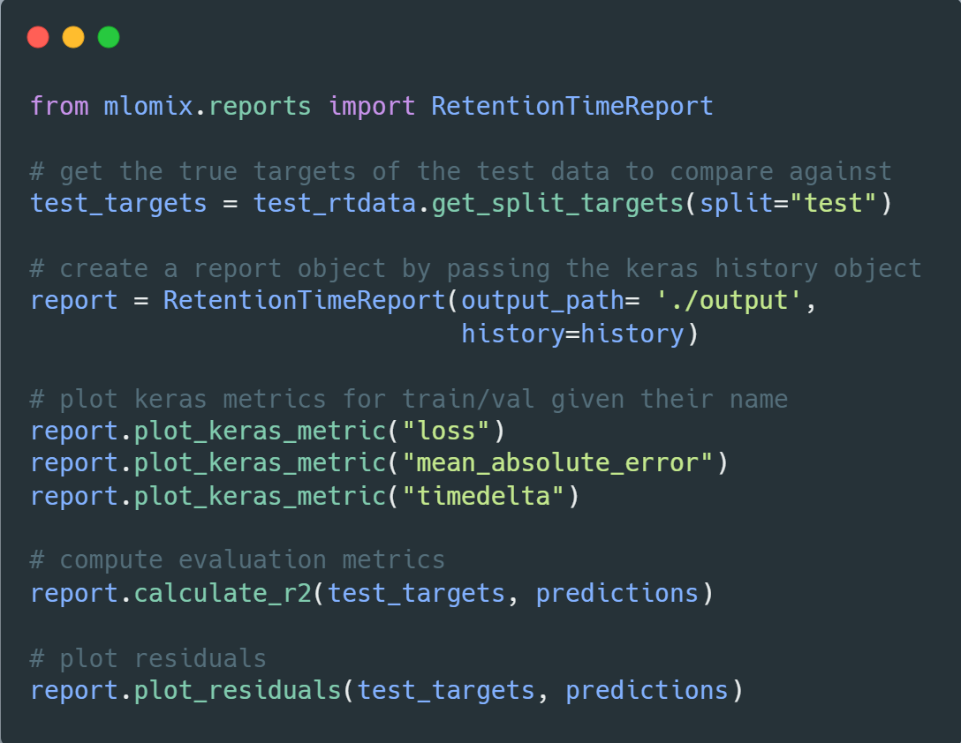
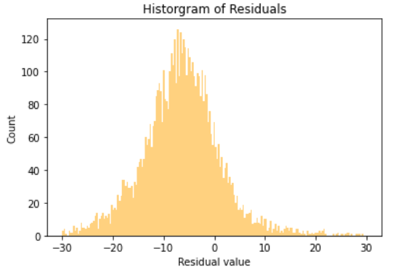
Example Use-case
Report:
Plot metrics
Compute scores
Other relevant plots

Slide 19
Example Use-case
Please go through the detailed example in the Juypter Notebook
Example_RTModel_Walkthrough (Link???)

Slide 20
Task
A Learning Rate → Notebook (Link ???)
Use train_model method with different learning rates
check which learning rate would be the best to work with our dataset
B Loss Function → Notebook (Link ???)
Try different loss functions
check which would be the best to use for our model
Example: mae, mse, mape → check tf.keras documentation

Slide 21
Task
C. Model Architecture → Notebook (Link ???)
Change model architecture (embedding output dimensionality and encoder layer type)
explore how this would change the model performance
Note: change one thing at time to see how it will affect the model
D. Train Test Split → Notebook (Link ???)
Use different train test splits where you omit certain types of data from training dataset
see how that affects the predictions on the test dataset

Slide 22
References
Abadi, M.; Agarwal, A.; Barham, P.; Brevdo, E.; Chen, Z.; Citro, C.; Corrado, G.S.; Davis, A.; Dean, J.; Devin, M. (2016): Tensorflow: Large-scale machine learning on heterogeneous distributed systems. In: arXiv preprint arXiv:1603.04467, (2016).
Paszke, A.; Gross, S.; Massa, F.; Lerer, A.; Bradbury, J.; Chanan, G.; Killeen, T.; Lin, Z.; Gimelshein, N.; Antiga, L. (2019): Pytorch: An imperative style, high-performance deep learning library, pp. 8026-8037.
Raghu, M.; Schmidt, E. (2020): A survey of deep learning for scientific discovery. In: arXiv preprint arXiv:2003.11755, (2020).
Gessulat, S.; Schmidt, T.; Zolg, D.P.; Samaras, P.; Schnatbaum, K.; Zerweck, J.; Knaute, T.; Rechenberger, J.; Delanghe, B.; Huhmer, A. (2019): Prosit: proteome-wide prediction of peptide tandem mass spectra by deep learning. In: Nature methods, Vol. 16 (2019) No. 6, pp. 509-518.

