Slide 1
Tutorial: The generation of a retention time prediction model DLOmix – framework for deep learning in proteomics
PROTrEIN Summer School
Mathias Wilhelm
16th September 2021
Notes:
slide asking for feedback at the end of the slide

Slide 2




Agenda
Overview and Motivation
Assumptions and Design
Example Use-case
Task

Slide 3
Overview and Motivation
Deep Learning
Robust in supervised settings
Outperformed classical ML (e.g. Vision, NLP)
Enablers
Better processing units (incl. GPUs)
Lower hardware costs
Advances in ML research
Availability of datasets

Slide 4
Overview and Motivation
Plethora of Models and Methods
Where to Start?
Which Architecture?
Problem Formulation
Data Format
Task Definition
DL Concepts
Programming Skills
Python Stack
PyTorch/TensorFlow

Slide 5
Overview and Motivation
Abstract: build a framework abstracting out lower-level details wrapping TensorFlow (Abadi et al. 2016) or PyTorch (Paszke et al. 2019)
Domain-specific: oriented toward a subset of models, tasks, or applications implied by proteomics
Objectives:
Wrap domain-specific models and pipelines
Introduce toy datasets and benchmarks
Higher adoption in the domain
Faster prototyping
Better reproducibility of research results

Slide 6
Assumptions and Design
Inspired by the workflow presented by Raghu/Schmidt 2020, our plan is to cover the following aspects of workflow:
Data | Learning |  | Validation + Analysis
 | Model | Training
Toy datasets Available | Implementation of common architectures | Training/Validation pipelines | Evaluation metrics
 |  |  | Baseline comparison
Larger datasets downloadable | Pre-trained models (for inference, fine-tuning)
 |  | Optimizers, schedulers | Analysis of performance
Preprocessing (Typing, scaling, encoding) |  | Regularization techniques
 |  | Implementation of loss functions | Report generation based on tasks
Exploratory Data Analysis
 |  | Inference pipelines for raw data
Data splitting and loading | Easily configurable models
Data augmentation

Slide 7
Assumptions and Design
Start with a Keras-TensorFlow backend since it is the most popular for fast prototyping, later integrate PyTorch
Maintain compatibility with Keras APIs as much as possible due its wide adoption when breaking into deep learning:
Use of Optimizers, Schedulers
Model training API (compile, fit, predict)

Slide 8
Assumptions and Design
Current Architecture
Package is still in very early phases of development
DLOmix
pipelines
eval
layers
constants
data
reports
utils
models
classes for representing dataset, wrappers around TensorFlow Dataset
constants to be used in the framework (e.g. Aminoacid alphabet mapping)

Slide 9
Assumptions and Design
Current Architecture
DLOmix
pipelines
eval
layers
constants
data
reports
utils
models
custom evaluation metrics implemented in Keras/TF to work as metrics for model training
custom layer implementation required for the models - different model implementations (currently for Retention Time Prediction)

Slide 10
Assumptions and Design
Current Architecture
DLOmix
pipelines
eval
layers
constants
data
reports
utils
models
complete pipelines to run a task (e.g. Retention Time prediction)
Modules for generating reports and plots
Helper modules

Slide 11
Example Use-case
Task: Peptide retention time prediction
Regression task
Input: peptide sequence (unmodified, modification to be introduced later)
Output: predicted indexed retention time
Model: we will use an implementation of Prosit by Gessulat et al. (2019), a deep learning architecture for retention time prediction
(but we also have a simple DeepLC and a base 1D-CNN as examples)

Slide 12
Example Use-case
Solution Steps:
Load and create dataset
Create model
Train model
Predict and evaluate
Report

Slide 13
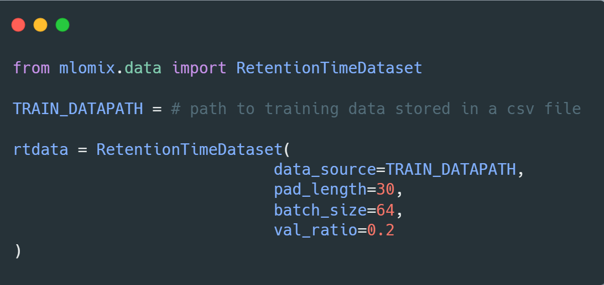

Example Use-case
Dataset:
Load data
Padding
Train-val split
tf.Dataset

Slide 14
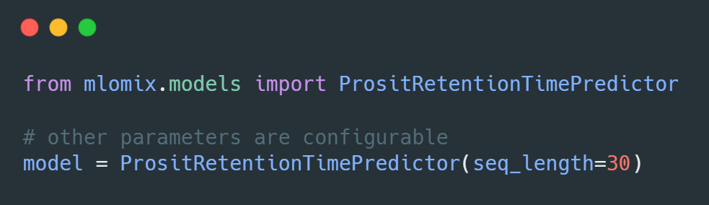

Example Use-case
Model:
Model implementation
Compatible with tf.keras Model API

Slide 15
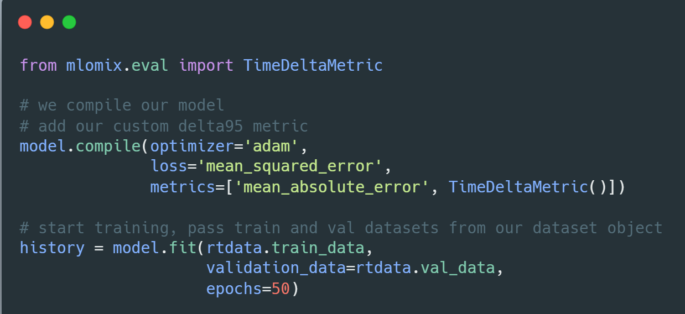

Example Use-case
Training:
Add optimization parameters - add loss and metrics
Train model

Slide 16
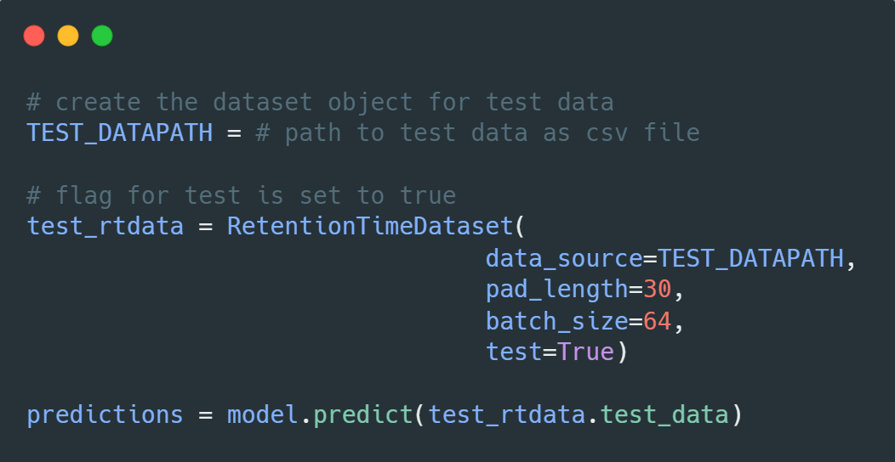
Example Use-case
Evaluation:
Predict on test data

Slide 17
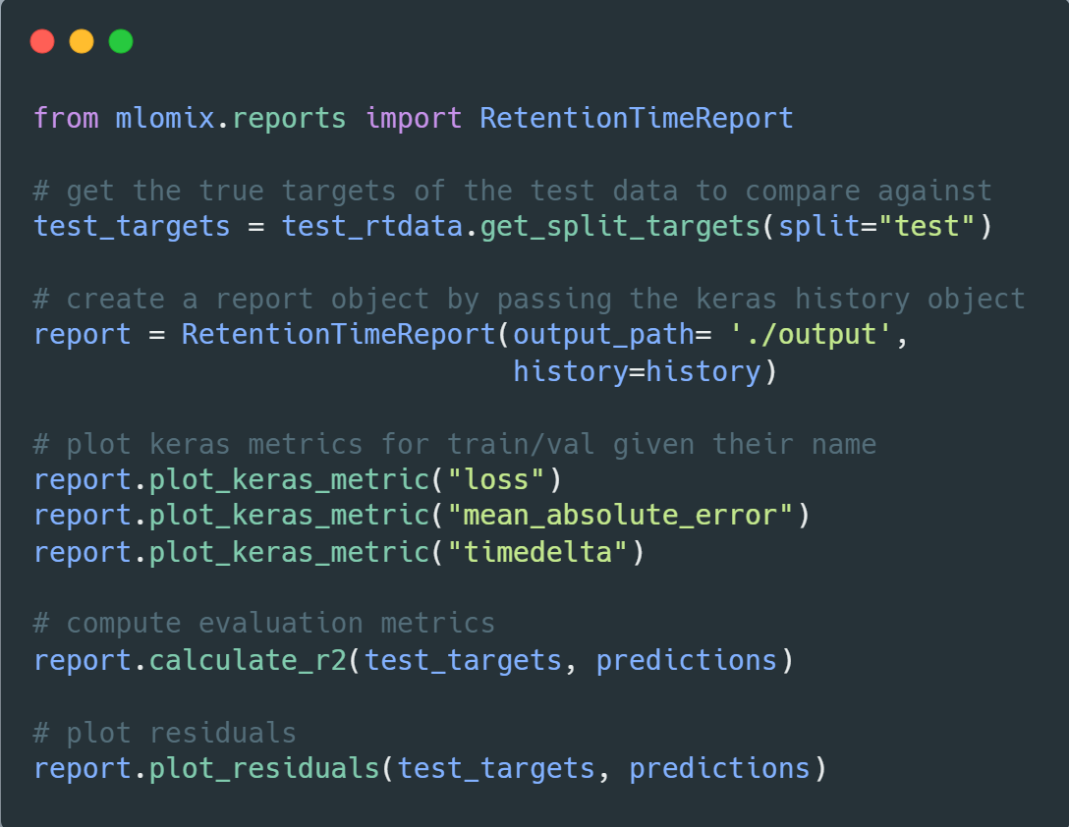
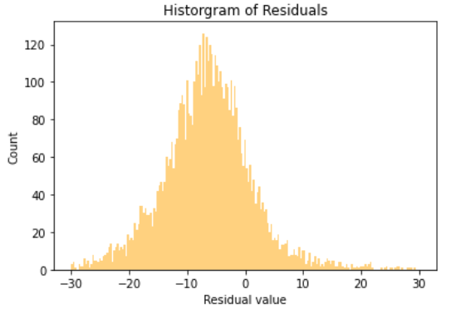
Example Use-case
Report:
Plot metrics
Compute scores
Other relevant plots

Slide 18

Example Use-case
Please go through the detailed example in the Juypter Notebook:
Example_RTModel_Walkthough
Notebook Link: Example_RTModel_Walkthrough_colab.ipynb

Slide 19
Task
A Learning Rate → Notebook
Understand how the learning rate can affect the training
check which learning rate would be the best to work with our dataset
Take a look at the loss curves to see the impact

Slide 20
Task
B Loss Function → Notebook
Try different loss functions
check which would be the best to use for our model
Example: mae, mse → check tf.keras documentation
Look at the histogram of residuals and see if you can spot a difference

Slide 21
Task
C. Model Architecture → Notebook
Change model architecture (embedding output dimensionality and encoder layer type)
explore how this would change the model performance
Note: change one thing at time to see how it will affect the model
Check the time delta plots and the histogram of residuals to see which model architecture performs better

Slide 22
Task
D. Train Test Split → Notebook
Use different train test splits where we omitted certain types of data from training dataset
See how that affects the predictions on the test dataset and how this would affect our judgement on the model performance
What was omitted?

Slide 23
Feedback
At this stage, we very much appreciate your feedback on
The session
The current API and modules
What is good?
What can be improved?

Slide 24
References
Abadi, M.; Agarwal, A.; Barham, P.; Brevdo, E.; Chen, Z.; Citro, C.; Corrado, G.S.; Davis, A.; Dean, J.; Devin, M. (2016): Tensorflow: Large-scale machine learning on heterogeneous distributed systems. In: arXiv preprint arXiv:1603.04467, (2016).
Paszke, A.; Gross, S.; Massa, F.; Lerer, A.; Bradbury, J.; Chanan, G.; Killeen, T.; Lin, Z.; Gimelshein, N.; Antiga, L. (2019): Pytorch: An imperative style, high-performance deep learning library, pp. 8026-8037.
Raghu, M.; Schmidt, E. (2020): A survey of deep learning for scientific discovery. In: arXiv preprint arXiv:2003.11755, (2020).
Gessulat, S.; Schmidt, T.; Zolg, D.P.; Samaras, P.; Schnatbaum, K.; Zerweck, J.; Knaute, T.; Rechenberger, J.; Delanghe, B.; Huhmer, A. (2019): Prosit: proteome-wide prediction of peptide tandem mass spectra by deep learning. In: Nature methods, Vol. 16 (2019) No. 6, pp. 509-518.

