Slide 1

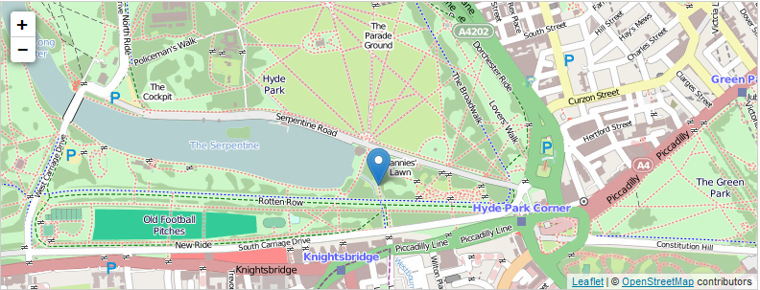
http://leafletjs.com/
Notes:
I would like to present leaflet. Leaflet is an open source javascript library to visualize easily maps in the browser.

Slide 2
Overview
developed by Vladimir Agafonkin with team of CloudMade
simplicity, performance, usability
mobile friendly
Plugins
API / tutorial
Used by: Flickr, OSM, CatoDB, …
less complicated than OpenLayers
Notes:
First I want get you an overview about the tool. The library is developed by this man and other people of the company CloudMade. The aim was to create a lightweight library which is simple in use, has a good performance and usability. Out of this it is a mobile friendly script library. The library has a light weight core source code. A javascript file and a css-file. Fore more features there are a lot of plugins which can be used. The homepage of Leaflet provides an API and a tutorial with some good examples. Leaflet is used by different websites like Flickr, OSM or CartoDB. OpenLayers is an other javascript library also to visualize maps. In contrast to it Leaflet is not so much complex with less features cause of the target of simplicity, performance and usability.

Slide 3
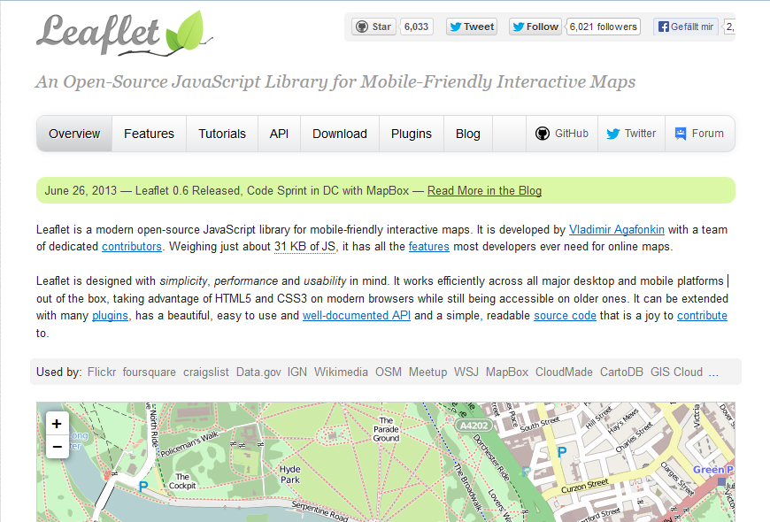
Notes:
This is the homepage. Here you can get much information about the library and can download the library. Also you can get the plugins on this website.

Slide 4
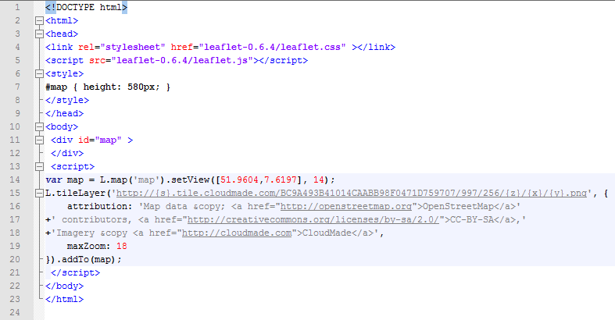
http://leafletjs.com/examples/quick-start.html
http://leafletjs.com/examples/quick-start-example.html
Notes:
This is the basic code to visualize a map. First you have to reference to the javascript and the css file. The size of the map has to be defined. In the body of the document a paragraph for the map is created. With javascript code an map object will be created. After that a layer will be added to the map. The layer needs a URL a map like openstreet map and a maximal zoom factor. For copyright and the source there have to be added label.
----> show map

Slide 5
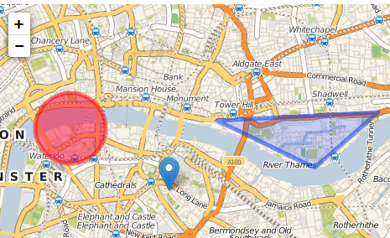
Features
Pan, zoom, drag
Marker, popups,
GeoJSON, WMS, raster/vector Layer (groups)
Events (click, mouseover, contextmenu,..)
Map projections (EPSG:4326, EPSG:3857 and EPSG:3395 (Mercator) out of the box)
Operation: contains, intersects, distance
Layer switcher

Slide 6
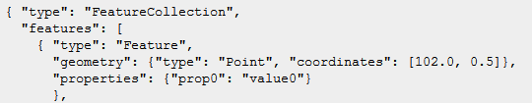
GeoJson
Data interchange format based on JSON
Define points, linestrings, polygons, geometry objects, features, feature collections
Coordinate Reference System (CRS)

Slide 7
Sources
http://leafletjs.com/
http://wiki.openstreetmap.org/wiki/Leaflet
http://geojson.org/
Picture:
http://leafletjs.com/examples/quick-start-example.html

