Slide 1
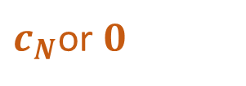

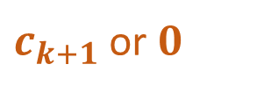




$$N$$
$c_{k+1}$or $0$
. . .
. . .
$$c_{1}$$
$$c_{2}$$
$$c_{k−1}$$
$c_{N}$or $0$
$c_{k}$ or $\tilde{R}+c_{k}$

Slide 2








$$N$$
. . .
Loan
$$c_{1}$$
$$c_{2}$$
$$c_{k−1}$$
$$\tilde{R}+c_{k}$$
$$\tilde{R}$$
Option
. . .
$$c_{k+1}$$
$$c_{N}$$

Slide 3









$$N$$
. . .
. . .
$$c_{1}$$
$$c_{2}$$
$$c_{k}$$
$$c_{k+1}$$
$$c_{N}$$
$$c_{k+1}$$
$$c_{N}$$
. . .
$$\tilde{R}$$

Slide 4
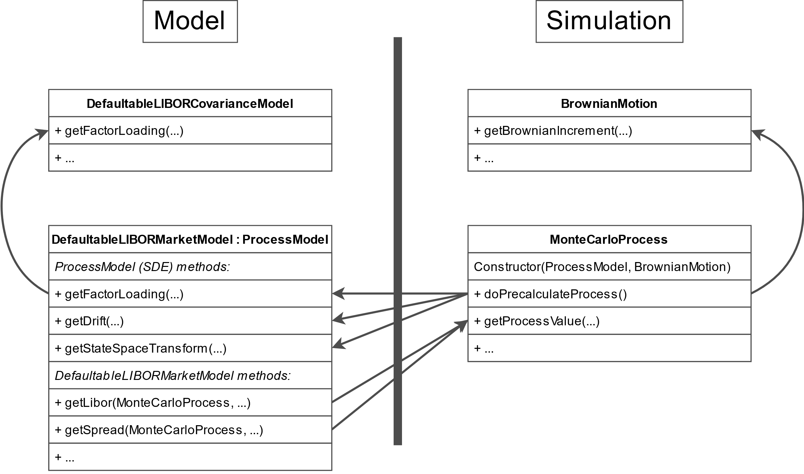

Slide 5
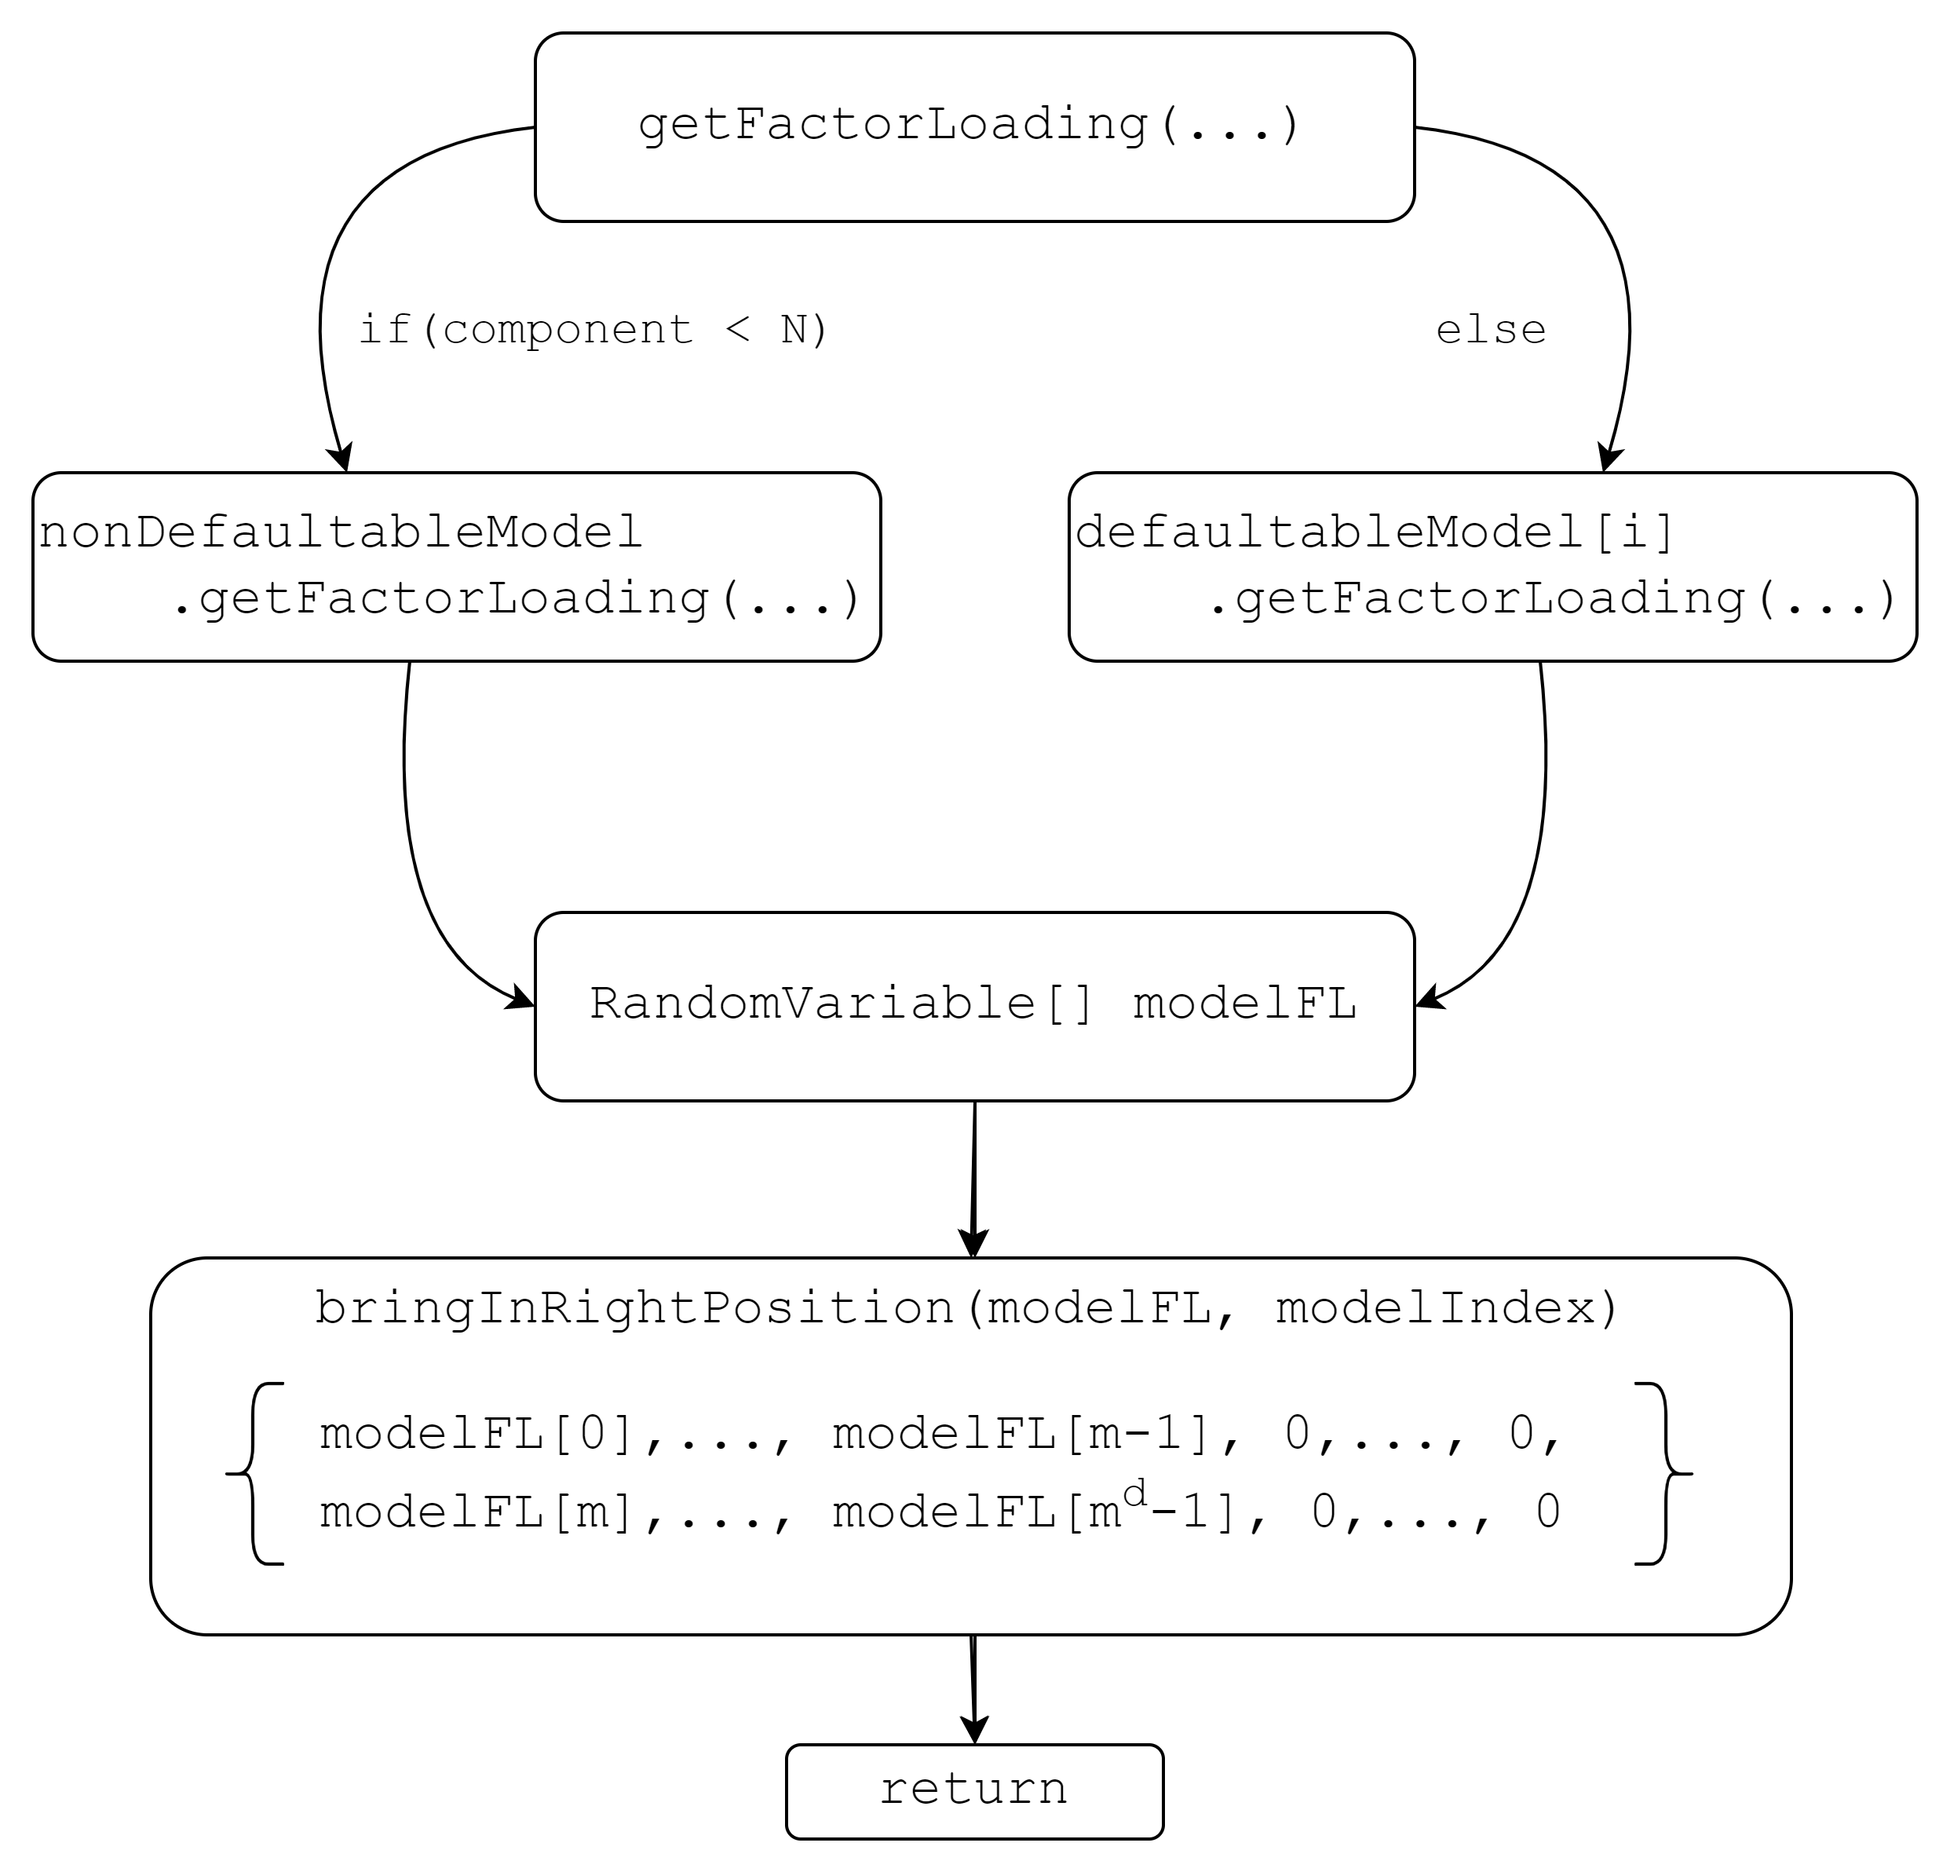

Slide 6
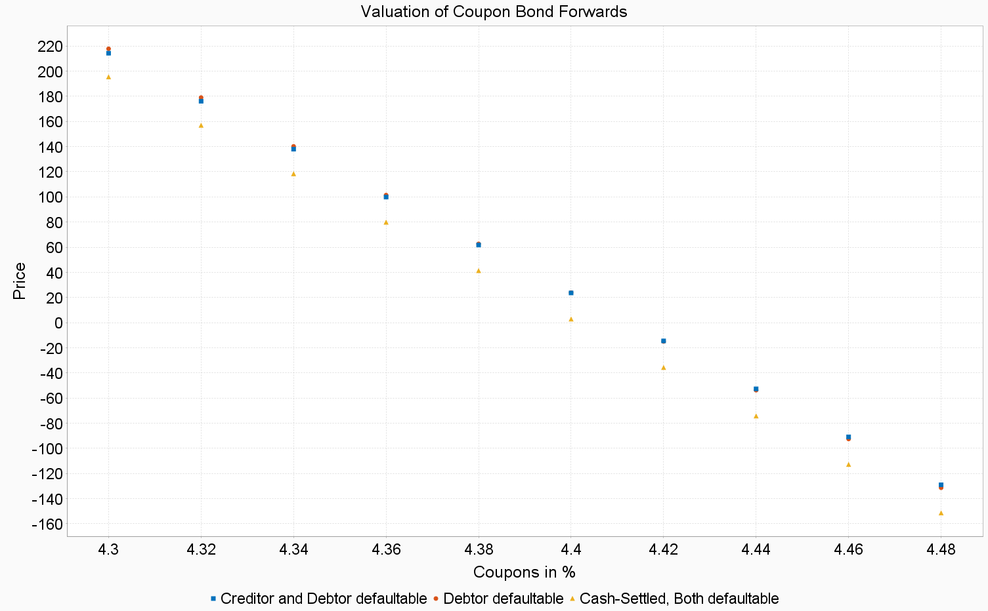
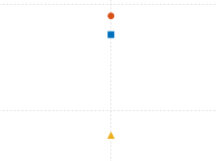
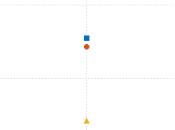

Slide 7
ABCDEFGHJKLMNOPQRSTUVWXYZ

