Slide 1
The company - Concrete Machinery Inc.
The Concrete Machinery Incorporation (abbreviated CM) is a US American multinational manufacturer of construction machinery. Headquarter in Houston, Texas, United States, Concrete Machinery designs, manufactures and sells machinery.
Although only founded in 2008 by Theodor E. Linson, Concrete Machinery has an annual revenue of 18 billion US$. One of the biggest competitors of Concrete Machinery is the Caterpillar Incorporation, the world’s leading manufacturer of construction and mining equipment and engines (about 66 billion US$).
The competitive advantage of Concrete Machinery Inc. is the high quality at a comparably low pricing level. Environmentally conscious, the CM Inc. is appreciated worldwide by its 11 000 employees for its numerous actions for Corporate Social Responsibility.
To steadily improve its customer relations Concrete Machinery announced to implement a new CRM system this year in cooperation with BrillianCRM, a German development and sales company.

Slide 2
The CRM Project
Implementation of the CRM solution brillianCRM at Concrete Machinery.
The aim is to improve the involved business processes within the sales department and improve the relationship with our customers.

Slide 3
The scope of the project
The scope of the project includes:
Current state analyses
Implementation of the CRM solution for non analytical business processes
Migration of the old data into the new CRM-system
Training of future users

Slide 4
The people involved in the project
At brillianCRM | At Concrete Machinery
Thomas Zimmermann - CEO | Jessica Oaks - Project Leader
Project Leader | Gundula Eberle - CFO
Vance Veba - Consultant | Priya Williams - Project Assistant
Avinash Gupta - IT Service Manager at Silicon Bombay | Billy-Ray Stylus - Head of Sales Department
 | Jeremy Jones - Member of Sales Department

Slide 5
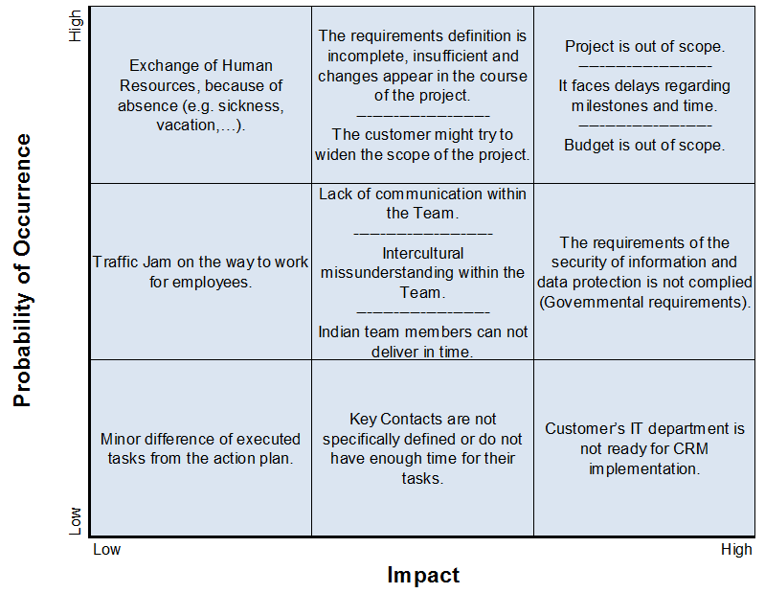
The risks of the project

Slide 6
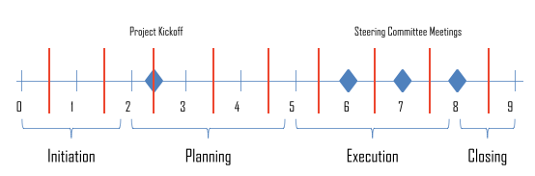
The milestones of the project

