Slide 1
CI/CD Presentation

Slide 2
How this helps manage our development:
Quicker turnaround time to code features
Fewer regression problems
Increased stability through unit and integration testing
Pinned / tagged releases
Increase in Security
Lower learning curve
Better documentation
Handling versioning for clients is made easier

Slide 3
CI/CD
Pipelines
Upstream & Downstream
Docker
Isolation
Security
Software Defined Networking
Github flow
Sematic Versioning

Slide 4

The DevOps Tech Stack
Infrastructure as Code

Slide 5











.
The Pipeline -
Visual Studio
GitHub
Build
Deploy
Plan
Release
Integration
Testing
Unit Tests
Monitoring &
Logging
Code Analysis

Slide 6
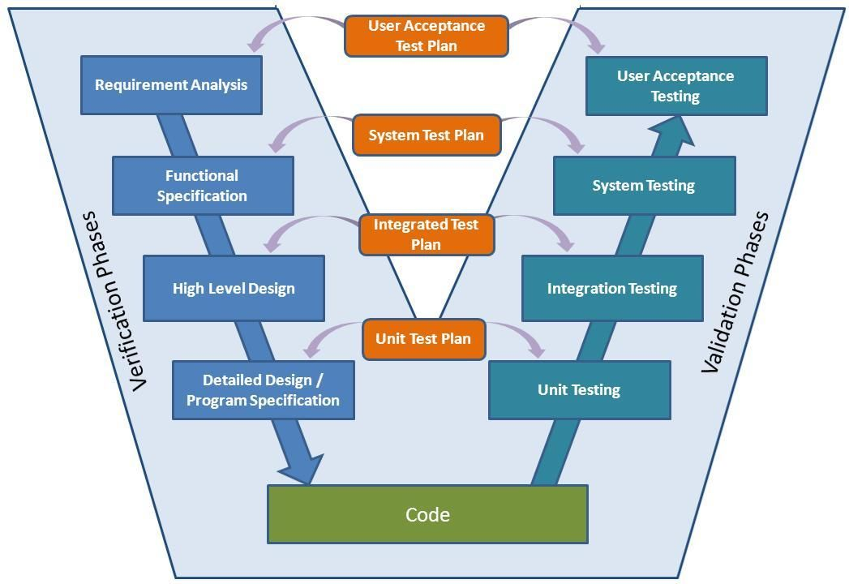
Wheredo Monitoring fit in the Pipeline
Where does Monitoring fit into the Pipeline
Benefits of Monitoring
Resource optimization
Cost savings
Anticipation and detection of incidents
Pro-active problem solving.
Notification of problems
Increase salability
Monitoring

Slide 7
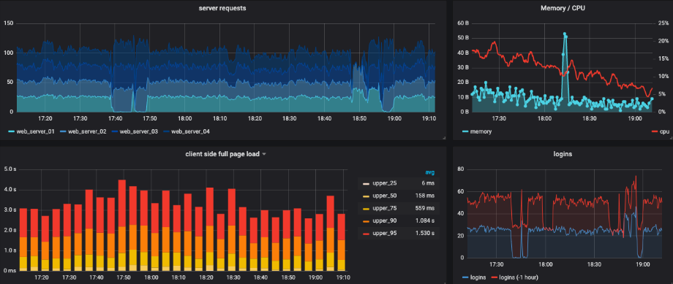

Slide 8
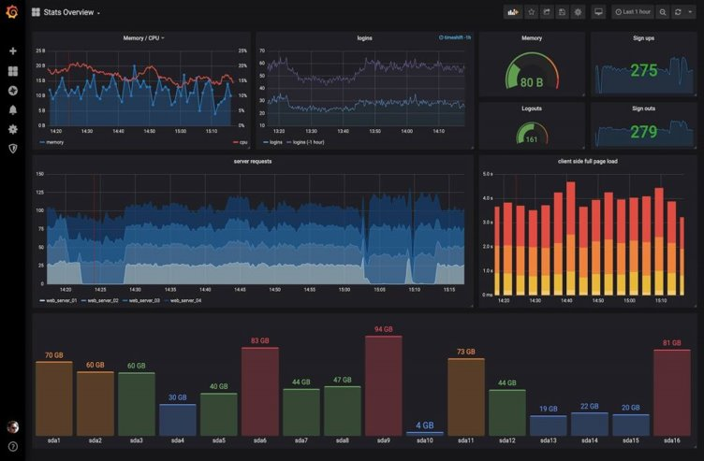

Slide 9
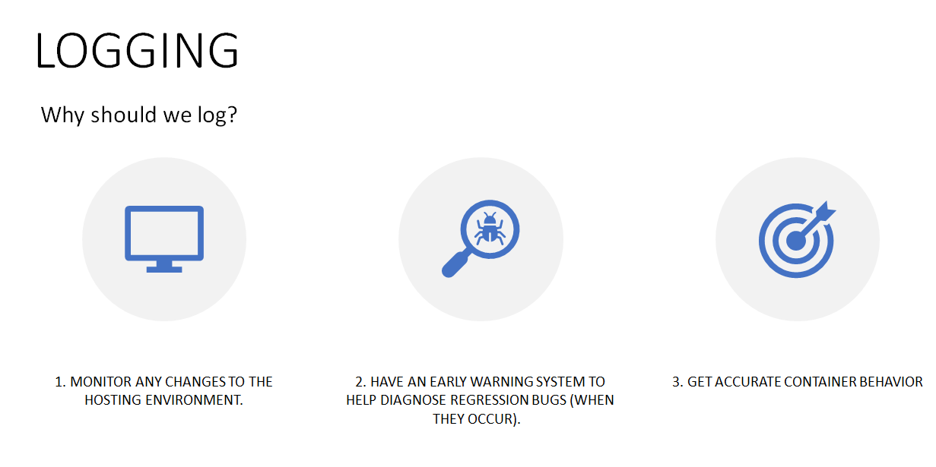

Slide 10
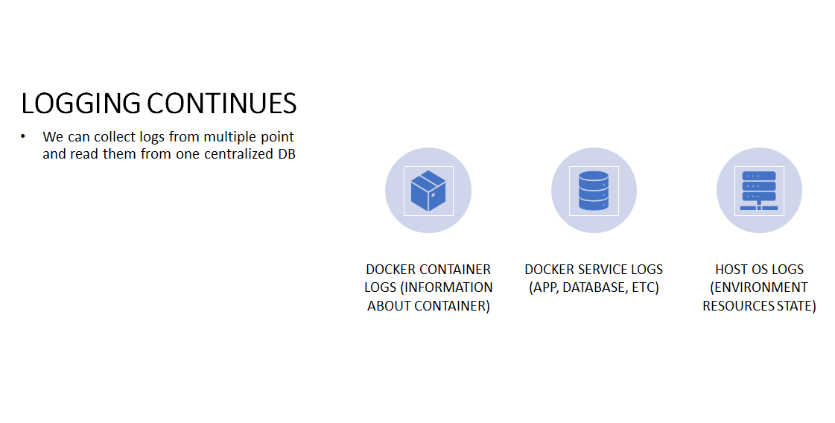

Slide 11
Pipeline demonstration
Starting Visual Studio project - Commit/Push
CircleCi stops running
Sonarcloud report
Postman tests
Positive pipeline run
Database Seeded with initial data
Postman test from local PC

