Slide 1
All wells (cleaned) vs field rate
PriorData.spline=[3 40]
PriorPrediction.spline=[3 20]
MinEigenValues = 3; EigenTolerance = 0.99;

Slide 2
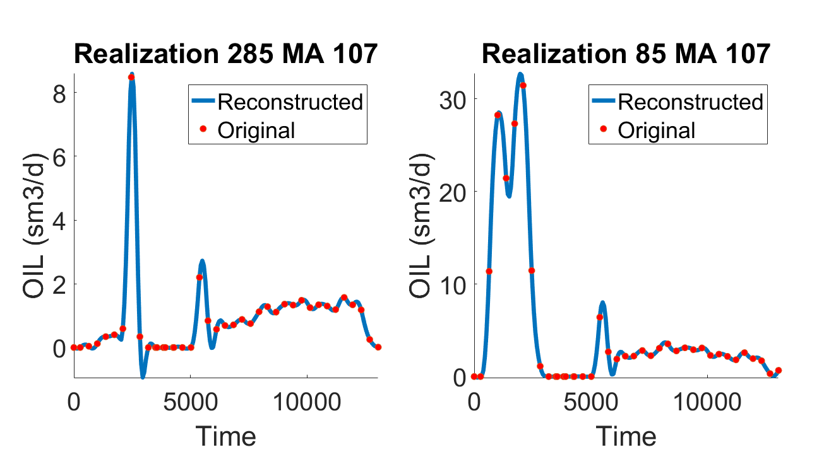
Data Variable

Slide 3
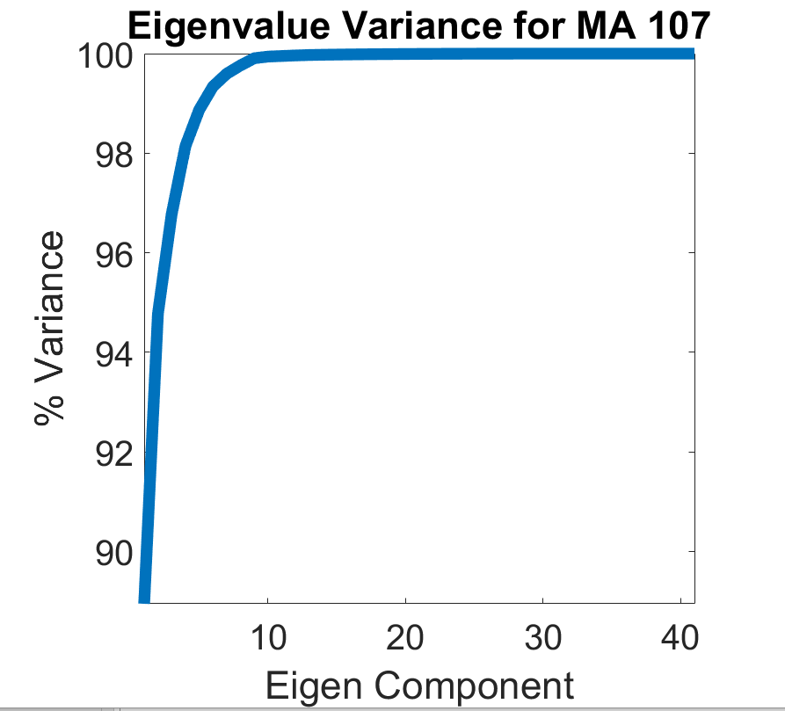
Data Variable

Slide 4
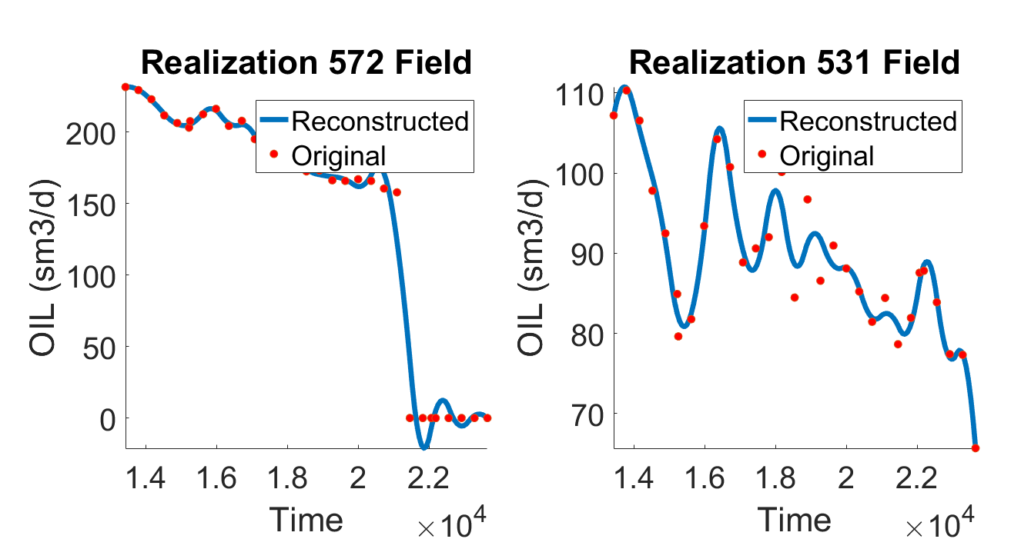
Prediction Variable

Slide 5
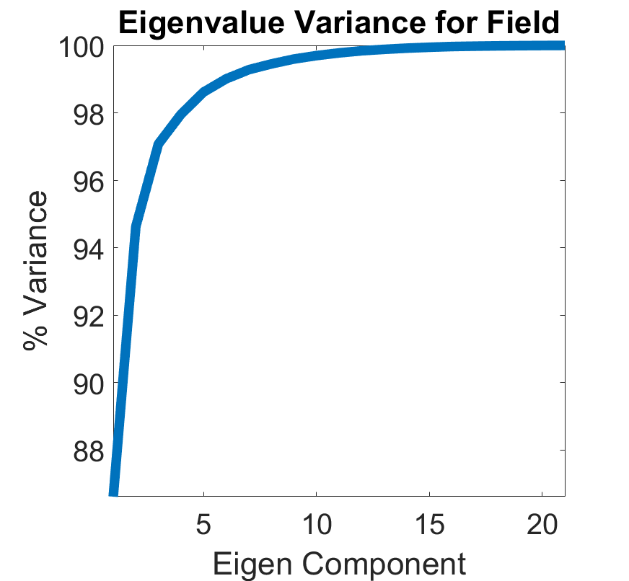
Prediction Variable

Slide 6
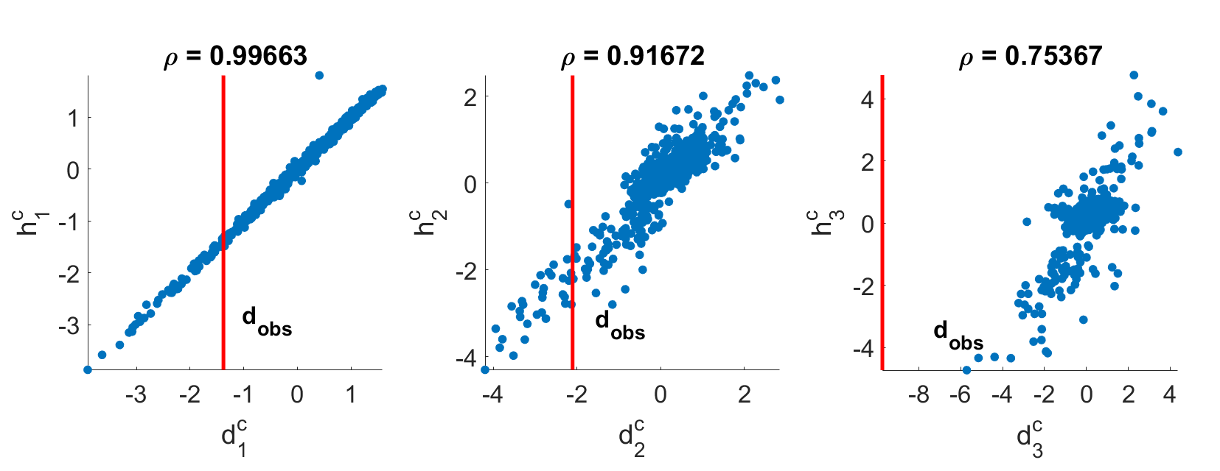

Slide 7
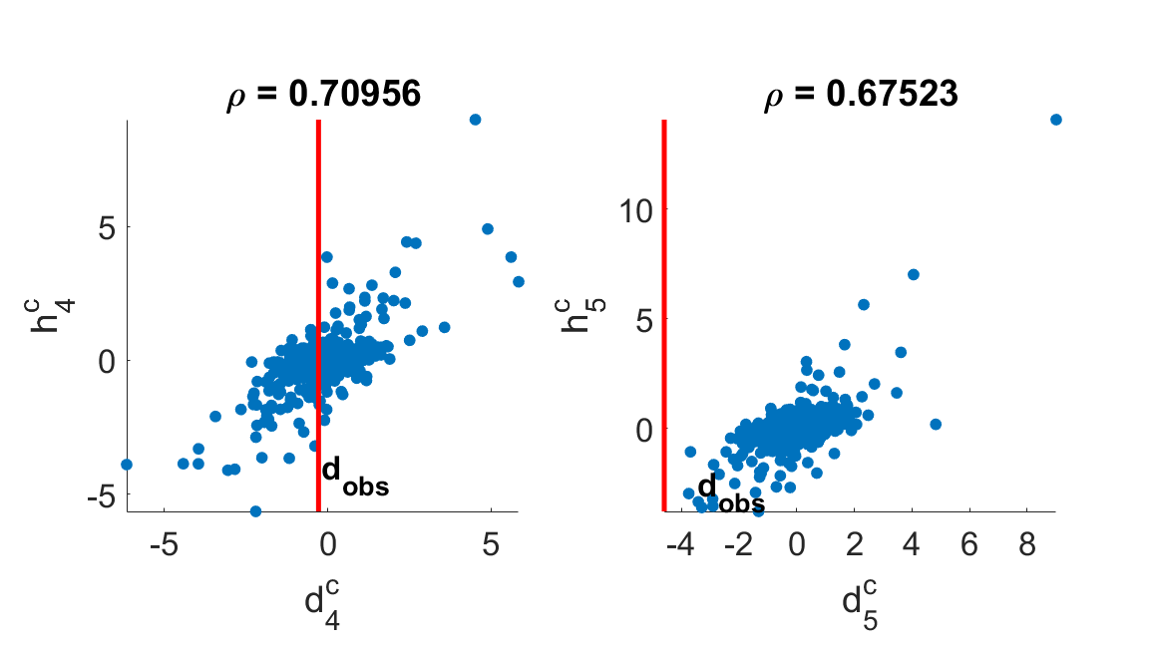

Slide 8
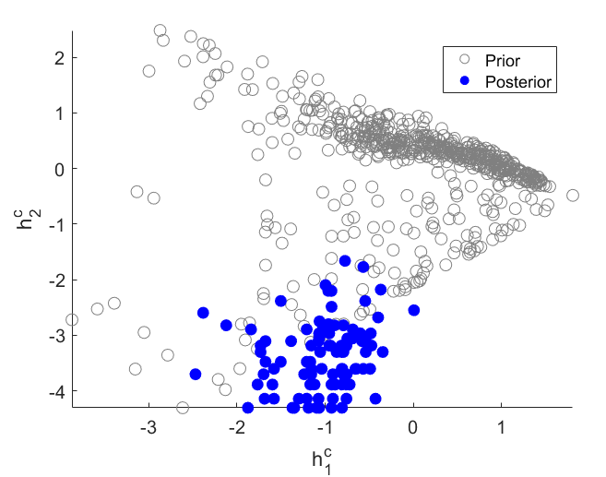

Slide 9
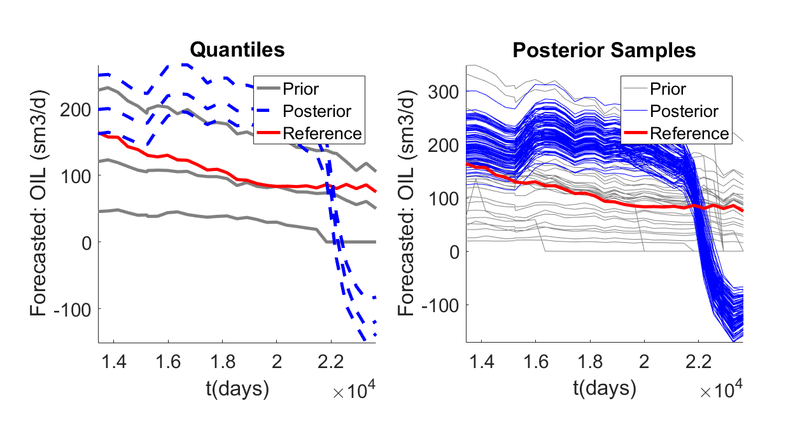
Data: all wells – oil rate
Prediction: field – oil rate
Dimension Reduction: FPCA
Eigen Tolerance: 0.99

Slide 10
Field(cleaned) vs field rate
PriorData.spline=[3 40]
PriorPrediction.spline=[3 20]
MinEigenValues = 3; EigenTolerance = 0.99;

Slide 11
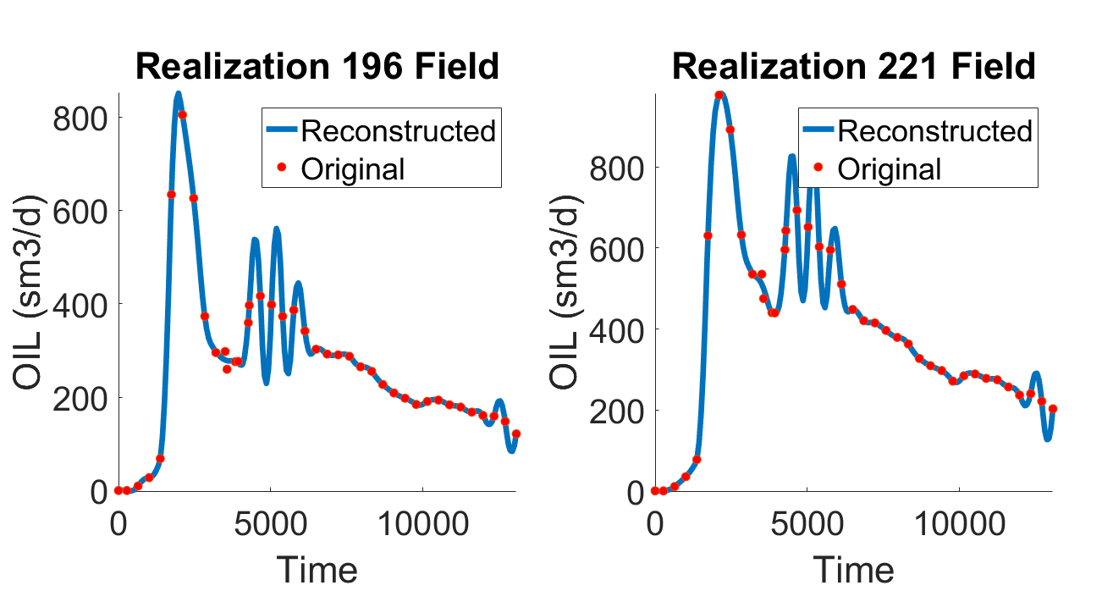
Data Variable

Slide 12
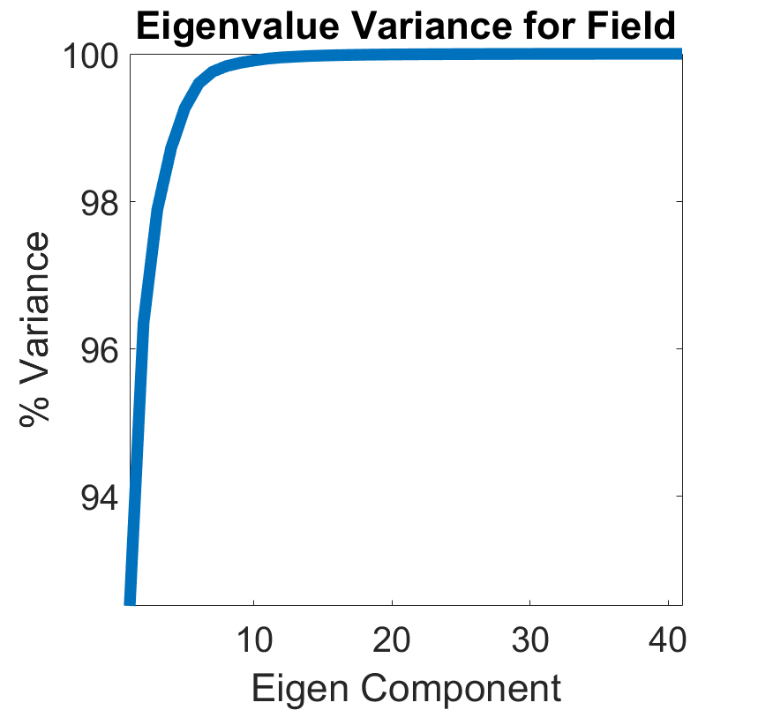
Data Variable

Slide 13
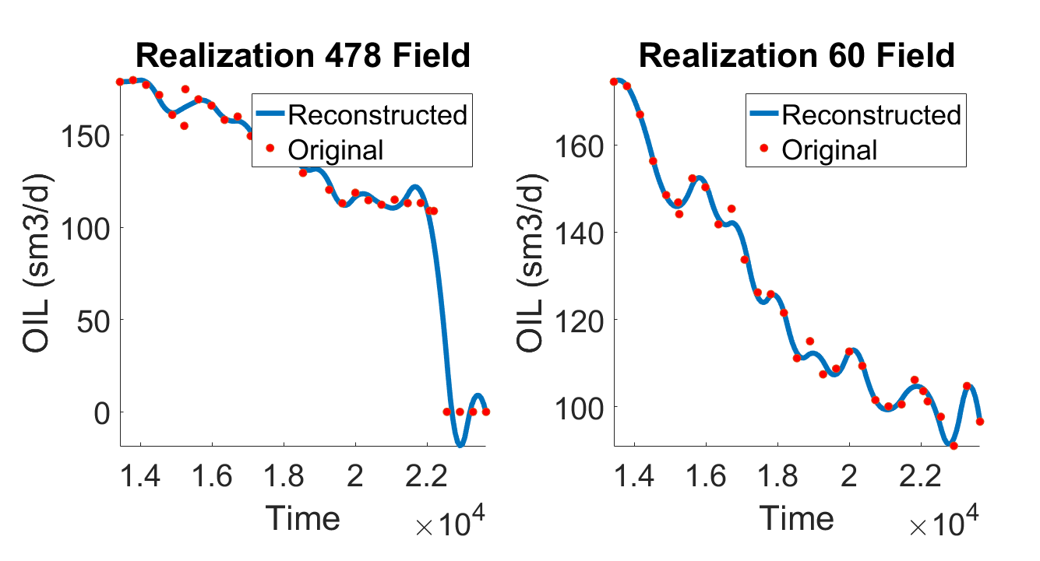
Prediction Variable

Slide 14
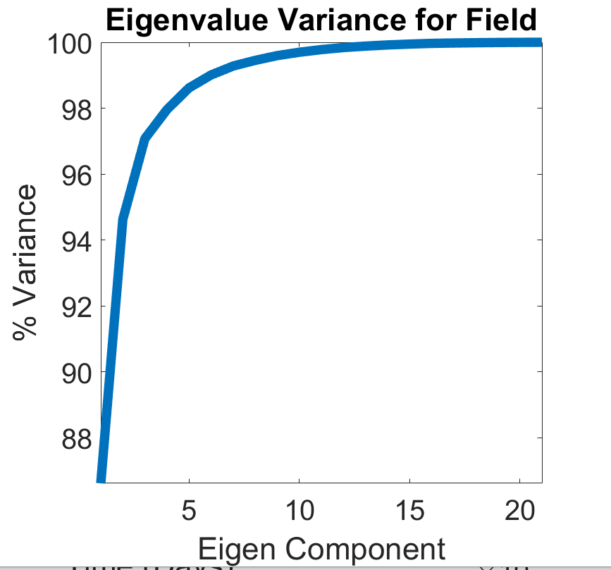
Prediction Variable

Slide 15
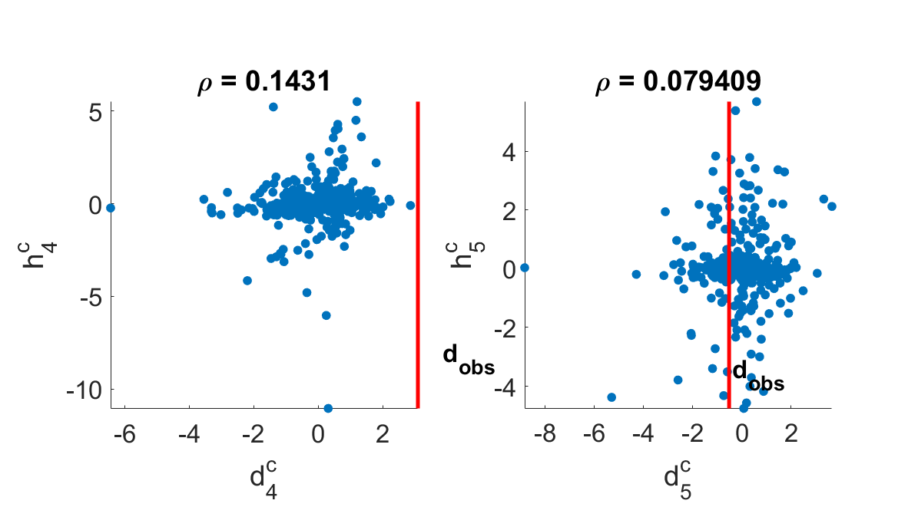

Slide 16
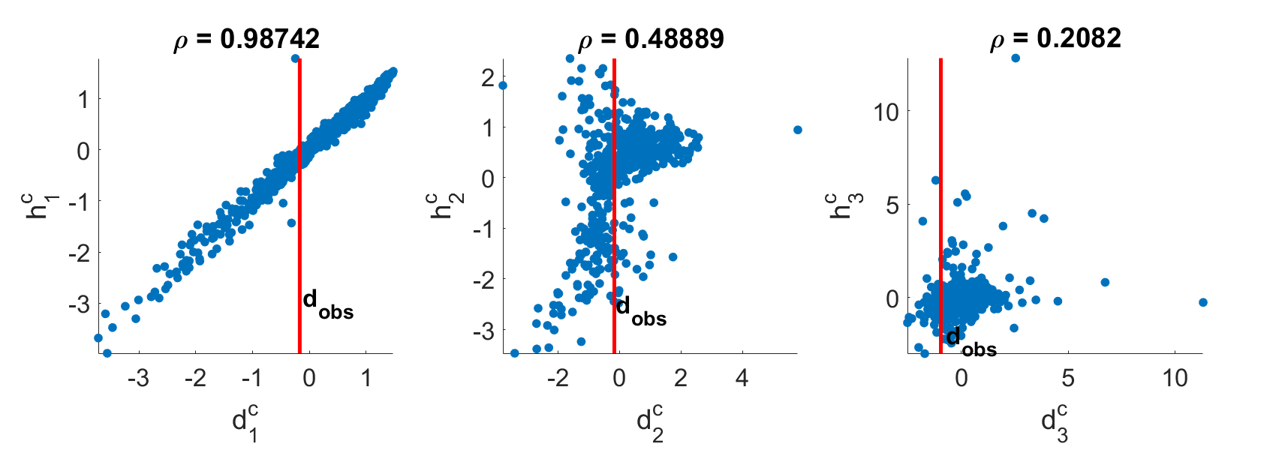

Slide 17
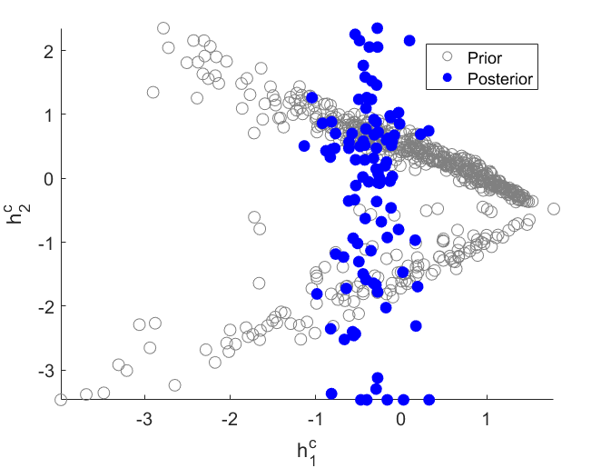

Slide 18
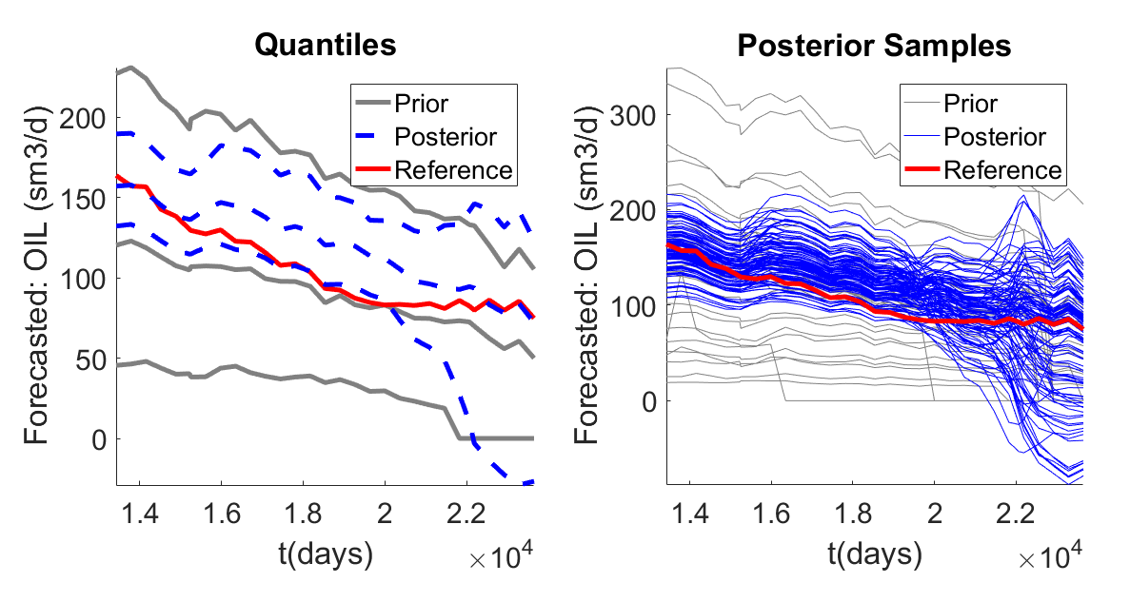
Data: field– oil rate
Prediction: field – oil rate
Dimension Reduction: FPCA
Eigen Tolerance: 0.99

Slide 19
Field(cleaned) vs field rate
PriorData.spline=[3 40]
PriorPrediction.spline=[3 20]
MinEigenValues = 3; EigenTolerance = 0.97;

Slide 20
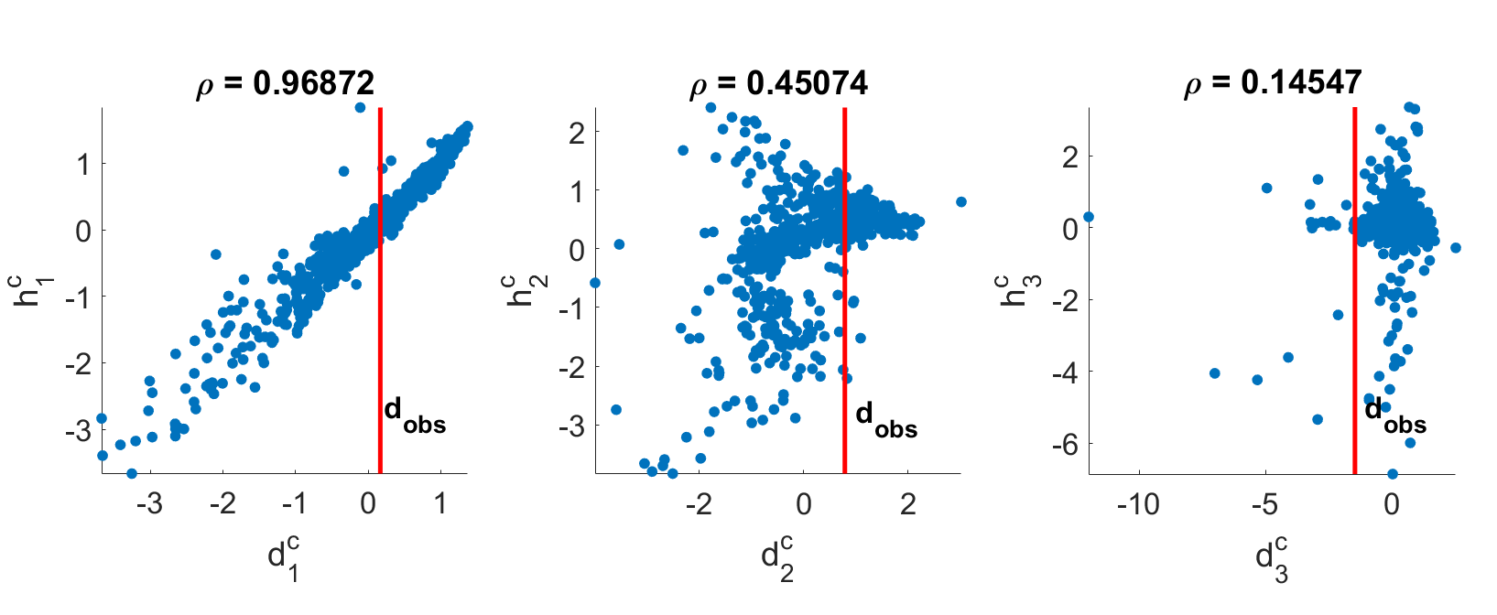

Slide 21
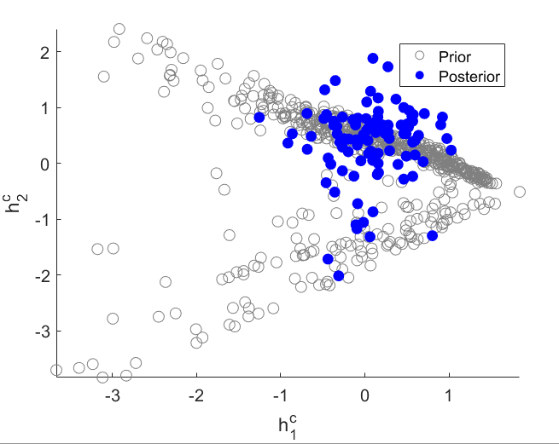

Slide 22
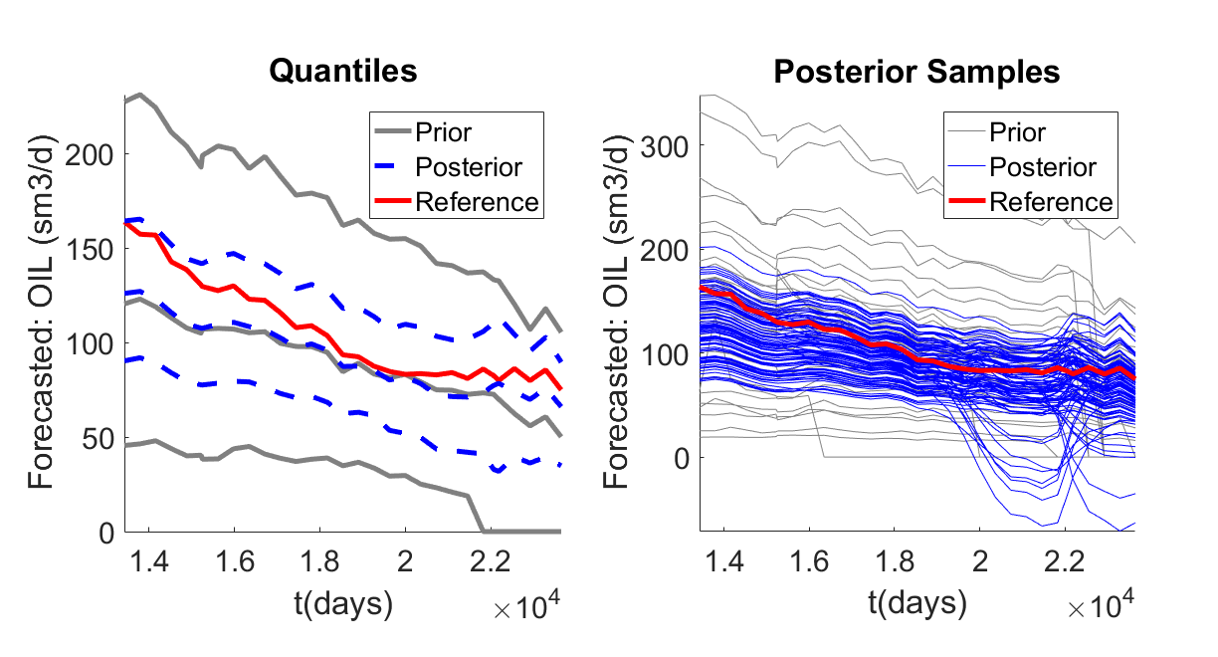
Data: field– oil rate
Prediction: field – oil rate
Dimension Reduction: FPCA
Eigen Tolerance: 0.97

Slide 23
All wells (cleaned) vs field rate
PriorData.spline=[3 40]
PriorPrediction.spline=[3 20]
MinEigenValues = 3; EigenTolerance = 0.90;

Slide 24
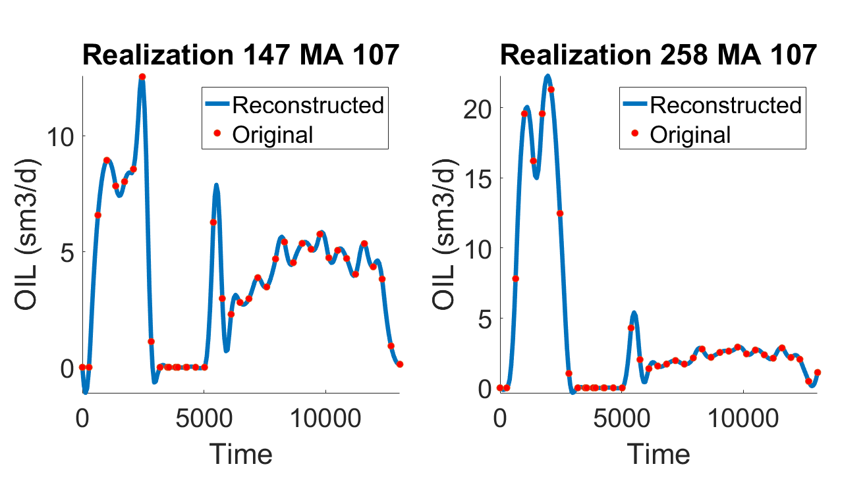
Data Variable

Slide 25
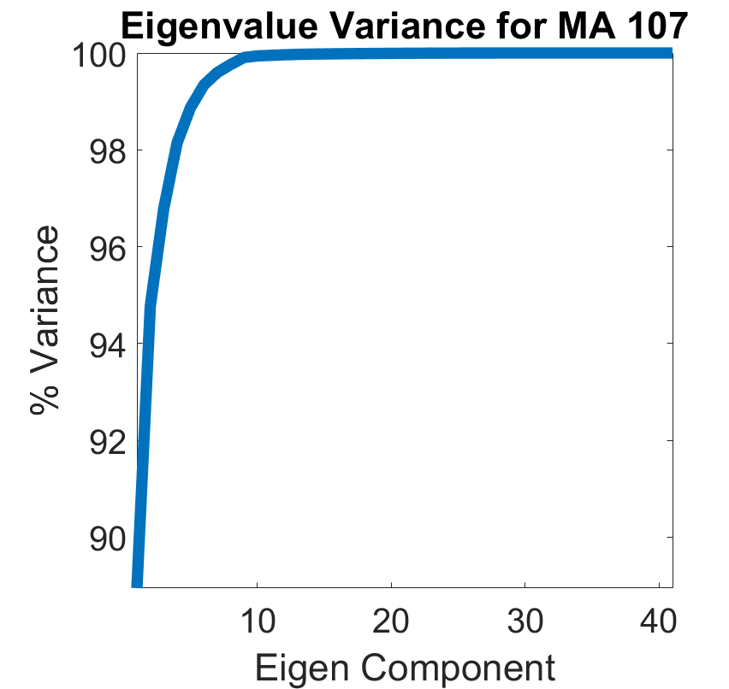
Data Variable

Slide 26
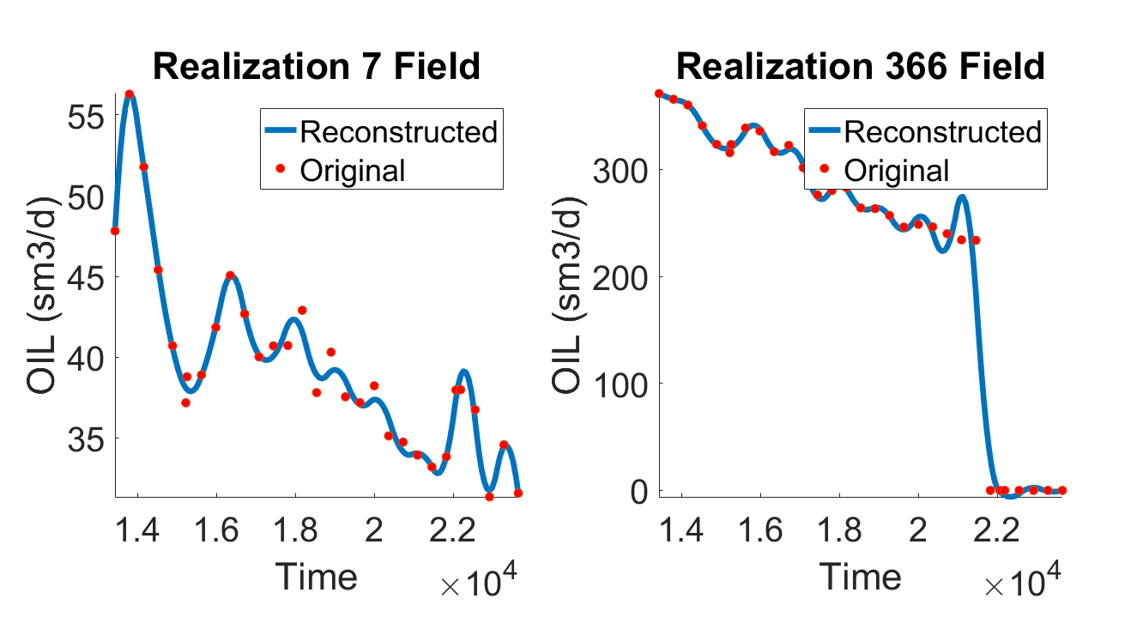
Prediction Variable

Slide 27
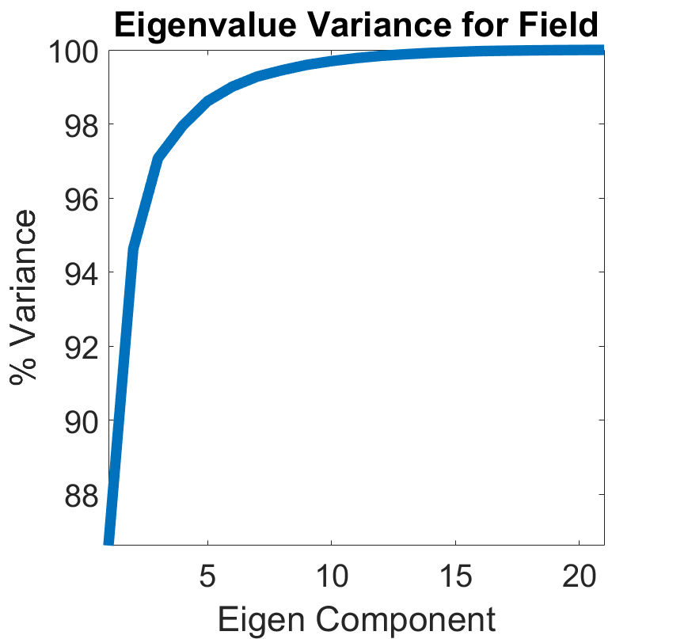
Prediction Variable

Slide 28
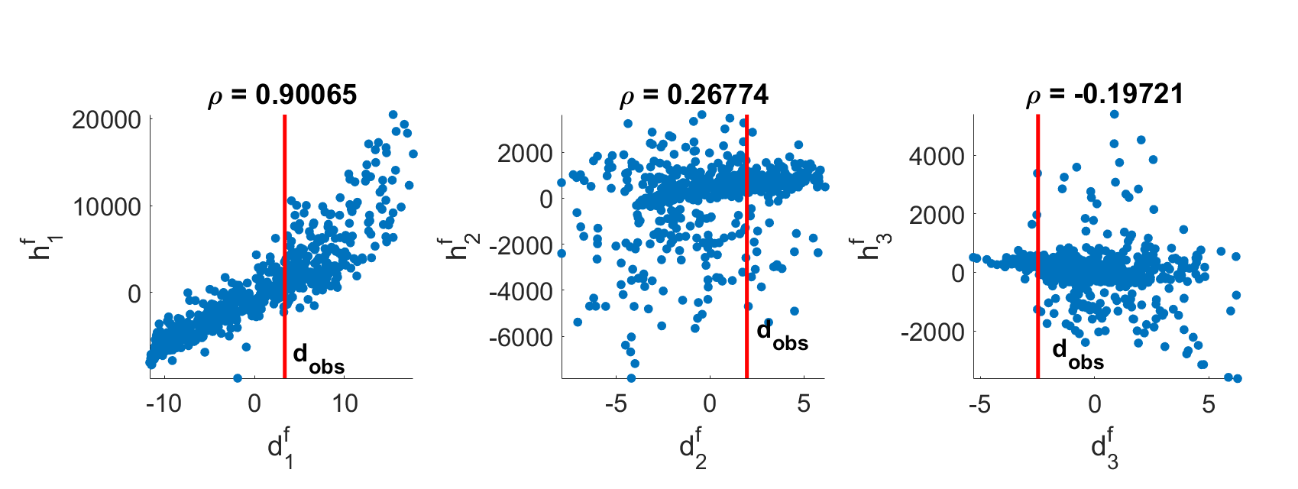

Slide 29
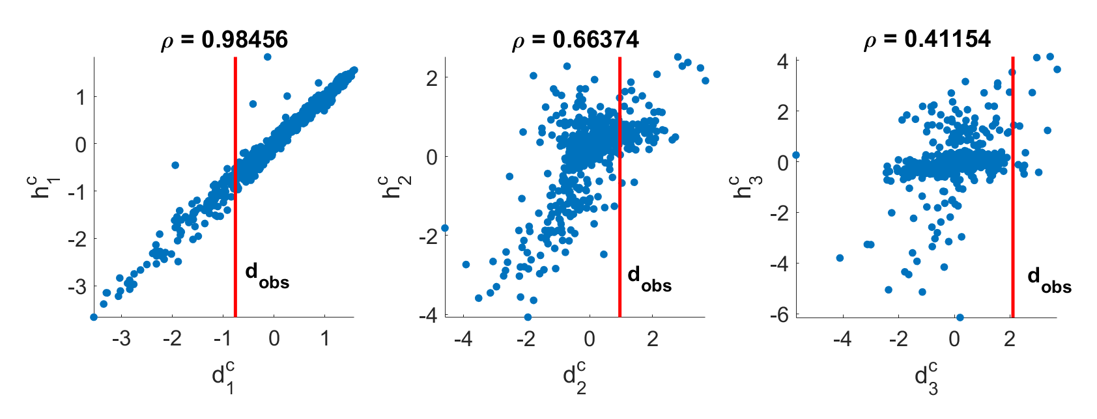

Slide 30
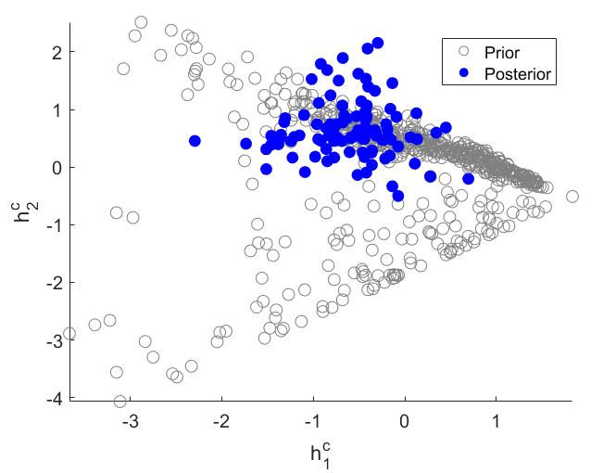

Slide 31
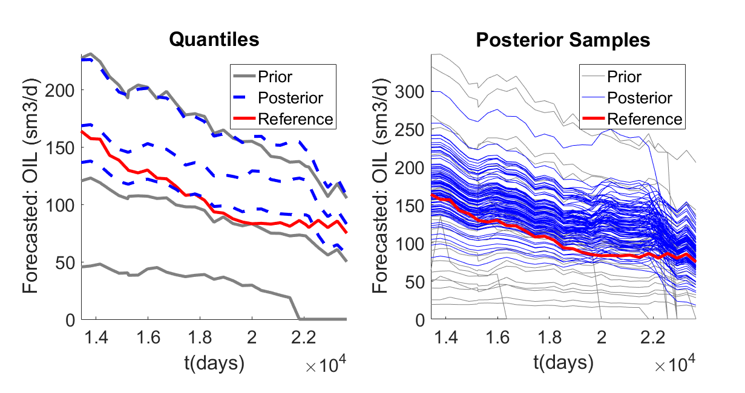
Data: all wells – oil rate
Prediction: field – oil rate
Dimension Reduction: FPCA
Eigen Tolerance: 0.90

