Slide 1
PCA only

Slide 2
All wells (cleaned) vs field rate
PCA only
MinEigenValues = 3; EigenTolerance = 0.99;

Slide 3
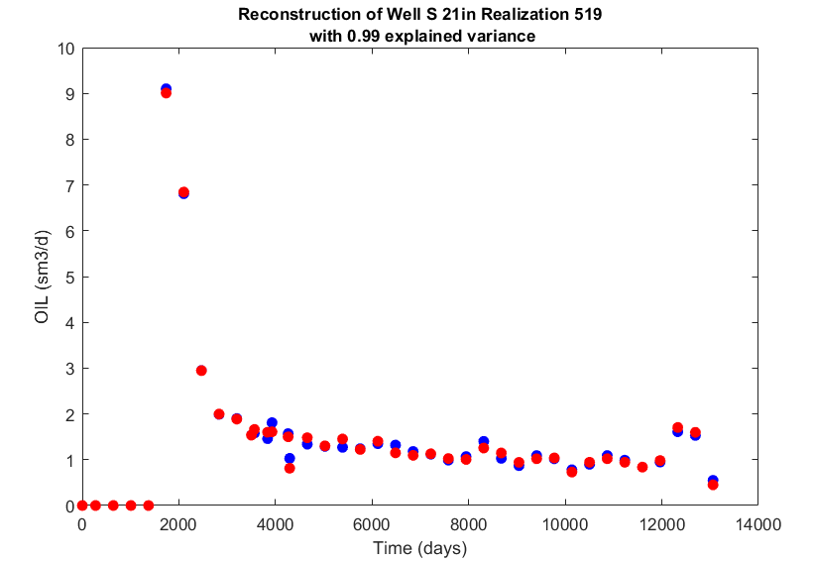

Slide 4
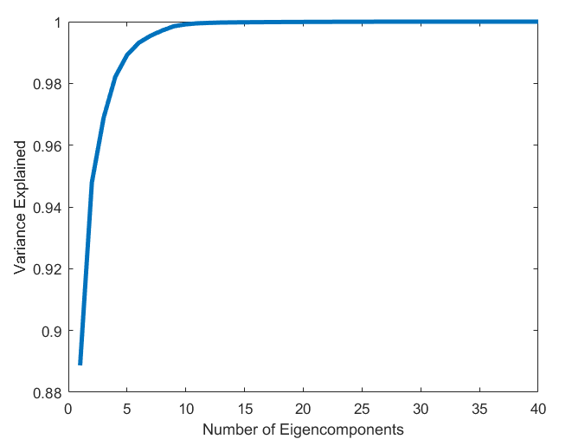

Slide 5
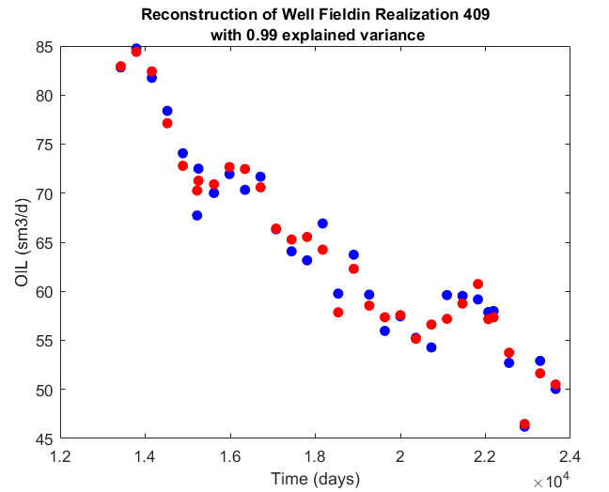

Slide 6
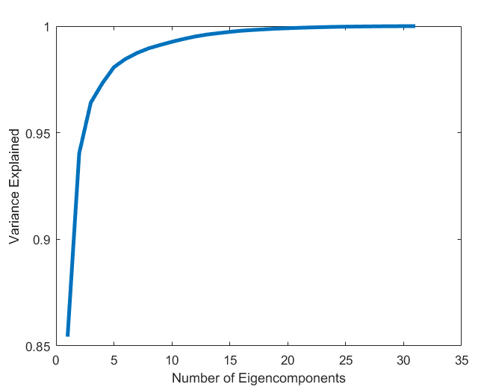

Slide 7
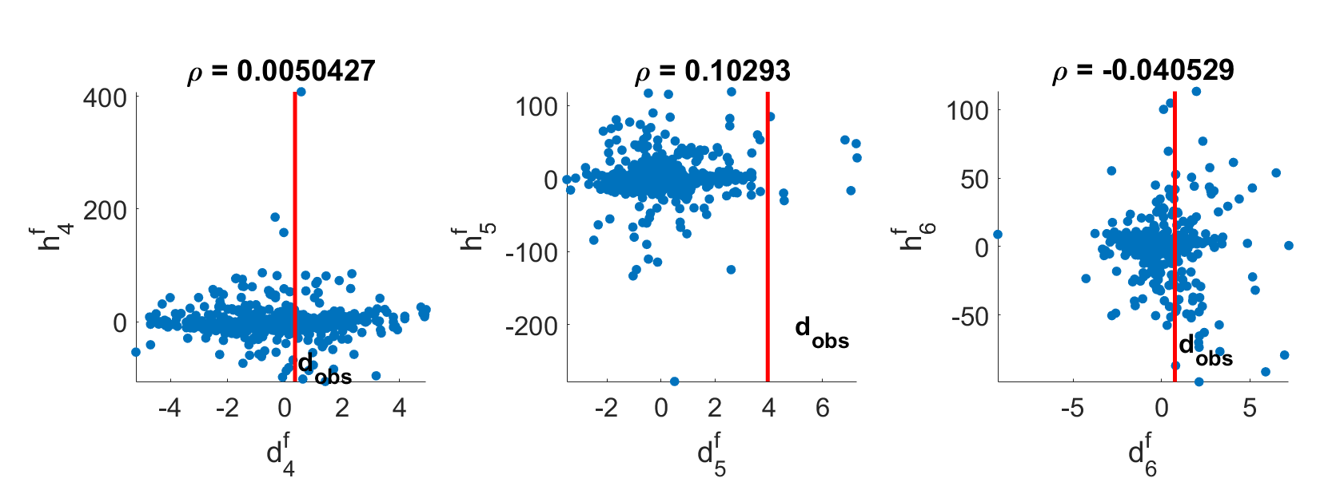

Slide 8
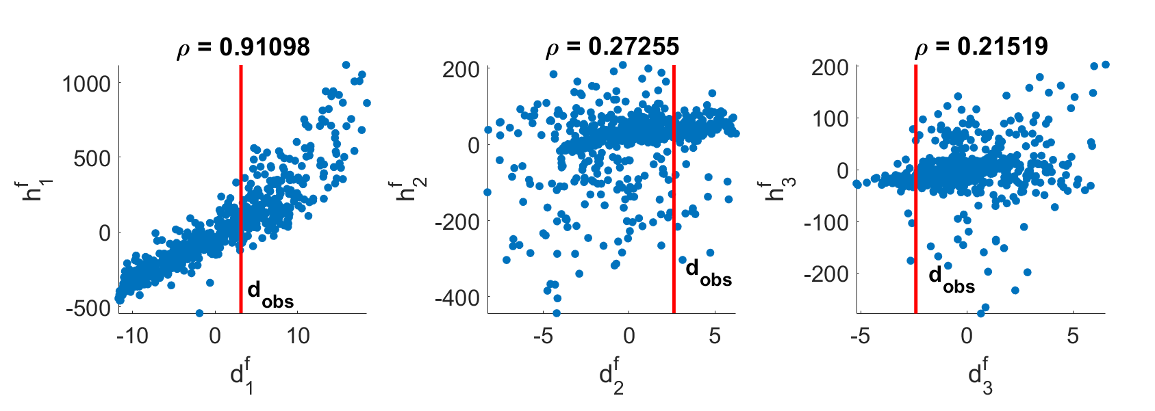

Slide 9
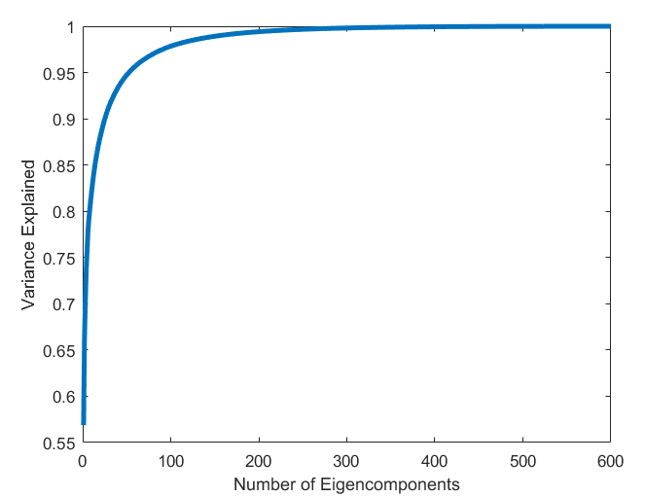
157 Eigenvalues are use to describe 0.99 of variance.

Slide 10
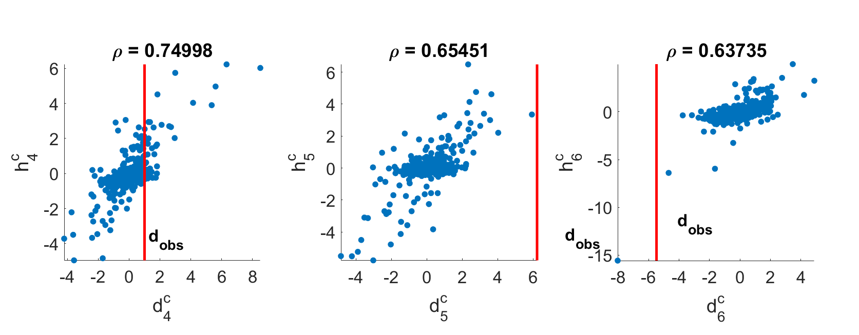

Slide 11
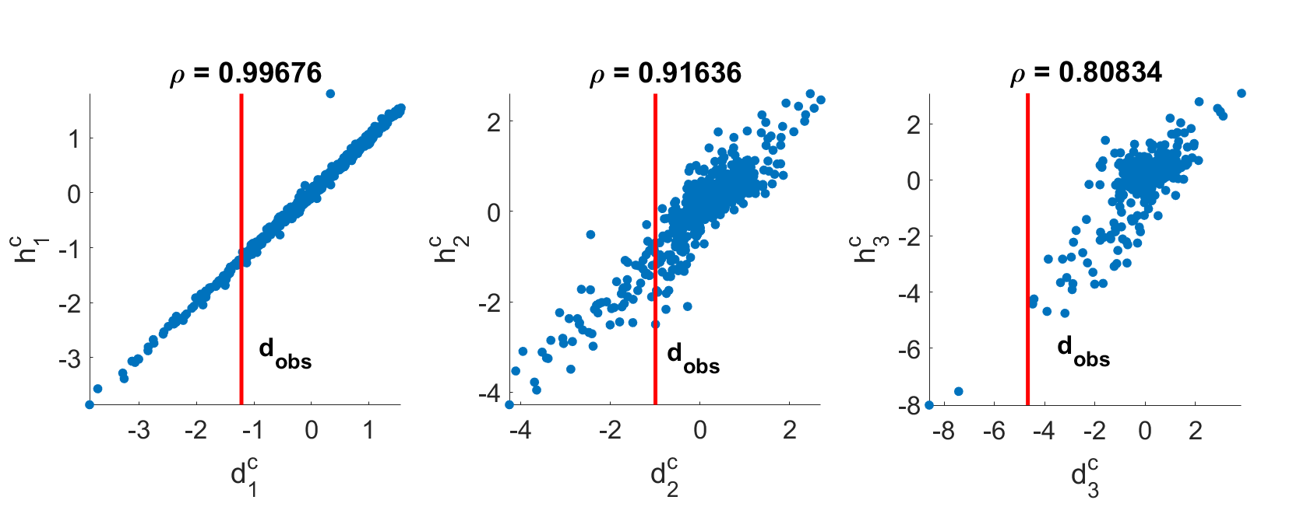

Slide 12
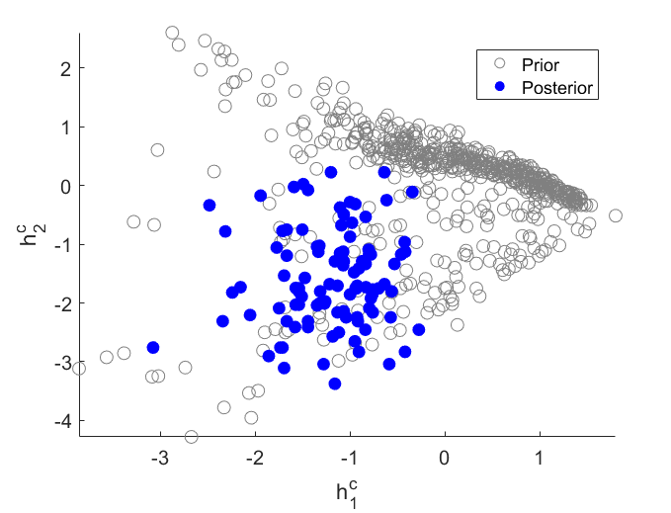

Slide 13
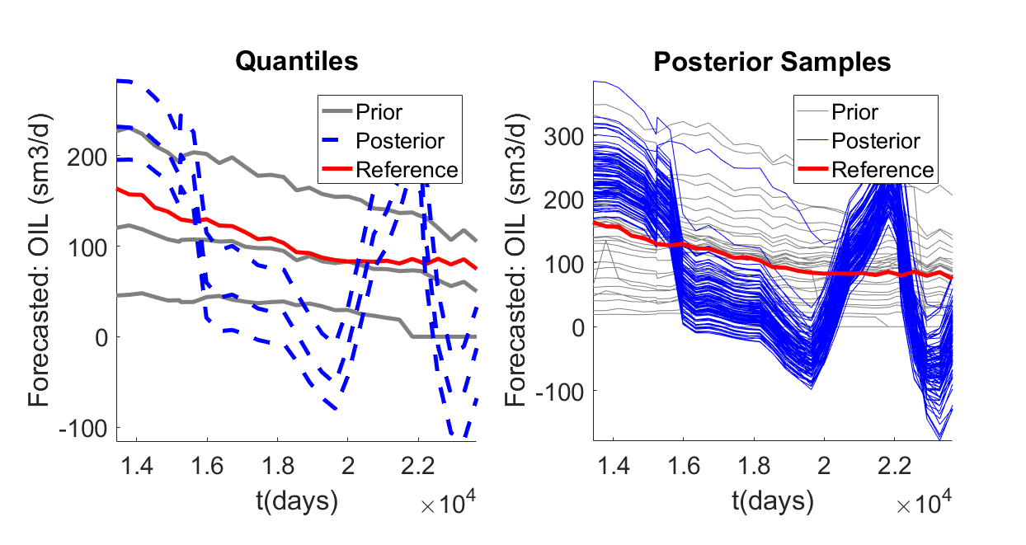
Data: all wells – oil rate
Prediction: field – oil rate
Dimension Reduction: PCA only
Eigen Tolerance: 0.99

Slide 14
All wells (cleaned) vs field rate
PCA only
MinEigenValues = 3; EigenTolerance = 0.90;

Slide 15
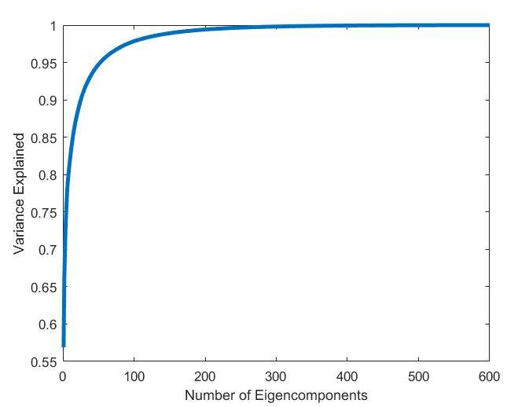
26 Eigenvalues are use to describe 0.90 of variance.

Slide 16
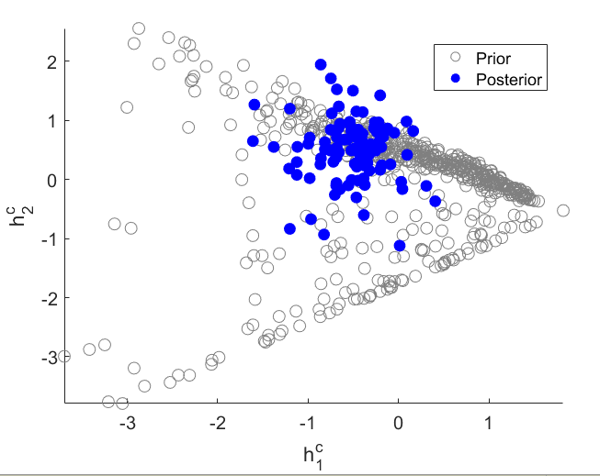

Slide 17
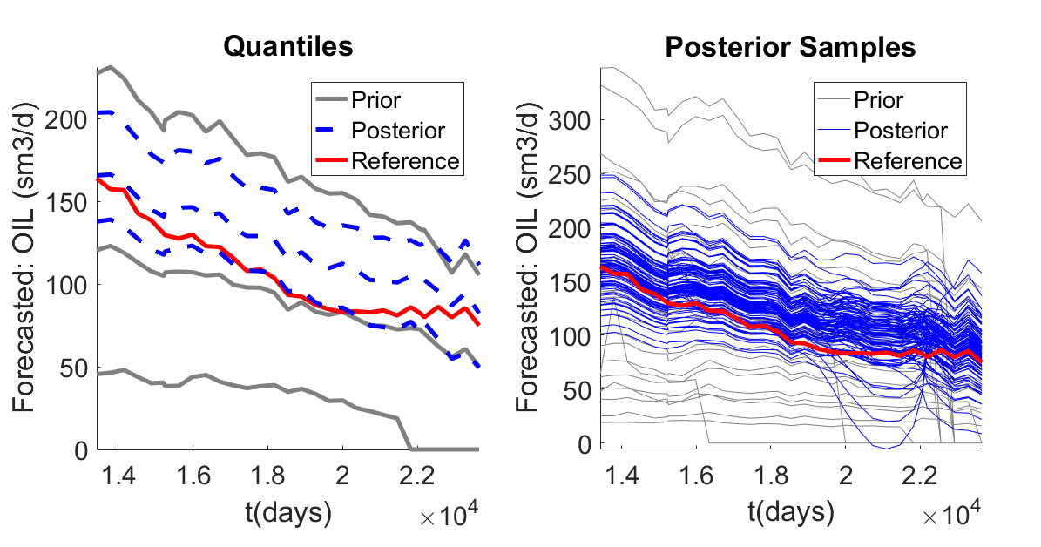
Data: all wells – oil rate
Prediction: field – oil rate
Dimension Reduction: PCA only
Eigen Tolerance: 0.90

Slide 18
Field(cleaned) vs field rate
PCA only
MinEigenValues = 3; EigenTolerance = 0.99;

Slide 19
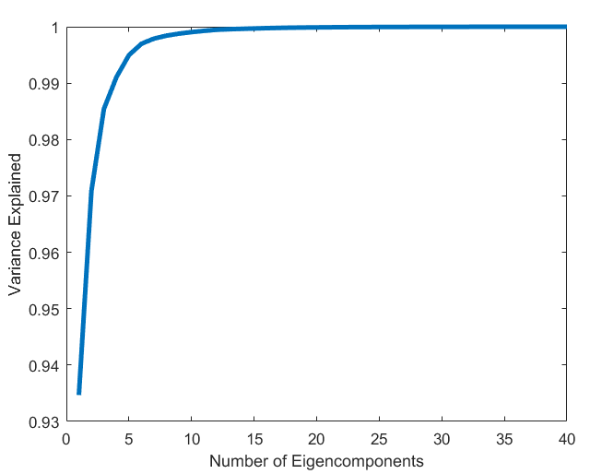
4 Eigenvalues are use to describe 0.99 of variance.

Slide 20
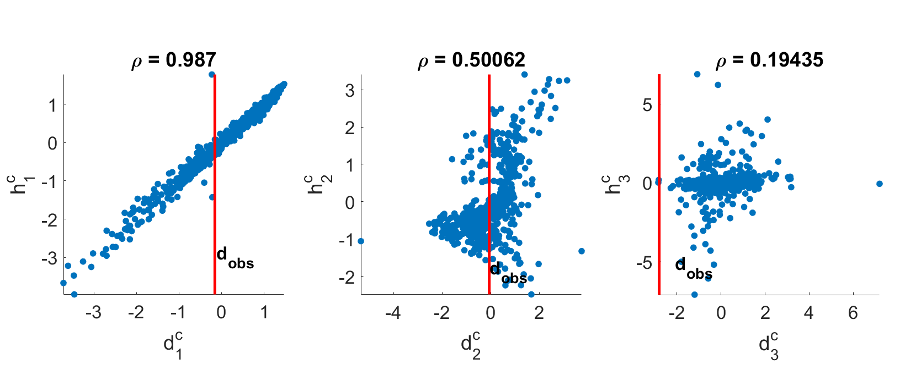

Slide 21
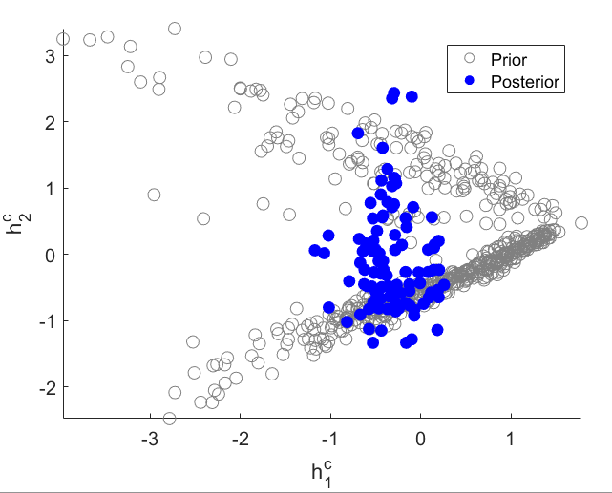

Slide 22
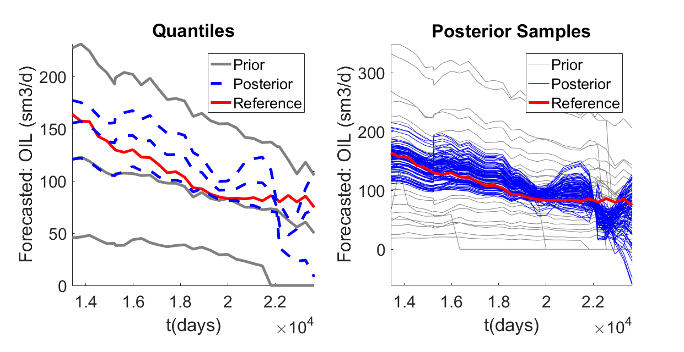
Data: field – oil rate
Prediction: field – oil rate
Dimension Reduction: PCA only
Eigen Tolerance: 0.99

Slide 23
Field(cleaned) vs field rate
PCA only
MinEigenValues = 3; EigenTolerance = 0.97;

Slide 24
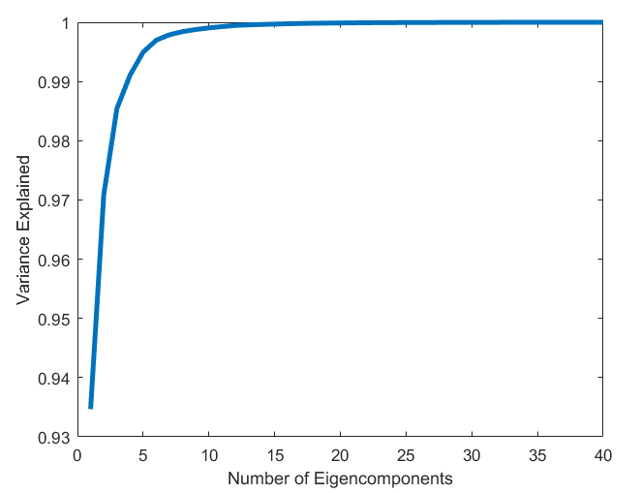
3 Eigenvalues are use to describe 0.97 of variance.

Slide 25
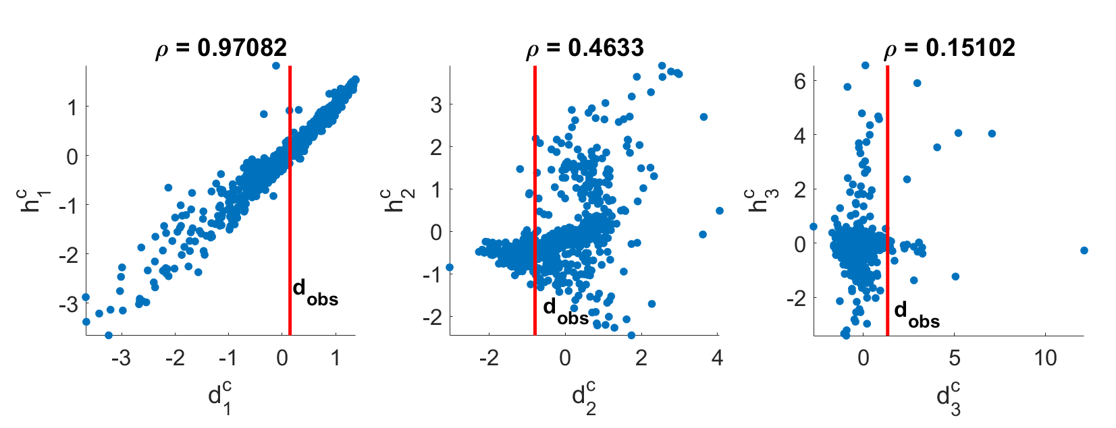

Slide 26
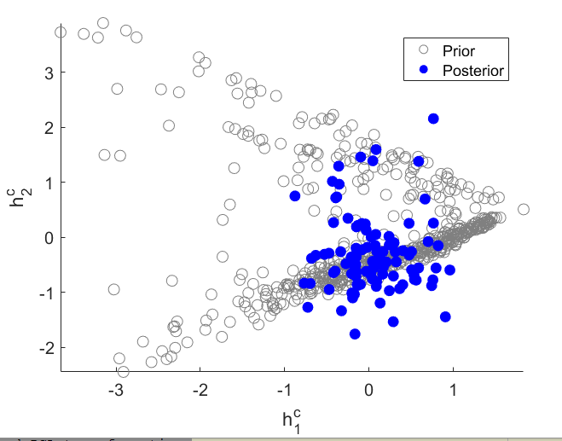

Slide 27
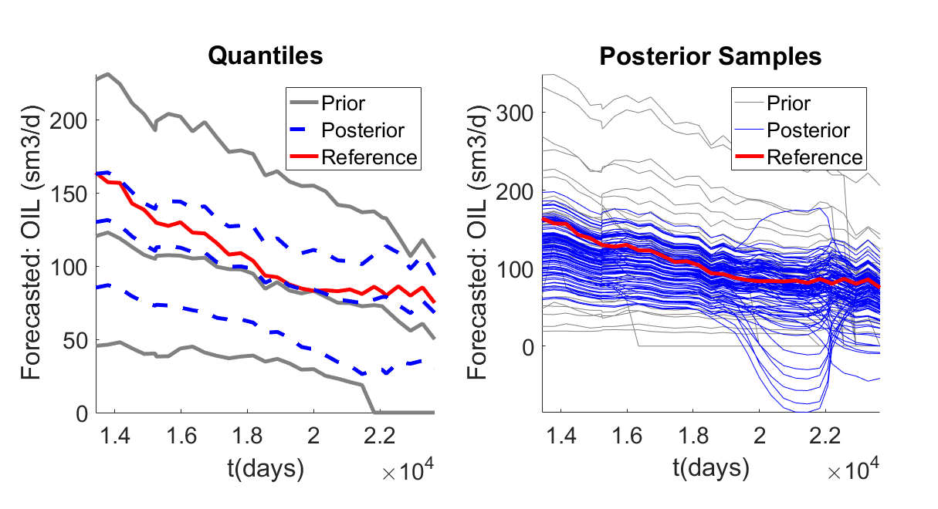
Data: all wells – oil rate
Prediction: field – oil rate
Dimension Reduction: PCA only
Eigen Tolerance: 0.97

