Slide 1
PCA only PredictionVar=single well

Slide 2
All wells (cleaned) vs S 65 (single well)
PCA only
MinEigenValues = 3; EigenTolerance = 0.99;

Slide 3
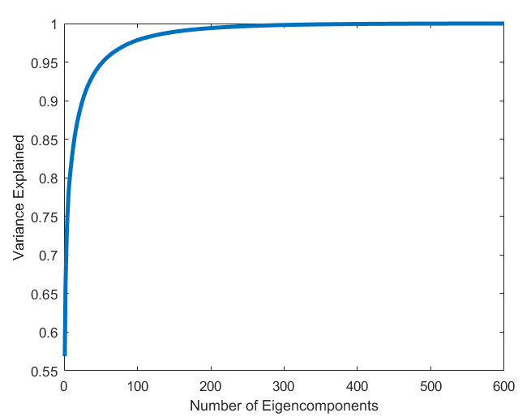
157 Eigenvalues are use to describe 0.99 of variance.
Mixed PCA

Slide 4
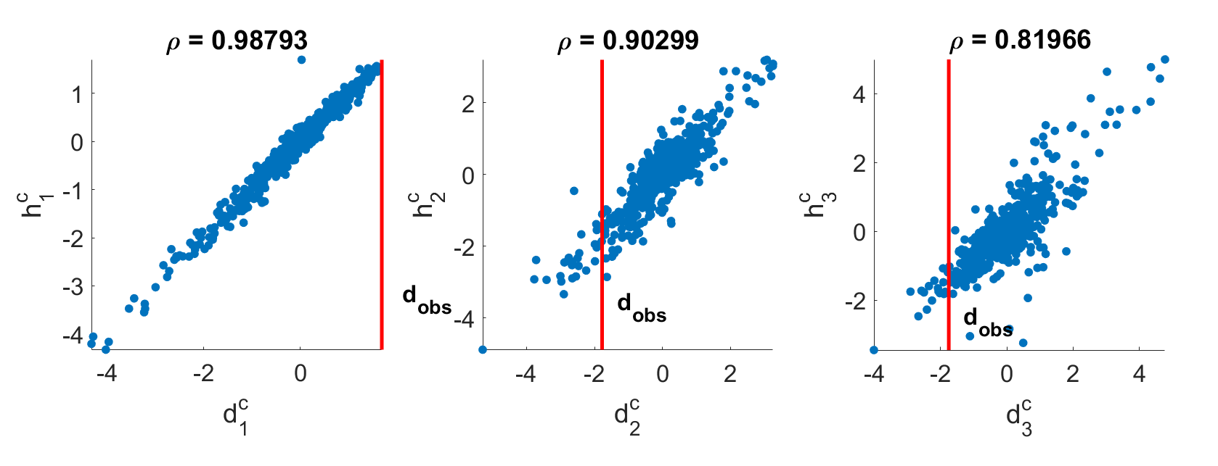

Slide 5
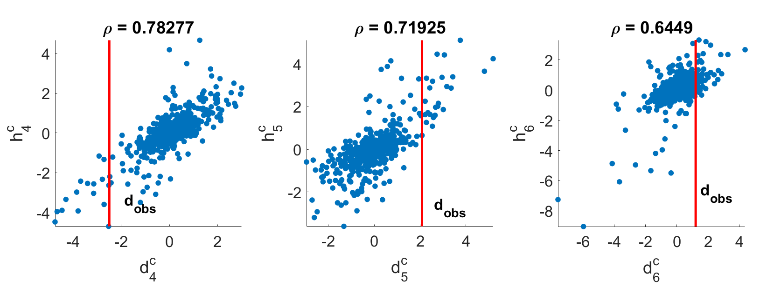

Slide 6
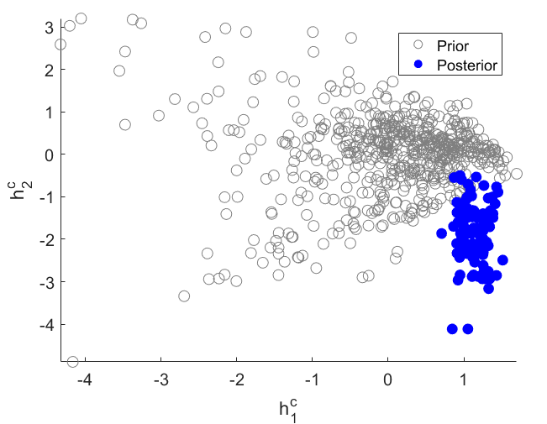

Slide 7
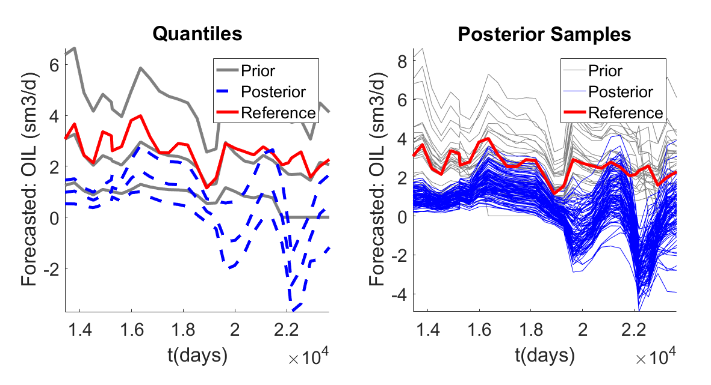
Data: all wells - oil rate
Prediction: Single well (S65)– oil rate
Dimension Reduction: PCA only
Eigen Tolerance: 0.99

Slide 8
All wells (cleaned) vs S 65 (single well)
PCA only
MinEigenValues = 3; EigenTolerance = 0.90;

Slide 9
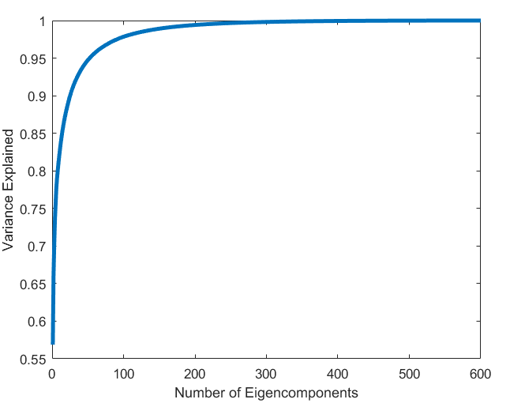
26 Eigenvalues are use to describe 0.90 of variance.
Mixed PCA

Slide 10
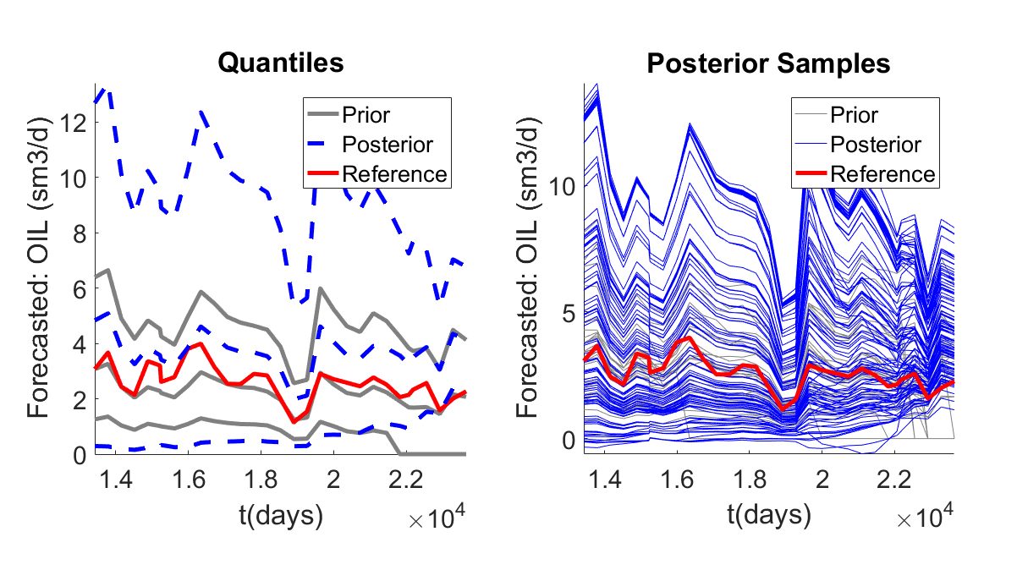
Data: all wells - oil rate
Prediction: Single well (S65)– oil rate
Dimension Reduction: PCA only
Eigen Tolerance: 0.90

Slide 11
All wells (cleaned) vs S 65 (single well)
PCA only
MinEigenValues = 3; EigenTolerance = 0.95;

Slide 12
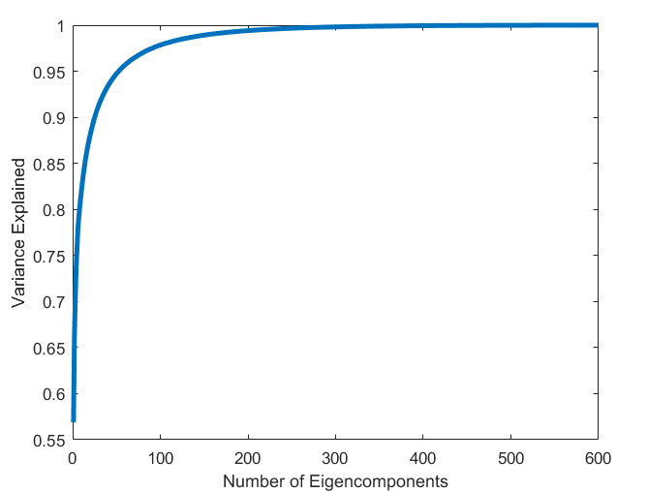
53 Eigenvalues are use to describe 0.95 of variance.
Mixed PCA

Slide 13
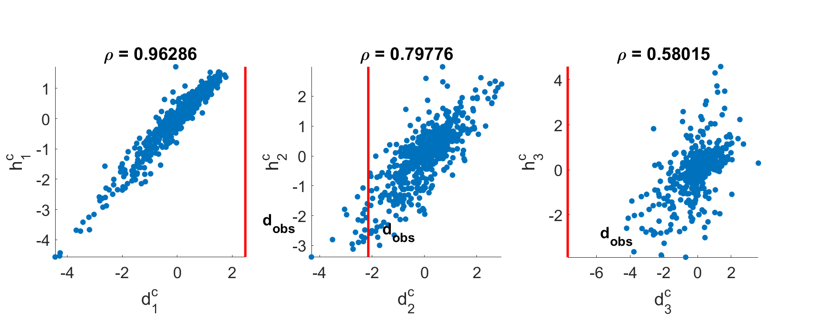

Slide 14
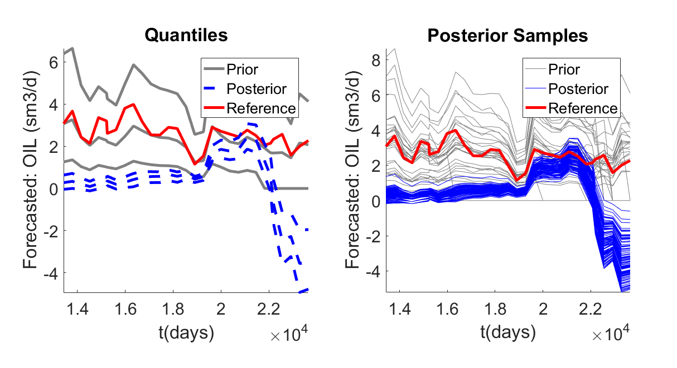
Data: all wells - oil rate
Prediction: Single well (S65)– oil rate
Dimension Reduction: PCA only
Eigen Tolerance: 0.95

Slide 15
All wells (cleaned) vs P60 (single well)
PCA only
MinEigenValues = 3; EigenTolerance = 0.95;

Slide 16
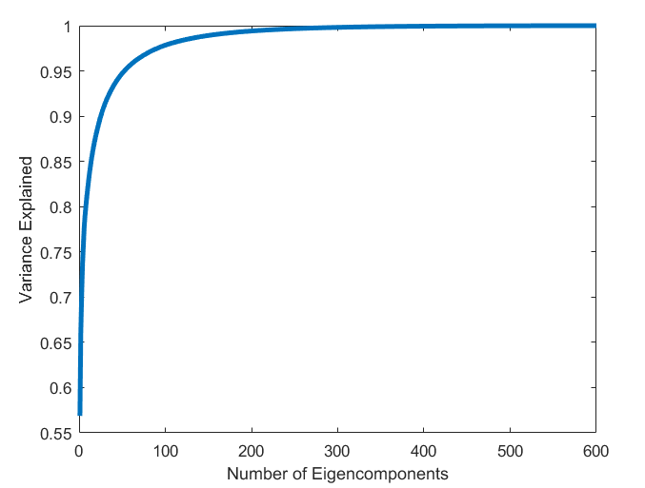
53 Eigenvalues are use to describe 0.95 of variance.

Slide 17
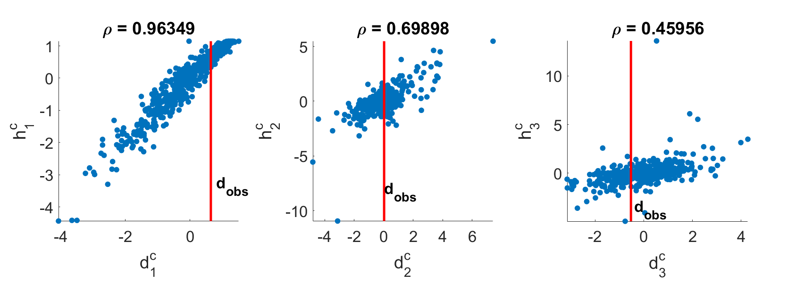

Slide 18
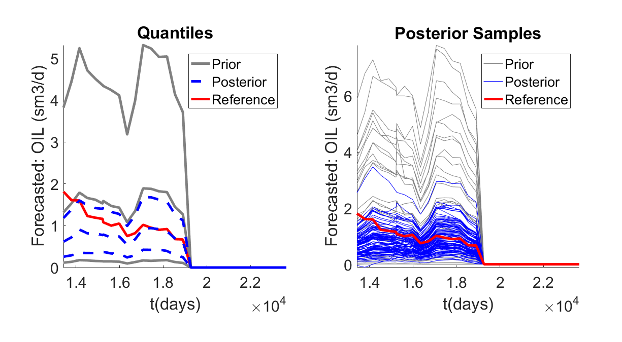
Data: all wells - oil rate
Prediction: Single well (P60)– oil rate
Dimension Reduction: FPCA
Eigen Tolerance: 0.95

