Slide 2
All wells (cleaned) vs S 65 (single well)
PriorData.spline=[3 40]
PriorPrediction.spline=[3 20]
MinEigenValues = 3; EigenTolerance = 0.99;

Slide 3
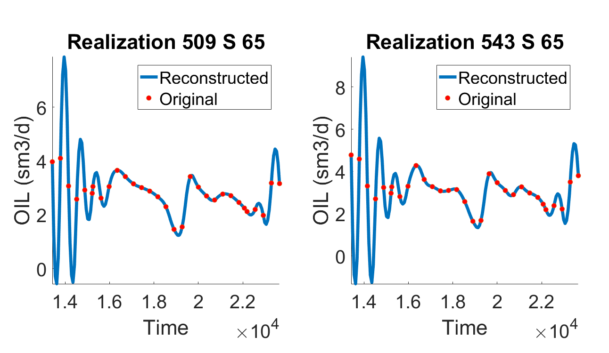

Slide 4
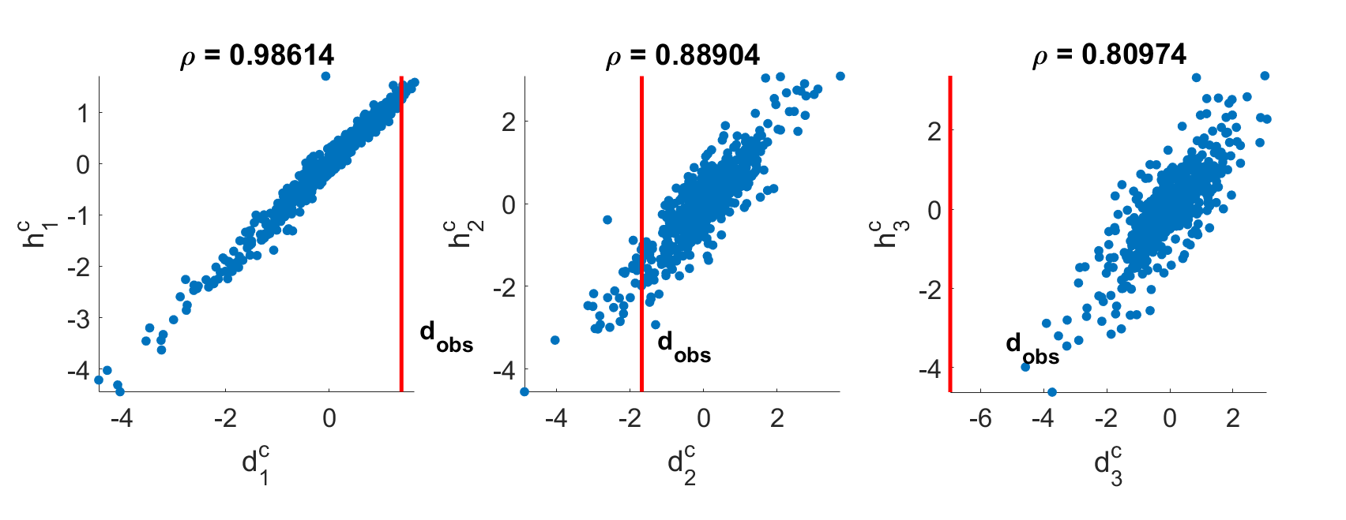

Slide 5
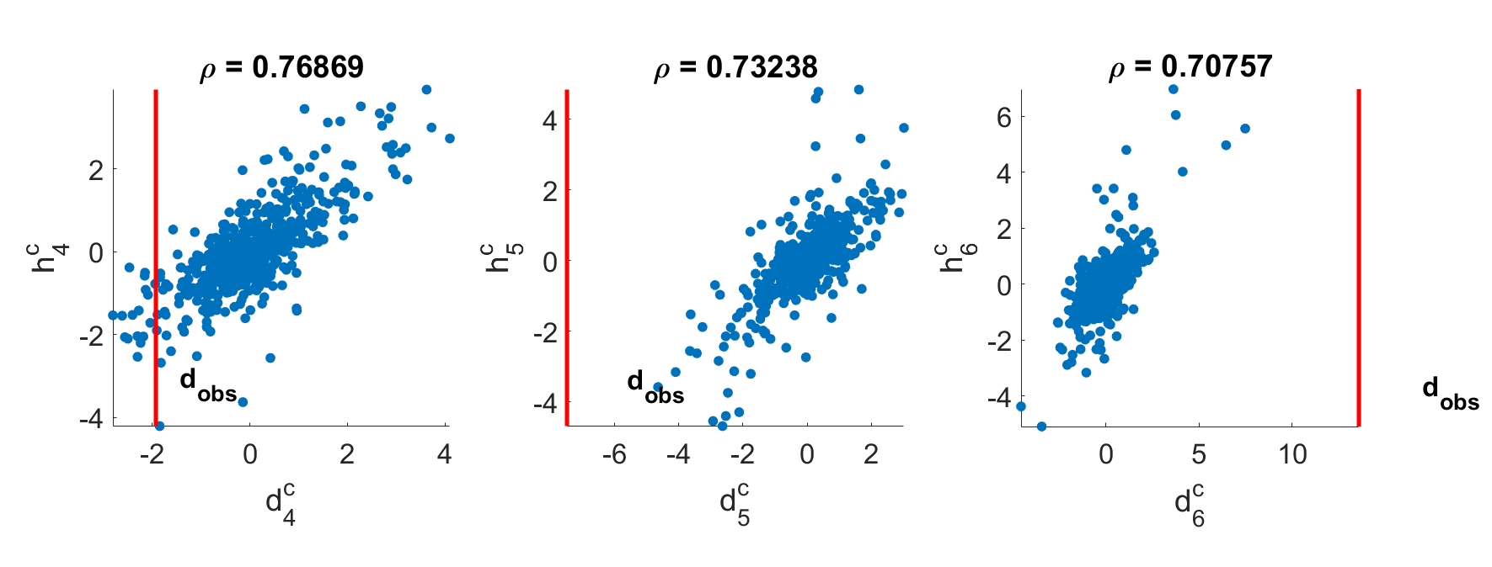

Slide 6
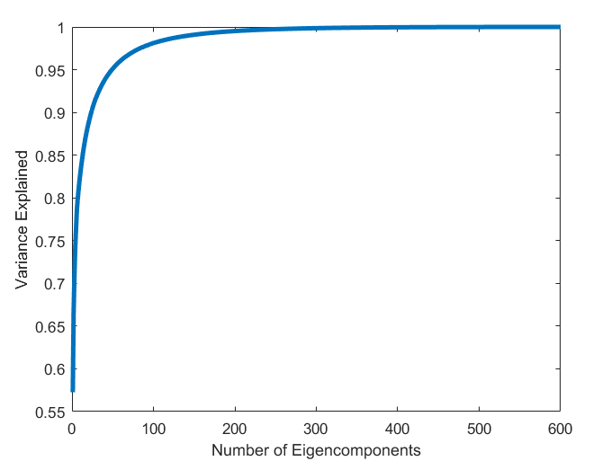
144 Eigenvalues are use to describe 0.99 of variance.
Mixed PCA

Slide 7
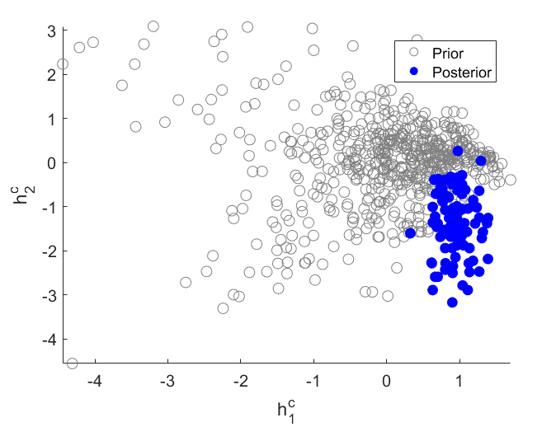

Slide 8
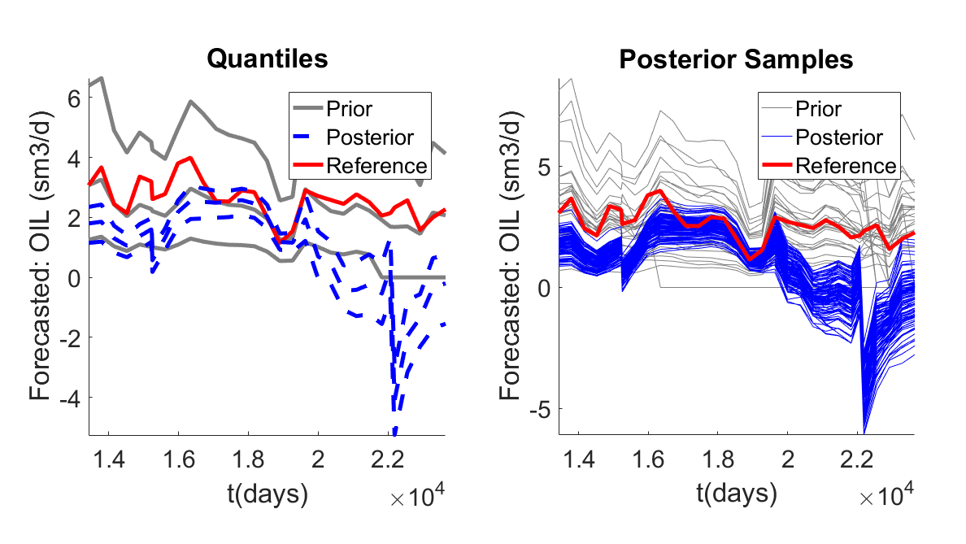
Data: all wells - oil rate
Prediction: Single well (S65) – oil rate
Dimension Reduction: FPCA
Eigen Tolerance: 0.99

Slide 9
All wells (cleaned) vs S 65 (single well)
PriorData.spline=[3 40]
PriorPrediction.spline=[3 20]
MinEigenValues = 3; EigenTolerance = 0.90;

Slide 10
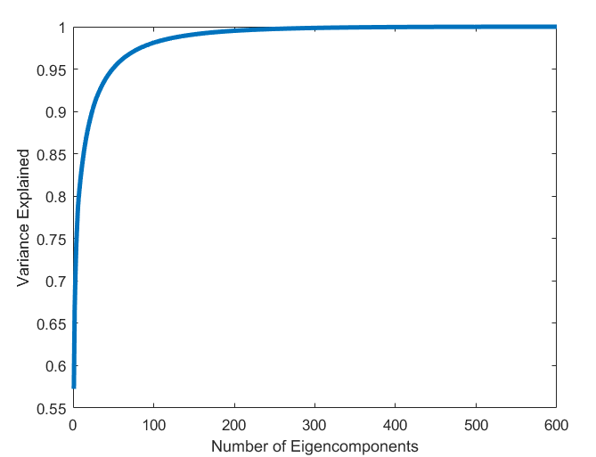
24 Eigenvalues are use to describe 0.90 of variance.

Slide 11
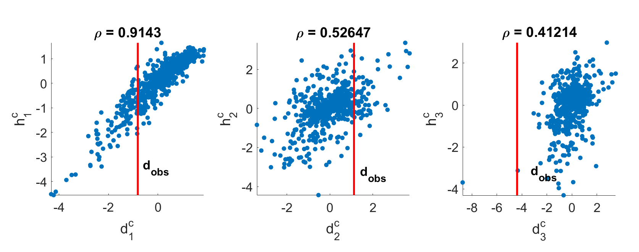

Slide 12
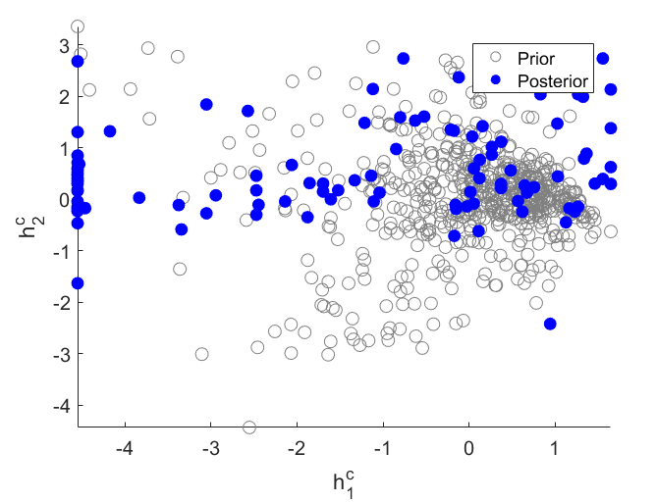

Slide 13
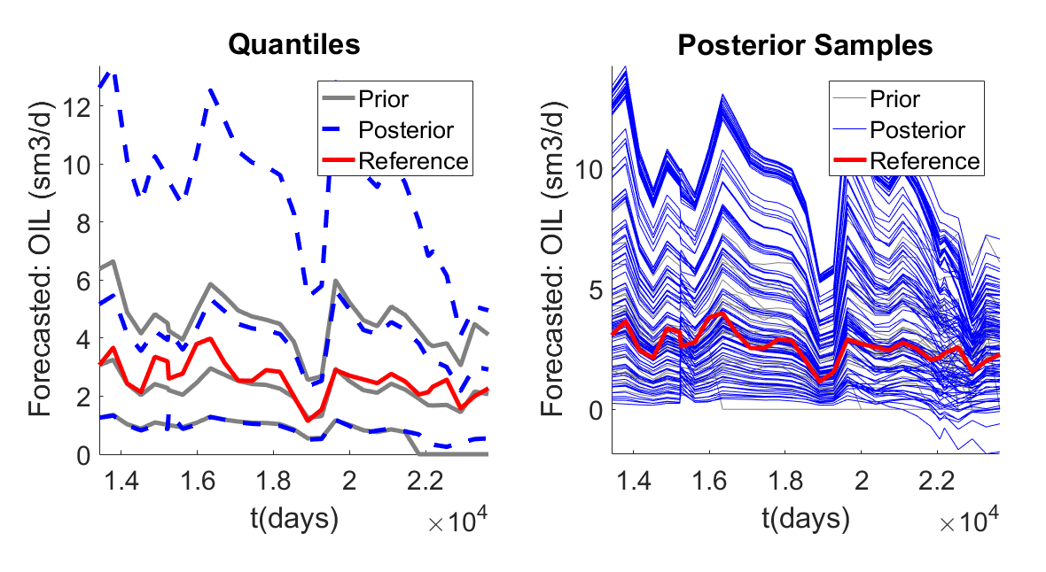
Data: all wells - oil rate
Prediction: single well (S65)– oil rate
Dimension Reduction: FPCA
Eigen Tolerance: 0.90

Slide 14
All wells (cleaned) vs S 65 (single well)
PriorData.spline=[3 40]
PriorPrediction.spline=[3 20]
MinEigenValues = 3; EigenTolerance = 0.95;

Slide 15
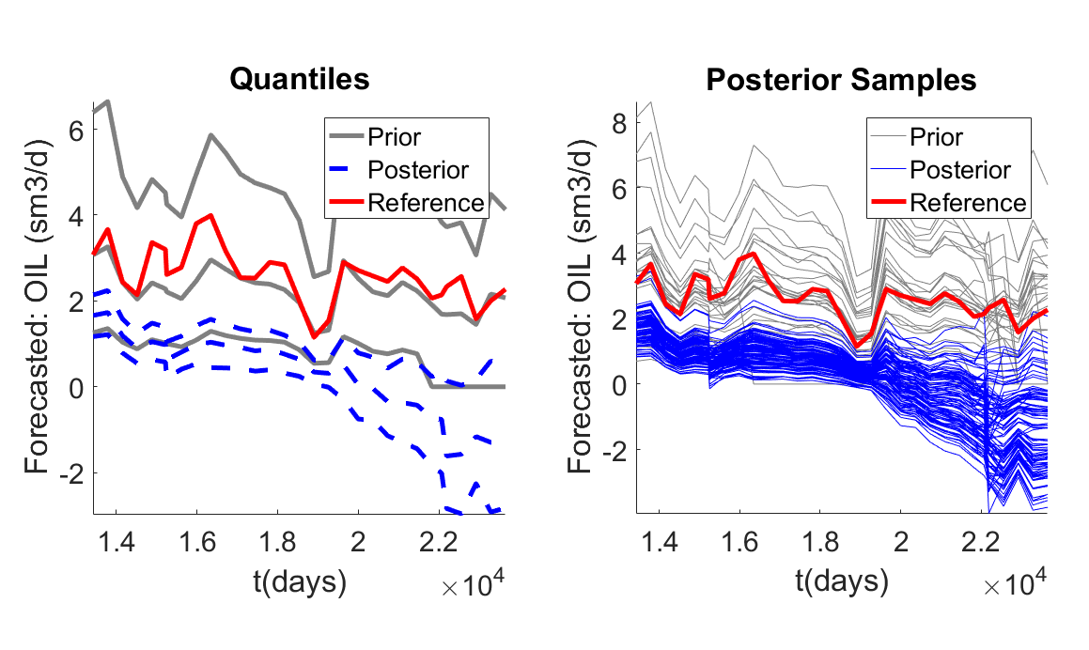
Data: all wells - oil rate
Prediction: Single well (S65)– oil rate
Dimension Reduction: FPCA
Eigen Tolerance: 0.95

