Slide 2
Case | Data Variable | Prediction Variable | Dimension Reduction | Eigen Tolerance
1 | all wells - oil rate | field - oil rate | FPCA | 0.99
2 | field - oil rate | field - oil rate | FPCA | 0.99
3 | field - oil rate | field - oil rate | FPCA | 0.97
4 | all wells - oil rate | field - oil rate | FPCA | 0.9
5 | all wells - oil rate | field - oil rate | PCA only | 0.99
6 | all wells - oil rate | field - oil rate | PCA only | 0.9
7 | field - oil rate | field - oil rate | PCA only | 0.99
8 | field - oil rate | field - oil rate | PCA only | 0.97
9 | all wells - oil rate | single well (S 65) - oil rate | FPCA | 0.99
10 | all wells - oil rate | single well (S 65) - oil rate | FPCA | 0.9
11 | all wells - oil rate | single well (S 65) - oil rate | FPCA | 0.95
12 | all wells - oil rate | single well (S 65) - oil rate | PCA only | 0.99
13 | all wells - oil rate | single well (S 65) - oil rate | PCA only | 0.9
14 | all wells - oil rate | single well (S 65) - oil rate | PCA only | 0.95
15 | all wells - oil rate | single well (P 60) - oil rate | PCA only | 0.95
 | All wells used have production in the historical period as well as in the prediction period.
 | The prediction period starts at time step 41 in order to compare it with the reference (measured data)

Slide 3
Prediction Variable: Field Oil Rate

Slide 4
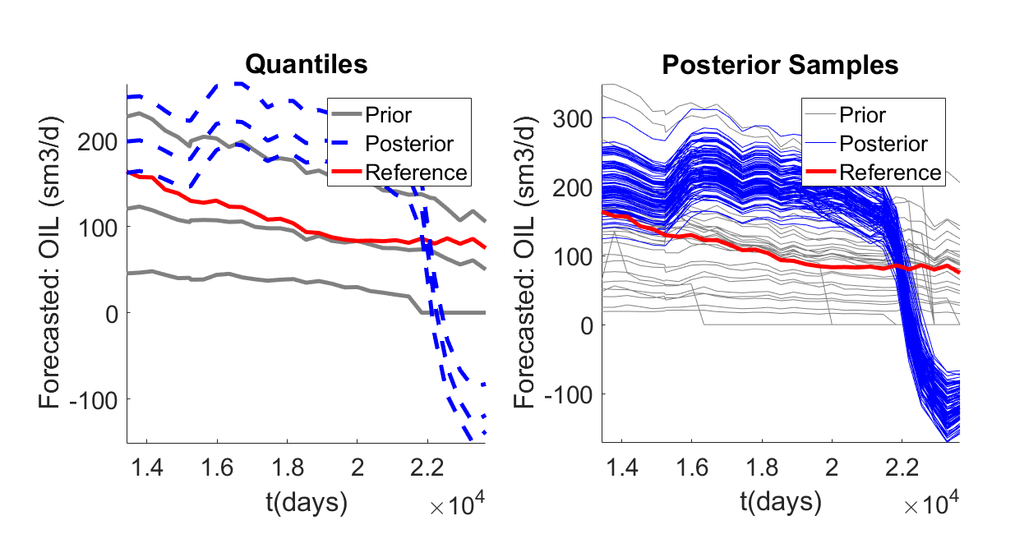
Data: all wells – oil rate
Prediction: field – oil rate
Dimension Reduction: FPCA
Eigen Tolerance: 0.99
FPCA

Slide 5
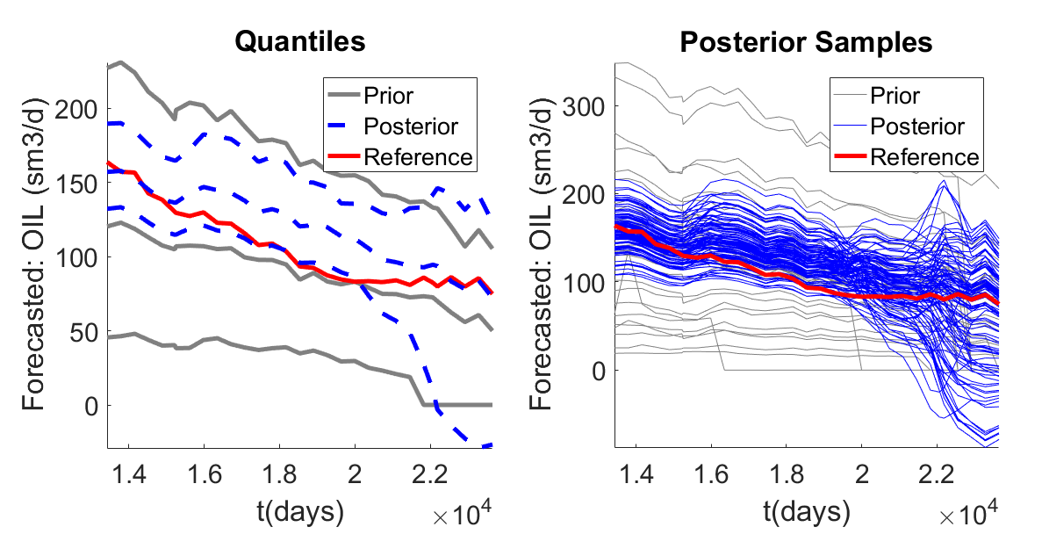
Data: field– oil rate
Prediction: field – oil rate
Dimension Reduction: FPCA
Eigen Tolerance: 0.99
FPCA

Slide 6
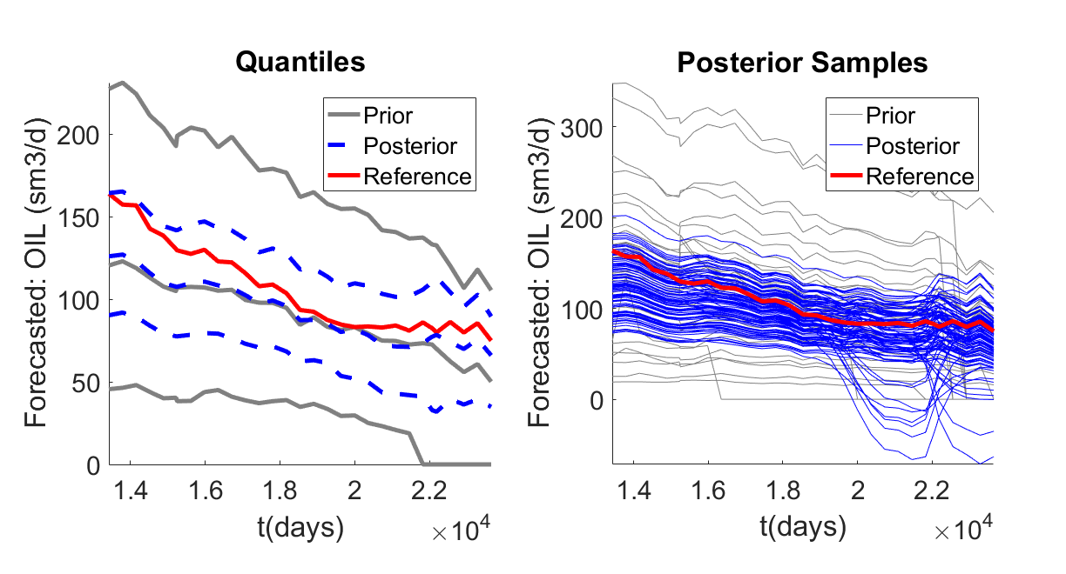
Data: field– oil rate
Prediction: field – oil rate
Dimension Reduction: FPCA
Eigen Tolerance: 0.97
FPCA

Slide 7
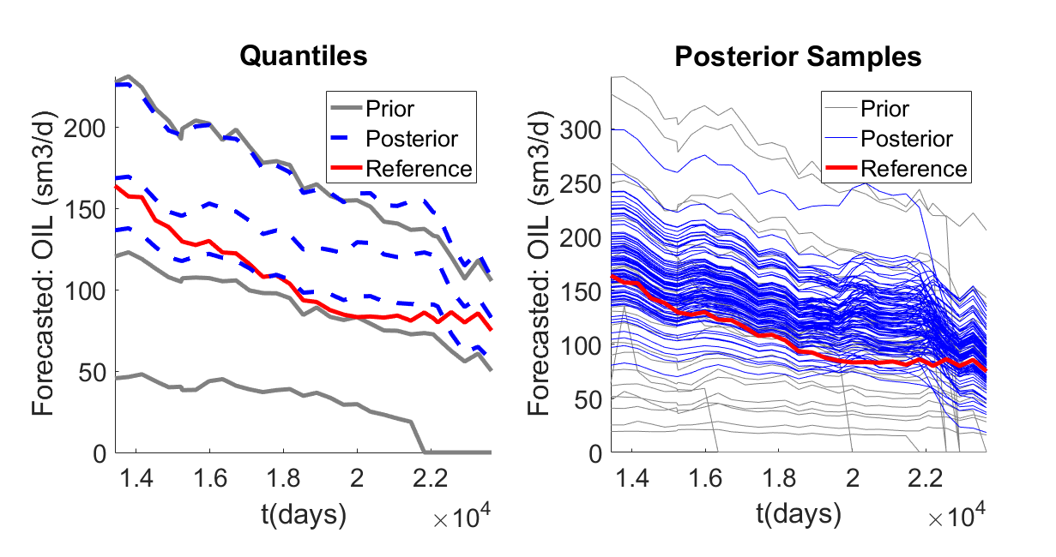
Data: all wells – oil rate
Prediction: field – oil rate
Dimension Reduction: FPCA
Eigen Tolerance: 0.90
FPCA

Slide 8
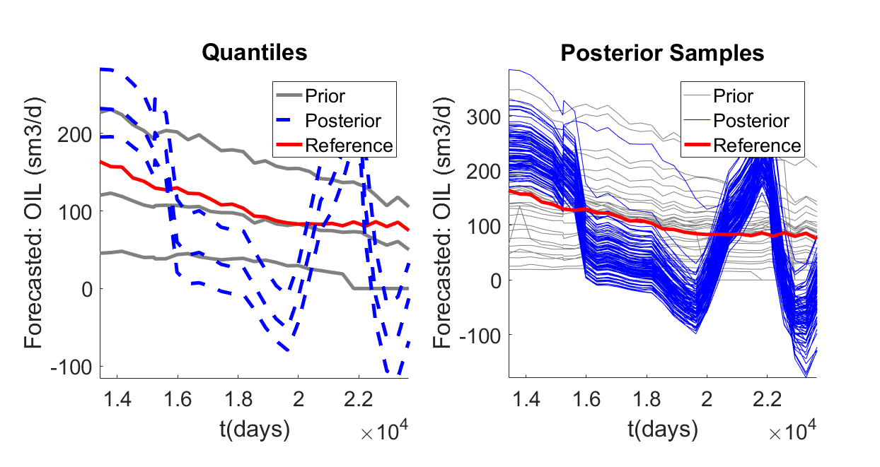
Data: all wells – oil rate
Prediction: field – oil rate
Dimension Reduction: PCA only
Eigen Tolerance: 0.99
PCA only

Slide 9
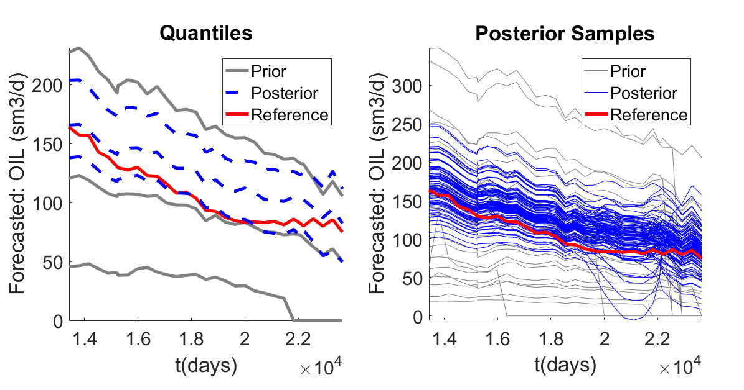
Data: all wells – oil rate
Prediction: field – oil rate
Dimension Reduction: PCA only
Eigen Tolerance: 0.90
PCA only

Slide 10
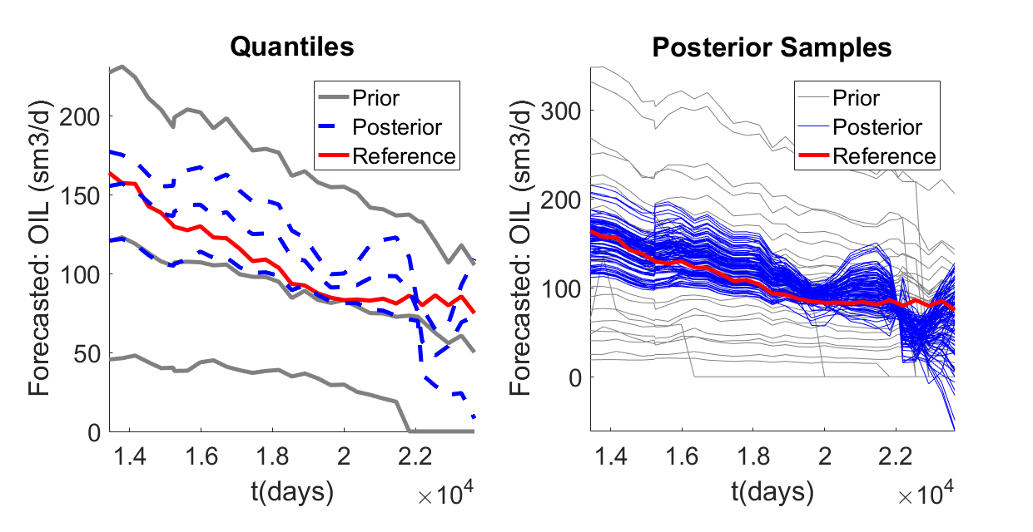
Data: field – oil rate
Prediction: field – oil rate
Dimension Reduction: PCA only
Eigen Tolerance: 0.99
PCA only

Slide 11
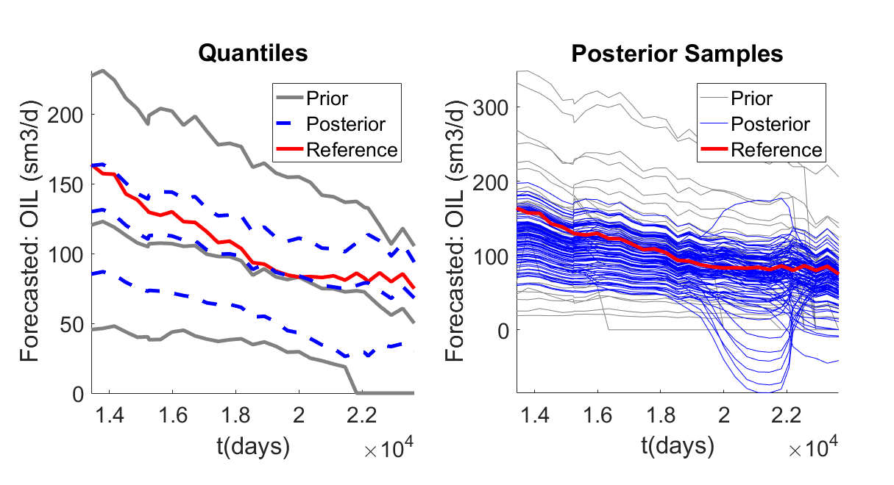
Data: all wells – oil rate
Prediction: field – oil rate
Dimension Reduction: PCA only
Eigen Tolerance: 0.97
PCA only

Slide 12
Prediction Variable: Single Well Oil Rate

Slide 13
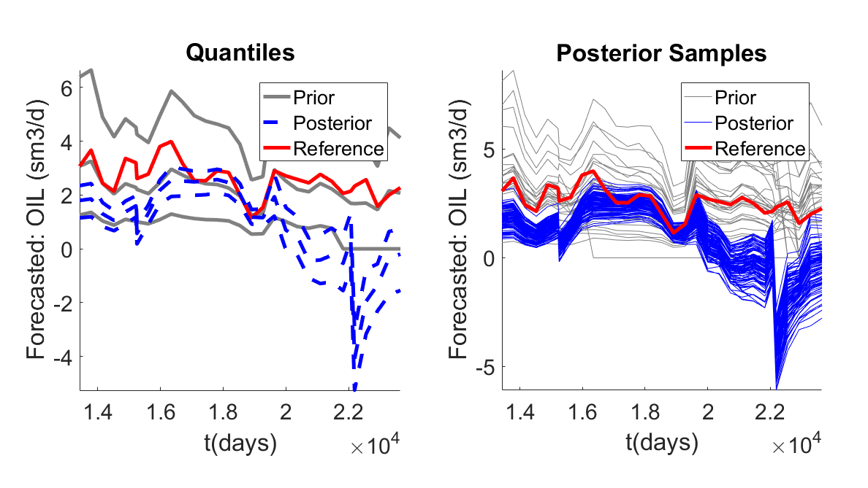
Data: all wells - oil rate
Prediction: Single well (S65) – oil rate
Dimension Reduction: FPCA
Eigen Tolerance: 0.99
FPCA

Slide 14
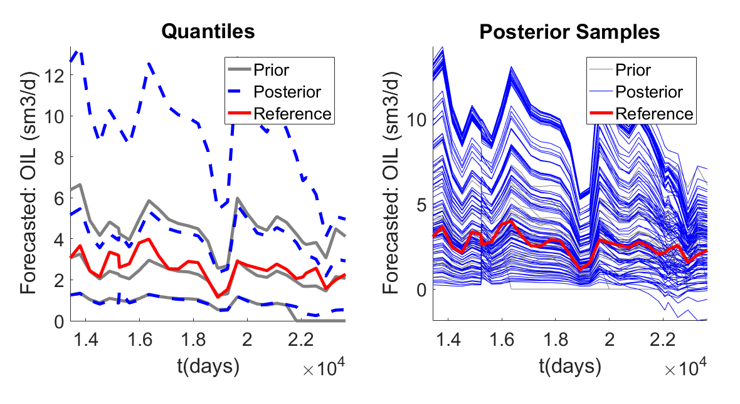
Data: all wells - oil rate
Prediction: single well (S65)– oil rate
Dimension Reduction: FPCA
Eigen Tolerance: 0.90
FPCA

Slide 15
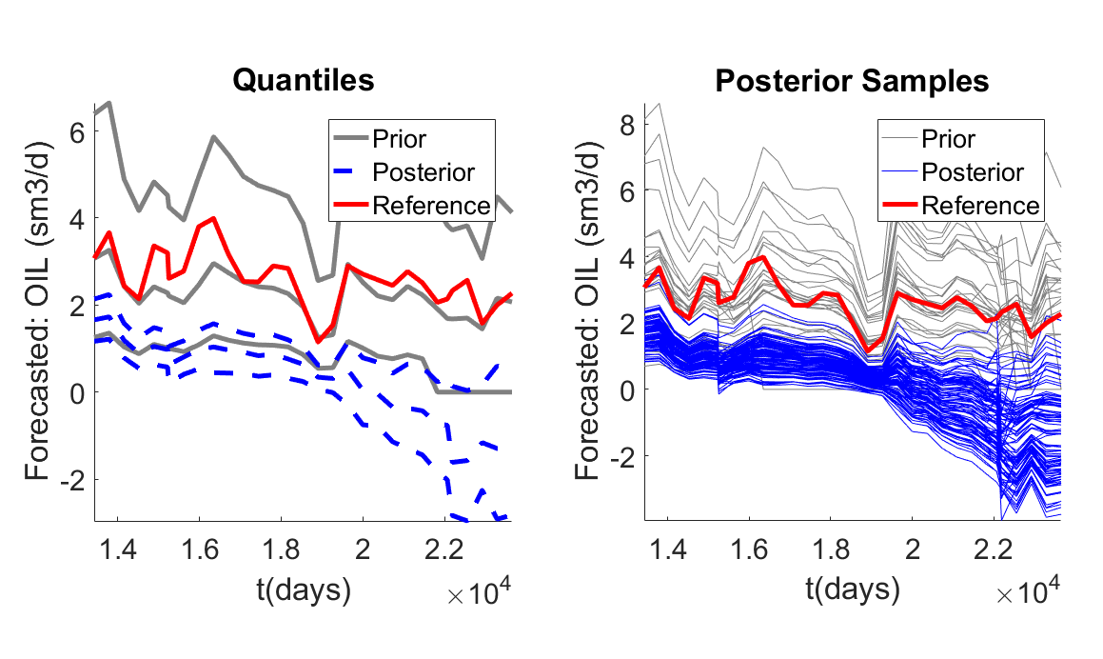
Data: all wells - oil rate
Prediction: Single well (S65)– oil rate
Dimension Reduction: FPCA
Eigen Tolerance: 0.95
FPCA

Slide 16
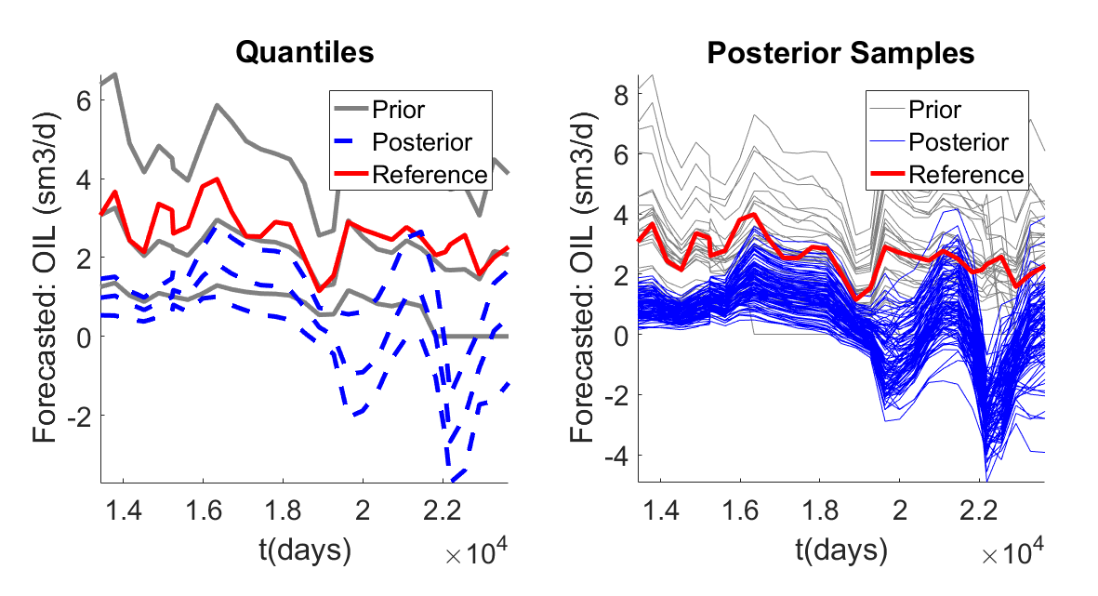
Data: all wells - oil rate
Prediction: Single well (S65)– oil rate
Dimension Reduction: PCA only
Eigen Tolerance: 0.99
PCA only

Slide 17
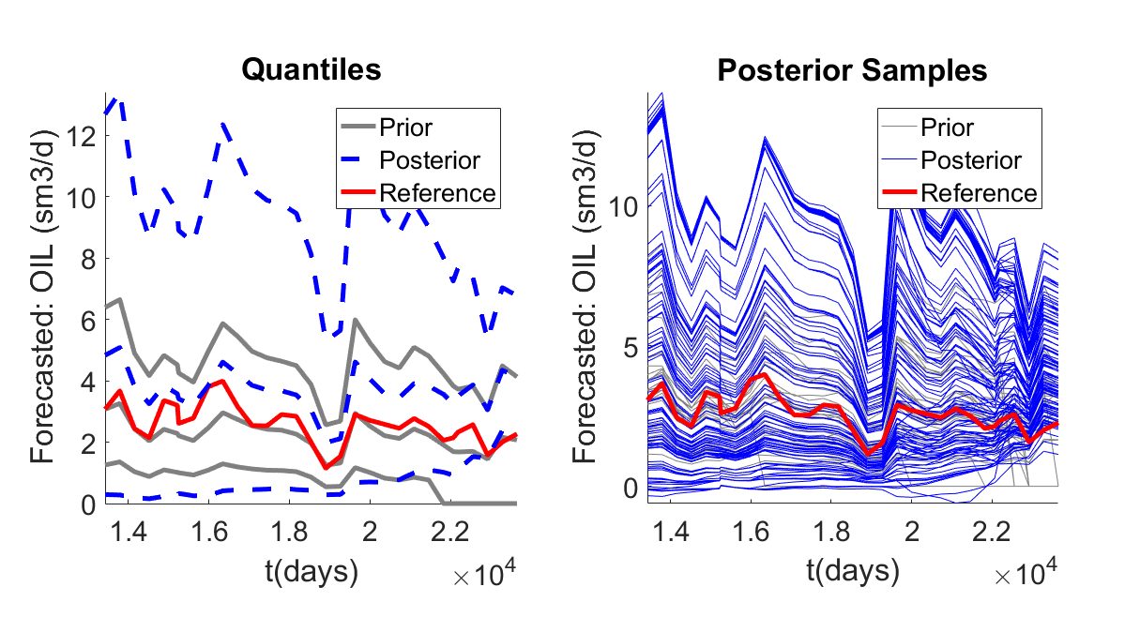
Data: all wells - oil rate
Prediction: Single well (S65)– oil rate
Dimension Reduction: PCA only
Eigen Tolerance: 0.90
PCA only

Slide 18
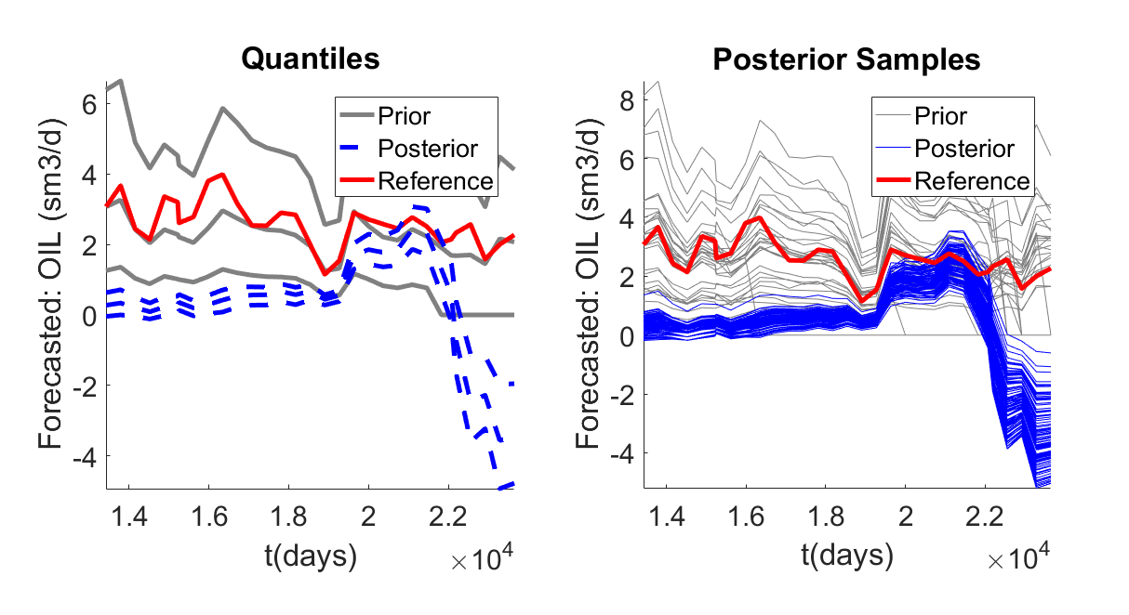
Data: all wells - oil rate
Prediction: Single well (S65)– oil rate
Dimension Reduction: PCA only
Eigen Tolerance: 0.95
PCA only

Slide 19
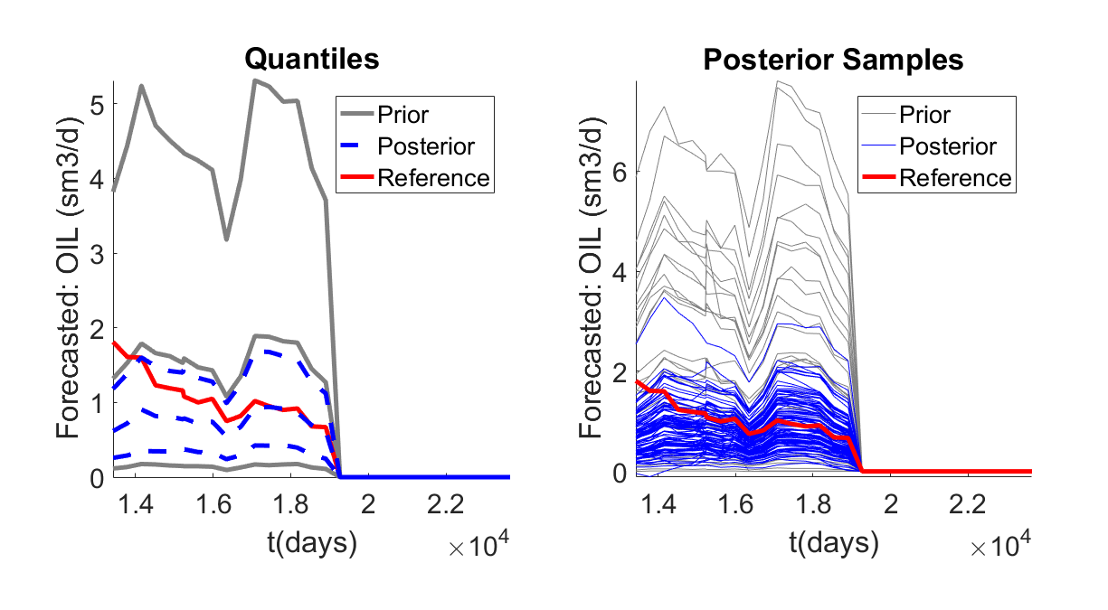
Data: all wells - oil rate
Prediction: Single well (P60)– oil rate
Dimension Reduction: FPCA
Eigen Tolerance: 0.95
PCA only

Slide 20
Thoughts
Posterior/Prior comparison – Prior does not look Gaussian
The Eigentolerance threshold is very sensitive
Smaller variance explained, less eigenvalues kept – lower dimensional
Comment Lewis: Norm Score transform – only each marginal not multivariate Norm Score Transform
Are we maybe applying a gaussian regression to a non gaussian distributed variable?

