Slide 1
Spring Introduction

Slide 2

Session Rules
COMMON RULES THAT PARTICIPANTS MUST FOLLOW DURING THE SESSION
Kindly switch off your mobile phone or put to silent mode during the session.
Active participation is highly encouraged, especially during Q&A segment.
Please wait for the trainer to pause, then raise your hand, and when the trainer acknowledges, ask your question.
Be courteous. Don’t interrupt or engage in private conversations while others are speaking.
Be respectful, even with your body language and nonverbal responses.
Notes:
Instructions to Facilitator:
Advice the participants on the session rules.

Slide 3

Context Setting: Overview
This session provides an overview on:
Spring Framework which is a Java open source framework that provides comprehensive infrastructure support for developing Java applications.
Spring Framework that handles the infrastructure so that you can focus on your application.
Spring that enables you to build applications from “Plain Old Java Objects” (POJOs) and also apply enterprise services non-invasively to POJOs.

Slide 4

Objectives
After completing this session, you will be able to:
Define Spring Framework.
Identify various modules in Spring Framework.
Analyze the benefits of using Spring Framework in Java Projects.

Slide 5

Agenda
Definition of Spring Framework
Modules in Spring Framework
Benefits of using Spring Framework in Java Projects
Indicates topics to be covered
Indicates the topic in discussion
Indicates topics covered
Notes:
Instructions to Facilitator:
The topics that are being covered in this course are shared.

Slide 6
Agenda (1 of 3)
Definition of Spring Framework
Modules in Spring Framework
Benefits of using Spring Framework in Java Projects
Indicates topics to be covered
Indicates the topic in discussion
Indicates topics covered
Notes:
Instructions to Facilitator:
The topics that are being covered in this course are shared.

Slide 7


What is Spring?
Science
Computer Science
Physics
F = -kx
Environmental Science
One of four seasons
An open-source application framework
Notes:
Instructions to Facilitator:
What is Spring? In physics, the force exerted on a spring is denoted by F = -kx; according to environmental science, spring is one among the four seasons; and in computers, spring is an open-source application framework.

Slide 8

Spring Application Framework
Spring is an open source, lightweight, application framework. It is intended to help structure an entire application in a consistent manner, pulling together the best of breed single-tier frameworks in a coherent architecture.
Notes:
Instructions to Facilitator:
Spring is an open source, lightweight, application framework. It is intended to help structure an entire application in a consistent manner, pulling together the best of breed single-tier frameworks in a coherent architecture.

Slide 9
Spring Framework Overview
Consider the following factors while choosing a framework:
Complexity of solution
Timeline
Maintainability
Familiarity with framework
Community and documentation
Notes:
Instructions to Facilitator:
When you choose a framework you should consider the following factors.
Complexity of solution: The solution provided by the framework should be simple and straight forward. Spring framework provides simple solution to complex problems.
Timeline: The time needed to provide the solution should be short. Spring APIs are simple and thus enable the developers to provide solution quickly.
Maintainability: The code of the framework should be easily maintainable. Spring favors programming to interface concepts, which make the code highly maintainable.
Familiarity with framework: Spring is one of the widely accepted frameworks among Java developers.
Community and documentation: Spring has a good number of open communities to support its development. Document provided by Spring Source is simple and effective to use.
Framework licensing: Spring comes under Apache License 2.0. This speaks to the credibility of the framework.

Slide 10
Spring Framework Overview (Contd.)
Spring aims at making JavaEE development easier.
Spring provides enterprise service to POJO.
Spring has a good balance between constraint and freedom. A good framework should provide guidance with respect to good practice, thus making the right thing easy to do. However, it should not be overly restrictive, placing requirements on code, using it, causing lock in, and constraining developers in appropriate ways.
Notes:
Instructions to Facilitator:
Spring aims at making JavaEE development easier.
Spring provides enterprise service to Plain Old Java Objects (POJO).
Spring has a good balance between constraint and freedom. A good framework should provide guidance with respect to good practice, thus making the right thing easy to do. However, it should not be overly restrictive, placing requirements on code, using it, causing lock in, and constraining developers in appropriate ways.

Slide 11
Agenda (2 of 3)
Definition of Spring Framework
Modules in Spring Framework
Benefits of using Spring Framework in Java Projects
Indicates topics to be covered
Indicates the topic in discussion
Indicates topics covered
Notes:
Instructions to Facilitator:
The topics that are being covered in this course are shared.

Slide 12
Module Components
The various modules of the framework are:
IoC container
Aspect-Oriented Programming framework (AOP)
Data access abstraction and JDBC simplifications
Transaction management
MVC web framework
Simplification for working with J2EE APIs such as JNDI, JTA etc.
Notes:
Instructions to Facilitator:
The various modules of the framework are:
IoC container
Aspect-Oriented Programming framework (AOP)
Data access abstraction and JDBC simplifications
Transaction management
MVC web framework
Simplification for working with J2EE APIs such as JNDI, JTA etc.

Slide 13
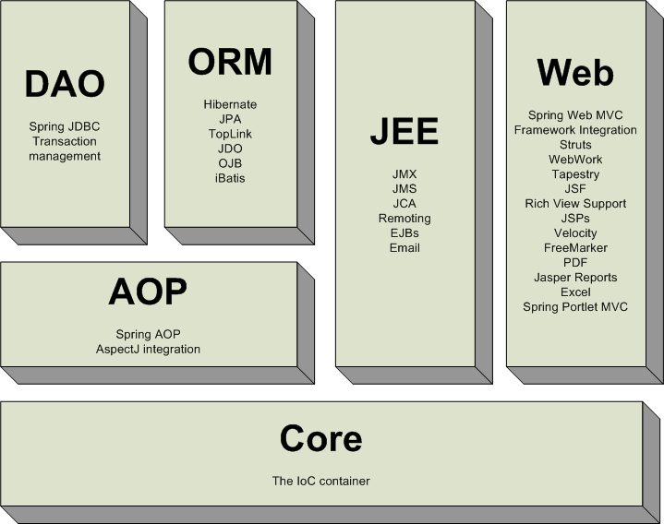
Spring Framework Modules
Here is a representation showing the various Spring Framework modules.
Notes:
Instructions to Facilitator:
The slide shows a representation of various Spring Framework modules.

Slide 14
Agenda (3 of 3)
Definition of Spring Framework
Modules in Spring Framework
Benefits of using Spring Framework in Java Projects
Indicates topics to be covered
Indicates the topic in discussion
Indicates topics covered
Notes:
Instructions to Facilitator:
The topics that are being covered in this course are shared.

Slide 15
Spring Benefits
Benefits of Spring are:
Non-invasive framework – code works outside framework, minimal lock-in, easy migration
Consistent model in any environment
Promotes code reuse and deferment of architectural decisions
Facilitates OO code and good practices such as programming to interfaces
Optional extraction of configuration using xml , pure Java or annotations
Promotes Architectural choice- choose best of breed frameworks
Does not reinvent the wheel – O/R, logging, etc.
Addresses each tier in a web application
Presentation Tier | Spring MVC similar to Struts, but more powerful
Business Tier | Lightweight IOC container and AOP support
Persistence Tier | DAO template support for popular ORMs and JDBC. Spring provides an excellent support for programmatic and declarative transaction management
Notes:
Instructions to Facilitator:
Benefits of Spring are:
Non-invasive framework – code works outside framework, minimal lock-in, easy migration
Consistent model in any environment
Promotes code reuse and deferment of architectural decisions
Facilitates OO code and good practices such as programming to interfaces
Extraction of configuration to consistent xml model
Promotes Architectural choice- choose best of breed frameworks
Does not reinvent the wheel – O/R, logging, etc.
Addresses each tier in a web application

Slide 16

Roadmap – Past Releases
Here is a roadmap showing the history and past releases of Spring Framework:
Spring Framework 3.0 RELEASE
Spring Framework 3.0 M3
Spring Framework 3.0 M2
July 2009
06.05.09
Spring Framework 3.0 M1
01.03.09
Spring Framework 2.5
08.12.08
Spring Framework 2.0
Spring Framework 1.0
19.11.07
05.10.05
24.03.04
Notes:
Instructions to Facilitator:
The screens shows the releases of Spring Framework.

Slide 17

Questions

Slide 18


Slide 19
Spring Introduction

Slide 20

Summary
Key points covered in the session are:
Spring Application Framework
Spring Framework is an open-source application framework.
Spring aims at making JavaEE development easier.
Spring provides enterprise service to POJO.
Spring has a good balance between constraint and freedom.
Spring Application Framework
Spring Framework is an open-source application framework.
Spring aims at making JavaEE development easier.
Spring provides enterprise service to POJO.
Spring has a good balance between constraint and freedom.

Slide 21
Summary
Benefits of using Spring Framework in Java Projects
The benefits of Spring Framework are as follows:
Non-invasive framework
Consistent model in any environment
Promotes code reuse and deferment of architectural decisions
Facilitates OO code and good practices such as programming to interfaces
Extraction of configuration to consistent xml model
Promotes Architectural choice- choose best of breed frameworks
Does not reinvent the wheel – O/R, logging, etc.
Addresses each tier in a web application
.

Slide 22

Source
http://www.martinfowler.com/, Martin Fowler
http://www.springframework.org
Disclaimer: Parts of the content of this course is based on the materials available from the Web sites and books listed above. The materials that can be accessed from linked sites are not maintained by Cognizant Academy and we are not responsible for the contents thereof. All trademarks, service marks, and trade names in this course are the marks of the respective owner(s).

Slide 23
You have successfully completed
Spring Introduction

