Slide 1
TSMS
BY ITECHS
CAPSTONE 1

Slide 2
STATEMENT OF THE PROBLEM
TSMS
The following are the causes that result in service inefficiencies of Maylaflor Airconditioning and Refrigeration Service, Inc.:
They continued to use traditional recording methods, which resulted in a damaged record that hampered their service. They also used daily written entry of schedules, which would be a lot of work because they need to attend to more than 100 clients in a month. If TSMS is used, daily input will be reduced since the system will allow users to automatically schedule services on a set date each month per client.
They have poor visibility of schedules as every schedule isn't organized. This visibility issue also causes hassle in the accomplishment of their target tasks/services.
The Accounting Department suffers from manually computing every service done per month in every branch.
The person-in-charge suffer great cause as the company would be compromised if all needed records aren't stored properly, and schedules aren't followed. It would cause to loss of clients' trust.

Slide 3
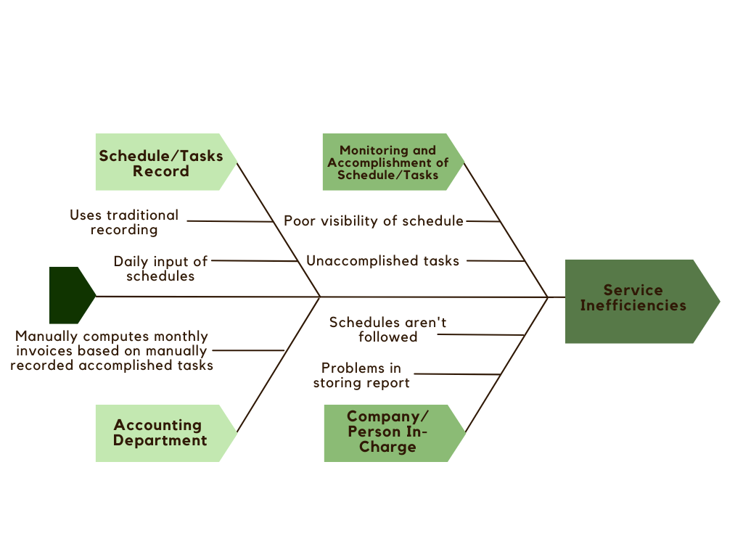
FISHBONE DIAGRAM
TSMS
Type something here.

Slide 4
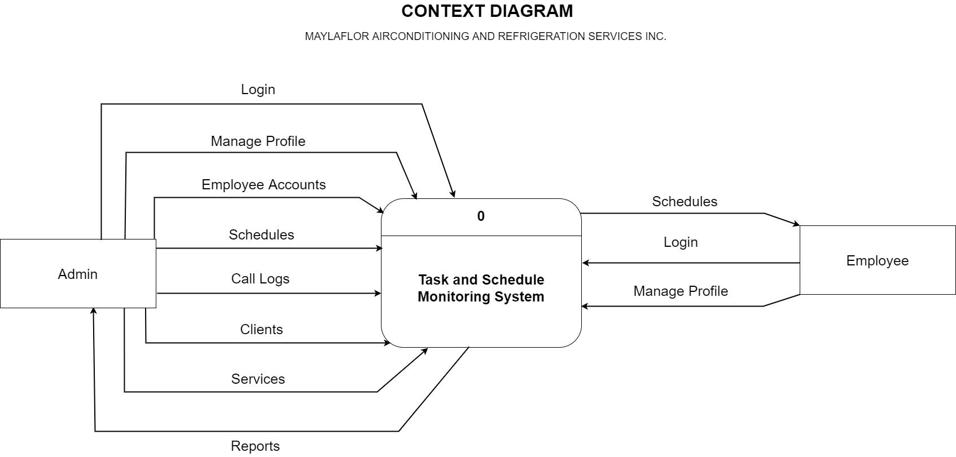
CONTExt DIAGRAM
TSMS
Type something here.

Slide 5
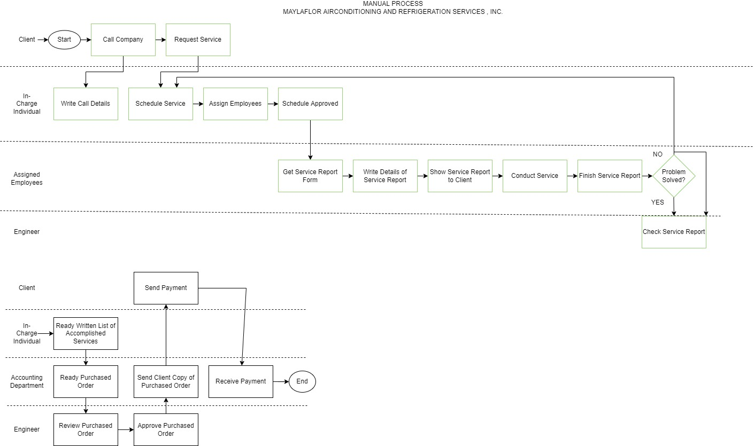
MANUAL system FLOW
TSMS

Slide 6
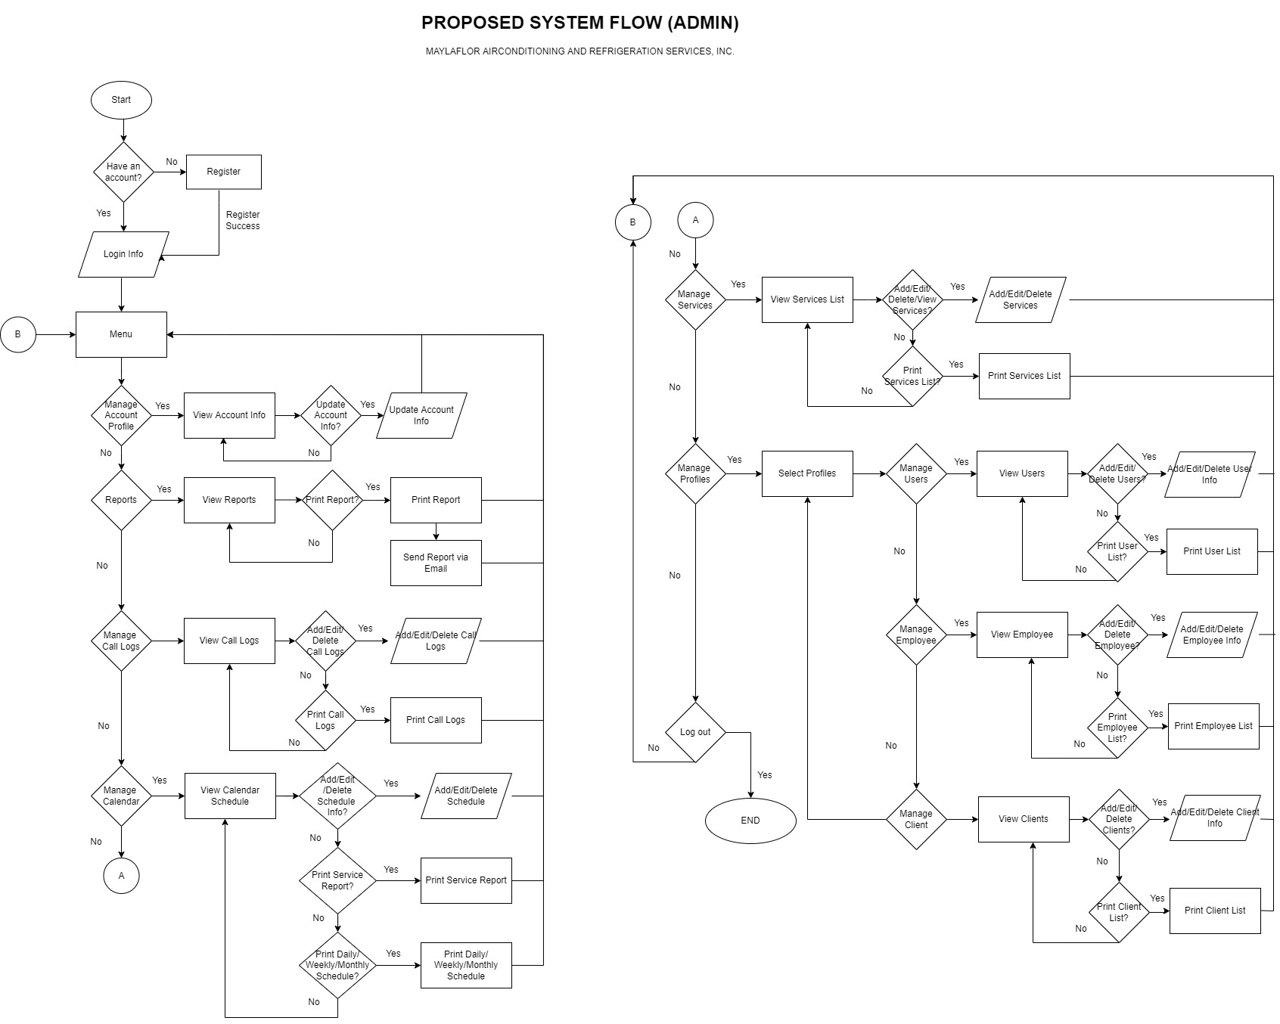
PROPOSED SYSTEM FLOW
ADMIN
TSMS

Slide 7
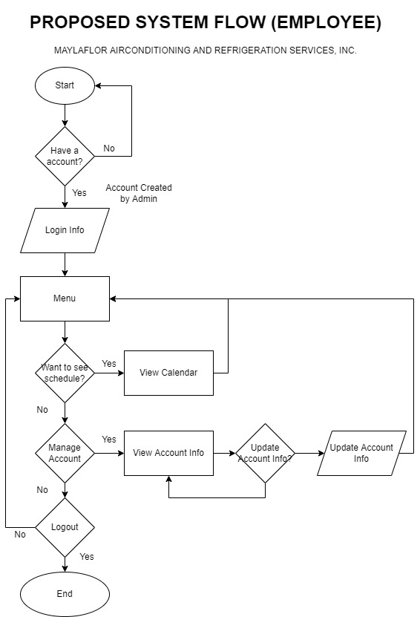
PROPOSED SYSTEM FLOW
TSMS
EMPLOYEE

Slide 8

TASKS AND SCHEDULE MONITORING SYSTEM
TSMS
Thank you

